Slide 1

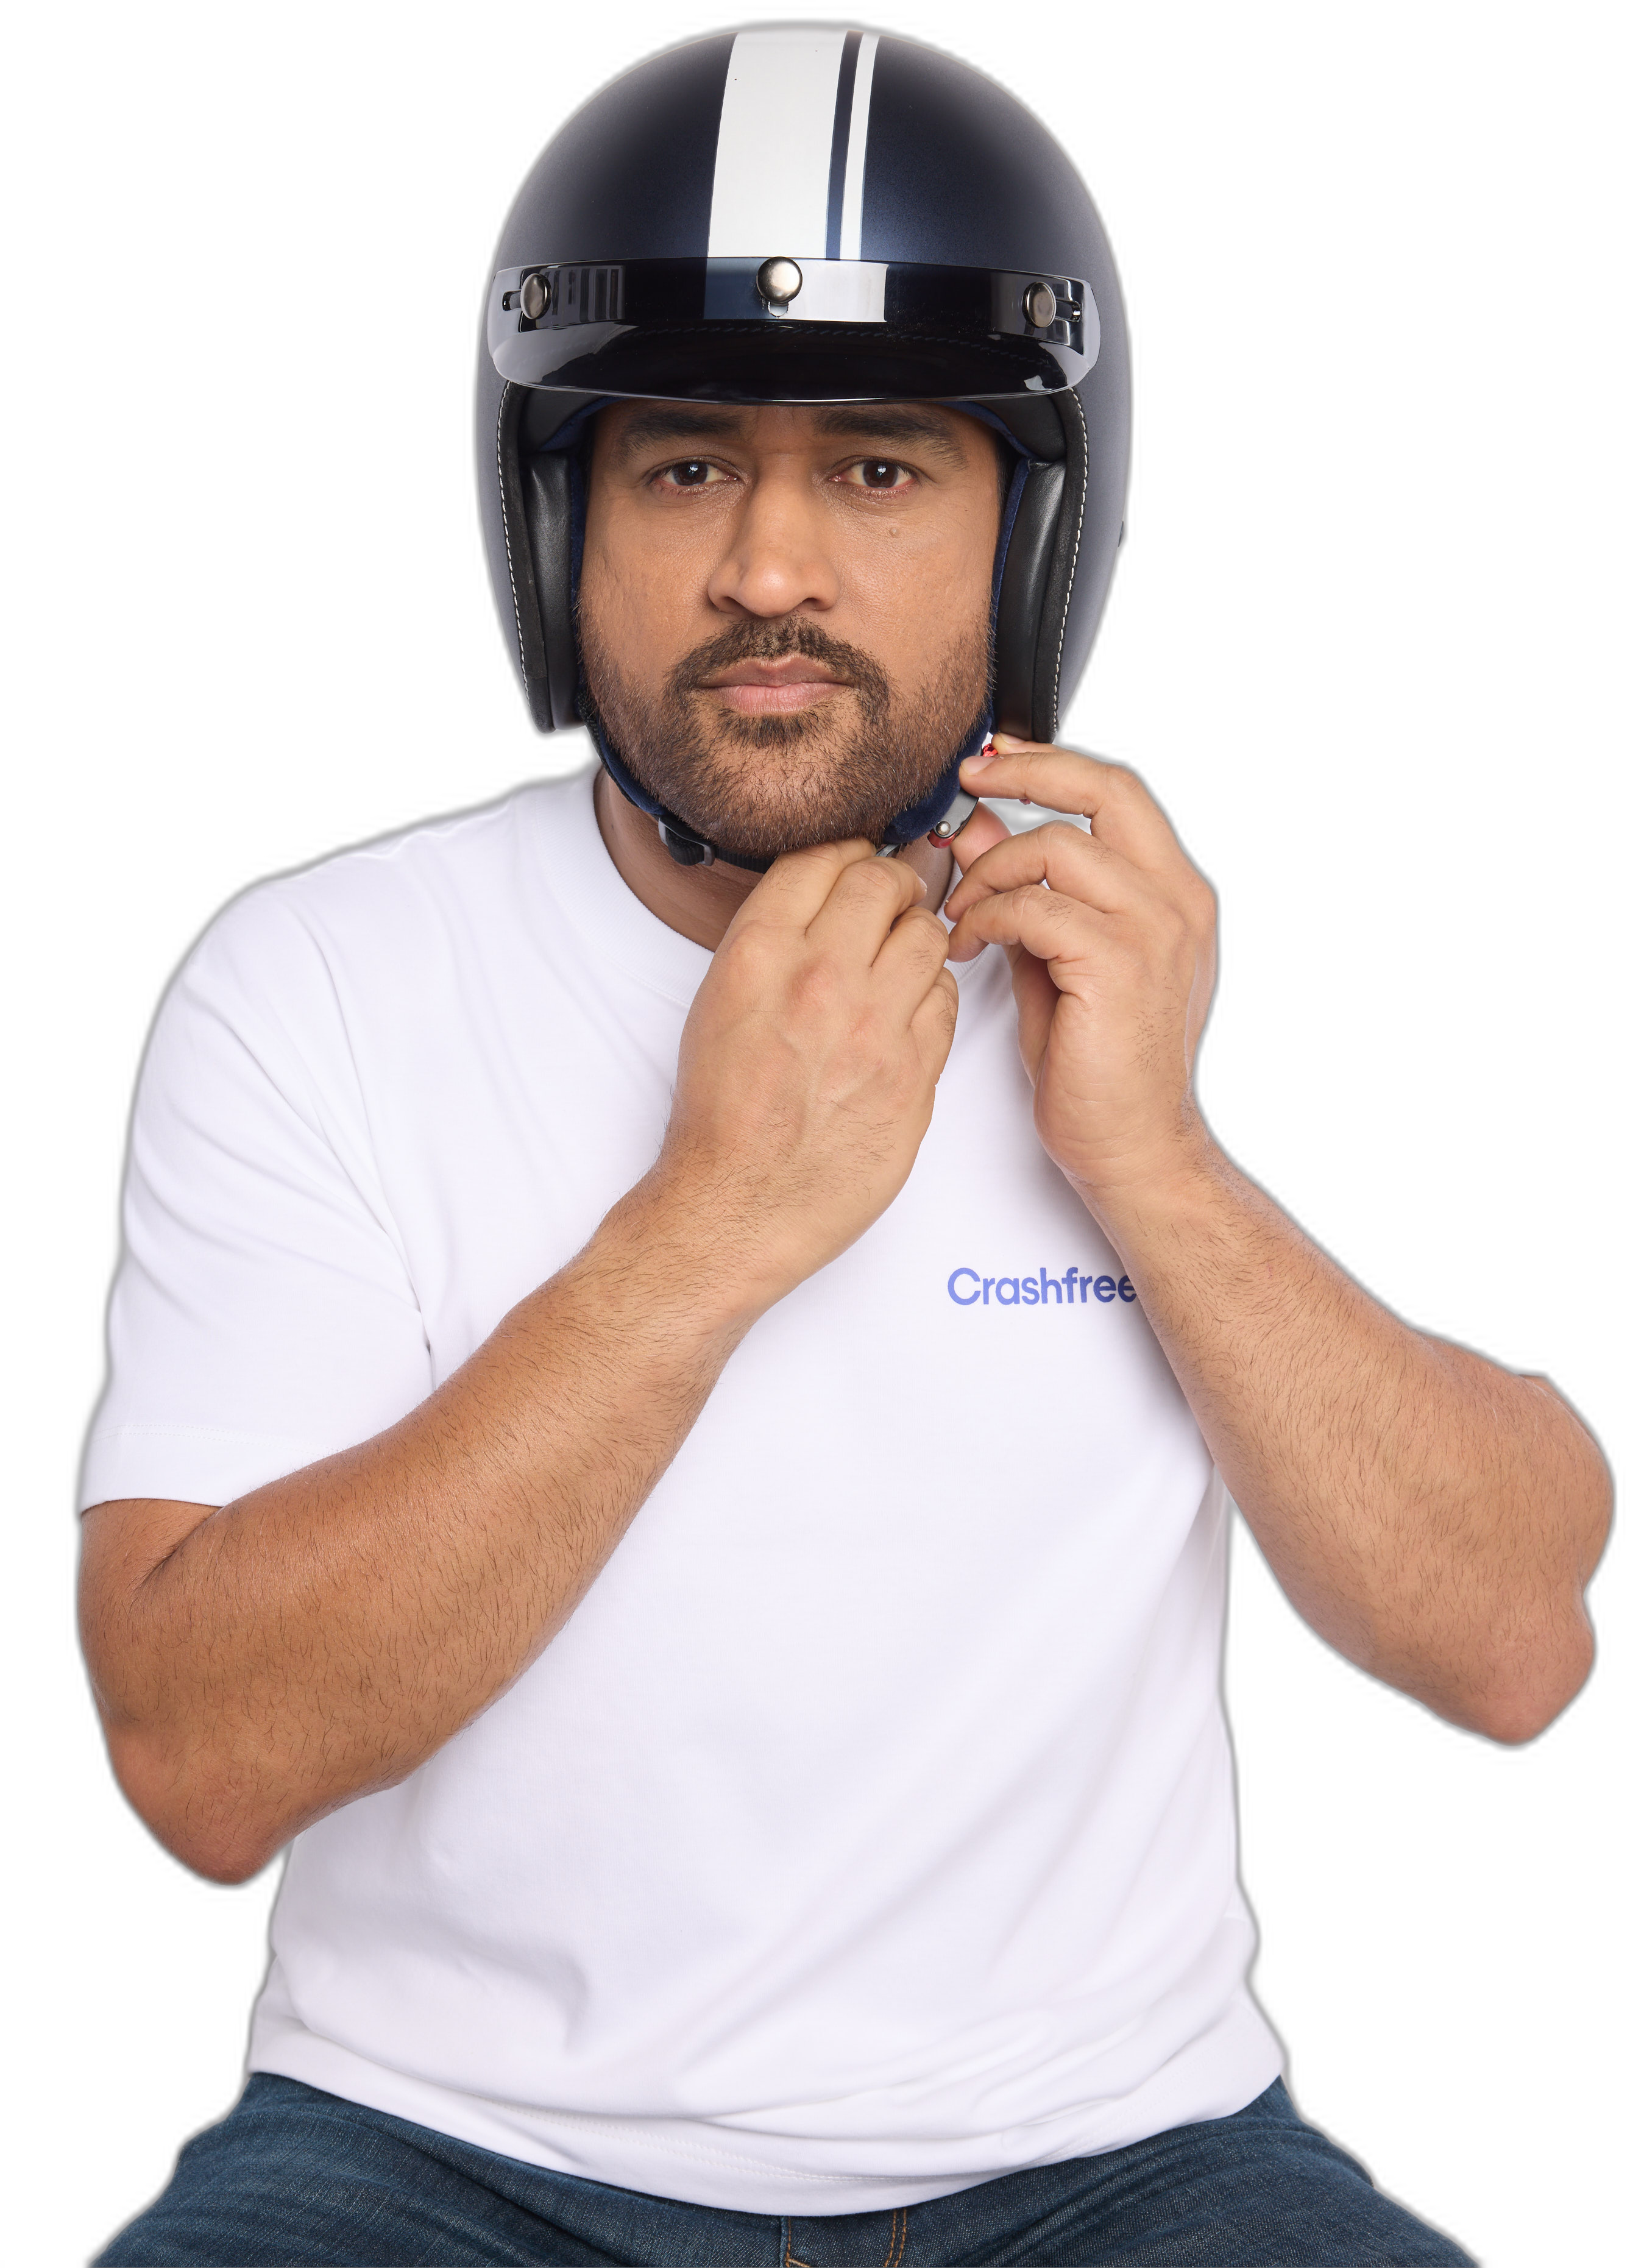
I
THE PROBLEM
II
WHO WE ARE
CRASHFREE INDIA · A CARS24 COMMITMENT
Systems work because
III
WHAT WE DO
we hold them accountable.
IV
OUR PEOPLE
MS DHONI · GOODWILL AMBASSADOR
Who we are, what we do, and what we have built — a nonprofit working for zero road deaths in India by 2040.
Partner overview · July 2026 · crashfreeindia.org

Slide 2



THE PROBLEM · WHY ROAD DEATHS PERSIST
Most road deaths in India are failures of
roads and systems — not just of drivers.
59%
Crash records went digital
e-DAR and digitised FIRs make every death traceable to a place, a road design, a file.
Vehicles became identifiable
ANPR cameras and live national vehicle APIs surface repeat offenders instantly.
of road deaths in India involve no traffic
violation by the victim at all.
Failure became attributable
Open data ties deaths to specific junctions, specific processes, specific desks.
Ministry of Road Transport & Highways data
India has strong road-safety laws. What has been missing is an institution that makes them work on the ground.
THE PROBLEM
02 / 15

Slide 3
THE PROBLEM · THE SCALE
485
people are killed on Indian roads every single day.
ONE DEATH EVERY 3 MINUTES
1,77,175
66%
1% → 11%
killed in 2024
aged 18–34
of world's vehicles → of its road deaths
Source: MoRTH, Road Accidents in India 2024 · Crashfree India Crash Data Dashboard
THE PROBLEM · THE SCALE
03 / 15

Slide 4




THE PROBLEM · THREE GAPS
Where the system fails today.
We studied how India responds to a road death. Three gaps repeat everywhere — and no institution owns the follow-through.
GAP 1 · DANGEROUS ROADS
GAP 2 · COMPENSATION
GAP 3 · ENFORCEMENT
Audits stop at the report.
₹80,000 Cr sits undelivered.
Repeat offenders go unchecked.
Hazards get reported and studies get filed — but no institution tracks whether a single fix is ever built.
10.46 lakh compensation cases pending. In one Gurugram audit: 102 hit-and-run files since 2022 — only 2 settled.
46 crore e-challans issued, ~75% unpaid — while roadside enforcement still stops vehicles at random.
The distance between what is known and what gets done is the gap Crashfree India was created to close.
THE PROBLEM · THREE GAPS
04 / 15

Slide 5

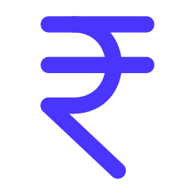




WHO WE ARE · ABOUT CRASHFREE INDIA
A nonprofit institution working towards
zero road deaths in India by 2040.
Launched in June 2025 and funded by Cars24, we identify road-safety failures, get fixes approved by government, and track every fix to completion.
Founded June 2025
$3M over 3 years
Vision Zero Trust
Launched by Cars24 with the Indian Road Safety Campaign; roots in a decade of IRSC campus audit work.
Cars24's committed institutional funding — programme-first: 71% of FY26-27 budget goes to programmes.
Registered public trust; trustees include Cars24 co-founder Gajendra Jangid.
One north star
18 cities and counting
MS Dhoni
Zero road fatalities in India by 2040 — pursued as system repair, not sensitisation.
Programmes live across India — Delhi NCR, Jaipur, Indore, Bengaluru, Chennai, Guwahati and more.
Goodwill Ambassador since April 2026 — lending India's most trusted voice to the cause.
ABOUT CRASHFREE INDIA
05 / 15

Slide 6





WHO WE ARE · OUR APPROACH
How we work: audit, advocate, and
follow through until the fix is built.
WHAT WE DELIBERATELY AVOID
Awareness-only campaigns
AUDIT
ADVOCATE
ACCOUNTABILITY
Event counts as impact
Find
Name
Unblock
Replacing government's role
Field evidence to IRC / MoRTH standards — blackspots, claim files, enforcement gaps.
Findings published and presented — to district committees, state departments, MoRTH, the press.
Every recommendation tracked in public — from approval to build, from claim to payout.
Reports without follow-up
Every recommendation tracked to implementation.
Institutionally embedded: 4 District Road Safety Committees · MoUs with Jaipur Traffic Police & Gurugram Police · formally tasked by SW Delhi DRSC.
OPERATING MODEL
06 / 15

Slide 7
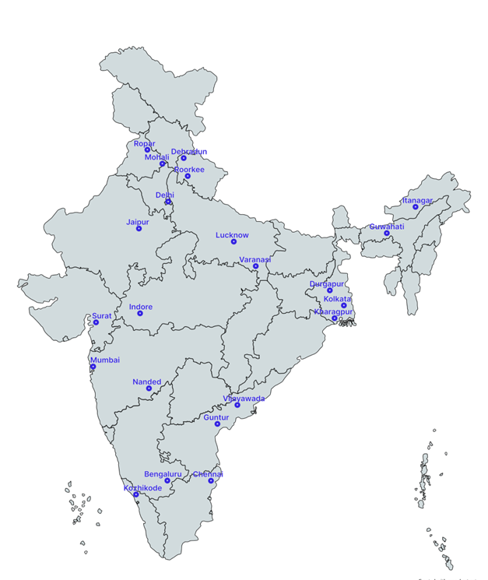


WHAT WE DO · 01 ROAD INFRASTRUCTURE
Project Rakshak — engineering students
audit dangerous roads; governments fix them.
A national programme that mobilises trained student teams to audit high-risk locations to official standards and hand authorities ready-to-build fixes.
120+
31
25+
15
high-risk locations
screened nationwide
sites fully audited,
incl. 11 official blackspots
written government
approvals secured
implementations
begun on the ground
18 cities
20 institutions · 9 IITs
900+ stakeholder surveys
Example: Tejaji Nagar Junction, Indore
Student-audited redesign to IRC / MoRTH standards — signals, lighting, footpaths, speed management — approved by CPWD and the Additional Collector's office. Guided by Prof. Geetam Tiwari (TRIPC, IIT Delhi).
Every audit public: crashfreeindia.org/rakshak/dashboard
WHAT WE DO · PROJECT RAKSHAK
07 / 15

Slide 8




WHAT WE DO · 02 ENFORCEMENT TECHNOLOGY
SATARK — an AI platform that helps traffic
police identify and stop high-risk vehicles.
Cameras read every passing number plate and check it against live national records, so officers act on evidence instead of stopping vehicles at random.
ANPR camera
reads every plate
Live vehicle record
via national APIs
Rule engine flags
habitual offenders
Public billboard
names the risk
Officer app routes
the interception
3,00,000+
₹30 Cr+
350+
2 cities live
vehicles scanned
pending challans surfaced
high-risk vehicles intercepted
Jaipur & Bengaluru · 5 police approvals
First 72 hours in Jaipur: 1,240 vehicles flagged, 58 intercepted. · 100 AI challan billboards already live in Gurugram; 12+ cities in discussion.
WHAT WE DO · SATARK
08 / 15

Slide 9





WHAT WE DO · 03 VICTIM SUPPORT & COMPENSATION
Helping crash victims and families claim
the compensation the law promises them.
THE GAP WE DOCUMENTED
THE MACHINERY WE BUILT
10.46 lakh
compensation cases pending nationwide — ₹80,000 Cr stuck
Aasha — India's first 24/7 multilingual AI chatbot guiding victims step-by-step, on WhatsApp and voice
Free Compensation Calculator based on Supreme Court principles (Sarla Verma, Pranay Sethi)
205 vs ~25,000
hit-and-run claims actually filed vs. eligible crashes (FY22-23)
Legal helpdesks inside hospital trauma wards — 100+ victims supported in the first 4 days
3.6 years
average wait for a claim — with 20–40 office visits
Plain-language comic books and Hindi guides explaining rights, schemes and the claim process
2 of 102
hit-and-run files settled since 2022 in our Gurugram audit
‘Justice Unserved’ research presented to MoRTH; claim pipeline being rebuilt with Rajasthan Transport Dept.
‘Justice Unserved’ (launched at IIT Delhi, 2026) is now the reference dataset on why crash compensation fails in India.
WHAT WE DO · VICTIM SUPPORT
09 / 15

Slide 10


WHAT WE DO · 04 OPEN DATA PLATFORMS
Public data tools we built so that
road-safety problems cannot be ignored.
Four self-updating platforms — free for government, researchers, journalists and citizens.
National Road Defect Repository
Road Safety in Parliament
AI reads local news in 13 languages across 146 districts — potholes, missing signage, unlit stretches — mapped publicly so authorities can act.
Every parliamentary road-safety question since 2014 — 1,423 of them — searchable by MP and state. 282 sitting Lok Sabha MPs have never asked one.
Supreme Court Litigation Tracker
National Crash Data Dashboard
18 live road-safety cases and 190+ orders, with each government deadline tracked — 11 were already overdue at launch.
Government crash statistics (2019–2024) turned into report cards for 36 states and 50 cities — free and openly licensed.
‘JUSTICE UNSERVED’, IN PRINT
Deccan Herald
Economic Times
Fortune India
IndiaSpend
Moneycontrol
Scroll.in
The Wire
WHAT WE DO · OPEN DATA
10 / 15

Slide 11
IMPACT · OUR FIRST YEAR
Year one: measurable results
across 18 Indian cities.
1M+
18
25+
THE FIRST 400 DAYS
citizens reached
cities active
govt approvals won
Jun 25
Launched as a Cars24 commitment
15
4
2
Sep 25
NextMile finale · first AI billboard live in Bengaluru
implementations begun
district committees joined
cities enforcing with SATARK
Jan 26
‘Justice Unserved’ published
Apr 26
IIT Delhi national forum · Dhoni joins
150+
50+
10+
Jun 26
SATARK live with Jaipur Police
members & interns
experts engaged
national media features
Jul 26
Rakshak Cohort 2 · 4 open-data products shipped
Every figure above is from our public dashboard and quarterly updates — audited numbers, not estimates.
IMPACT · OUR FIRST YEAR
11 / 15

Slide 12
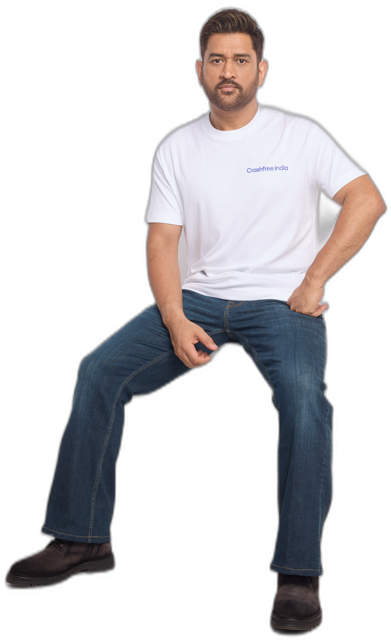

OUR AMBASSADOR
MS Dhoni is Crashfree India's
Goodwill Ambassador.
One of India's most trusted public figures joined us in April 2026, unveiled at our national forum at IIT Delhi. His role — lending his voice where it moves people to act:
Inviting India's students to join Project Rakshak road audits
Championing safer school zones
Spreading awareness of victims' compensation rights and Aasha
“Because every ride deserves to end safely.”
Announcement covered by Business Standard · The Tribune · The Wire
CFI shoot · June 2026
OUR AMBASSADOR
12 / 15

Slide 13
OUR PEOPLE · BOARD OF ADVISORS
Guided by two of India's foremost
road-safety experts.
PT
Piyush Tewari
GT
Prof. (Dr.) Geetam Tiwari
Founder & CEO, SaveLIFE Foundation
Professor Emerita, TRIPC, IIT Delhi
Architect of India's Good Samaritan Law (Supreme Court, 2016)
Three decades leading India's foremost road-safety research centre — a WHO Collaborating Centre
Built the Zero Fatality Corridor model — ~40% fewer deaths on Mumbai–Pune Expressway; now scaling with MoRTH
Global authority on vulnerable road users & safe-system design · PhD, University of Illinois Chicago
Rolex Award for Enterprise · Elevate Prize · MPA, Harvard
Guides Project Rakshak's audit methodology; anchors our Expert Consortium
THE EXPERT BENCH BEHIND OUR AUDITS
Justice J. R. Midha (Retd.)
Dr. S. Velmurugan
Dr. Richa Ahuja
Delhi High Court · FastDAR architect
Head, Traffic Engg. & Safety, CSIR-CRRI
IIT Kharagpur · Rakshak advisor
Akhilesh Srivastava
Col. Sanjeev Sharma
Sarika Panda Bhatt
IRF India
CoERS, IIT Madras
Raahgiri Foundation
B. N. Puri
Dr. P. K. Sikdar
A. M. Rao
Transport economist
Ex-Director, CRRI
Traffic engineering
BOARD OF ADVISORS & EXPERTS
13 / 15

Slide 14
OUR PEOPLE · THE TEAM
A full-time team of eight, three trustees,
and 75+ engineering interns nationwide.
TRUSTEES · VISION ZERO TRUST
AS
Amar Srivastava
DG
Deepanshu Gupta
GJ
Gajendra Jangid
President
Managing Trustee
General Secretary
Founder, Indian Road Safety Council — 50,000+ volunteers · Diana Award 2019
Founder, IRSC · Global Youth Coalition for Road Safety leadership board
Co-founder, Cars24 · ex-Schlumberger
FULL-TIME TEAM
AH
Akhtar Hussain
SK
Shubham Kumar
MY
Muskan Yadav
AS
Aastha Shreeharsh
Mission Lead
Policy Advocacy
Programs · Infrastructure
Strategy & Operations
IIT Delhi · ex-Bain & Co., Deloitte
DU + NALSAR · byline: Scroll.in
TISS Mumbai
HKUST · quoted in The Wire
RS
Rohan Sharma
IR
Ishita Rathore
YY
Yuvraj Yadav
SK
Shipra Kushwaha
Cause Marketing
People & Culture
Product Design
Graphic Design
+ 75+ part-time road-engineering interns across India
THE TEAM
14 / 15

Slide 15



THE YEAR AHEAD
Year two: fewer bets, deeper districts,
and more fixes built on the ground.
Every three minutes, a life is lost on an Indian road. Join us in changing that.
YEAR TWO, WITH YOU — THE TARGETS
START THE CONVERSATION
150+ blackspots audited by the national pipeline
crashfreeindia.org
Model districts: Gurugram · SW Delhi · Jaipur
helpdesk@crashfreeindia.org
12+ district-committee presentations
Live proof: crashfreeindia.org/rakshak/dashboard
Rakshak Audit Manual v1.0 — usable by NHAI without rework
Crashfree India · A Cars24 Commitment · operated by Vision Zero Trust

