Slide 1

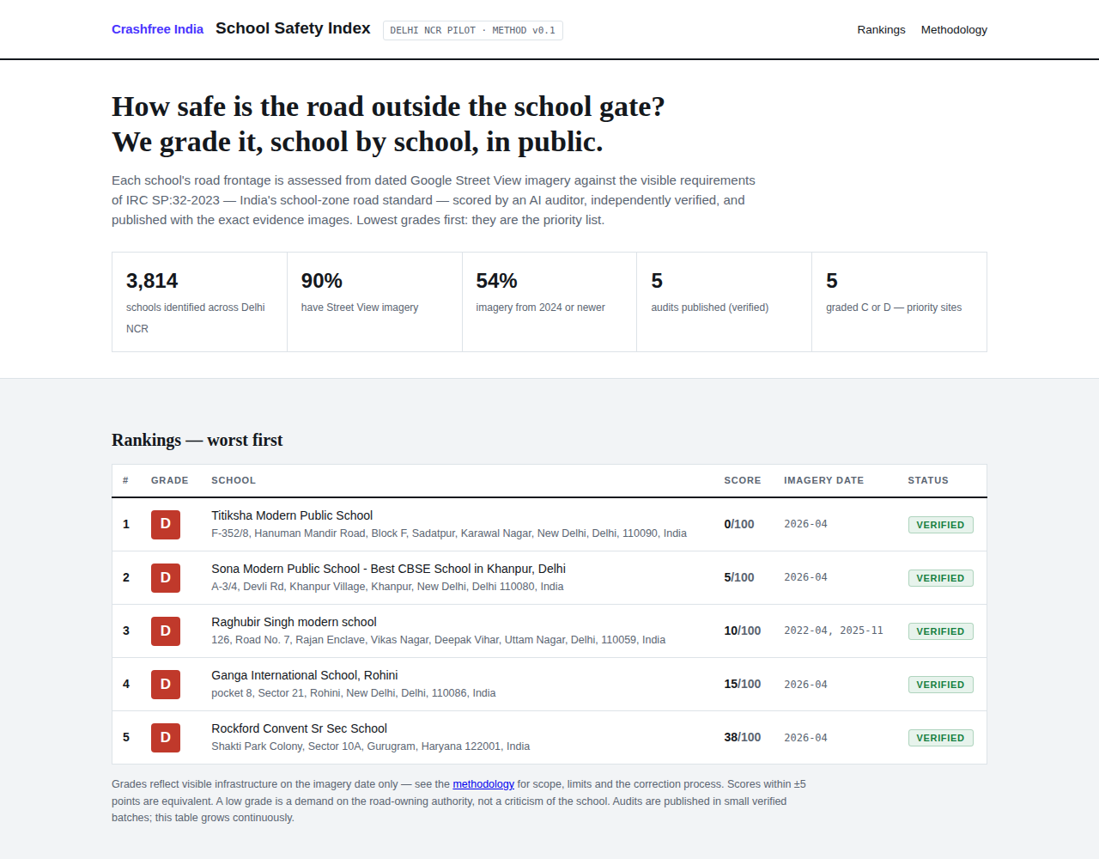
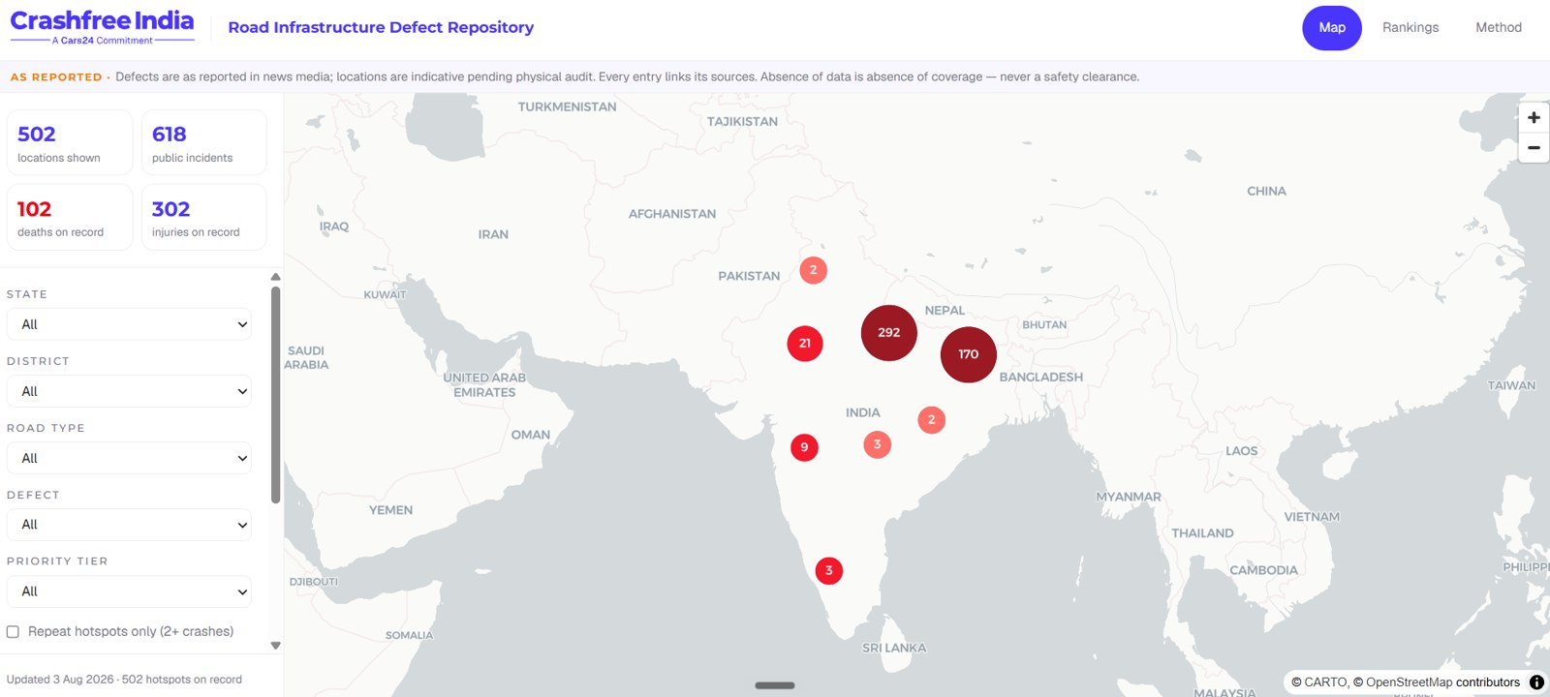



AUGUST 2026 · NEW DELHI
FOR DISCUSSION · CRASHFREE INDIA × TRAFFICURE · GOOGLE MAPS PLATFORM
The safety layer
Traffic data already manages congestion.
Together it can start preventing crashes.
School Safety Index, Delhi NCR prototype, live.
TraffiCure has proved the traffic layer: Pune from 20 to 26.8 km/h, 964 roads live
RMI's May 2026 feeds carry safety signals: harsh braking, vehicle counts, incidents
We bring the safety products and the government seats to put them to work
Road-Infrastructure Defect Repository, live.
Ideas to shape together, each pressure-tested. Nothing here is a commitment.
crashfreeindia.org

Slide 2


01 · WHY THIS CONVERSATION, NOW
WHY NOW
Three facts that were not true six months ago
Our read of the moment, stated plainly so it can be corrected.
TRAFFICURE PROVED THE TRAFFIC LAYER
RMI NOW CARRIES SAFETY SIGNALS
NOBODY HAS BUILT THE SAFETY PRODUCT
Pune, Jan 2026: 964 roads watched every 2 minutes, no hardware. 20 → 26.8 km/h average speed, measured by the police. Data became a ranked junction list and an engineering brief to the municipal corporation. Fixes got built.
May 2026, experimental: hourly vehicle counts, harsh-braking events at intersection scale, and user-reported incidents. “The safety signal nobody else has… the first proxy for road-design risk at network scale.” — TraffiCure's own RMI guide
Congestion has a product. Safety does not, yet. Turning these signals into safer school zones, junctions and corridors needs safety method, field verification and standing inside government. That is what we do all day.
The shape we see: TraffiCure proves time saved. Together, the same feed can prove lives saved — two products, one pipeline, and a wider government door for both.
Crashfree India · Discussion deck · Crashfree India × TraffiCure, Google Maps Platform
02 / 15

Slide 3




HOW THIS DECK IS ORGANISED
Mostly ideas, each one pressure-tested
1
The idea we lead with
04 – 05
School Safety Index × speed data: prototype built, launch with government planned.
2
Three more to shape together
06 – 08
The near-miss map, proving every fix, and SATARK deployment intelligence.
3
Further out on the shelf
09
Three smaller directions, each with its own caveat attached.
4
What each side brings
10
The partnership shape, and the government doors we can open together.
5
About us · SATARK · the plan
11 – 14
Who we are, SATARK in the field, a 90-day plan with a decision gate, and our questions.
Crashfree India · Discussion deck · Crashfree India × TraffiCure, Google Maps Platform
03 / 15

Slide 4



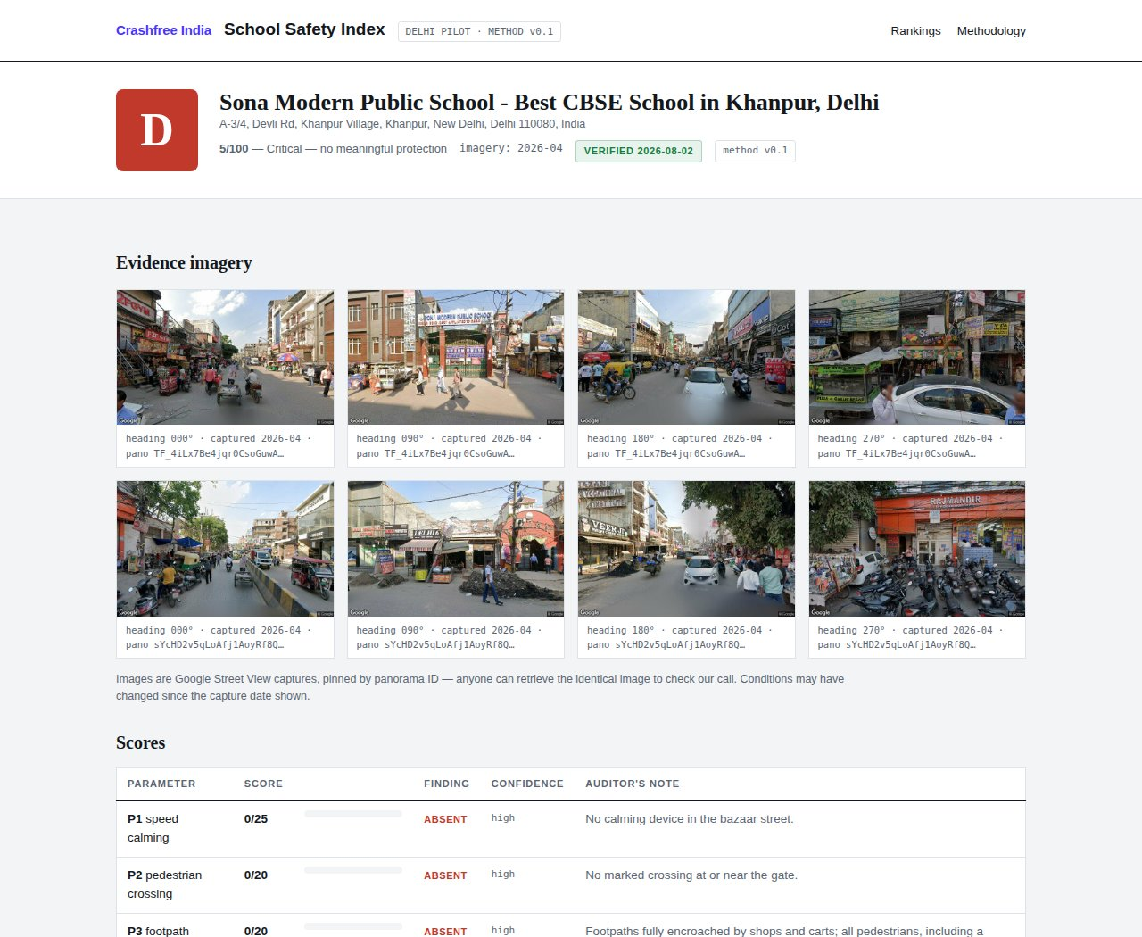

02 · IDEA 01, THE ONE WE LEAD WITH
IDEA 01 · SCHOOLS
School Safety Index: the prototype is already built
A public 0–100 grade for the road outside every school gate, anchored to IRC:SP:32, India's school-zone standard.
Delhi NCR prototype, live
3,814 schools mapped via the Places API; 90% with usable Street View imagery; pilot report cards published with pinned photo evidence.
Method before scale
AI desk audit against a 44-check IRC:SP:32 rubric, independently verified before anything is published. It grades the road, never the school.
Launch with government, planned
We are preparing the public launch with a government partner: our four District Road Safety Committee seats carry the worst-graded zones into the statutory forum, and student teams field-verify them.
The index, worst grades first.
The next city is ready
Jaipur: 1,572 schools mapped, 361 GPS-located blackspot crashes from police records, corridors already defined on our Google Cloud project.
What it cannot see today: the speed of traffic past the gate. A photograph never shows it.
A school's report card, evidence pinned.
Crashfree India · Discussion deck · Crashfree India × TraffiCure, Google Maps Platform
04 / 15

Slide 5





02 · IDEA 01, WORKING TOGETHER
IDEA 01 · SCHOOLS
Add the one input a photograph cannot give: speed past the gate
Imagery shows the missing crossing. TraffiCure's feed shows the danger moving through it, hour by hour, school-run by school-run.
Speed-exposure per school zone
Share of school-run hours with traffic above safe speed at the gate, from RMI segment speeds; harsh-braking points near gates as the risk flag.
PRESSURE TEST
Must be true
RMI segments resolve the short streets outside gates, and school-run-hour slices are supported; terms allow a nonprofit public index to cite the data with attribution.
One ranking, by measured danger
Imagery grade × measured speed × vehicle counts as exposure: every school ranked by danger, not by anecdote — and re-measured after a district builds the fix.
Where it breaks
How we would split it
We hold method, verification, the public index and the DRSC seats. TraffiCure holds the feed and corridor tooling. The launch names both.
If segments are too coarse for 30-metre gate zones, or the experimental feeds are thin in Delhi and Jaipur, the speed layer stays anecdote. And a public index must survive a school district challenging its grade.
How we find out fast
One working session on 10 gate corridors we have already defined. Pull real segments, check granularity and density against our field audits of the same gates. A week, not a quarter.
A first for India: no one has published measured speed outside school gates at city scale. The index gives that number a public home and a government audience.
Crashfree India · Discussion deck · Crashfree India × TraffiCure, Google Maps Platform
05 / 15

Slide 6

02 · IDEA 02
IDEA 02 · NEAR-MISSES
Harsh braking: the near-miss map, validated against real crashes
Crash data arrives after the funeral. Braking data arrives every day. The question worth answering: does one predict the other on Indian roads?
What we hold
361 GPS-located crashes at Jaipur's notified blackspots (police e-DAR, via our DRSC seat), 96 mapped clusters, and a live national defect repository with 500+ locations.
PRESSURE TEST
Must be true
Braking events are dense enough per junction to be statistically usable, and the anonymisation thresholds still leave signal on two-wheeler-heavy Indian streets.
What the feed adds
Anonymised harsh-braking points at intersection scale — TraffiCure calls it the safety signal nobody else has. Overlaid on known crash sites, it can be tested, not assumed.
Where it breaks
What it becomes
An India-first validation study: where braking predicts crashes, authorities get a risk-ranked corridor list before the next fatality — and Google gets published, citable evidence from India.
Braking correlates with congestion, not danger — chaos that never crashes. If the correlation with e-DAR crash sites is weak, this is a research note, not a product.
How we find out fast
A 4-week overlay on Jaipur's 96 clusters: braking density at crash sites vs matched control junctions. Clear threshold agreed up front — publish either way.
Worst case, we learn the feed's limits. Best case, India's road-risk maps stop waiting for people to die first.
Crashfree India · Discussion deck · Crashfree India × TraffiCure, Google Maps Platform
06 / 15

Slide 7


02 · IDEA 03
IDEA 03 · PROOF
Prove every fix: before-and-after for road safety spending
Pune used the feed to prove a decongestion plan worked. The same instrument can prove safety works — nobody has pointed it there.
The pipeline exists
15 Rakshak sites are in implementation now and 75+ implementations are targeted this year — speed humps, crossings, junction geometry, each with a known build date.
PRESSURE TEST
Must be true
Corridors can be subscribed before construction starts (baseline needs weeks of history), and speed changes at fixed sites clear the noise of seasons, weather and traffic growth.
The measurement is one subscription away
Corridor speeds and counts before the fix, after the fix, against control corridors. Today India evaluates road-safety works by inspection photos; this gives them a measured outcome.
Where it breaks
Where it lands
Every before-after goes to the District Road Safety Committee in the statutory record, onto our public dashboard — and into TraffiCure's case-study shelf as the first safety deployments.
Attribution: speeds move for many reasons. Without control corridors and honest stats, a sceptical engineer dismisses it — and one over-claimed result poisons the method.
How we find out fast
Pick 2 sites entering construction this quarter, subscribe now, pre-register the analysis with control corridors. First honest result inside 90 days of the build.
This is the cheapest idea in the deck, and the fastest to show working: the fixes are being built either way.
Crashfree India · Discussion deck · Crashfree India × TraffiCure, Google Maps Platform
07 / 15

Slide 8



02 · IDEA 04, EXPLORATORY
IDEA 04 · ENFORCEMENT
SATARK × the feed: enforcement standing where the risk is
An early idea, listed honestly. It builds only on assets we already run with police partners, and carries no commitments.
What already runs
SATARK screens vehicles for police in Jaipur, Bengaluru and Gurugram: 3,00,000+ screened, 350+ intercepted, challan billboards live. MoUs govern all of it.
PRESSURE TEST
Must be true
Police continue to pull this — the MoUs and three years of working trust are the asset — and the speeding-concentration view is granular enough to move a patrol roster.
What the feed could add
A weekly view of where and when speeding concentrates near people — so patrols, camera vans, billboards and SATARK sites stand where the risk is, corridor-hour by corridor-hour.
Where it breaks
How we keep it honest
Success measured as speeds before and after a deployment, never as challan counts. RMI stays aggregate — no plates, no individual vehicles. Any pilot starts small, inside an existing MoU.
Optics: 'Google data guiding enforcement' can be misread as surveillance. The aggregate-only line must hold absolutely, and the police must own every decision.
How we find out fast
One city, four weeks: hand Jaipur Traffic Police a weekly speeding-concentration map for existing patrol corridors. If rosters change, it works. If not, we shelve it.
Everything named here is ours or the police's. No third party is required for a first version.
Crashfree India · Discussion deck · Crashfree India × TraffiCure, Google Maps Platform
08 / 15

Slide 9


02 · FURTHER OUT
THE SHELF
Three more on the shelf, each with its caveat attached
Not proposals yet. Listed so the conversation can pick anything up, or put it down.
Incident feed × the under-reporting gap
Safe-route research for two-wheelers
School-run advisories
Maps users report crashes police never record. Compare the incident feed against FIR and e-DAR records in our districts to size India's crash under-reporting, a number policy people cite for a decade.
Join our audit and crash data with speed layers to ask whether a marginally slower route is materially safer, starting with the delivery riders we already study.
Where the index and speed data agree a gate is dangerous at 8 am, that knowledge could reach parents and schools through channels Google already owns.
Caveat: incident reports are noisy and unverified; needs careful matching before any claim.
Caveat: research first; a consumer nudge is Google's call, never ours.
Caveat: only after the index and speed layer are validated; advisories without method invite panic.
Crashfree India · Discussion deck · Crashfree India × TraffiCure, Google Maps Platform
09 / 15

Slide 10






03 · WHAT EACH SIDE BRINGS
THE SHAPE
A partnerships channel into government, and a clean split
Cities buy operations software. Safety products stay public and free. The pilots that prove both run through doors we already hold open.
WHAT WE BRING
WHAT TRAFFICURE + GOOGLE BRING
Standing inside government: seats on 4 District Road Safety Committees, MoUs with Jaipur and Gurugram police, 25+ written authority approvals across six states, EoIs before NRSB working groups.
The data layer nothing else matches: every road, every 2 minutes, plus the May 2026 safety feeds — no hardware, weeks to deploy.
Safety method that survives review: IRC and MoRTH-anchored audits, adversarial verification, student field teams in 18 cities.
A working product and playbook: TraffiCure live with Pune City Traffic Police, corridors measured in four cities, activation in 4–8 weeks.
Public products and credibility: live index and repository, national press coverage, MS Dhoni as Goodwill Ambassador.
Reach and legitimacy: a Premier Partner network and the Google name, which opens rooms and closes doubts.
The clean split: no money needs to move between us. Cities subscribe to TraffiCure for operations; our safety products stay public, free and attributed; joint district pilots become the reference deployments that open the next city for everyone.
Crashfree India · Discussion deck · Crashfree India × TraffiCure, Google Maps Platform
10 / 15

Slide 11
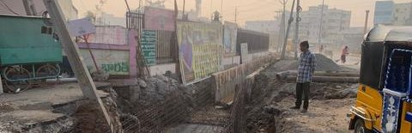
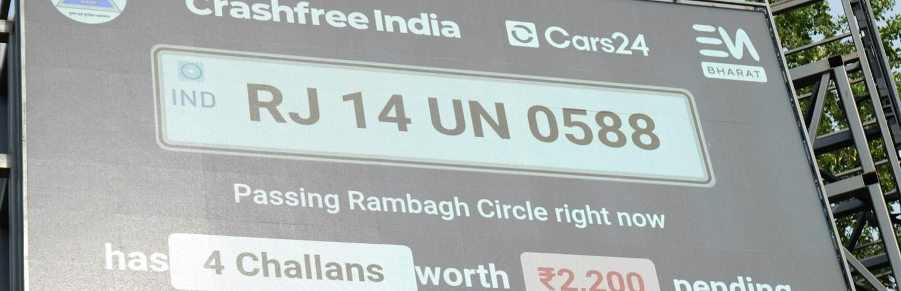
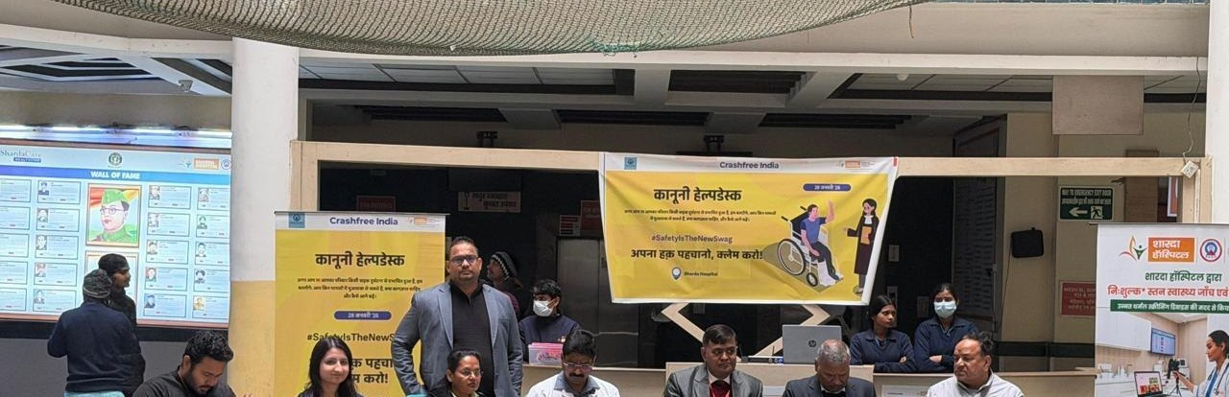

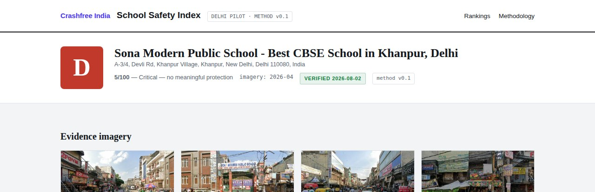

04 · ABOUT US
ABOUT US
Six lines of work, one connected system
A nonprofit registered as the Vision Zero Trust · Co-founded by Cars24 and the Indian Road Safety Council · 18 cities · everything below is live.
Project Rakshak
SATARK enforcement
Victim support
Student-led road audits, fixed with authorities
AI support that helps police find high-risk vehicles
Aasha chatbot, calculator, hospital helpdesks
31 sites · 15 in implementation
3,00,000+ vehicles screened
100+ victims helped in first 4 days
Open public data
School Safety Index
Youth & policy
Four self-updating data platforms, free to use
Public grading of school-zone road safety
NextMile ideathon and national dialogue series
36 states & 50 cities covered
3,814 Delhi NCR schools mapped
2,000+ participants engaged
Crashfree India · Discussion deck · Crashfree India × TraffiCure, Google Maps Platform
11 / 15

Slide 12
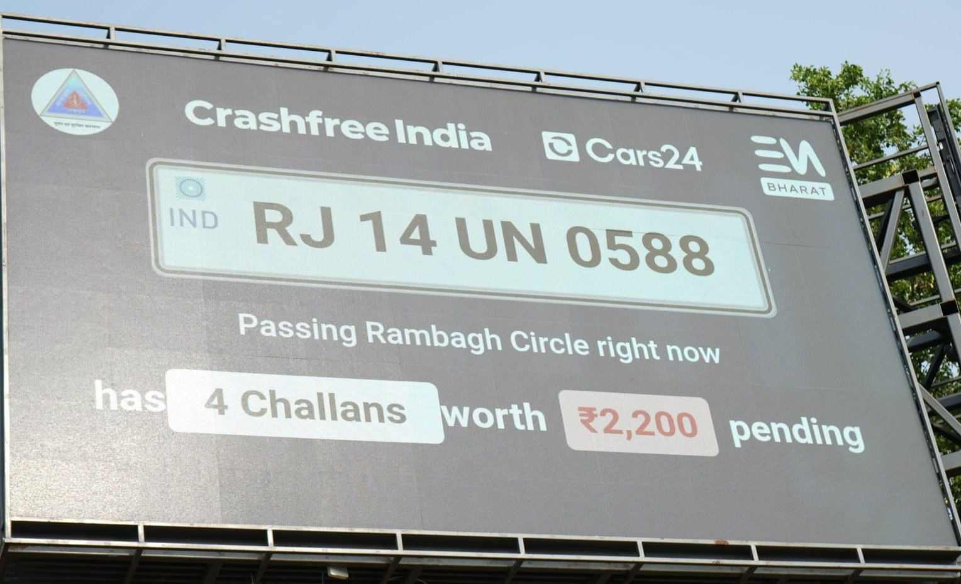
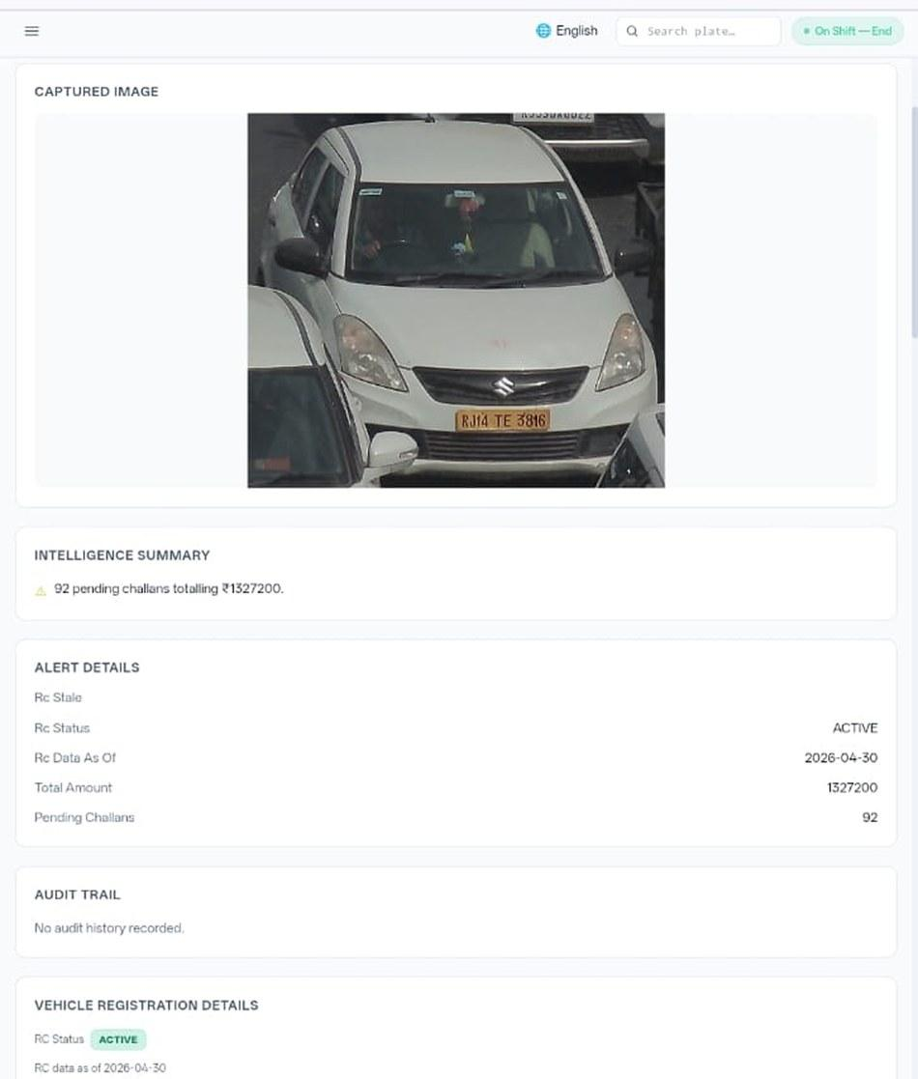


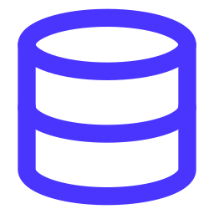





04 · ABOUT US, SATARK IN THE FIELD
ABOUT US
SATARK: AI that helps police stop the right vehicle
Built with Cars24 engineers. Reads number plates, checks government records, and alerts officers to repeat offenders, in real time.
3,00,000+
₹30 Cr+
vehicles screened
pending challan value identified
350+
70,019
high-risk vehicles intercepted
vehicles found with pending challans
LIVE · Jaipur & Bengaluru
NEW · Gurugram
Officer view, challans,
RC & compliance status.
Bengaluru's Trinity Circle billboard was India's first, covered by Deccan Herald and national press. Pune and Ahmedabad are next.
Rambagh Circle, Jaipur, live plate, pending challans and dues on a public billboard.
ANPR camera
Plate read
Records check
Risk flag
Officer alert
Billboard
Interception
Enforcement
Crashfree India · Discussion deck · Crashfree India × TraffiCure, Google Maps Platform
12 / 15

Slide 13
05 · THE PLAN
THE PLAN
Ninety days, with a decision gate at the end
Small, funded on our side, and honest: each idea carries its own kill-test. What survives, scales.
1
WEEKS 1 – 2
2
WEEKS 3 – 8
3
WEEKS 9 – 13
The technical session
Two pressure tests run
Into the statutory record
Lepton + Maps + CFI at one table, on real data: 10 school-gate corridors and Jaipur's 96 crash clusters, already defined on our configured cloud project. Granularity and density answered in the room.
The SSI speed layer scored on ~100 school zones in one city, and the harsh-braking overlay against Jaipur's crash sites — thresholds agreed up front, results shared either way.
Surviving results go to the District Road Safety Committees and into the public index; before-after subscriptions start on 2 Rakshak sites entering construction; the government launch of the index is scoped with a named partner.
Day 90, the gate: each idea is scaled, reshaped, or shelved — in writing. Our side runs at no cost to Google. The one ask: feed access for public-good use, with attribution on everything we publish.
Crashfree India · Discussion deck · Crashfree India × TraffiCure, Google Maps Platform
13 / 15

Slide 14

05 · FOR TOMORROW
THE QUESTIONS
Four questions we bring to the table
Held loosely. The ranking of ideas is ours to lose; the starting point is yours to shape.
Access and terms
The granularity truth
Can a nonprofit safety layer sit on the feed — harsh braking and counts included — with terms that allow a public, attributed index? What does that take, and through whom: Google, Lepton, or both?
On the short urban streets outside school gates, what segment resolution and experimental-feed density should we honestly expect in Delhi and Jaipur?
Which doors matter to you
The working session
Which cities and stories help TraffiCure and RMI most in the next two quarters? Our committee seats, police MoUs and NRSB engagement work best when pointed somewhere specific.
Can we fix a date for the Lepton + Maps + CFI technical session? Our corridors, zones and cloud project are ready this week.
Crashfree India · Discussion deck · Crashfree India × TraffiCure, Google Maps Platform
14 / 15

Slide 15

Traffic data already runs the daily commute.
Together it can start preventing the crash.
Every idea in this deck is offered with its own kill-test attached. We would rather shelve three honestly than overclaim one.
Akhtar Hussain
Deepanshu Gupta
Gajendra Jangid
Mission Lead · akhtar@crashfreeindia.org
Trustee · deepanshu@crashfreeindia.org
Trustee · gajendra@crashfreeindia.org
Crashfree India · A Cars24 commitment · Operated by Vision Zero Trust, New Delhi · crashfreeindia.org

