Slide 1

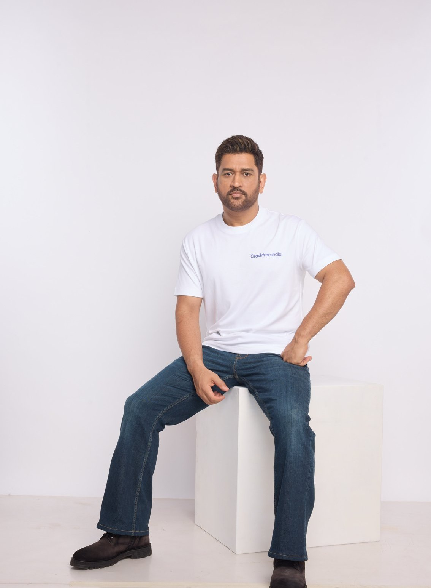



ORGANISATION OVERVIEW · 2026
A ROAD SAFETY NONPROFIT · NEW DELHI
Crashfree India
Adding capacity to India's road safety system:
evidence, institutions, and technology that follows through
Field audits and research to official standards, fixed with the authorities that own the road
Technology for police, victims and the public: enforcement, open data, and a chatbot on WhatsApp
MS DHONI · GOODWILL AMBASSADOR,
CRASHFREE INDIA
Working inside the machinery: 4 district committees, police MoUs, 25+ written approvals
Registered as the Vision Zero Trust · A Cars24 commitment · Co-founded with the Indian Road Safety Council
crashfreeindia.org

Slide 2

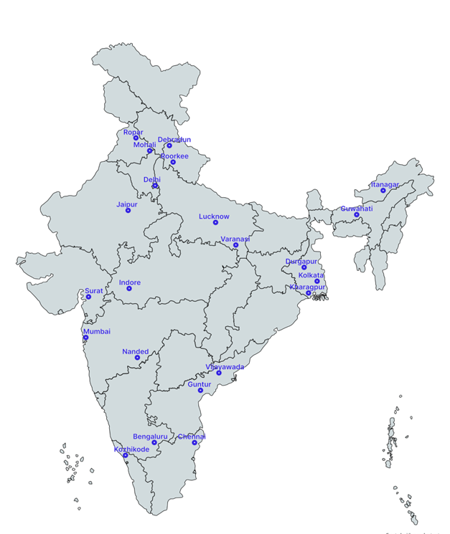


01 · ABOUT US
ABOUT US
Crashfree India: a nonprofit that adds capacity to road safety work
Registered as the Vision Zero Trust · Co-founded by Cars24 and the Indian Road Safety Council · Working since June 2025 · New Delhi
Evidence first
Structured field audits, file reviews and research to official standards, not opinion.
Institutional collaboration
We work through PWDs, NHAI, transport departments, police and District Road Safety Committees.
Youth-led capacity
Trained student teams from IITs, NITs and SPAs add the auditing hands the system needs.
Technology for follow-through
Public dashboards track every recommendation from submission to completion.
Backed by a US$3 million, three-year commitment from Cars24. Programmes, not overheads, receive 71% of the budget.
Where we work today, 18 cities, north to south.
Crashfree India · Organisation Overview · 2026
02 / 17

Slide 3


01 · ABOUT US, OUR APPROACH
ABOUT US
Our approach: work with the system, and prove it with data
Four steps, applied to every problem we take up, from a dangerous junction to a stalled compensation claim.
1 · Evidence
2 · Institutional partnership
3 · Technology
4 · Follow-through
Field audits, file reviews and research to official standards.
→
Work through the authority that owns the problem, never around it.
→
Dashboards, AI and WhatsApp tools that fit how officials already work.
→
Every recommendation tracked publicly to completion.
31 sites audited · 50+ stakeholder consultations
31 sites audited · 50+ stakeholder consultations
25+ written approvals · 4 DRSCs · MoUs with police
25+ written approvals · 4 DRSCs · MoUs with police
Aasha · SATARK · 4 open data platforms
Aasha · SATARK · 4 open data platforms
Implementation started at 15 sites · 7 fully built
Implementation started at 15 sites · 7 fully built
We do not replace the system and we do not campaign against it. We add hands, evidence and tools to work the system has already committed to.
Crashfree India · Organisation Overview · 2026
03 / 17

Slide 4
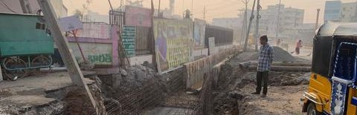
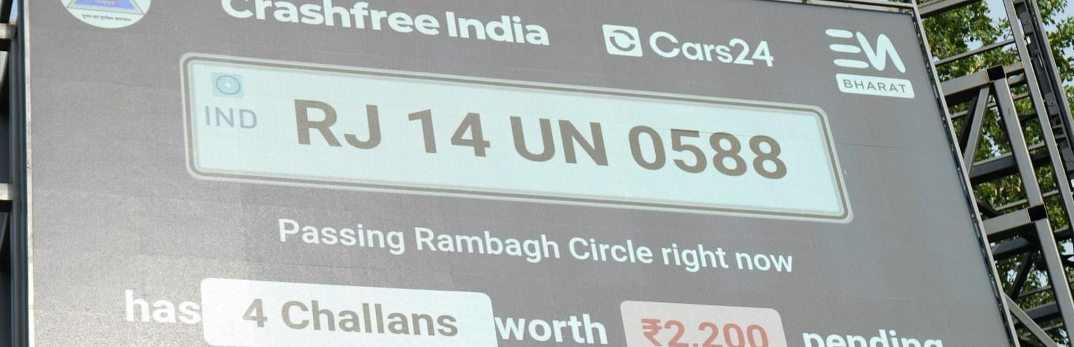
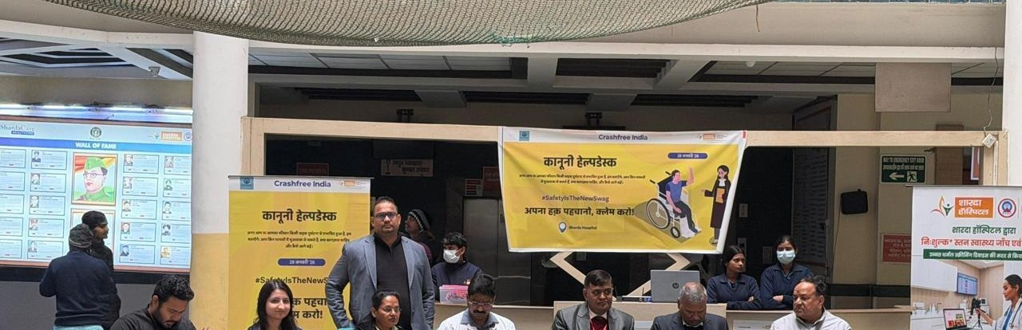
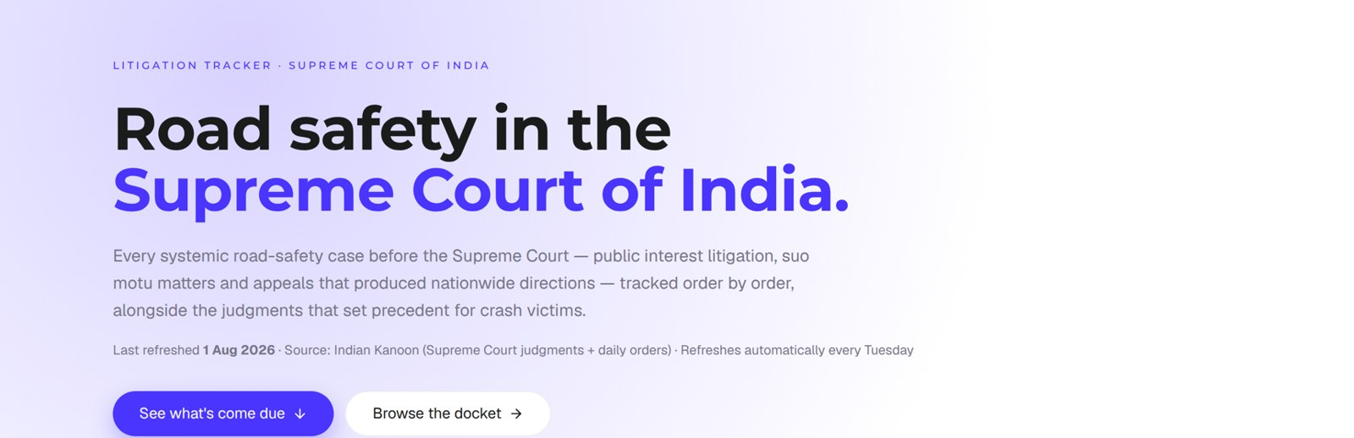
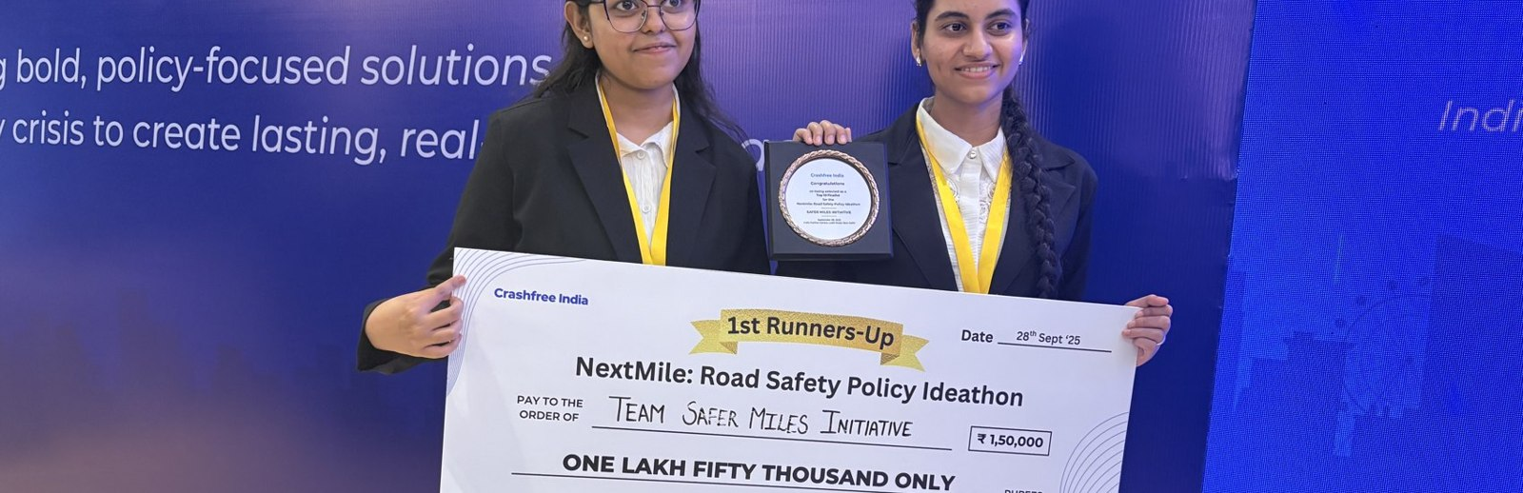
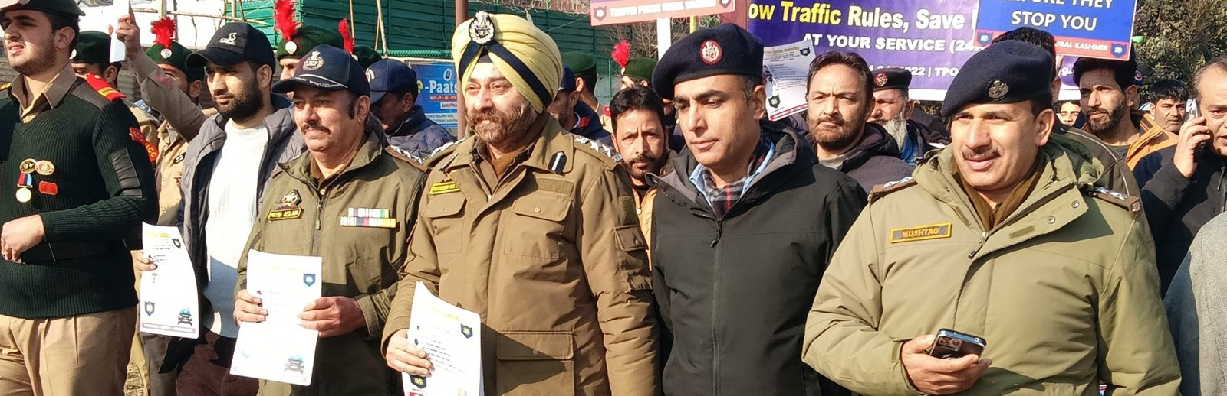
02 · WHAT WE HAVE BUILT
WHAT WE HAVE BUILT
Six lines of work, one connected system
Audits create data · data supports policy · policy guides the field. Everything below is live today.
Project Rakshak
SATARK enforcement
Victim support
Student-led road audits, fixed with authorities
AI support that helps police find high-risk vehicles
Aasha chatbot, calculator, hospital helpdesks
31 sites · 7 fixes fully built
3,00,000+ vehicles screened
100+ victims helped in first 4 days
Open public data
Youth & policy
Public campaigns
Four self-updating data platforms, free to use
NextMile ideathon and national dialogue series
Road Safety Month with police & schools; MS Dhoni
36 states & 50 cities covered
2,000+ participants engaged
1M+ citizens reached
Crashfree India · Organisation Overview · 2026
04 / 17

Slide 5
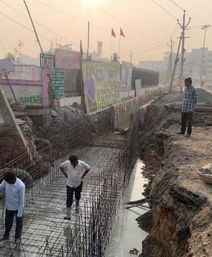
02 · WHAT WE HAVE BUILT, ROAD INFRASTRUCTURE
WHAT WE HAVE BUILT
Project Rakshak: student audits that end in built fixes
Trained student teams, guided by senior experts, audit dangerous locations to IRC codes, and we walk each fix through the road-owning authority until it is built.
120+
31
25+
15
→
→
→
locations screened
sites audited, 11 official black spots
written authority approvals
sites in implementation, 7 fully built
31 student teams · 20 institutions including nine IITs · 900+ stakeholder surveys · 17 subject-matter experts guiding every audit
MARQUEE CASE, OUTER RING ROAD, SOUTH DELHI
On our audit, PWD built a continuous 1.8 m accessible pedestrian corridor, upgraded drainage at ponding sites, installed bollards against footpath encroachment, and deployed camera-backed speed-feedback boards.
Every site is tracked on a public dashboard from submission through approval to completed construction, an honest read on how quickly agencies can act.
Construction underway after a student audit, tracked publicly to completion.
Crashfree India · Organisation Overview · 2026
05 / 17

Slide 6
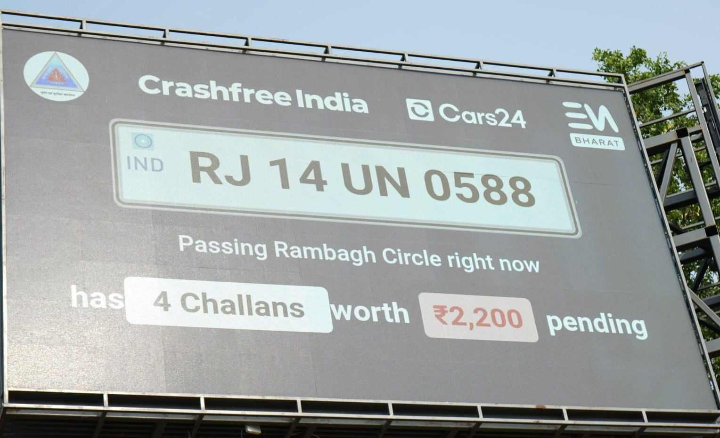
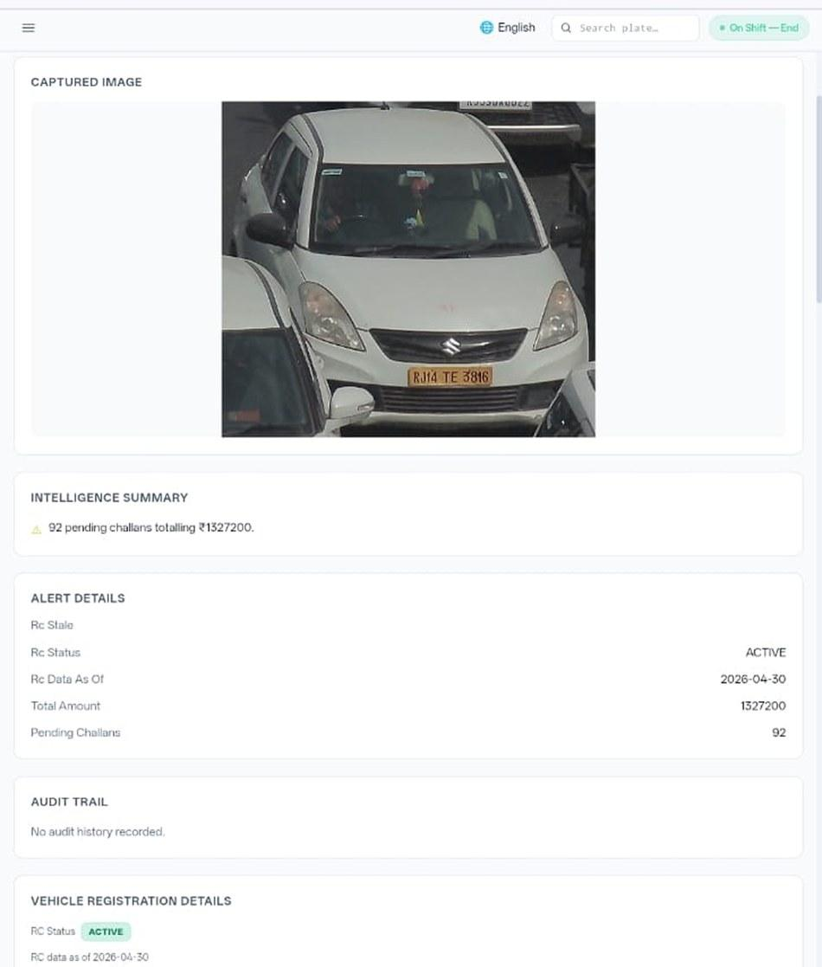








02 · WHAT WE HAVE BUILT, ENFORCEMENT TECHNOLOGY
WHAT WE HAVE BUILT
SATARK: AI that helps police stop the right vehicle
Built with Cars24 engineers. Reads number plates, checks government records, and alerts officers to repeat offenders, in real time.
3,00,000+
₹30 Cr+
vehicles screened
pending challan value identified
350+
70,019
high-risk vehicles intercepted
vehicles found with pending challans
LIVE · Jaipur & Bengaluru
NEW · Gurugram
Officer view, challans,
RC & compliance status.
Bengaluru's Trinity Circle billboard was India's first, covered by Deccan Herald and national press. Pune and Ahmedabad are next.
Rambagh Circle, Jaipur, live plate, pending challans and dues on a public billboard.
ANPR camera
Plate read
Records check
Risk flag
Officer alert
Billboard
Interception
Enforcement
Crashfree India · Organisation Overview · 2026
06 / 17

Slide 7
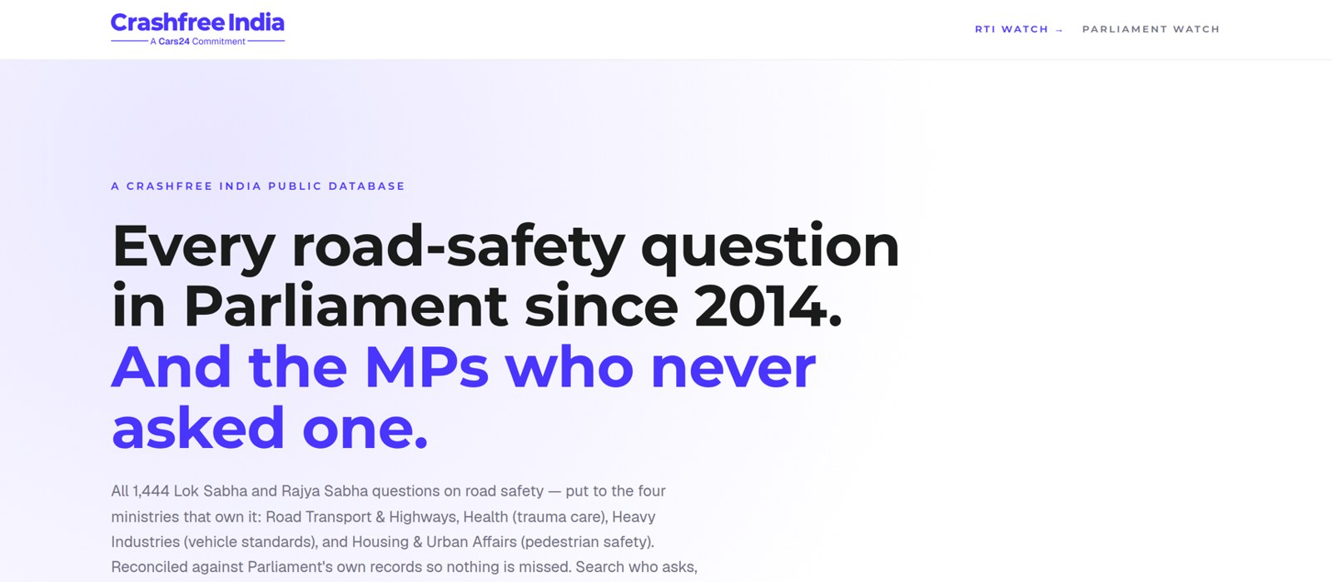



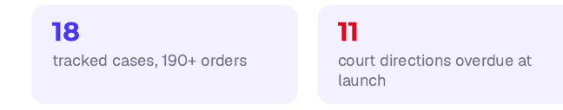
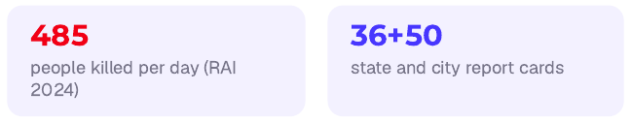
02 · WHAT WE HAVE BUILT, OPEN PUBLIC DATA
WHAT WE HAVE BUILT
Live public data platforms, free for any authority
Four platforms, each turning a scattered public record into structured, citable evidence. The Parliament tracker is shown live, as captured this week.
National Road-Infrastructure
Defect Repository
DAILY · 07:00 IST
An AI pipeline reads local-language news every morning and turns road-defect reports into structured, mapped, ranked evidence, each entry carrying its verbatim source.
Potholes
Missing signage
Unlit stretches
Blind curves
Broken dividers
146
districts scanned daily
13
languages read
21
defect codes tracked
Road Safety in Parliament: all 1,444 questions since 2014 across four ministries; 275 of 540 sitting Lok Sabha MPs have never asked one.
Local news → AI extraction → confidence gate → human review → public map. Live across Bihar, UP and Rajasthan districts today.
Supreme Court Litigation Tracker
WEEKLY · LIVE
Crash Data Dashboard
ANNUAL · OPEN DATA
Every systemic road-safety matter before the Supreme Court, orders indexed, precedent judgments digested, refreshed every Tuesday.
MoRTH's annual 'Road Accidents in India' books as a usable product: report cards for 36 states and 50 cities, every number reconciled against the printed books, open licence (CC-BY).
Crashfree India · Organisation Overview · 2026
07 / 17

Slide 8
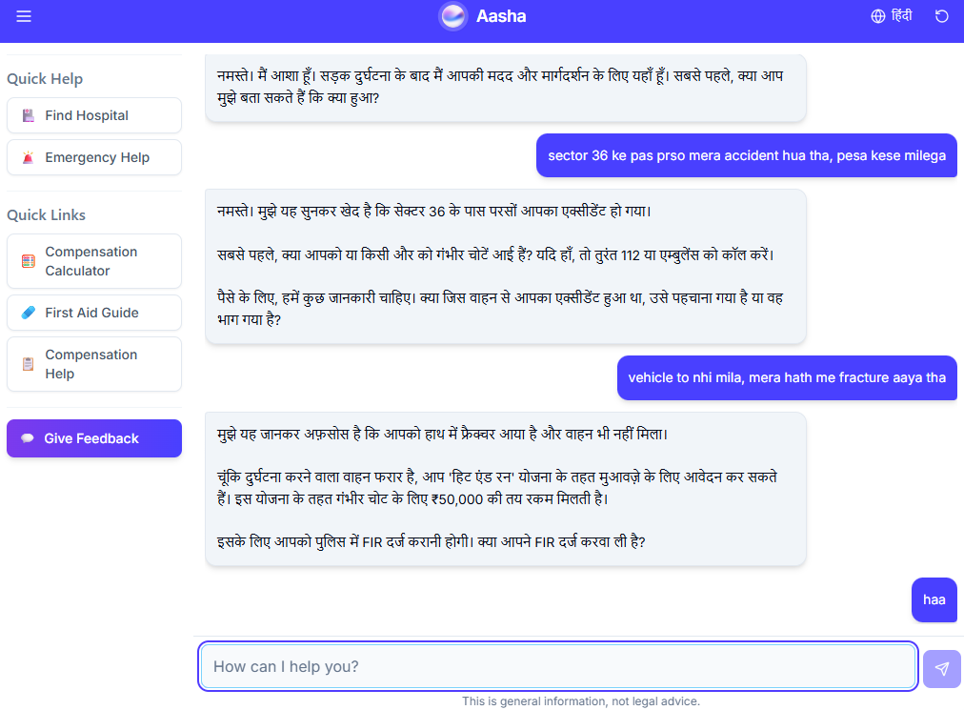
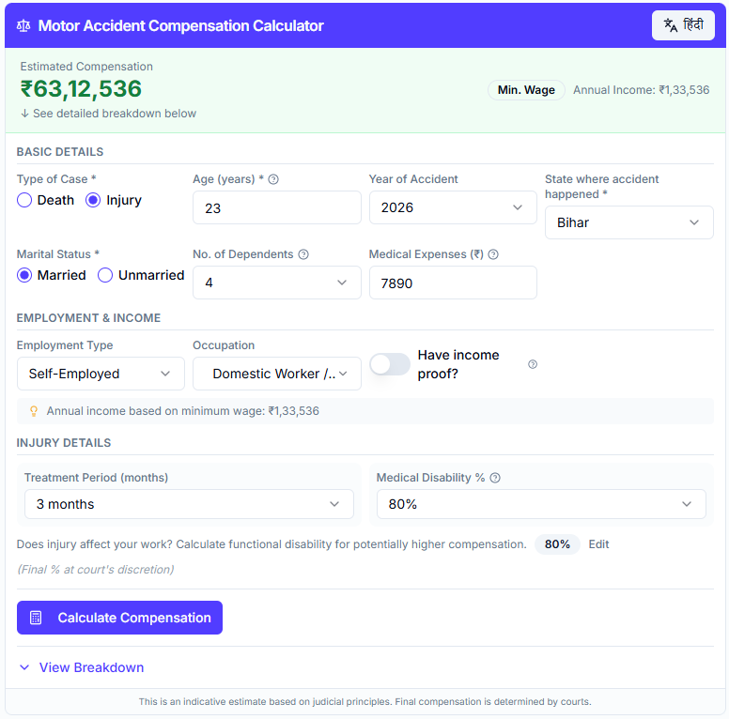
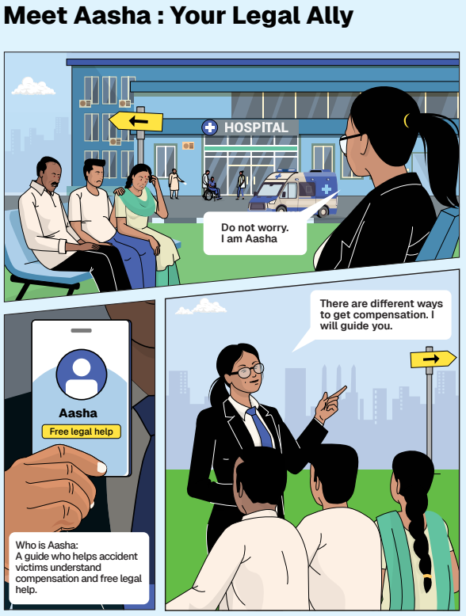
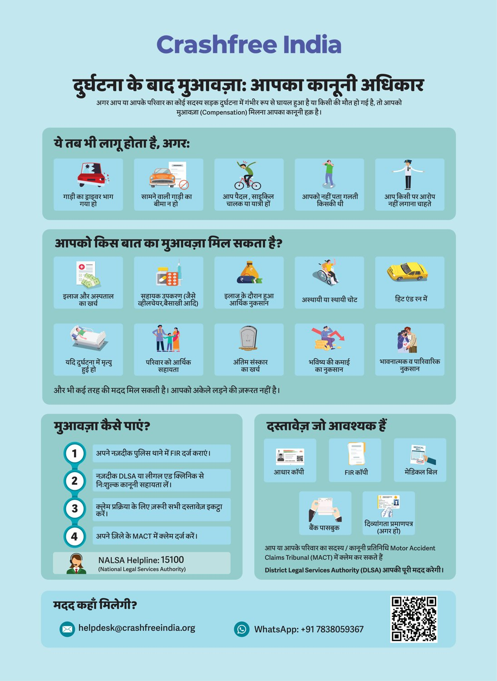




02 · WHAT WE HAVE BUILT, VICTIM SUPPORT
WHAT WE HAVE BUILT
Help a family can actually use, in their language
From the first hours after a crash to the final compensation order, on WhatsApp, on paper, and in person.
Aasha chatbot
Compensation Calculator
'Meet Aasha' comics
Hindi rights guide
India's first AI legal companion for crash victims, on WhatsApp and voice, no app needed.
Free instant estimates computed on Supreme Court principles (Sarla Verma, Pranay Sethi).
Plain-language legal education that families actually read, at desks and in schools.
All three compensation routes, NALSA 15100 and the Cashless Treatment Scheme 2025.
Hospital helpdesks bring all of this to the trauma-ward bedside , 100+ victims supported in the first four days, run with DLSA and Neev Foundation.
Crashfree India · Organisation Overview · 2026
08 / 17

Slide 9
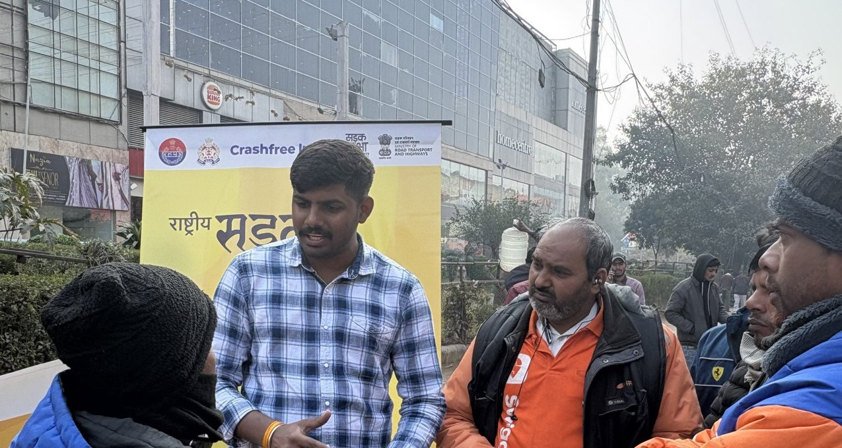



02 · WHAT WE HAVE BUILT, VULNERABLE ROAD USERS
WHAT WE HAVE BUILT
The fastest-growing risk on Indian roads rides a two-wheeler
Two-wheeler riders carry the largest share of road deaths, and gig and delivery work concentrates that exposure. We study it, and we work it.
~45%
23.5 M
1 in 2
of India's crash fatalities are two-wheeler users, rising year on year
gig and platform workers projected by 2029-30 (NITI Aayog)
delivery riders in a 431-rider Mumbai crash study had already crashed
A published study
'When Risks Become Routine' (Feb 2026): 40 pages, 87 references, from incentive design and helmet compliance to the e-bike regulatory blind spot.
A 300-rider study, now in the field
Quantifying how often riders face near-misses, which risk factors matter most, and what rider profiles exist, so interventions can be targeted.
Field, not only desk
Fieldwork included shadowing a delivery rider through a full nine-hour shift, documented on video.
Delivery-rider outreach, Road Safety Month 2026.
Crashfree India · Organisation Overview · 2026
09 / 17

Slide 10
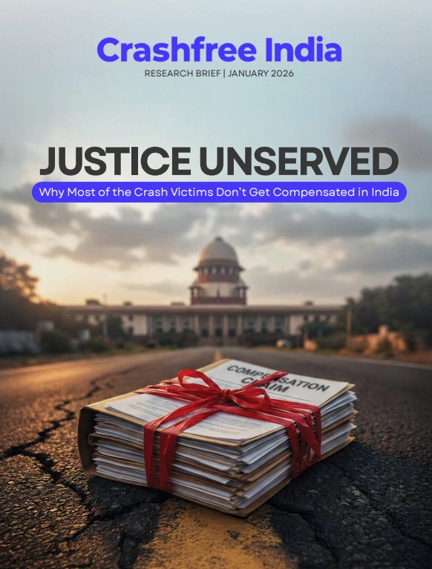
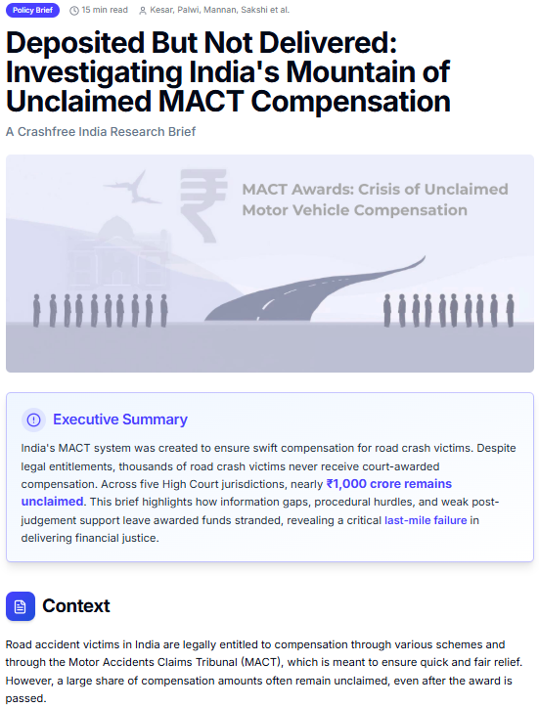
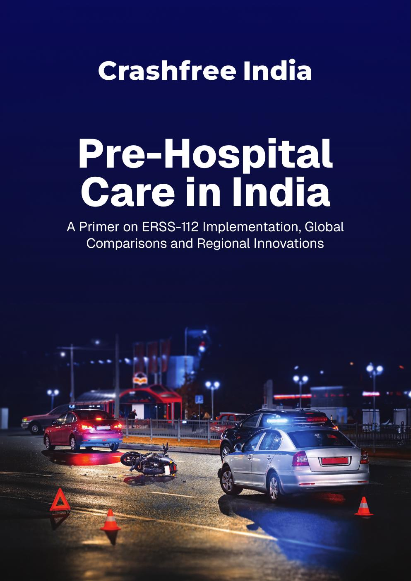
02 · WHAT WE HAVE BUILT, OUR RESEARCH
WHAT WE HAVE BUILT
Published evidence the sector cites
Original research, launched publicly and covered by national press. Each report turns a policy gap into something authorities can act on.
'Justice Unserved'
'Deposited But Not Delivered'
Pre-Hospital Care Primer
Jan 2026
2026
Sep 2025
Why so few hit-and-run and third-party claims reach the families entitled to them. Launched at IIT Delhi; findings presented to MoRTH.
~₹986 crore of court-awarded compensation lies unclaimed across five High Court jurisdictions, a bottleneck the Supreme Court noted in 2025.
Benchmarks ERSS-112 response and documents state EMS innovations, with contributions from the AIIMS Trauma Centre.
Plus: the gig-rider brief 'When Risks Become Routine', and four open public-data platforms, all free to use and openly licensed.
Crashfree India · Organisation Overview · 2026
10 / 17

Slide 11
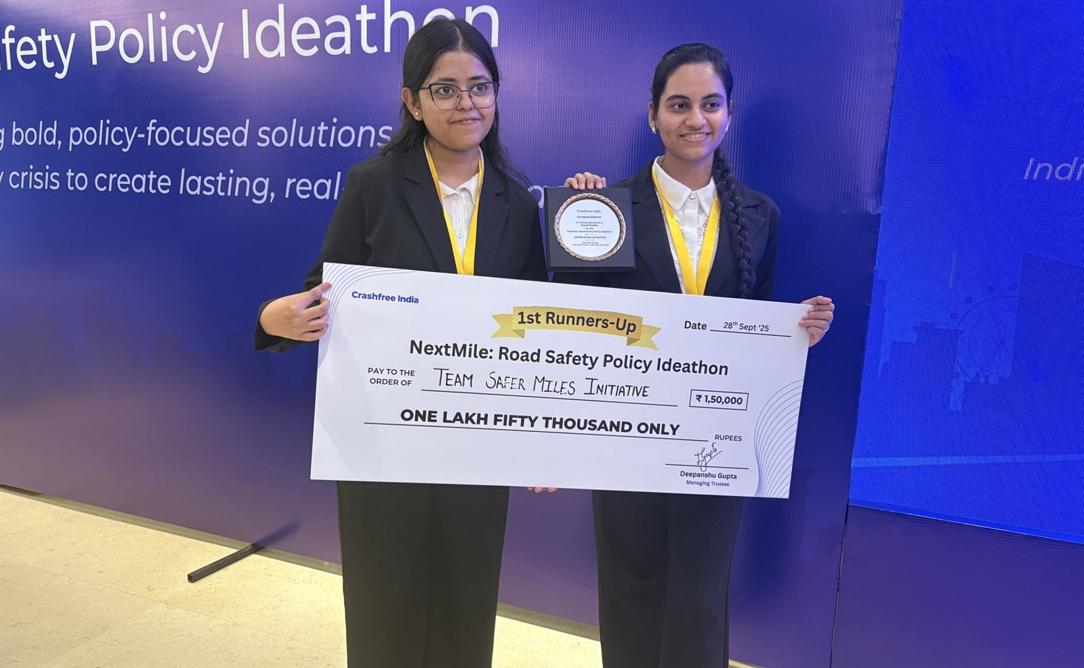
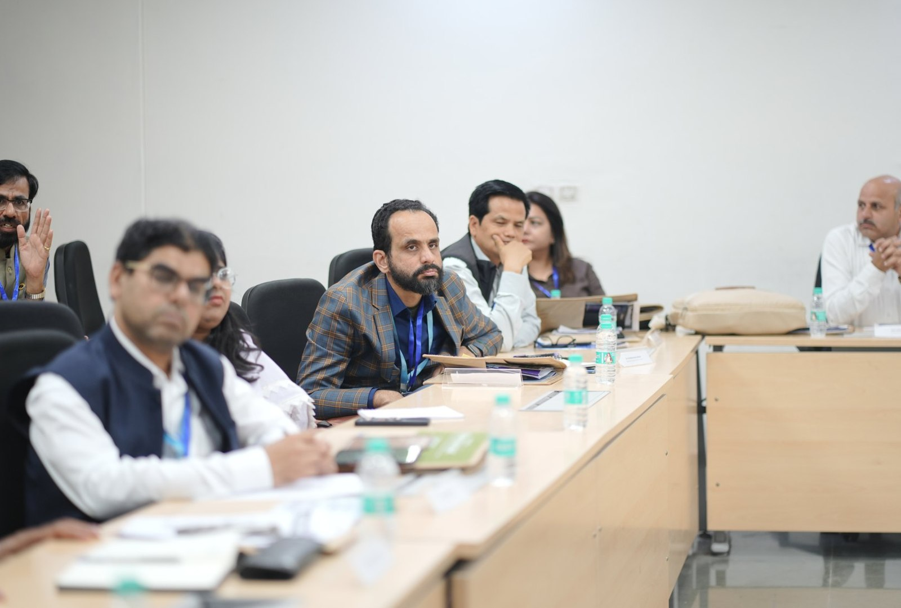



02 · WHAT WE HAVE BUILT, YOUTH & POLICY
WHAT WE HAVE BUILT
Young talent and senior experts, working the same problem
A steady pipeline of engineers and policy minds, so road safety work never runs out of hands.
National Road Safety Dialogue Series
200+ live attendees; speakers from MoRTH, CIRT, AIIMS Trauma Centre, CSIR-CRRI and ARAI.
Three sessions so far
Bus safety · Delivery rider safety · Good Samaritan law & the Cashless Treatment Scheme.
NextMile: Road Safety Policy Ideathon, grand finale, 28 Sep 2025, New Delhi.
National Road Safety Implementation Forum, IIT Delhi: 60+ experts from MoRTH, WHO, UNICEF, iRAP and CSIR-CRRI reviewed the work.
Advocacy on video
Our YouTube channel documents hazards and fixes on camera: ground-audit walkthroughs, Dialogue Series recordings and victim-education explainers. A public record any authority can cite.
2,000+
250+
700+
10
Mentors and jury from the Government of Rajasthan, NIUA, OMI, NASSCOM and CSEP judged the student teams; winning tracks now feed our audit and research pipeline.
participants
concept notes
teams
finalist teams
Next: 'Be a Rakshak' university chapters at IITs, NITs and SPAs.
Crashfree India · Organisation Overview · 2026
11 / 17

Slide 12
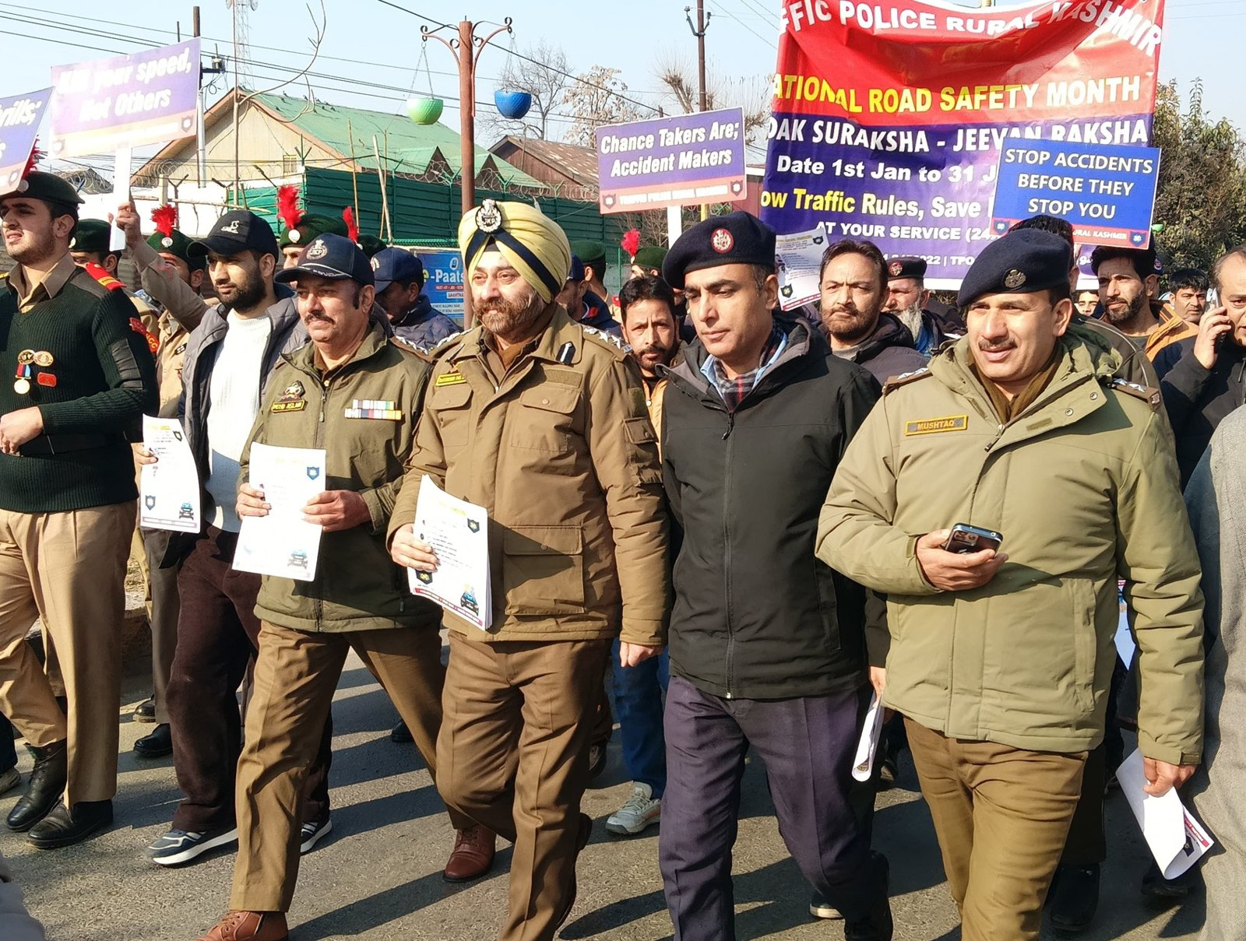
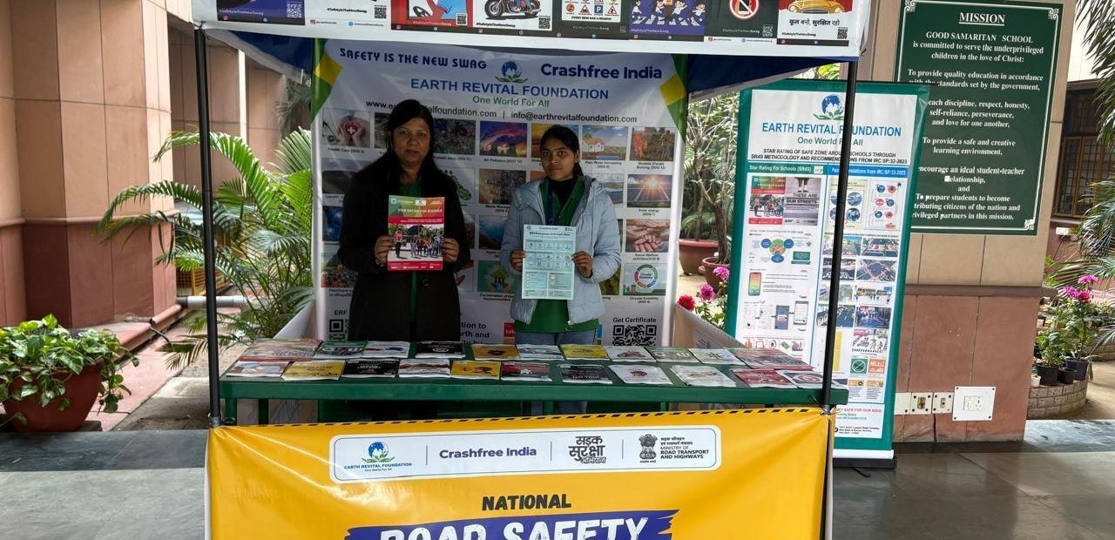
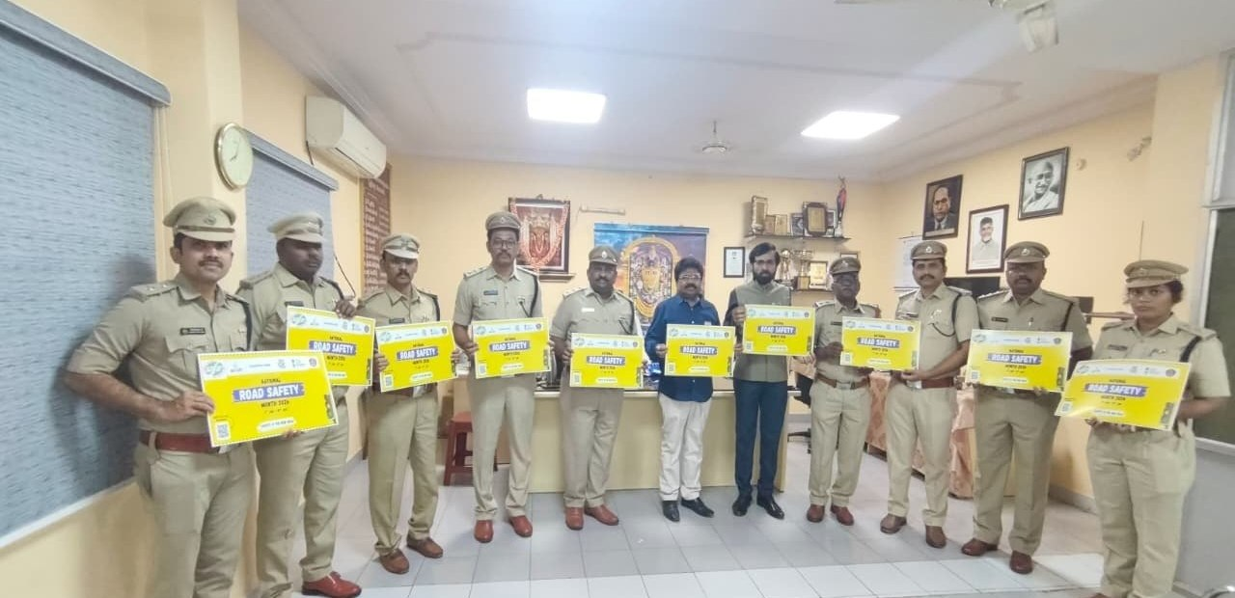
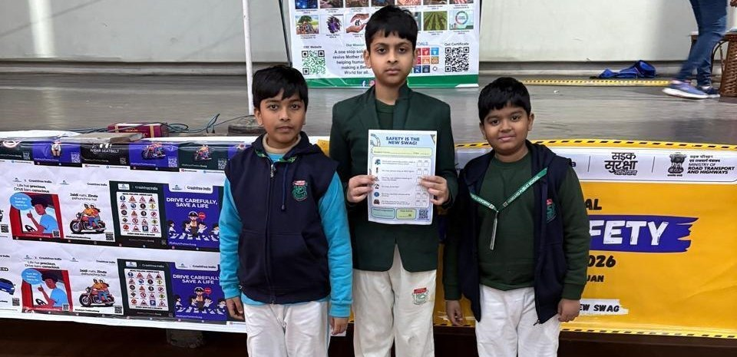
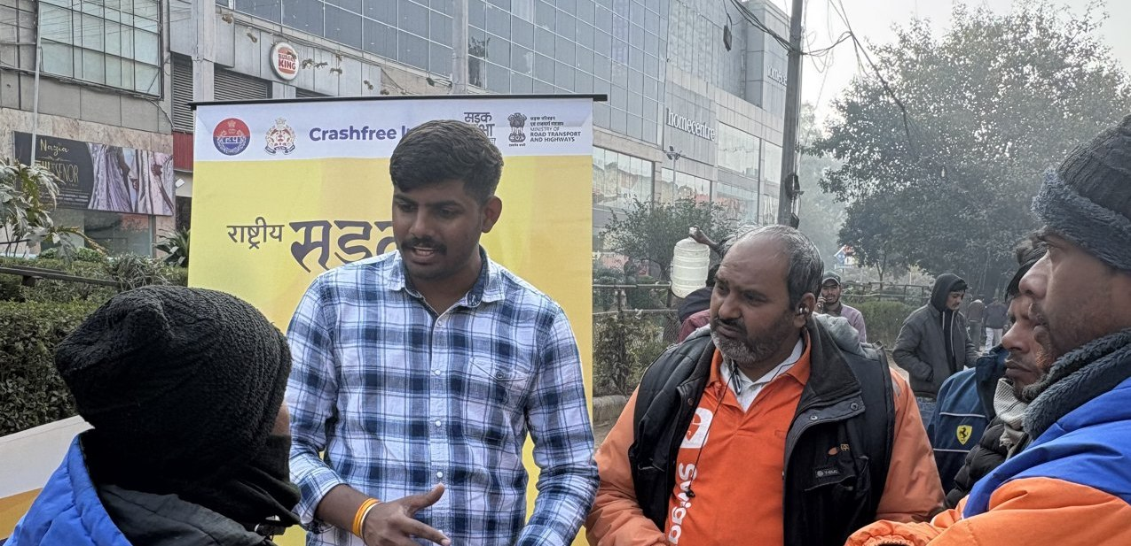
02 · WHAT WE HAVE BUILT, ON THE GROUND
WHAT WE HAVE BUILT
Road Safety Month 2026, run with the system
With district police, schools, hospitals and delivery platforms, in Hindi and local languages.
CFI stall at a government office
Materials briefing with police staff
National Road Safety Month rally, on the road with district traffic police, Jan 2026.
School programme with certificates
Delivery-rider outreach, Swiggy & Instamart
1M+ citizens reached across campaigns in year one.
Crashfree India · Organisation Overview · 2026
12 / 17

Slide 13
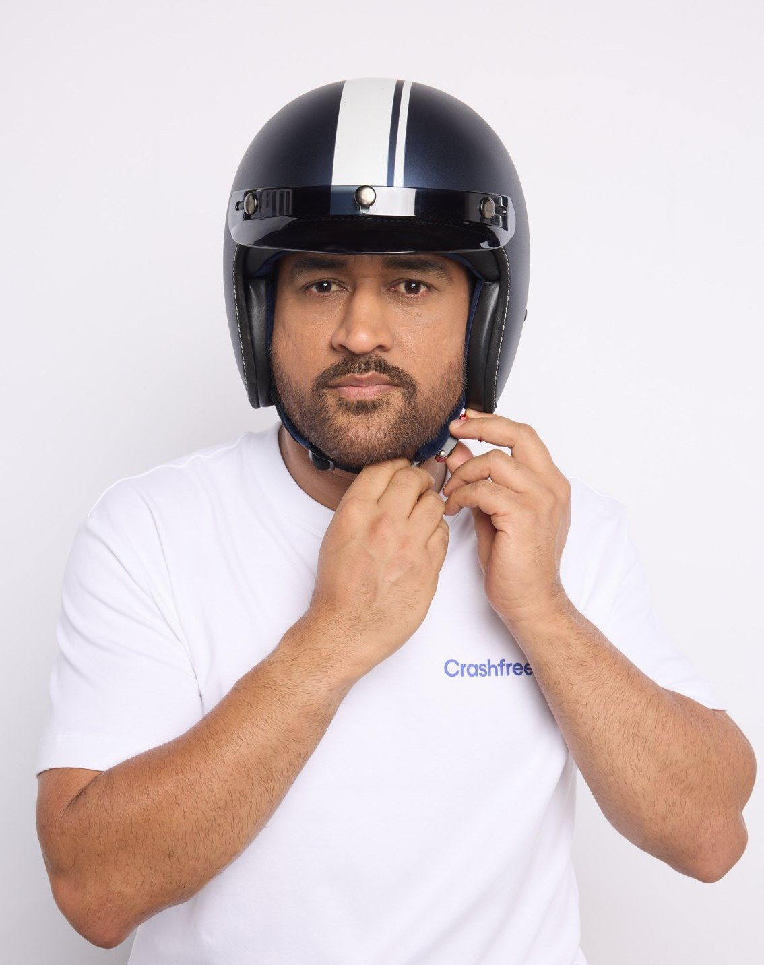
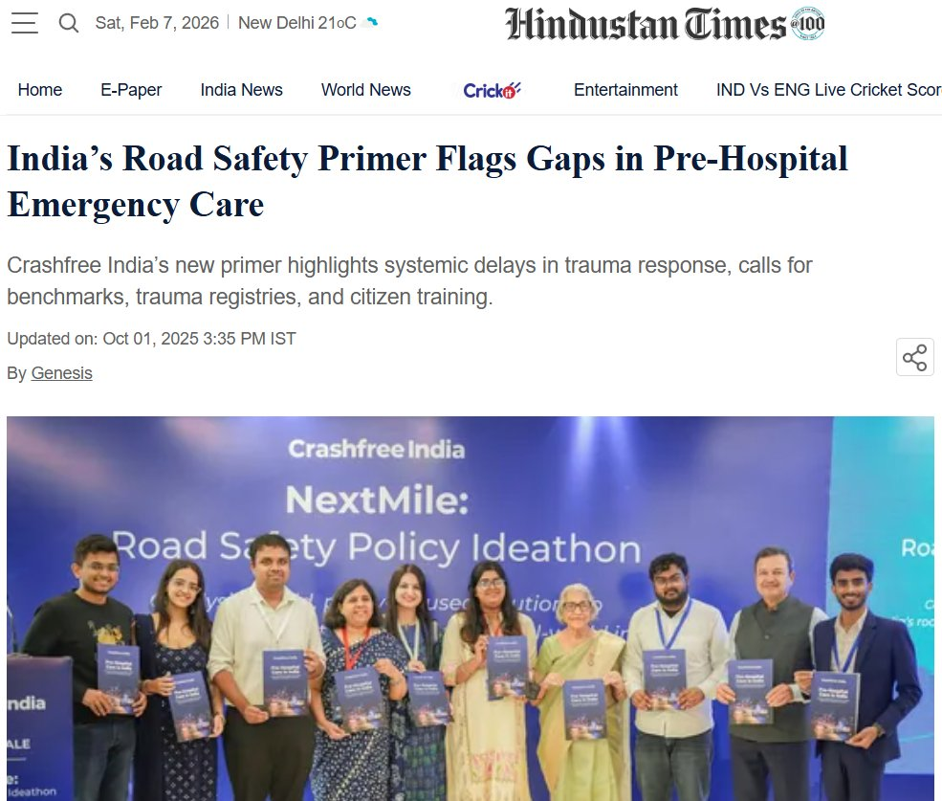
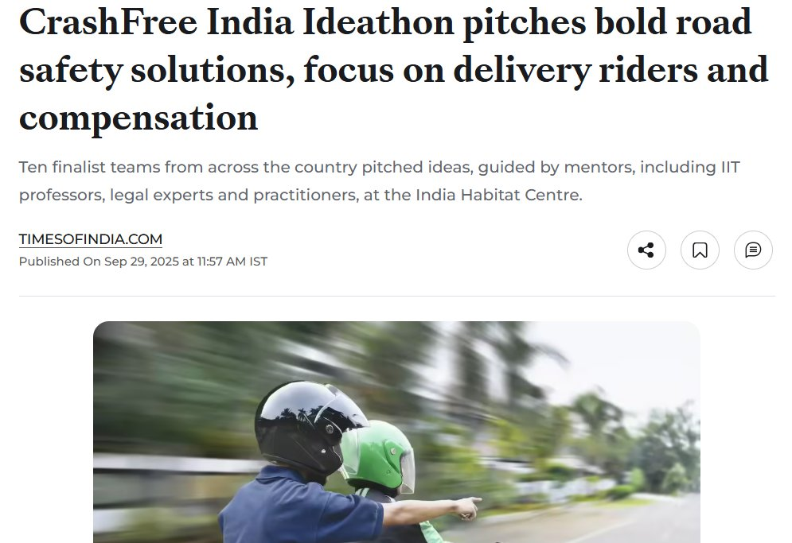

02 · WHAT WE HAVE BUILT, PUBLIC VOICE
WHAT WE HAVE BUILT
MS Dhoni gives road safety a national voice
AS SEEN IN THE PRESS
"We already know what is going wrong. What we need now is more responsibility, more discipline, more respect for life."
ThePrint, on the NextMile
ideathon finale.
MS Dhoni, at the National Road Safety
Implementation Forum, IIT Delhi
Hindustan Times, on our
Pre-Hospital Care Primer.
Deccan Herald
Economic Times
Fortune India
MS Dhoni, Goodwill Ambassador, announced April 2026.
IndiaSpend
Scroll.in
The Wire
Dhoni's voice powers 'Be a Rakshak', school-zone safety and compensation-awareness campaigns.
Times of India
Business Standard
Crashfree India · Organisation Overview · 2026
13 / 17

Slide 14
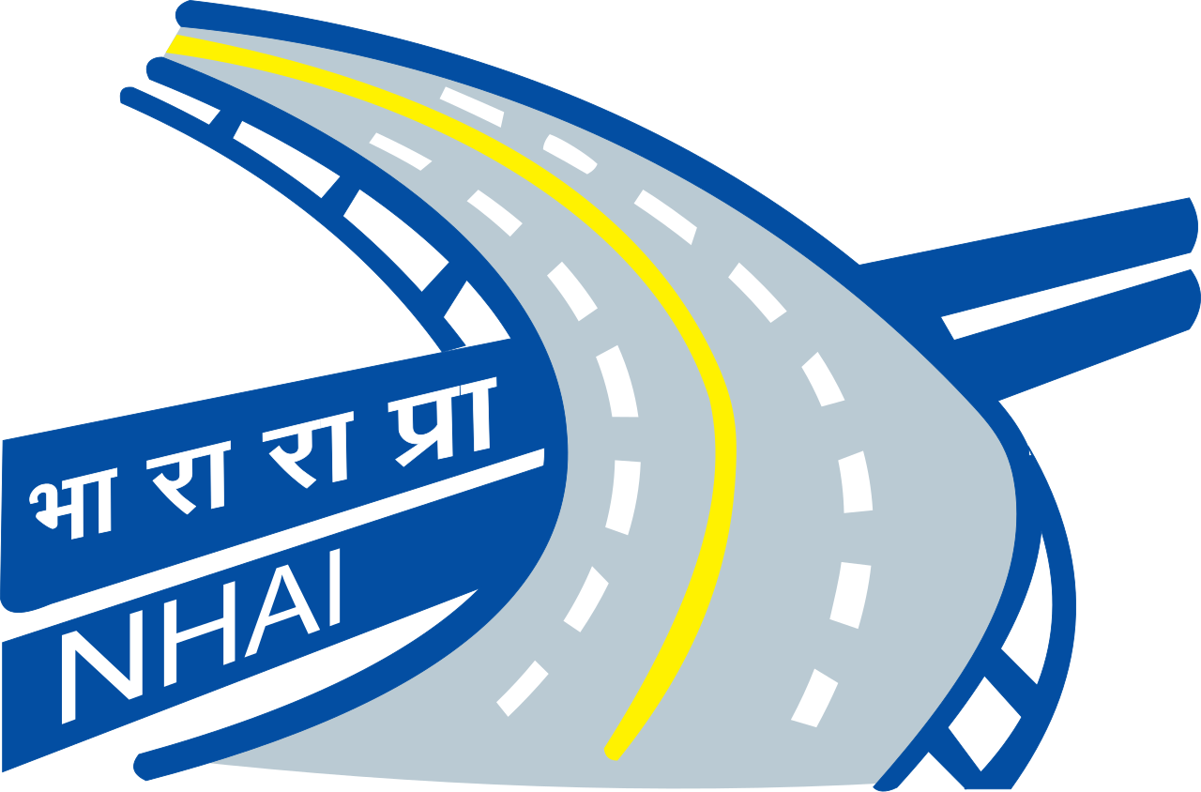
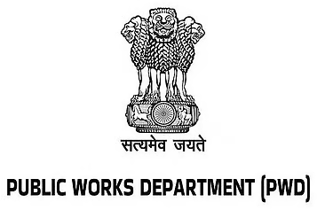
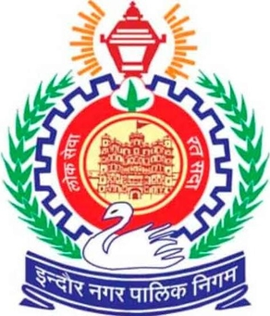
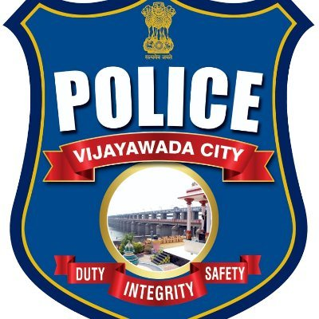
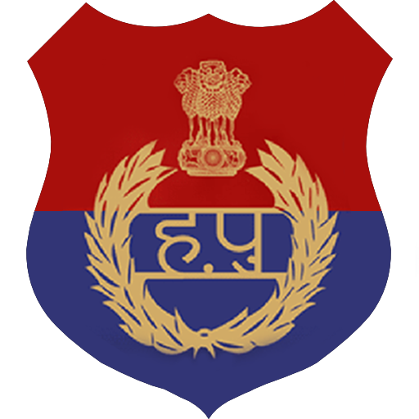
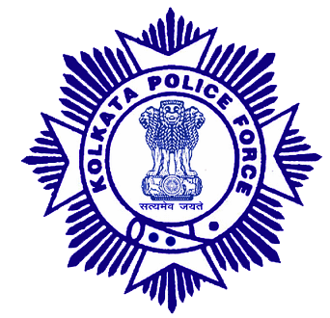
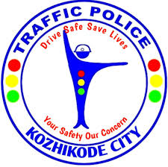
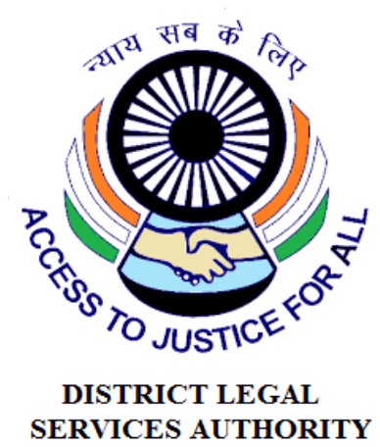















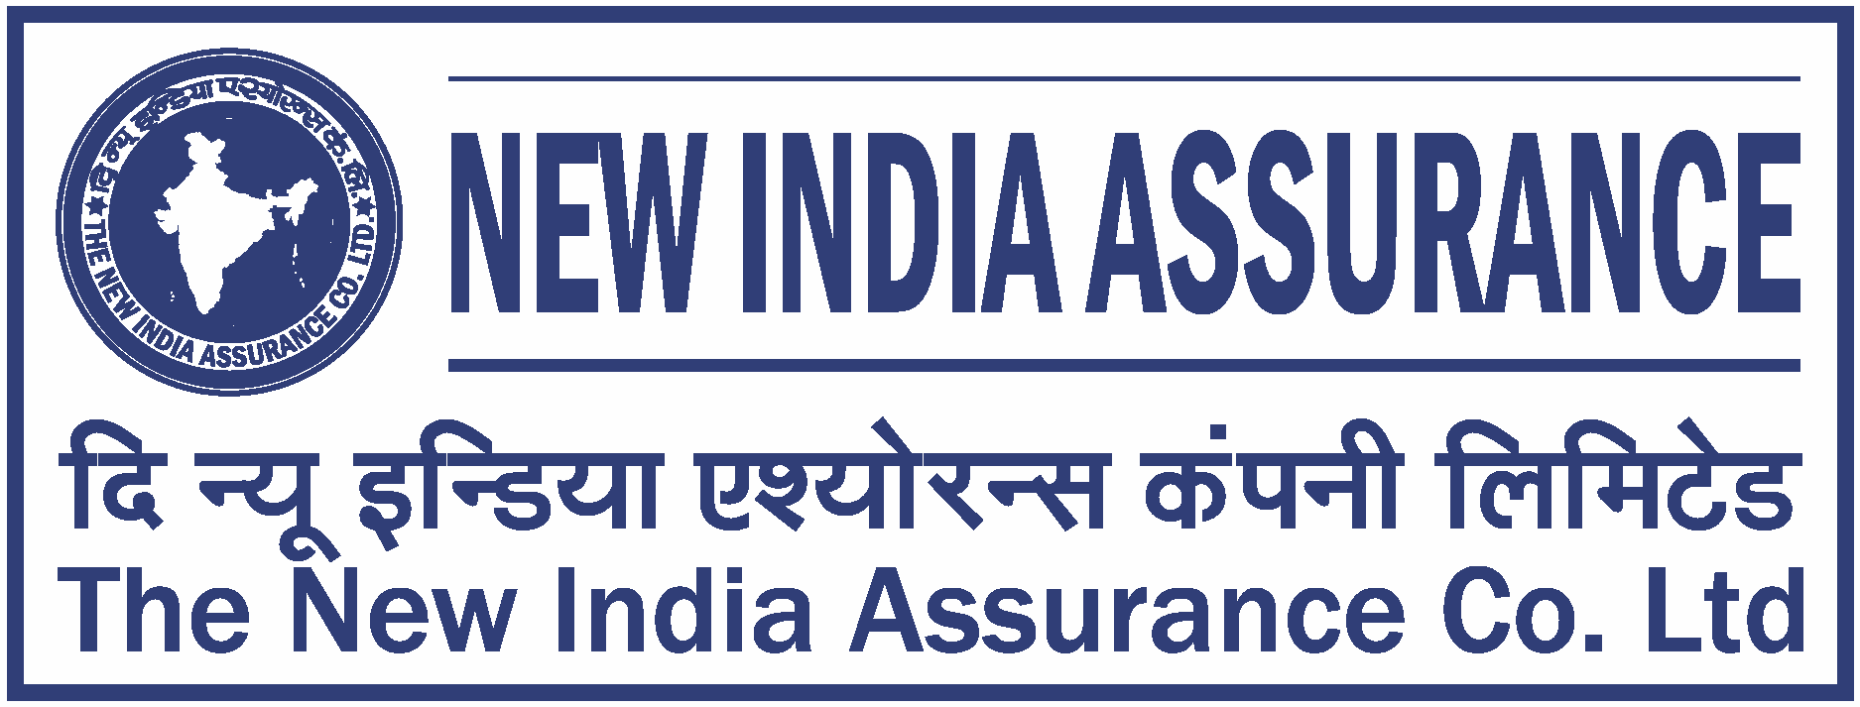
02 · WHAT WE HAVE BUILT, THE NETWORK
WHAT WE HAVE BUILT
The institutions around the work
As they appear in our working decks, engagement ranges from formal MoUs and written approvals to jury, mentoring and research collaboration.
AUTHORITIES & PUBLIC BODIES WE WORK WITH
UNIVERSITIES & INSTITUTES FIELDING AUDIT TEAMS
EXPERT & ECOSYSTEM PARTNERS
Plus: Jaipur Traffic Police & Gurugram Police (MoUs) · CPWD & district administrations · Bloomberg, Johns Hopkins, Centre for Green Mobility and PwC experts on juries and reviews.
Crashfree India · Organisation Overview · 2026
14 / 17

Slide 15
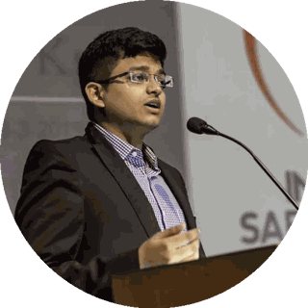
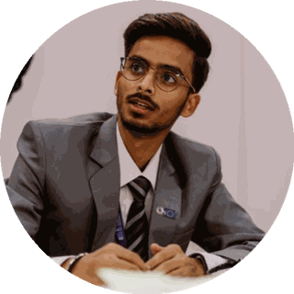
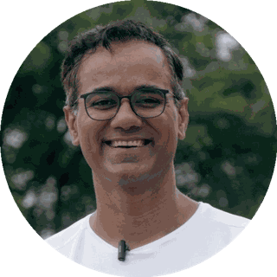
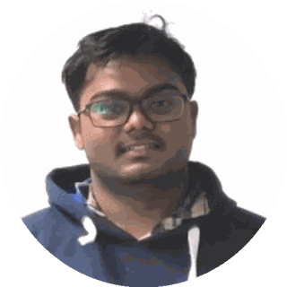
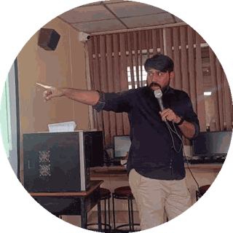
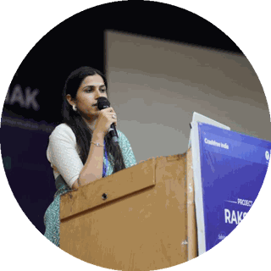
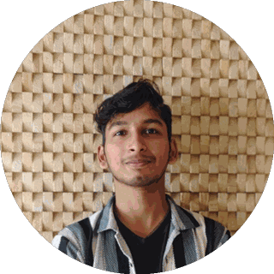
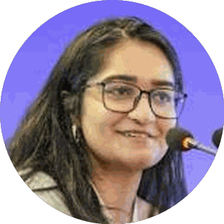
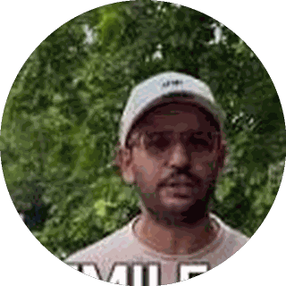




03 · OUR PEOPLE
OUR PEOPLE
A full-time team built for this work
Engineering, law, policy, product and field operations, under trustees who have led Indian road safety for a decade.
Amar Srivastava
Deepanshu Gupta
Gajendra Jangid
President · Founder, Indian Road Safety Campaign · Member, National Road Safety Council
Managing Trustee · Founder, IRSC · Global Youth Coalition for Road Safety
General Secretary · Co-founder, Cars24
THE FULL-TIME TEAM
Akhtar Hussain Mission Lead
Shubham Kumar Policy & Advocacy
Muskan Yadav Programmes
IIT Delhi · ex-Bain · strategy, programmes, new initiatives, partnerships and product
NALSAR Hyderabad · programmes, policy advocacy, legal research, government relations
TISS · district programmes, Project Rakshak, infrastructure interventions, DRSC work
Krishna Jain Tech & Product
Aastha Shreeharsh Development Communications
Rohan Sharma Cause Marketing
Builds and runs Aasha, SATARK and the open public data platforms
HKUST · institutional communications, government relations
Awareness campaigns, digital advocacy, community mobilisation
Ishita Rathore People & Culture
Yuvraj Yadav Operations
Lovish Creative (Video)
Talent and hiring, volunteers, the 75+ intern engineering corps
Field operations across 18 cities · works with police on SATARK and enforcement rollouts
Video explainers, ground-audit films and the YouTube channel
Shipra Kushwaha Creative (Graphic)
Plus 75+ engineering interns and 31 student audit teams.
Guides, comics and bilingual campaign material families actually read
In-house capabilities: road-engineering audits · legal & policy research · AI product development · district operations · behaviour-change communication
Crashfree India · Organisation Overview · 2026
15 / 17

Slide 16











03 · OUR PEOPLE, THE EXPERT BENCH
OUR PEOPLE
Advised by the people who built India's road safety practice
Prof. Geetam Tiwari, Board of Advisors
Piyush Tewari, Board of Advisors
Professor Emerita & Chair, TRIP Centre, IIT Delhi · four decades of transport safety research
Founder & CEO, SaveLIFE Foundation · Architect of the Good Samaritan Law · Zero-Fatality Corridors
JURY, MENTORS & REVIEWERS AROUND OUR WORK
Justice J.R. Midha
Vaibhav Dange
Dr. Maya Tandon
R. Venkat Ratnam
Akhilesh Srivastava
Delhi High Court (Retd.)
Ex-Advisor, MoRTH
Sahayta Trust
Government of Punjab
ITS India · IRF
Aishwarya Raman
Neeraj Kumar
R.S. Pandey
Dipak K. Dash
OMI Foundation
Tata AIG
FICCI Road Safety
Times of India
Engaged through the National Road Safety Dialogue Series: Balraj Bhanot (ex-Chair, CMVR-TSC) · I.V. Rao (TERI; ex-Maruti Suzuki) · D.P. Saste (CIRT / ex-MoRTH) · Dr. Sushma Sagar (AIIMS Trauma) · Dr. S. Velmurugan (CSIR-CRRI), and jurors from OMI, NIUA, WRI, CII and Tata AIG.
Crashfree India · Organisation Overview · 2026
16 / 17

Slide 17



No life lost on an Indian road
is acceptable.
We add the hands, the evidence and the tools that turn that goal into work the system can carry, and we track it in public.
"We already know what is going wrong. What we need now is more responsibility, more discipline, more respect for life."
MS Dhoni · Goodwill Ambassador, Crashfree India
crashfreeindia.org
akhtar@crashfreeindia.org · helpdesk@crashfreeindia.org
Crashfree India · A Cars24 commitment · Operated by Vision Zero Trust, New Delhi

