Slide 1
MACHINE LEARNING–GUIDED SCREENING OF MAGNETIC MATERIALS
DFT Validation of Ground-Truth
Magnetic Ordering Labels
24-candidate real-DFT check against Materials Project's stored magnetic ordering
Prepared for advisor review · 21 August 2026 · snapshot, 2 of 26 still running

Slide 2
BACKGROUND
Why check labels the pipeline treats as ground truth
This project's screening pipeline treats Materials Project's stored magnetic ordering as
ground truth (confidence=1.0) wherever MP is the source database.
The first crack
One shortlisted candidate (mp-861559, TaFeO4) was checked with real DFT and its FM label was overturned — AFM came out 7.6 meV/atom lower. MP's own workflow relaxes each structure from a single initial magnetic-moment guess and never enumerates AFM alternatives.
That was one data point. This report extends the same check to the full set of eligible
ground_truth/FiM candidates in the shortlist — 24 of 26 complete so far.
2

Slide 3
METHOD
Same pipeline, matched to MP's own DFT convention
1
Take the candidate's relaxed structure from the harmonized dataset
2
Enumerate symmetry-distinct FM/AFM spin configurations (pymatgen MagneticStructureEnumerator + enumlib)
3
Generate VASP inputs with MPRelaxSet — MP's own GGA+U, ENCUT, k-point density — overriding only MAGMOM
4
Run each configuration to convergence (48 cores/job; paramsanganak VASP 5.4.4, then paramrudra VASP 6.4.3)
5
Compare converged total energies per atom — lowest is the DFT ground state
All configurations for the 24 complete candidates converged cleanly — every OUTCAR reports “reached required accuracy.” 2 more still running (mp-1173143, mp-682554).
3

Slide 4
HEADLINE RESULT
4 of 24
ground-truth FM labels confirmed by real DFT
17 clearly overturned
(0.31–24.68 meV/atom, AFM lower)
3 statistically degenerate
(≤0.10 meV/atom — inside DFT noise floor)
4

Slide 5
RESULTS
Per-candidate DFT ground state vs. the FM label
Candidate | Formula | DFT ground state | Margin (meV/atom) | Signal
mp-1228376 | Ba3Fe2WO9 | AFM | 24.68 | Overturned
mp-1218521 | Sr3TaFeO7 | AFM | 14.03 | Overturned
mp-1519427 | BaCaFeBiO6 | AFM | 11.74 | Overturned
mp-1520073 | SrCaFeBiO6 | AFM | 11.71 | Overturned
mp-1522159 | BaSrFeBiO6 | AFM | 11.66 | Overturned
mp-1217456 | Ti4FeBiPb4O15 | AFM | 9.18 | Overturned
mp-1217946 | TaFeO4 (entry 2) | AFM | 8.92 | Overturned
mp-861559 | TaFeO4 (entry 1) | AFM | 7.61 | Overturned
mp-22972 | Tb6FeBi2 (FiM label) | AFM | 7.32 | vs FM only
mp-775194 † | Li2Fe3WO8 | AFM | 6.59 | Overturned
mp-1301722 | Ca3Fe2(WO6)2 | AFM | 2.73 | Overturned
mp-754090 † | Li4Fe2TeWO12 | FM | 2.41 | Confirmed
mp-1079285 | Tb6FeBi2 (entry 2) | FM | 2.32 | Confirmed
mp-769471 † | Fe3Co2P6WO24 | AFM | 2.17 | Overturned
mp-850225 † | FeP6(WO8)3 | FM | 2.10 | Confirmed
mp-1343817 | CaFeReO6 | AFM | 1.77 | Overturned
mp-1197024 | FeBi(SeO3)3 | AFM | 1.19 | Overturned
mp-1228547 | Ba4Ta10FeO30 | FM | 1.18 | Confirmed
mp-755203 † | Li4NbFe(WO6)2 | AFM | 0.73 | Overturned
mp-551086 | CrFe(BiO3)2 (FiM label) | AFM | 0.57 | vs FM only
mp-1173139 | Ta2FeO6 | AFM | 0.31 | Overturned
mp-1047414 | Zn2FeWO6 | AFM | 0.10 | Noise-level
mp-1043970 | CaLaTaFeO6 | AFM | 0.09 | Noise-level
mp-1216981 | TiFeBiPbO6 | FM | 0.02 | Noise-level
5

Slide 6
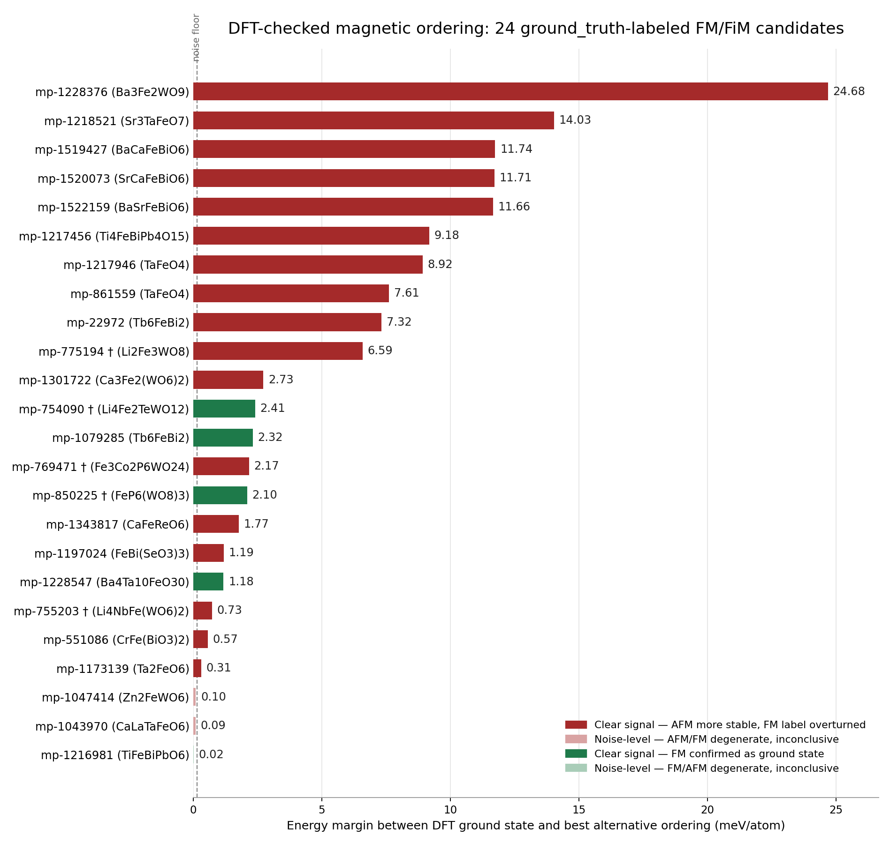
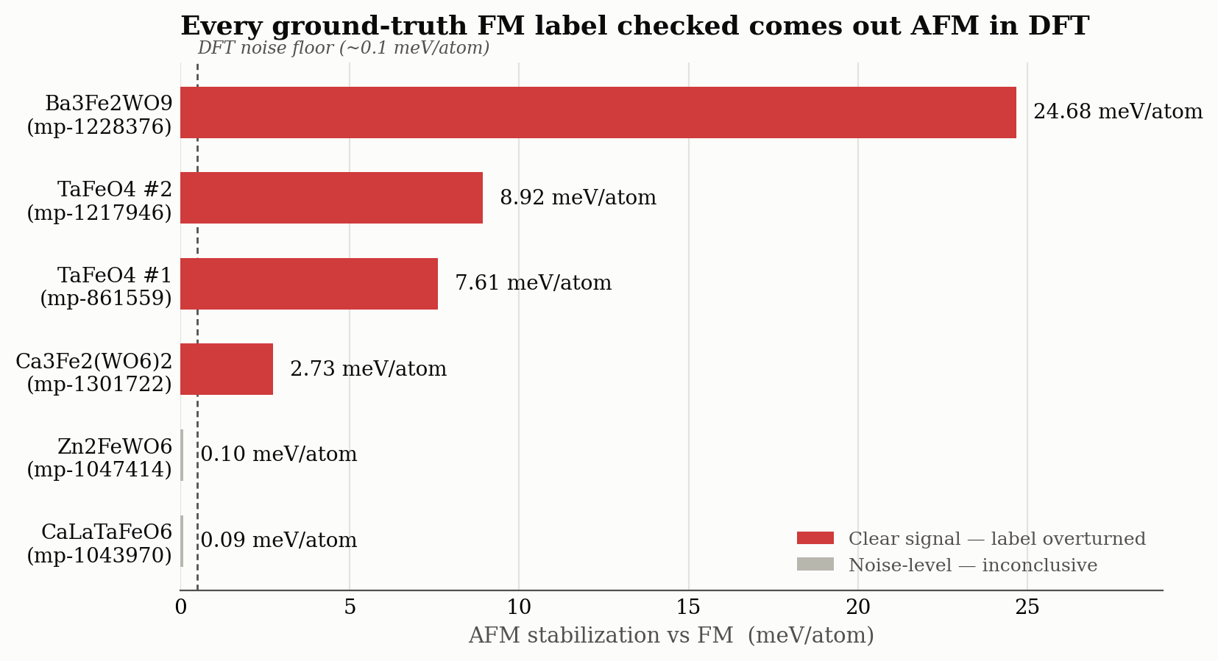
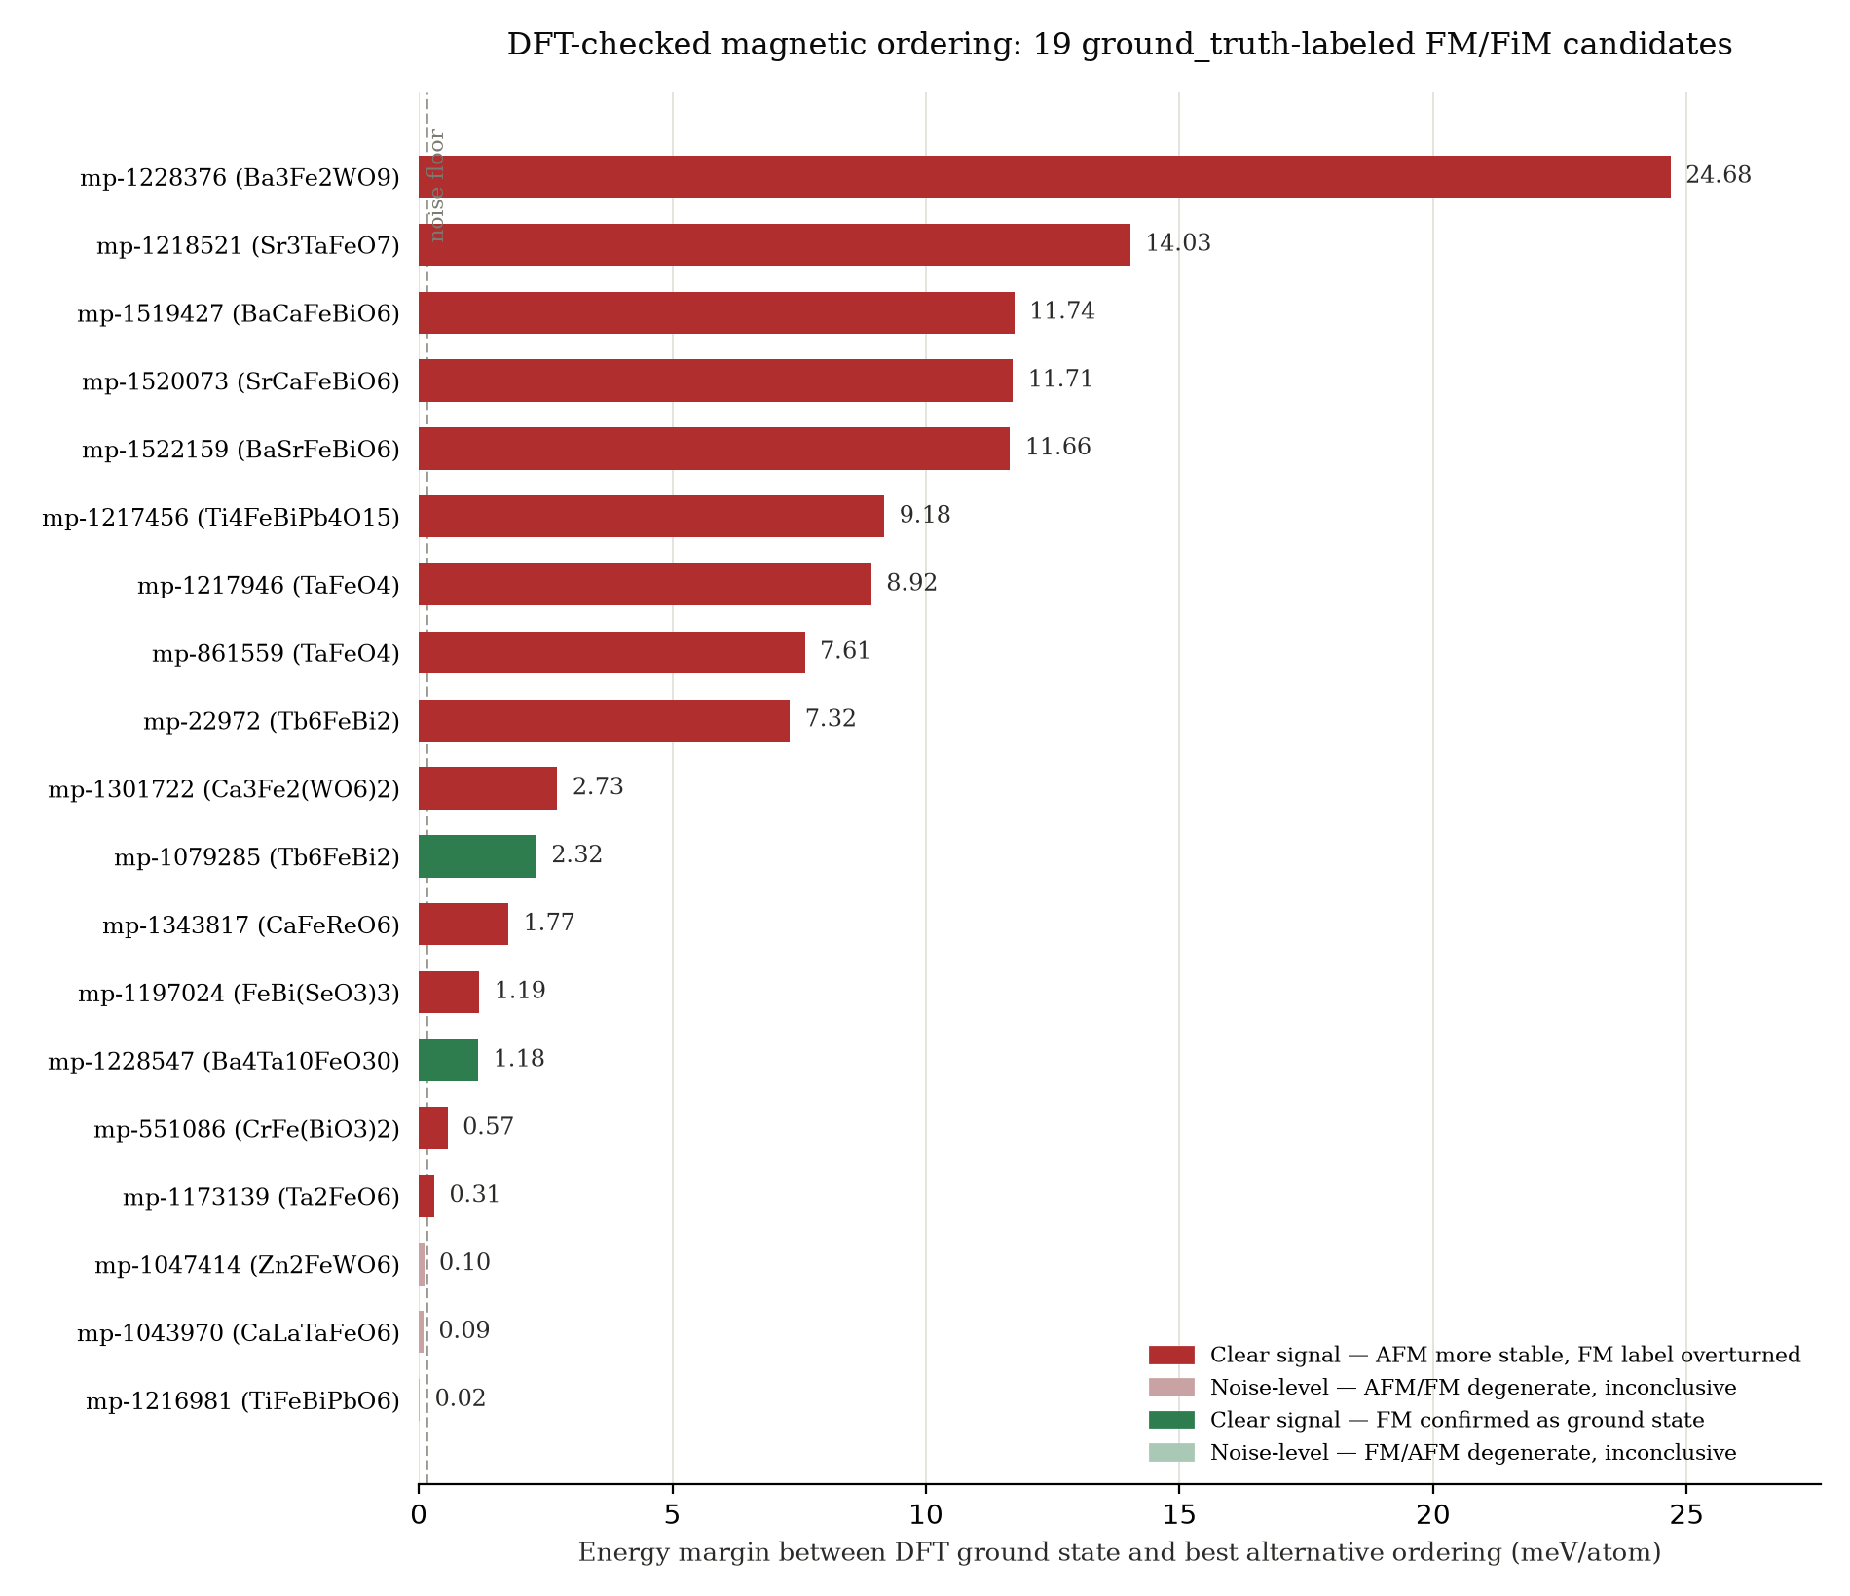
RESULTS
DFT ground state vs. label, ranked by resolvable margin
6

Slide 7
CAVEAT
What this sample does and doesn't establish
Not a random sample
All 24 candidates were pulled from the top of the DMI-filtered shortlist (noncentrosymmetric, heavy-SOC-element, net-moment structures). It's plausible this structural family is more AFM-prone than the ground_truth population as a whole — the true project-wide mislabeling rate could be lower than “17/24.”
What is firmly established
The label cannot be taken at face value for candidates in this specific shortlisted population without an actual DFT check.
7

Slide 8
FOR DISCUSSION
Open questions for the advisor meeting
HEADLINE
17 of 24 shortlisted ground_truth/FiM labels are clearly wrong, 4 are confirmed with a resolvable margin, 3 are statistical ties.
IMPLICATION
Treat MP's ordering label as a screening prior, not ground truth, for this shortlist's structural family. Does this change how ordering_final feeds the net-moment filter in screen_candidates.py (AFM is currently excluded entirely)? Also worth scoping: a dedicated FiM-configuration check for mp-22972 and mp-551086.
OPEN QUESTION
Is 24–26 of 1,647 candidates enough evidence to act on — or does this need a larger, stratified random sample across the whole ground_truth population before changing how the pipeline treats these labels?
8

