Slide 1
Covid Sentimental Analysis
Team 7 Farooque Akhtar
Muhammad Rehman

Slide 2

Overview
We analyzed tweets and built ML models to classify the sentiments.
Determined people's sentiment is evolving with time regarding coronavirus vaccine
Lastly what is the general sentiment of public about Coronavirus or its vaccine in a particular location for period of time

Slide 3
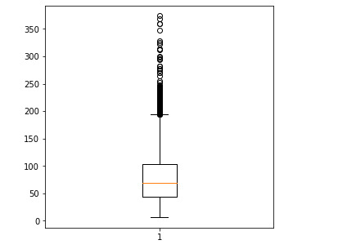
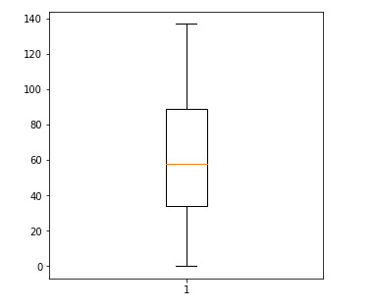
One of very important steps in cleaning Raw data for Sentiment Analysis Training Direct Removal from Tweets : Http links Username ByteOrderMark Analysis was only done on textual data Empty tweets removed
Data Cleaning

Slide 4
Use Cases
Visitors can input location name and date for which to ﬁnd general sentiments
System can analyze the gathered tweets and label them as positive/negative
User can determine if the sentiment has changed over time and requires intervention
User can determine the majority sentiment in a location

Slide 5
Methodology
Gather tweets using Twitter API / Data Ingestion
Data pre-processing/cleaning using Regex
Use BERT embeddings to transform textual data in pySpark & TF
Using Naive Bayes , LR, SVM, RandomForest to to predict sentiment of Tweets

Slide 6
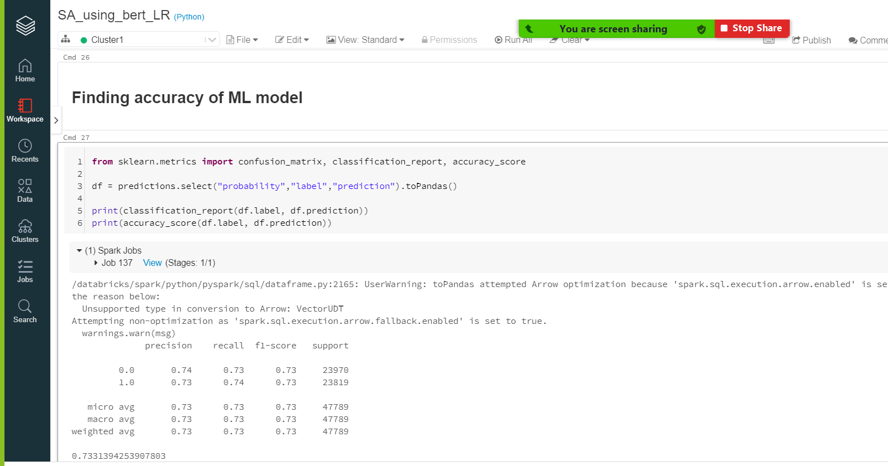
Evaluation Metrics

Slide 7
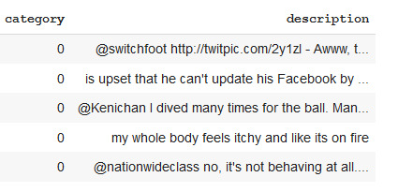
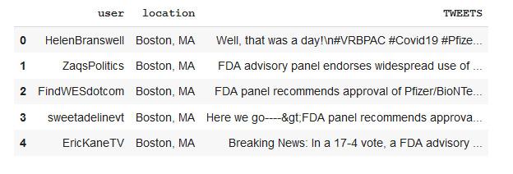
Sample Data & Test Data

Slide 8
Successfully met all the criterias as proposed in the initial proposal : System is generating sentiment for a given week within 2 mins Accuracy of ML model reached 80% in few models and 76% in LR Precision of model > 75%
Acceptance Criteria

Slide 9
Data Sources
Kaggle (Historical Tweets : 1.6 Million tweets)
Twitter Stream

Slide 10
Program Details
Scala
Spark
Python

Slide 11
https://github.com/akhtarfarooque/Scala_Project_CSYE7200
Github Repository

Slide 12
Create a Live Dashboard using Tableau
Improvements that can be made

Slide 13
Goals
Create a data pipeline to analyze stream of data
NLP model using BERT embeddings to classify a tweet

