Slide 1
blinkit
POWER BI • SALES ANALYTICS
Blinkit Grocery
Sales Analysis
$1.20M
TOTAL SALES
An interactive dashboard to explore sales,
product categories and outlet performance.
Power BI | Power Query | DAX
Prepared by Akash Das
Portfolio Project • 2026

Slide 2
Project Overview
Dataset, objective and tools at a glance.
8,523
10
$1.20M
3.92 / 5
records
outlets
total sales
average rating
Objective
Tools & techniques
Compare sales by item type, fat content and outlet characteristics.
Power BI Desktop
Power Query data cleaning
DAX measures and KPI cards
Interactive slicers and visuals
Dataset: BlinkIT Grocery Data.xlsx • Kaggle sample dataset
02 / 07

Slide 3
Business Problem
What questions should a sales dashboard help answer?
The challenge
Headline sales alone do not explain which product groups or outlet characteristics are associated with stronger performance.
Which item types contribute the most sales?
How do sales differ by fat content?
How do outlet size and location tiers compare?
How do sales vary by outlet establishment year?
Scope limitation: no transaction dates or customer IDs are available, so this report does not claim monthly trends or customer-level behaviour.
03 / 07

Slide 4
My Approach
From raw data to an interactive Power BI report.
01
Inspect & clean
02
Build measures
Standardized fat-content labels and checked missing item-weight values.
Created DAX measures for sales, average sales, item count, rating and outlets.
03
Design visuals
04
Enable exploration
Built KPI cards, category charts, outlet comparisons and a summary table.
Added slicers and a metric selector for interactive comparisons.
Workflow: Power Query → DAX → Visual design → Interactive analysis
04 / 07

Slide 5
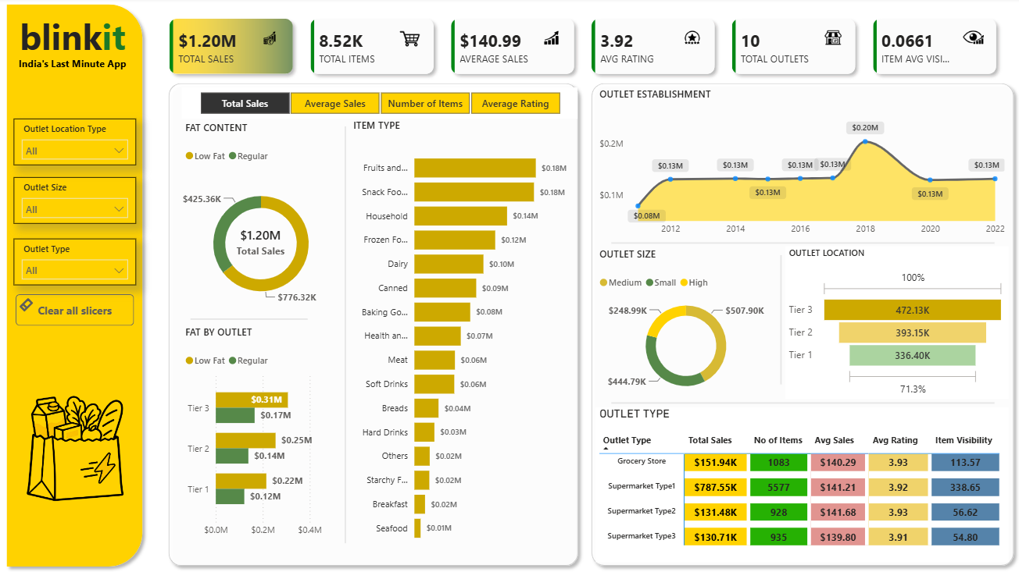
Dashboard & Key Insights
Findings are based on the dashboard built for this project.
What the data shows
Total sales are about $1.20M across 8,523 item records.
Regular-fat items: about $776.32K; low-fat: about $425.36K.
Fruits & Vegetables and Snack Foods are top item types (about $0.18M each).
Tier 3 outlets lead the displayed location comparison (about $472.13K).
Descriptive patterns only; they do not establish cause and effect.
05 / 07

Slide 6
Recommendations
Actions to investigate based on the observed patterns.
Review top categories
Check availability and assortment for Fruits & Vegetables and Snack Foods.
Compare outlet tiers
Investigate what differentiates Tier 3 outlets before replicating practices.
Review product mix
Compare regular vs low-fat sales with margin and demand before changing assortment.
Strengthen future analysis
Add transaction dates, units, margins and order/customer data for deeper insights.
Validate recommendations with operational and profitability data before implementation.
06 / 07

Slide 7
Conclusion
This project converts a grocery sales sample dataset into an interactive report for comparing product and outlet performance.
Delivered
Data cleaning • DAX KPIs • Interactive visuals • Slicers • Recommendations
Dataset source
Kaggle — BlinkIT Grocery Data sample used for this project.
Thank you
Note: sample/educational data; not verified internal Blinkit transaction data.
Akash Das • Data Analytics Portfolio

