Slide 1
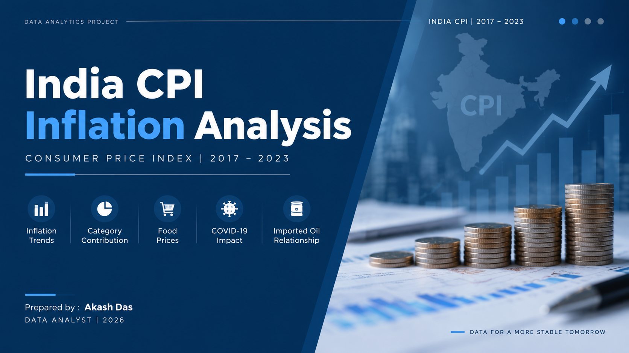

Slide 2
Executive Summary
India CPI | 2017–2023
177.57
Latest CPI Index
4.9%
Average YoY Inflation
20.0%
Highest Monthly Inflation
-10.8%
Lowest Monthly Inflation
9.31%
Top Contribution
Key findings
• CPI increased steadily from 2017 to 2023, reaching 177.57 in 2023.
• Annual YoY inflation peaked at 7.7% in 2019 in the dashboard trend.
• Pan, Tobacco & Intoxicants had the highest contribution share at 9.31%.
• Food MoM inflation peaked at +0.97% in Oct-22 and fell to -1.36% in Dec-22.
Analytical takeaway
• Imported oil rose +20.0% in Mar-22 and fell -10.8% in Dec-22.
• General CPI had the strongest tested oil correlation, but only 0.13.
• COVID impact differed by category rather than moving uniformly.
• Monitoring food, fuel, transport and external energy shocks together is useful.
2

Slide 3
CPI Trend & Inflation Pattern
Annual view
Analytical read
• General CPI increased every year from 2017 through 2023.
• The annual index moved from 133.50 in 2017 to 177.62 in 2023.
• Annual YoY inflation was highest at 7.7% in 2019.
• Inflation pressure remained elevated through 2022 before easing in 2023.
3

Slide 4
CPI Contribution by Category
Latest category view
What stands out
• Pan, Tobacco & Intoxicants leads at 9.31%.
• Clothing & Footwear and Health are also among the higher shares.
• Transport & Communication has the lowest displayed share at 7.63%.
• All category contribution shares together equal 100%.
4

Slide 5
YoY Inflation Trend (2017–2023)
Annual Inflation View
Analytical read
• YoY inflation declined from 5.3% in 2017 to 2.3% in 2018.
• Inflation peaked at 7.7% in 2019, the highest level in the period.
• Inflation remained elevated at around 5.7%–6.0% during 2020–2022.
• YoY inflation dropped sharply to 1.5% in 2023, indicating a significant easing in inflation pressure.
• The 2019 inflation spike was largely driven by rising food prices, particularly vegetables and onions. Unseasonal rains and supply disruptions affected crop availability, pushing food prices higher.

Slide 6
Food Inflation | Jun 2022 – May 2023
Monthly view
Key food insights
• Highest food MoM inflation: Oct-22 at +0.97%.
• Lowest food MoM inflation: Dec-22 at
-1.36%.
• Food index rose from 175.53 in Jun-22 to about 178.87 in May-23.
• Spices had the largest absolute increase: +30.47.
• Oils & fats had the largest absolute decline: -29.97.
5

Slide 7
COVID-19 Impact on Inflation
Before vs After
Category-level impact
• Food: 0.65% → 0.81%
• Transport: 0.48% → 0.70%
• Fuel: 0.45% → -0.19%
• Health: 0.36% → 0.13%
• General: 0.50% → 0.42%
6

Slide 8
Crude Oil Price Trend (Jan 2021–Apr 2023)
Monthly Price Trend
Key findings
• Crude oil prices showed a strong upward trend from 2021 into mid-2022.
• Prices rose from around 54 in Jan-2021 to a peak of about 115 in Jun-2022.
• After mid-2022, crude oil prices declined significantly, reaching around 78 by Dec-2022.
• During early 2023, prices remained relatively stable around 80–85, with moderate fluctuations.

Slide 9
Imported Oil vs Category Inflation (2021–2023)
Monthly Inflation Comparison
Key findings
• Crude oil showed much higher monthly volatility than the CPI categories, with sharp rises and falls during 2021–2023.
• Oil recorded its largest monthly increase of +20.0% in Mar-22 and its sharpest decline of -10.8% in Dec-22.
• Food, Health, Fuel, Transport and General inflation remained relatively close to zero compared with oil's larger fluctuations.
• General CPI had the highest correlation with oil at 0.13, while all tested category correlations remained weak.

Slide 10
Imported Oil & Inflation Relationship
2021–2023
Key findings
• Oil MoM peaked at +20.0% in Mar-22.
• Oil MoM reached -10.8% in Dec-22.
• General CPI had the strongest tested correlation: 0.13.
• All tested correlations were weak.
• Correlation shows association, not causation.
7

Slide 11
Insights & Recommendations
Action-oriented conclusion
01
Monitor food volatility
Track high-change food categories such as spices and oils & fats to identify emerging food-price
pressure early.
02
Monitor External Energy Shocks
Track imported oil alongside fuel and transport inflation to identify potential transmission of
energy-price shocks.
03
Use Category-Level Analysis
Monitor individual CPI categories instead of relying only on headline CPI, as inflation impacts
can vary significantly across categories..
04
Consider Multiple Inflation Drivers
Weak oil correlations suggest that broader economic and category-specific factors should be
considered when assessing inflation movements.
8

Slide 12
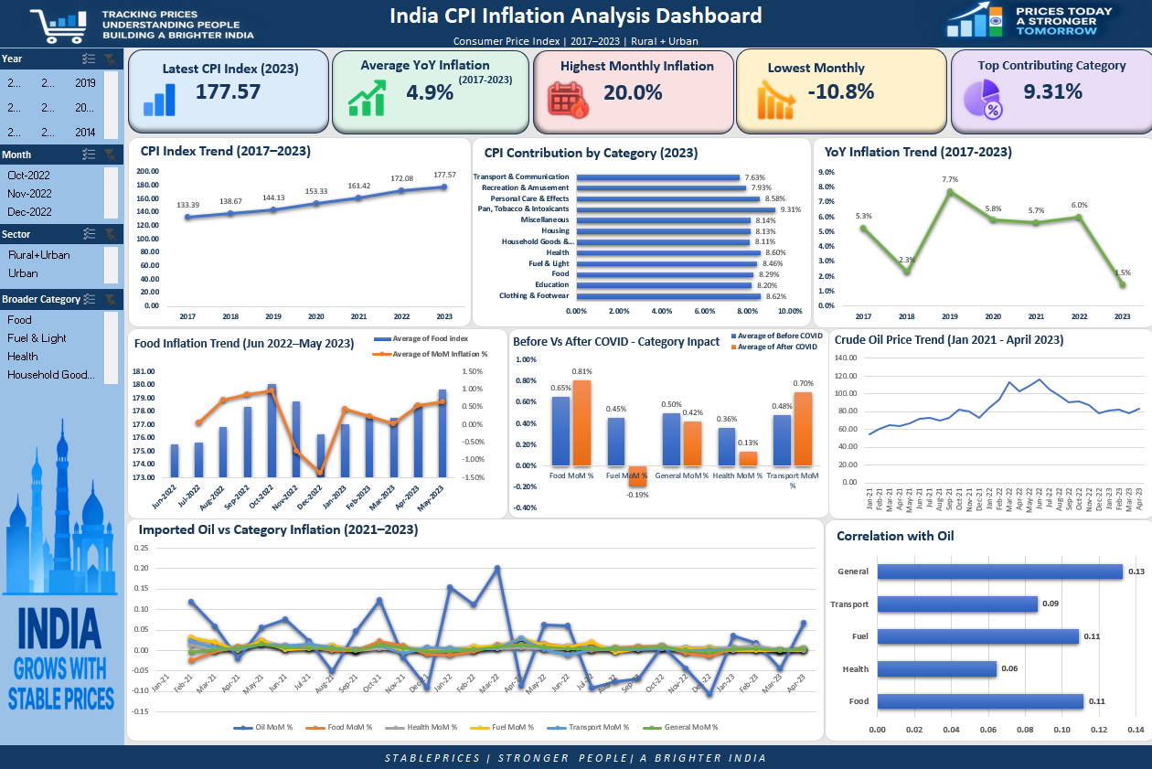
Final Dashboard
Interactive workbook view
9

