Slide 1
MUSIC FESTIVAL
ANALYSIS
Excel + Power BI Project
Festival Attendance, Revenue & Audience Insights
A practical end-to-end Data Analyst case study
Prepared by Akash Das
Excel • Power BI • DAX • Business Analysis
01

Slide 2
1. Business Requirement
What the analysis was designed to answer
Business questions
Key stakeholders
• Festival organizers
• Marketing & audience teams
• Sponsorship / revenue teams
• Artist & event programming teams
• City expansion / business strategy teams
• Where is festival demand highest by month and city?
• Which ticket-price ranges balance attendance and revenue?
• How much attendance is associated with local vs international headliners?
• What are the major revenue contributors: tickets, sponsorship and merchandise?
• Which cities and genres show stronger expansion potential?
02

Slide 3
2. Dataset & Scope
Two datasets were combined to build one analytical story
Festival Attendance & Revenue
Artist Popularity & Engagement
• Festival, city, date and headlining artist
• Ticket price and total attendance
• Merchandise sales and sponsorship revenue
• Total revenue
• Artist and genre
• Average ticket price
• Average attendance per city
• Social media followers & streaming plays
• Merchandise revenue per concert
100 unique festival records after duplicate removal
10 artist records used for artist-level analysis
03

Slide 4
3. Excel — Data Cleaning & Validation
The analysis started with a clean, validated foundation
01
Missing values
Handled blanks using overall or group-based averages where appropriate.
02
Duplicates
Removed 5 duplicate festival records; 100 unique records remained.
03
Outliers
Used IQR checks to identify extreme values and retained genuine high-performing events.
04
Consistency
Checked naming consistency and prepared clean Power BI input sheets.
Important: extreme revenue / merchandise values were investigated, not blindly deleted.
04

Slide 5
4. Excel — Case Study Analysis
Six stages converted the cleaned data into business answers
Stage
Analysis
Output / decision support
1
Data Cleaning & Validation
Reliable dataset for downstream analysis
2
Attendance Trends & Revenue Growth
Peak month, top cities, local vs international attendance
3
Ticket Pricing Optimization
Price-range attendance, revenue and price variation
4
Artist Impact
Artist attendance influence, genre mix, performance proxy
5
Sponsorship & Merchandise
Sponsorship by price range; merchandise contribution
6
Regional Preferences & Expansion
City demand, genre preference, revenue per attendee
05

Slide 6
5. Excel — Analysis Work
Examples of the workbook outputs used before building the Power BI dashboard
Stage 2 — Monthly Attendance
Stage 3 — Pricing
Stage 6 — City Economics
Peak month
₹0–1,500
26,158.99 avg attendance
Bengaluru
₹4,202.93
August
Kolkata
₹4,099.16
288,400.9
₹1,501–3,000
55.79M avg revenue
total attendance
Pune
₹3,867.31
₹3,001–4,500
88.96M avg revenue
Formula-driven monthly summary + chart
Nagpur
₹3,405.29
₹4,500+
99.37M avg revenue
Delhi
₹3,341.95
Revenue per attendee
06

Slide 7
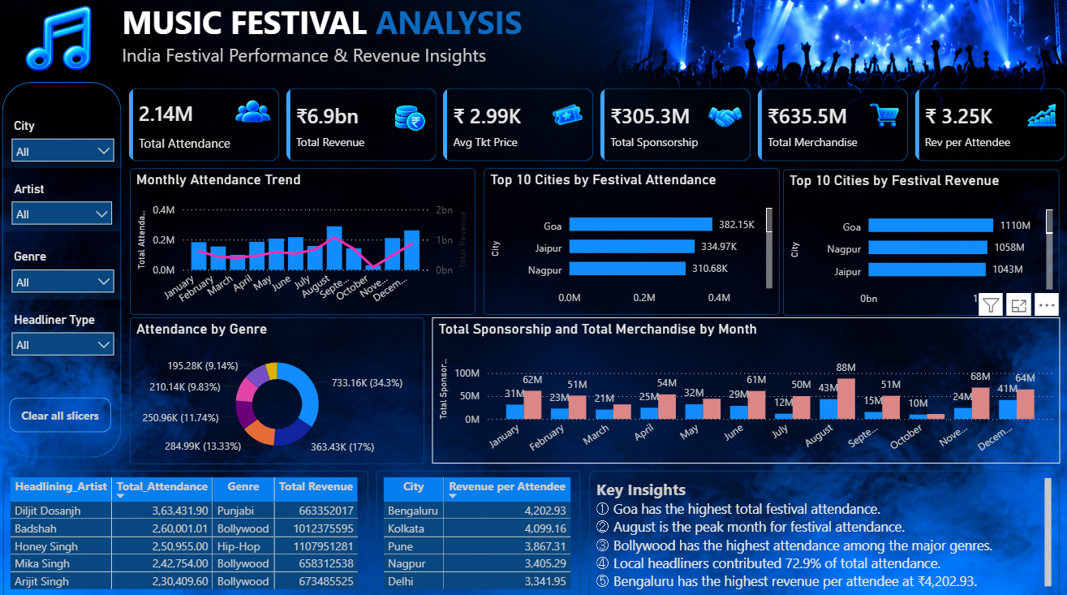
6. Power BI — Interactive Dashboard
Excel outputs were transformed into a single decision-ready dashboard
07

Slide 8
7. Key Findings
What the analysis tells a festival decision-maker
2.14M
₹6.9bn
₹3.25K
72.9%
August
₹4,202.93
Total attendance
Total revenue
Revenue / attendee
Local headliner attendance
Peak month
Bengaluru rev/attendee
01
Goa has the highest total festival attendance.
02
August is the peak month for festival attendance.
03
Bollywood has the highest attendance among the major genres.
04
Local headliners contributed 72.9% of total attendance.
05
Bengaluru has the highest revenue per attendee at ₹4,202.93.
08

Slide 9
8. Recommendations
Actions grounded in the observed dataset patterns
1
Demand planning
Use August as a benchmark peak period and plan capacity, marketing and inventory accordingly.
2
City strategy
Prioritize high-attendance markets such as Goa, Jaipur and Nagpur; use Bengaluru, Kolkata and Pune for revenue-focused expansion.
3
Artist strategy
Continue leveraging strong local headliners for attendance, while using international artists selectively to diversify the lineup.
4
Pricing
Use balanced, city-specific pricing. The ₹4,500+ range generated the highest average revenue per festival, while lower prices supported higher average attendance.
5
Revenue mix
Strengthen sponsorship and merchandise strategies, especially where their contribution is already meaningful.
Note: the dataset does not include artist booking costs or explicit ticket tiers, so ROI and tier-level conclusions are not claimed.
09

Slide 10
9. Project Takeaway
A complete Excel + Power BI workflow
Raw Data → Clean & Validate → Analyze in Excel → Model in Power BI → Visualize → Recommend
Excel
Power BI
Business
Cleaning • formulas • case-study analysis
Data model • DAX • interactive dashboard
Insights • recommendations • decision support
The project demonstrates hands-on data cleaning, analysis, visualization and business communication.
Music Festival Analysis | Excel + Power BI
10

