Slide 1
NETFLIX
Movies & Shows
Data Analysis Dashboard
Power BI Portfolio Project
Interactive analysis of Netflix content, ratings, popularity, audience categories and release trends.

Slide 2
Project Overview
A Power BI dashboard built to explore Netflix movie and TV show data.
DATASET
CONTENT TYPES
PLATFORM
5,283
2
Power BI
Movie and TV show records
Movies and TV Shows
Interactive dashboard and DAX analysis
• Reviewed and prepared the raw Netflix dataset.
• Cleaned and transformed data before visualization.
• Created calculated fields and analytical categories.
• Built an interactive dashboard for content exploration.
02

Slide 3
Data Preparation & Transformation
Data was prepared before building the final dashboard.
STEP 01
STEP 02
STEP 03
Raw Data
Data Cleaning
Calculated Fields
Imported and reviewed the Netflix dataset.
Prepared fields and handled data-quality issues.
Created additional fields/categories for analysis.
• Power Query was used for data preparation and transformation.
• Created Rating*Votes from IMDb score × IMDb votes.
• Created runtime_hrs using DAX by converting runtime minutes to hours.
• Created additional categories used by the dashboard.
03

Slide 4
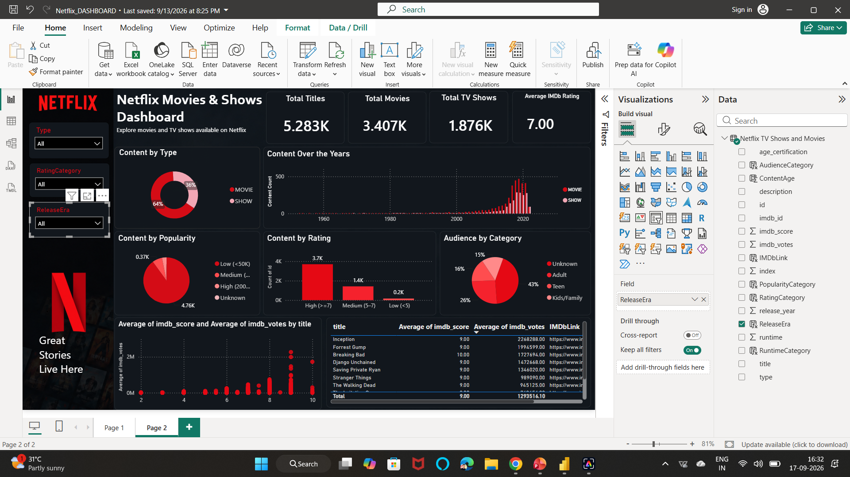
Interactive Power BI Dashboard
Final dashboard created for exploration and storytelling.
04

Slide 5
Dashboard KPIs
High-level metrics provide a quick view of the dataset.
TOTAL TITLES
TOTAL MOVIES
TOTAL TV SHOWS
AVG. IMDb RATING
5.283K
3.407K
1.876K
7.00
All titles
Movie content
TV show content
Dashboard average
• Movies form the larger share of the content mix.
• The dashboard separates Movies and Shows for interactive analysis.
• KPI cards summarize the dataset before detailed visual exploration.
05

Slide 6
Content Mix & Release Trends
Visuals used to understand portfolio distribution and changes over time.
CONTENT BY TYPE
CONTENT OVER THE YEARS
64% MOVIE | 36% SHOW
Release trend
Donut chart showing the content split.
Year-wise content count for Movies and Shows.
• The dashboard clearly separates the movie and show content mix.
• Content volume is substantially higher in the later years shown.
• The trend visual supports year-wise exploration of content volume.
06

Slide 7
Popularity & Rating Analysis
Additional analysis created from IMDb-based fields.
CONTENT BY POPULARITY
CONTENT BY RATING
Popularity categories
IMDb rating groups
Low, Medium, High and Unknown categories based on the project classification.
High, Medium and Low rating categories.
• Popularity categories help segment titles by audience voting volume.
• Rating categories summarize the distribution of IMDb scores.
• Together, the visuals provide a compact view of title performance indicators.
07

Slide 8
Audience & Title-Level Analysis
Moving from aggregate metrics to audience categories and individual titles.
AUDIENCE BY CATEGORY
TITLE-LEVEL TABLE
Audience distribution
Top titles
Unknown, Adult, Teen and Kids/Family categories.
Title, average IMDb score, average IMDb votes and IMDb link.
• Audience categories add another dimension to content classification.
• The table supports title-level inspection rather than only aggregate analysis.
• IMDb links provide direct reference for individual titles.
08

Slide 9
Interactive Slicers
Users can dynamically change the dashboard view.
SLICER 01
SLICER 02
SLICER 03
Type
Rating Category
Release Era
Dropdown filter for Movies / Shows.
Filter the dashboard by rating category.
Filter content by release-era category.
• Slicers make the dashboard interactive rather than static.
• Changing a filter updates connected visuals for segment-level exploration.
• A screen recording was prepared to demonstrate the slicer interaction.
09

Slide 10
Key Dashboard Observations
Observations are taken directly from the final dashboard.
• The dataset contains 5.283K titles: 3.407K movies and 1.876K TV shows.
• Movies account for 64% of the displayed content mix; shows account for 36%.
• The dashboard displays an average IMDb rating of 7.00.
• The release trend shows much higher content volume in later years than in early years.
• The dashboard combines KPIs, category analysis, trends and title-level details in one interactive report.
10

Slide 11
Tools & Skills Demonstrated
Technical skills applied in the project.
Power BI
Power Query
Dashboard design, visuals and interactivity
Data cleaning and transformation
DAX
Data Analysis
Calculated runtime_hrs column
KPIs, trends and categories
Data Visualization
Dashboard Design
Charts, cards and tables
Layout, formatting and slicers
11

Slide 12
Project Deliverables
Portfolio-ready materials prepared for the project.
01
02
03
Power BI Project
Presentation
Screen Recording
Interactive .pbix dashboard
Project explanation and analysis
Demonstration of dashboard interaction
• Dashboard screenshot can be used as the visual preview.
• The Power BI file, presentation and recording can be shared as supporting project materials.
12

Slide 13
Thank You
Netflix Movies & Shows Data Analysis
Power BI • Power Query • DAX • Data Visualization
13

