Slide 1

Chronicles of Exoplanets
TEAM : TECMOI30
NASA Space Apps Challenge 2024

Slide 2
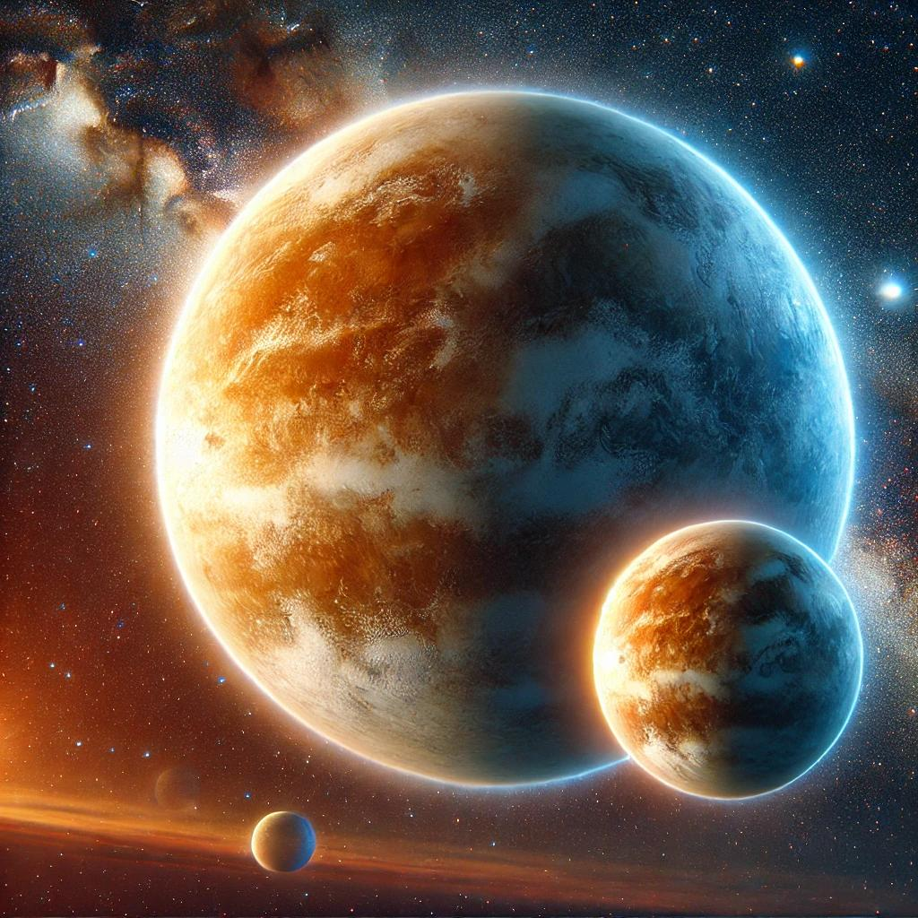
What Are Exoplanets?
Exoplanets are planets that orbit stars outside of our solar system.
First confirmed discovery in 1992, opening up a new field of astronomical research.
These planets are key to understanding planetary systems and the potential for life beyond Earth.
Some exoplanets are Earth-like and exist in the habitable zone of their stars.

Slide 3

Objectives of the Chronicles of Exoplanets Project
The goal of the project is to increase public engagement and knowledge about exoplanets.
This will be achieved through multiple-choice questions (MCQs) that encourage learning in a fun, interactive way.
MCQs will cover basic facts about exoplanets, their discovery, methods of detection, and their importance in the search for life.

Slide 4
Aligning with NASA’s Educational Goals
The project supports NASA’s objective of promoting education and outreach in space exploration.
NASA’s mission includes inspiring new generations of scientists, astronomers, and engineers.
Exoplanets are a hot topic within NASA’s outreach programs, and engaging the public through interactive content helps advance these goals.

Slide 5
Tools and Resources
Research was supported by information from credible space agencies:
European Space Agency (ESA)
Canadian Space Agency (CSA)
NASA data and resources
The project’s code and questions are available on GitHub for public access and future collaboration.
GitHub Repository: https://github.com/akhundubedullah/Chronicles-of-Exoplanet-Exploration

Slide 6
Example Questions
Display 2-3 sample MCQs from your project.
Sample 1: What is an exoplanet?
A. A planet within our solar system
B. A planet orbiting a star outside our solar system
C. A moon of Jupiter
Correct Answer: B
Sample 2: How do scientists detect exoplanets?
A. By observing dips in the brightness of stars
B. By sending probes to other stars
C. By listening to radio signals from exoplanets
Correct Answer: A
These MCQs are designed to educate users on exoplanet basics and get them excited about space research.

Slide 7
Project Summary & Contact
Project Summary:
Exoplanet Research Significance:
Exoplanets are one of the most exciting areas of modern astronomy. They offer insight into how planetary systems form and evolve. By studying exoplanets, we can better understand the conditions that might make planets habitable, contributing to the ongoing search for extraterrestrial life.
Educational Impact:
The Chronicles of Exoplanets project serves an educational purpose by making complex astronomical concepts accessible to the general public. Through the use of engaging and interactive multiple-choice questions (MCQs), users are encouraged to learn about exoplanets, how they are discovered, and why they are important in the broader context of space exploration.
By aligning with NASA’s goals of education and outreach, this project plays a small but meaningful role in sparking interest in space science, potentially inspiring the next generation of astronomers and space enthusiasts.

