Slide 1
From data foundation to financial investigation
Oracle AI Data Platform • Meridian Demo Bank
Abhijit Khuperkar • 18 October 2026
Demonstration dataset • INR display assumption
1
Abhijit Khuperkar | Reference implementation
Notes:
Abhijit Khuperkar | 18 October 2026. Mixed business and technical audience. Follow one monthly investigation from portfolio context to account evidence and policy. Demonstration dataset; amounts shown in INR, a display assumption without FX conversion. No confirmed-fraud, calibrated-probability or realized-loss claim.

Slide 2
AI outcomes depend on data and workflow design
Two independent research findings; different survey populations
63%
21%
Lacked or were unsure of suitable data-management practices for AI.
Reported fundamental redesign of at least some workflows.
Gartner • July 2024 survey • n=1,203
McKinsey • respondents using generative AI
Different survey populations. These findings motivate the design; they do not measure this project’s impact.
2
Abhijit Khuperkar | Reference implementation
Notes:
Gartner, 26 Feb 2025: https://www.gartner.com/en/newsroom/press-releases/2025-02-26-lack-of-ai-ready-data-puts-ai-projects-at-risk . McKinsey, 12 Mar 2025: https://www.mckinsey.com/capabilities/quantumblack/our-insights/the-state-of-ai-how-organizations-are-rewiring-to-capture-value . These findings motivate explicit data contracts and workflow design; neither establishes causation or a measured benefit from this project. Do not invert adoption statistics into disconnected-workflow claims.

Slide 3
Make the serving paths explicit
Gold data supports analytics and a separate agent snapshot path
AILH publication
Oracle Analytics Cloud
Spark medallion
Two native Oracle Gold tables
Schema + full-row verification
Portfolio • trends • queue
Six executive canvases
Bronze → Silver → Gold
Delta tables
Agent SQL snapshots
Investigation Copilot
finance.agent_demo_fs
Seven parameterized tools
Structured facts + policy
Agent Hub or Streamlit
Separate ML pipeline
Fit and evaluate
Rule-derived labels
Policy knowledge base
Eight fictional documents
3
Abhijit Khuperkar | Reference implementation
Notes:
See docs/architecture.md and media/diagrams/architecture.svg. Actual implementation: Spark Delta finance Bronze/Silver/Gold; optional publication to native Oracle AILH tables consumed by OAC. Seven current agent SQL tools query finance.agent_demo_fs materialized Spark snapshots. Eight fictional policy documents feed RAG. Separate ML model predictions are not the agent queue input. Oracle SQL tool source options: https://docs.oracle.com/en/cloud/paas/ai-data-platform/aidug/agent-flow-tools.html .

Slide 4
Curate data at the grain each decision needs
Spark and Delta medallion processing
BRONZE
SILVER
GOLD
Raw transaction records
Account, time, amount and type
Reference for transformation
Required-field checks
Time-derived features
Consistent processing inputs
Account-month analytics
Transaction-level features
Reusable data products
The separate ML workflow fits and evaluates a model. Its predictions are not the source of the agent’s investigation queue.
4
Abhijit Khuperkar | Reference implementation
Notes:
Four public notebooks preserve the supplied code and markdown, with saved outputs cleared for publication. The separate random forest pipeline demonstrates fitting and evaluation with rule-derived labels: is_fraud = risk_score > 60, where score is randomly generated. Features exclude risk_score. No validated fraud-detection effectiveness follows; representative outcomes and independent model validation are required for a production claim. Source generator is unseeded, so rerun totals differ. Oracle overview: https://docs.oracle.com/en/cloud/paas/ai-data-platform/aidug/overview-oracle-ai-data-platform.html .

Slide 5
Publish Gold with a verification contract
Autonomous AI Lakehouse is the analytical serving layer
Decision | Implementation | Proof
Connection | Existing external catalog | Configurable catalog + schema
Types | Decimal + native JSON | Schema and exact-amount checks
Publication | Two native Oracle tables | Counts + full-row multiset
Layout | Preserve Delta; native indexes | No Delta clustering in Oracle
Initial publication verified. Changed-data replacement and optional index execution remain separate checks.
5
Abhijit Khuperkar | Reference implementation
Notes:
Initial publication was verified after a wallet change, with schema, count, decimal, JSON and full-row duplicate-aware comparison. Changed-data replacement remains unvalidated after DATA_ACCESS_LAYER_0068. DDL includes CREATE TABLE IF NOT EXISTS; optional index DDL is supplied, not automatically executed by the catalog writer. Source tables remained unclustered when the runtime rejected retrofit ALTER clustering. See notebook appendix and docs/troubleshooting.md. External catalogs: https://docs.oracle.com/en/cloud/paas/ai-data-platform/aidug/external-catalogs.html .

Slide 6
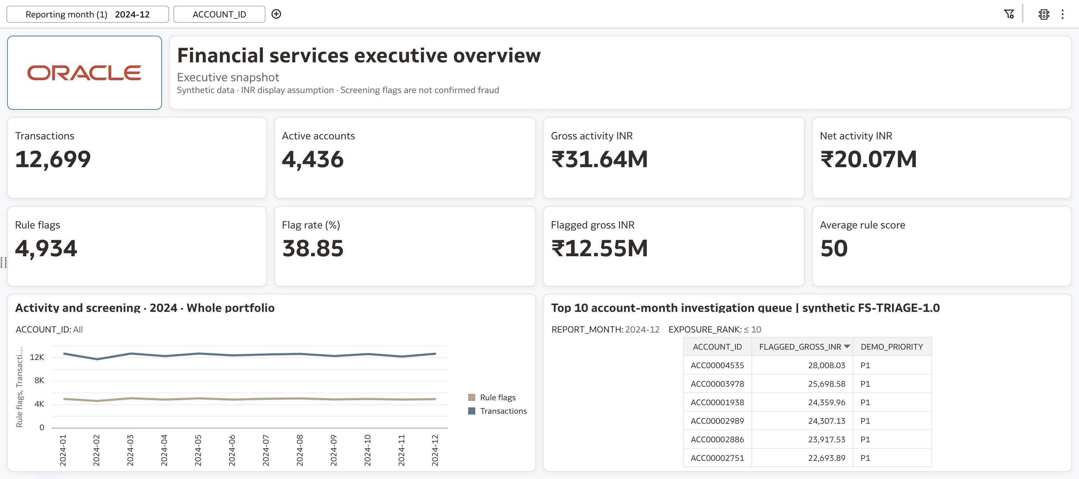
Start with a portfolio view; drill into evidence
December 2024 • OAC reference verified 17 October 2026
6
Abhijit Khuperkar | Reference implementation
Notes:
Reference data/reference-snapshot.json: 12,699 transactions, 4,436 active accounts; INR31,642,312.97 gross, INR20,071,594.45 net; 4,934 score>60 flags,38.853453027797464% count flag rate; INR12,547,752.55 flagged gross. Six AutoFit canvases: executive snapshot, executive brief, activity/risk trends, investigation queue, exposure breakdown, monthly changes. Whole-portfolio monthly comparisons are independent of account filters. Demonstration dataset; amounts shown in INR. Screening exposure is not confirmed fraud or loss. The screenshot is cropped, never reconstructed.

Slide 7
Combine structured evidence with cited policy
Supervisor + four specialist executors • seven SQL tools + RAG + Prompt
INPUT GUARDRAILS
Investigation supervisor
Routes request; preserves period and snapshot
Portfolio SQL
Investigation SQL
Policy RAG
Brief composition
Reporting context
Snapshot, trend and mix
Ranked queue
Account totals + evidence
Policy + definitions
Sources and document version
Literal evidence_packet
Markdown tables + citations
4 SQL tools
3 SQL tools
1 RAG tool
1 Prompt tool
Period + snapshot + account • Actual SQL rows • Cited policy • Explicit gaps and human review
7
Abhijit Khuperkar | Reference implementation
Notes:
Current node configurations and prompts are in agents/. Supervisor xai.grok-4.7; reference executor choices/settings are explicitly recorded there and may vary by tenant. Current Prompt tool argument: evidence_packet, String; it supersedes the earlier setup-notebook evidence_json template. Resolve the reporting period once, preserve snapshot/account scope, retrieve actual bounded evidence rows and applicable FS-POL-001 policy text. A risk_score is not a probability. No external-action tools or implemented approval gate. Guardrail and human-review language do not establish a technical authorization control.

Slide 8
Deploy once; keep client transports separate
Agent card → deployment → AI Registry → Agent Hub or local application
Agent card → Deploy → AI Registry → Agent Hub / local client
AIDP AGENT HUB
STREAMLIT COPILOT
Discover the registered agent
Test scope and cited answers
Use deployed runtime permissions
AIDP A2A + OCI or OAuth
Independent PAF provider adapter
Customer branding + title override
Transport and a SQL response were verified historically. Fresh hosted hybrid evidence reconciliation remains required.
8
Abhijit Khuperkar | Reference implementation
Notes:
The author reports successful Agent Hub use and seven prompts. Exported trace covers root only. Historical Streamlit checks verified a signed card, minimal invocation and a SQL response. One hybrid follow-up completed transport but failed evidence reconciliation; fresh hosted acceptance is required. Do not show that prior answer as validated. No populated credentials, real endpoints or session histories are included. Run app from apps/copilot to load theme and secrets. Existing working PAF project is untouched.

Slide 9
Build the evidence before claiming the outcome
A reproducible path for a focused customer validation
01
02
03
04
05
Curate
Publish
Visualize
Investigate
Accept
Grain and
definitions
Gold row
reconciliation
Filters and
measures
Cited rows
and policy
Analyst time
and rework
Next proof: reconcile a fresh hybrid answer, validate changed-data publication, then record the complete walkthrough.
Notebooks • SQL / RAG / Prompt • OAC recipe • A2A client • Hosted acceptance
9
Abhijit Khuperkar | Reference implementation
Notes:
Repository: https://github.com/akhuperkar/aidp-financial-investigation-copilot . User guide covers notebooks, OAC, Agent Builder, deployment and the client. Local mocked tests are distinct from hosted acceptance; the tenant CSV remains NOT_RUN until populated. Next: reconcile a fresh hybrid answer; validate changed-data publication; record the chapter sequence and add the final MP4 via Git LFS. Suggested value measurement: time to assemble a review packet and verification rework. These have not been measured by this project. Video and Medium URLs remain pending publication.

Slide 10
10

