Slide 1


Financial Performance Analysis of Western Countries
Presented By: Akash Kumar Vinodiya
Date: 10-12-2024

Slide 2

Introduction
Analysis Objectives:
To analyze sales, profit, and discount trends across segments, products, and countries.
Identify top-performing countries and products.
Explore yearly, quarterly, and segment-wise performance metrics.
www.reallygreatsite.com

Slide 3

Dataset Overview
The dataset contains 700 records and 16 columns, representing financial data for various products sold in Western countries.
Key attributes include Segment, Country, Product, Discount Band, Units Sold, Gross Sales, Discounts, Profit, and time-related fields like Date, Month Name, and Year.
Products are categorized across five segments and sold in five countries, with attributes detailing their pricing, sales performance, and profitability.
The Units Sold range from 200 to 4492.5, with gross sales peaking at $1,207,500 and discounts varying significantly.
The data spans from September 2013 to December 2014, allowing for time-series and segment-based analysis of sales trends and profitability.

Slide 4
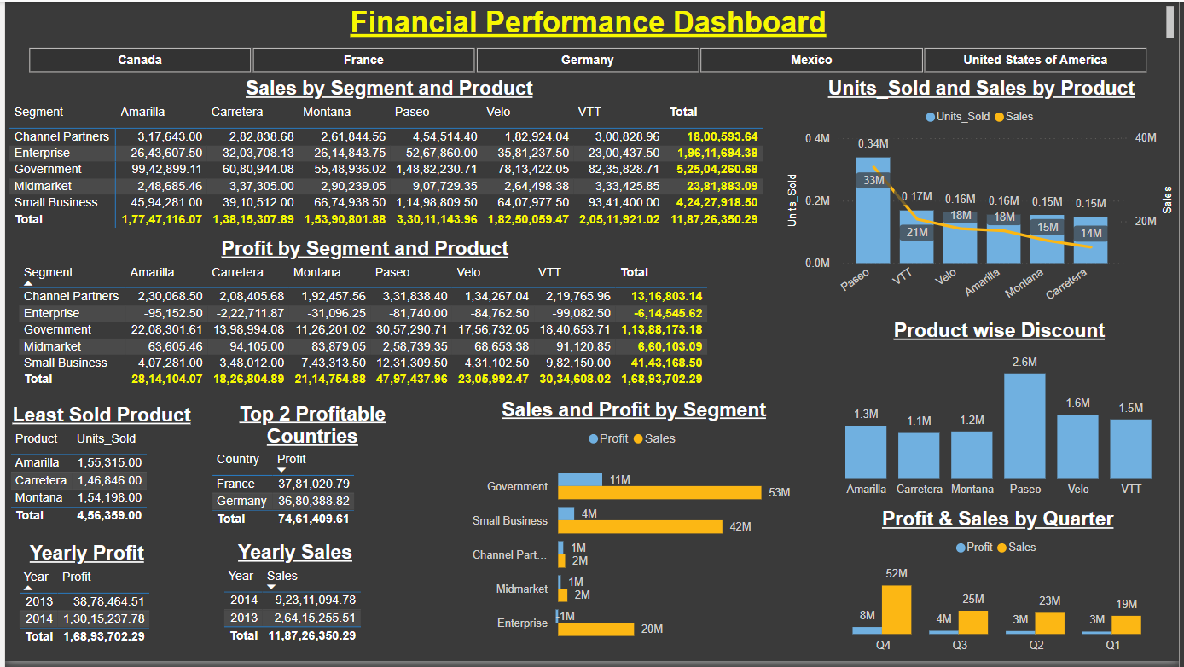
Dashboard Overview

Slide 5
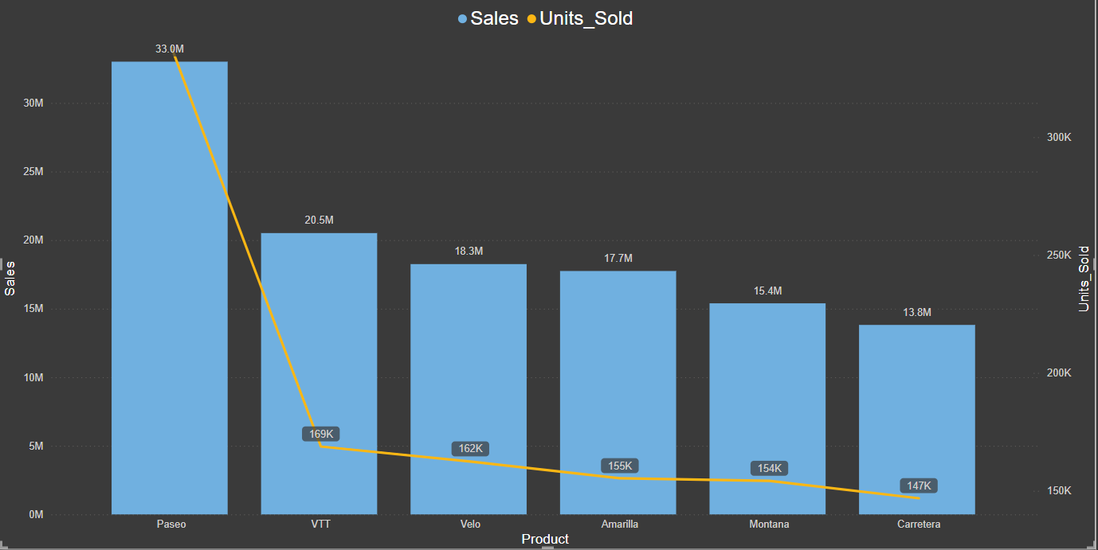
Sales & Units Sold by Product
Highest sales: Paseo ($33 M) Lowest sales: Amarilla ($13.8 M)

Slide 6
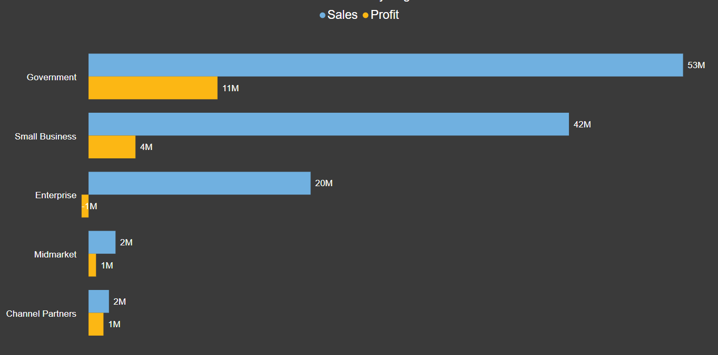
Sales & Profit by Segment
Highest sales: Government ($53M) Highest Profit: Government ($11M)
Lowest Sales: Channel Partners ($2M) Lowest Profit: Enterprise ($-1M)

Slide 7
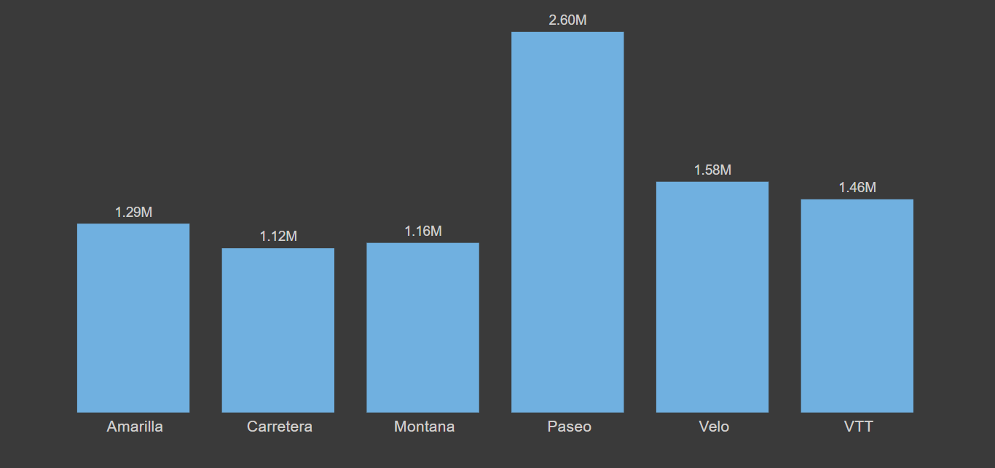
Product-Discount
Maximum Discount: Paseo ($2.60 M) Least Discount: Carretera ($1.12 M)

Slide 8


Key Insights
Country-Wise Performance: France & Germany are top 2 profitable countries.
Bottom 3 products based on sales are Amarilla, Montana and Carretera.
Performance in Q4 is better than other Quarter. Point which we have to consider as there are two quarter 4 in the Dataset.
Yearly profit is better for the year 2014.

Slide 9

Thank You
We would love to hear your questions.
+91 7772098393
akhvnd@gmail.com

