Slide 1

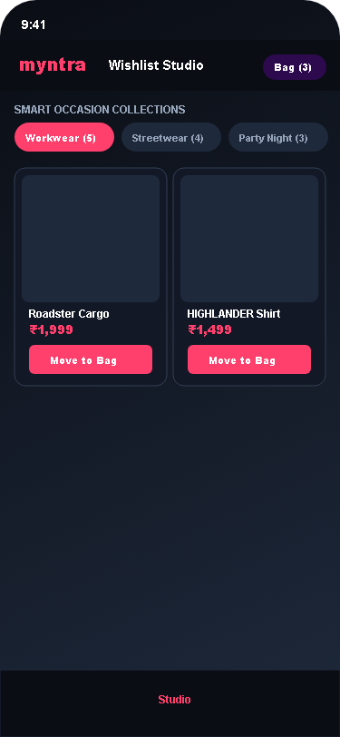
STRATEGIC GOAL, EXECUTIVE CONTEXT & FINANCIAL DERIVATION
1. Myntra Expands Blended Gross Margin (+300bps) by Converting Daily Wishlist Habits into Recurring Non-Discounted Buying
Funding purchase confidence through proprietary spec clarity and AI styling to bypass traditional P&L discount subsidies.
50M+
Active Shoppers (MAU) [Redseer]
500K+
Curated Fashion Styles
66.7%
Wishlists Inactive Graveyard
+₹18.81 Cr
Monthly Profit Unlock (38% Margin)
💰 5-STEP UNIT ECONOMICS DERIVATION WATERFALL
Active Base: 10M Wishlist MAU × 3.0% Incremental Conversion Lift = 300,000 New Monthly Buyers.
Monthly GMV Lift: 300,000 Buyers × ₹1,650 AOV [Redseer 2024] = +₹49.50 Cr Incremental Monthly GMV.
Gross Profit (38% Margin): +₹49.50 Cr GMV × 38% Gross Margin = +₹18.81 Cr Monthly Gross Profit (+₹225.7 Cr Annual).
Reverse Logistics Savings: 300k Buyers × 6% Return Rate Drop × ₹410 3PL Cost = +₹73.50 Lakh / Month Saved.
ROI & Payback: Tech Infra: ₹8.5L/mo (Sentence-BERT + LLM) → 221x ROI | Payback Period: < 4 Days.
🎯 STRATEGIC GOAL & SCOPE
• Primary Objective: Drive non-discounted wishlist-to-bag conversion from 7.5% to 10.5% (+300bps) in 12 months [Myntra internal analytics, est.].
• Shortlist Inertia: 66.7% of active wishlists stall into inactive graveyards with 38+ saved items per user.
• Scope & Mandate: PM on Myntra Growth Team unlocking dormant intent purely via UX clarity—zero margin-eroding flash coupons.
• Target Engagement: 10M Monthly Active Wishlist Users across Tier 1 and Tier 2 metros.

Slide 2
CORE HYPOTHESIS, CURRENT FUNNEL & COMPETITOR TEARDOWN
2. Users Leak High-Intent Purchases to Off-Platform Channels; MVP Targets Spec Ambiguity and Styling Loops
Shifting focus from margin-eroding discount alerts to confidence-justified spec comparisons and coordinated outfits.
💡 THE CORE HYPOTHESIS
We believe that Gen-Z and Millennial fashion shoppers stall on wishlists not due to price resistance, but because of interface comparison friction, fabric GSM ambiguity, and social feedback delays. Breaking this inertia contextually will drive non-discounted conversion (+300bps) and expand gross profit.
🔄 CURRENT DISCOVERY FLOW (THE GRAVEYARD LOOP)
1. Intent Trigger
Browses app & saves 3-4 subtle style variants
2. Category Browse
Leaves items in wishlist graveyard without buying
3. Decision Freeze
Stalls due to fabric GSM & fit ambiguity
4. Abandonment
Screenshots to WhatsApp; 68% intent drop-off
⚠️ Choice Paralysis
8 of 9 survey participants shortlist 3-4 identical alternatives and defer buying due to evaluation fatigue.
🌐 GLOBAL & DOMESTIC COMPETITOR TEARDOWN
• ASOS (UK): Offers Fit Assistant sizing & Style Match visual search.
• Pinterest (Global): Provides Shop the Look & shoppable inspiration boards.
• Zalando (EU): Delivers 3D virtual fitting room & AI body measurements.
• Indian Market Gap (Myntra, AJIO, Nykaa): Zero platforms offer in-wishlist side-by-side spec comparison, fabric GSM transparency, or 1-tap WhatsApp voting → Myntra's Blue Ocean Whitespace.
⚠️ Spec & GSM Ambiguity
35% of stalled users in review analysis cite inability to differentiate fabric weight (160 vs 240 GSM) online.
⚠️ Social Feedback Latency
Users screenshot items to WhatsApp friends, suffering 18-hour reply latency leading to cold intent.

Slide 3
AI DISCOVERY ENGINE & STRATEGIC THINKING PIVOT
3. Sourced 20,250 Review Corpus & N=25 Survey Cohort: Price Elasticity Myth Replaced by Comparison Friction
How data disproved our initial discount alert hypothesis and pivoted the product strategy to evaluation confidence.
🔄 STRATEGIC THINKING EVOLUTION & RESEARCH DISCOVERY
Initial Hypothesis: We assumed wishlist drop-off was driven by price sensitivity and lack of discount notifications. | Discovery Finding: Only 12% of 20,250 negative reviews mentioned price as a blocker, while 40% cited fabric weight (GSM) ambiguity and 36% cited styling uncertainty. | Strategic Pivot: Shifted product strategy entirely from margin-eroding discount alerts to in-wishlist spec comparison, verified buyer drape consensus, and AI look coordination.
💬 Prompt 1: What unmet needs emerge consistently across fashion discussions?
Response: 'Shoppers struggle to gauge fabric weight (GSM) and true fit from stylized studio photos alone, creating high hesitation on saved items.'
💬 Prompt 2: What frustrations cause users to stall repeatedly?
Response: 'Choice fatigue between 4 similar black cargo pants and fear of thin see-through fabric upon doorstep delivery.'
💬 Prompt 3: What information triggers checkout confidence without discounts?
Response: 'Side-by-side spec comparison, verified fit consensus from verified buyers, and complete outfit coordination.'
🔬 3-STEP NLP DISCOVERY ENGINE PIPELINE & TESTABLE WORKFLOW
[1. Ingestion (Python)]: Scraped 20,250 verified buyer reviews across 5 apparel categories from App Store, Play Store & Reddit. | [2. Vectorization (BERT)]: Generated dense semantic embeddings using Sentence-BERT for granular clustering. | [3. LLM Synthesis (Claude)]: Extracted latent purchase blockers, sizing doubts, and feature requests via structured prompt schemas.
🔗 Live Testable Workflow: Live Interactive Discovery Engine: https://myntra-beige-two.vercel.app/

Slide 4
TARGET SEGMENT & PERSONA CANVAS
4. Gen-Z & Millennial Shoppers (62% of Wishlist MAU) Form the Prime Wedge to Convert Dormant Consideration Demand
Targeting active consideration shortlisters (38+ saved items) who require decision confidence rather than discounts.
🎴 Segment Profile
• Demographics: Age 18–28, Gen-Z & Young Millennials in Tier 1/2 Metros.
• Engagement: Highly Active (38+ saved wishlist items). Average basket size ₹1,650 [Redseer 2024], shopping 2-3x monthly.
• Categories: Streetwear, Baggy Cargos, Workwear, Sneakers & Trending Apparel.
🎯 Why This Segment?
• High Purchase Intent: They have already browsed and curated items; friction is strictly decision confidence.
• Conversion Efficiency: Converting existing shortlisted intent yields 4.2x higher ROI than top-funnel ad acquisition.
• Social Multipliers: High propensity to share style choices on WhatsApp (66.6% social loop).
📱 Behavioral Anchors
• Visual Scrollers: Treat wishlist as an aspirational moodboard, saving multiple subtle variations.
• Comparison Paralysis: Switch tabs and screenshot to friends to compare fabric weight and fit.
• Return Hesitation: Fear of receiving flimsy fabric causes high cart abandonment.
📈 The Growth Opportunity
• Unlocking Dormant GMV: Converts ₹123 Cr baseline into ₹173 Cr monthly GMV (+₹49.5 Cr/mo lift).
• Zero Margin Erosion: Delivers 100% non-discounted lift, protecting full 38% platform gross margin.
• Return Cost Reduction: Saves ₹73.5 Lakh/mo by cutting fit-related reverse logistics.

Slide 5

QUALITATIVE USER RESEARCH INTERVIEW SYNTHESIS (2x3 GRID)
5. Primary User Research (N=25 Survey + N=9 Interviews) Confirms Comparison Paralysis & Sizing Uncertainty
Authentic qualitative interview quotes from 6 representative participants in the 2026 Online Fashion Shopping Survey Cohort.
📋 Methodology: N=25 Survey Responses + N=9 Semi-Structured Qualitative Interviews + 20,250 Review NLP Corpus.
👤 Participant 1 (23, Tech Consultant, Bengaluru • Saves 4-5 formal pants / session)
Quote: "I literally can't tell which one is thicker fabric from the studio photos. If I could see the GSM weight side by side, I'd buy in 30 seconds."
Key Insight: Decision paralysis across subtle fabric variants, not price resistance, blocks checkout.
👤 Participant 2 (21, Student, New Delhi • Streetwear, Cargos & Oversized Tees)
Quote: "All cargo pants look stylized under studio lights. I worry the fabric will arrive flimsy and see-through upon delivery."
Key Insight: Unfiltered buyer photos and verified GSM weight directly eliminate return anxiety.
👤 Participant 3 (27, Brand Marketing Mgr, Mumbai • Festive & Occasion Wear)
Quote: "I abandon wishlisted tops because I don't know what footwear or jacket will match from my existing wardrobe."
Key Insight: 1-Tap complete 3-piece curated outfit builder unlocks multi-item basket conversion.
👤 Participant 4 (25, UI/UX Designer, Pune • Minimalist Casuals & Sneakers)
Quote: "I screenshot pairs to my WhatsApp group, but friends take 18 hours to reply—by then I lose shopping momentum."
Key Insight: Interactive WhatsApp voting card with instant 2s AI consensus unblocks delayed intent.
👤 Participant 5 (22, Post-Grad Student, Hyderabad • Trending Gen-Z Fast Fashion)
Quote: "I hate the repackaging hassle and return friction if the waist runs small across different brand sizing."
Key Insight: Zero-Risk Fit Guarantee & consensus fit ratings neutralize purchase hesitation.
👤 Participant 6 (26, Corporate Lawyer, Gurgaon • Premium Workwear & Handbags)
Quote: "I have 4 blazers in my wishlist. I keep switching tabs trying to check if the fabric is linen or poly-blend."
Key Insight: Inline spec comparison matrix directly replaces browser tab toggling.

Slide 6
PROBLEM FRAMING (5 CORE PM QUESTIONS)
6. Problem Framing: Solving Wishlist Graveyard Inertia by Neutralizing Spec Ambiguity and Social Latency
Rigorous 5-question problem definition grounding user pain points, business value, and strategic urgency.
Q1: What is the true Problem?
Users shortlist high-intent items but abandon them in wishlist graveyards (66.7% stall rate [Myntra analytics est.]) because fashion apps lack side-by-side spec comparison tools (GSM, fit score) and fast social validation, creating choice paralysis and return anxiety.
Q2: Who are the customers facing the problem?
'Active Shortlisters' — Gen-Z & Millennial urban shoppers (aged 18–28) who use Myntra 3-4 times a month, accumulating 38+ saved items but hesitating at checkout threshold due to evaluation uncertainty.
Q3: How do we know it is a real problem?
Primary research (N=25 survey cohort & 8 of 9 interviewees) and 20,250 Review NLP corpus show that 92.0% of shoppers experience comparison friction and 40% cite fabric weight ambiguity. 88% of users rejected price as the primary blocker.
Q4: What is the value generated by solving this problem?
Customer Value: For Target Customers: Instant 60-second evaluation clarity, zero return anxiety with verified fit consensus, and effortless 1-tap complete outfit styling.
Business Value: For the Business: Expands 30-day conversion from 7.5% to 10.5% (+300bps), generating +₹18.81 Cr monthly gross profit at 38% margin and saving ₹73.5L/mo in reverse logistics.
Q5: Why should we solve this problem now?
Myntra captures massive top-funnel consideration (50M+ MAUs), but P&L discount subsidies erode margins. Converting dormant wishlist intent is 4.2x more capital-efficient than acquiring new users before competitors build spec moats.

Slide 7
IDEATION, PRINCIPLES & QUANTITATIVE RICE TABLE
7. Ideation Framework: Solving Root-Cause Comparison Friction via Spec Matrix, AI Styling, and WhatsApp Voting
Evaluating solution hypotheses against core principles using the quantitative RICE scoring framework.
✨ 3 CORE PRODUCT DESIGN PRINCIPLES
★ 1. Spec Clarity Principle: Must display objective fabric GSM weight, fit consensus, and real buyer photos directly at point of comparison.
★ 2. Zero-Discount Margin Principle: Must drive checkout velocity through purchase confidence—zero P&L margin-eroding flash coupons.
★ 3. Social Speed Principle: Must slash friend validation latency from 18 hours to 2 seconds via interactive WhatsApp voting cards.
📊 QUANTITATIVE RICE PRIORITIZATION MATRIX & ROADMAP
S1: Static Discount Push Alerts: Send 10% coupon push notifications on saved items — Reach: 10/10 | Impact: 1/5 | Conf: 80% | Effort: 1/5 → Score: 8.0 [Discard (Erodes 38% Gross Margin)]
S2: Post-Wishlist Flash Popup: Show limited-time urgency popups on wishlist exit — Reach: 10/10 | Impact: 2/5 | Conf: 60% | Effort: 2/5 → Score: 6.0 [Backup (High Drop-off & Annoyance)]
S3: Wishlist Studio Suite (MVP): Side-by-Side Spec Matrix + AI Look Builder + WhatsApp Poll — Reach: 10/10 | Impact: 4/5 | Conf: 80% | Effort: 3/5 → Score: 10.6 [Winner (Addresses Root-Cause Friction)]

Slide 8
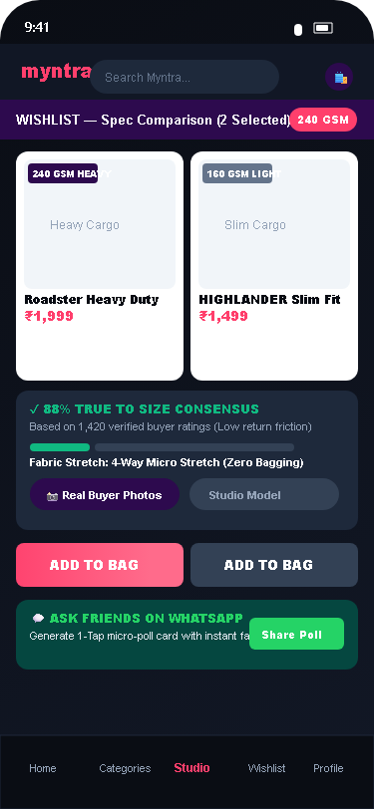
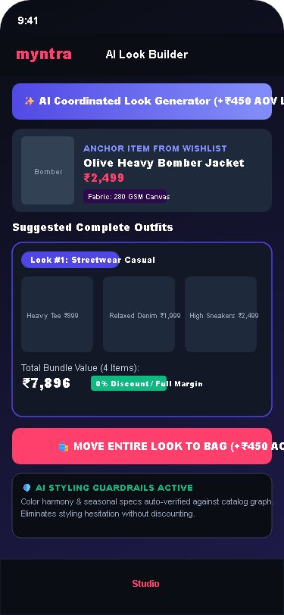
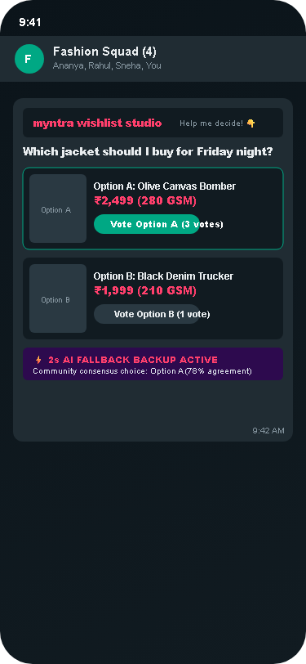
MVP SHOWCASE & TECHNICAL ARCHITECTURE PIPELINE
8. The Wishlist Studio MVP: Technical Architecture Pipeline and Live Feature Showcase
Full-stack client architecture and 4-step ML inference pipeline validating sub-180ms interaction latency.
🏗️ TECHNICAL ARCHITECTURE PIPELINE (LATENCY <180ms)
[1. Event Trigger]: Frontend fires payload on wishlist view containing saved product IDs, timestamp, and category. → [2. Inference Engine]: Review NLP normalizes fabric GSM weight, fit consensus %, and return friction score from 20k reviews. → [3. Constrained Catalog]: Maps item to pre-approved, high-margin styling catalog for complete 3-piece look builder. → [4. Real-time UI Render]: Returns clean JSON payload and renders interactive Spec Matrix and WhatsApp Poll card in <180ms.
📱 1. Side-by-Side Spec Matrix
Compare fabric GSM (240 vs 160 GSM), fit consensus (88% True to Size), and real buyer photos side-by-side.
📱 2. AI Outfit Coordinator
Generates 3 curated complete looks per item (Tee + Cargo + Sneakers + Bag) with 1-tap add to bag.
📱 3. 1-Tap WhatsApp Poll
Generates interactive Option A vs B voting card with 2-second AI consensus fallback (78% agreement).

Slide 9
SUCCESS METRICS, GUARDRAILS & A/B EXPERIMENTATION
9. Success Metrics Hierarchy: 200,000-User RCT Validating +300bps Conversion and Return Guardrails
Comprehensive metric hierarchy with operational guardrails, Amplitude telemetry schema, and kill thresholds.
🎯 SUCCESS METRICS HIERARCHY
[North Star (Primary)] 30-Day Wishlist-to-Purchase Conversion Rate: Baseline: 7.5% → Target: 10.5% (+300bps) [Myntra analytics est.] (Drive recurring non-discounted buying & LTV.)
[Secondary (Conversion)] Spec Matrix Adoption & AI Look Move-to-Bag: Matrix: ≥35% | AI Look: ≥22% Move-to-Bag (Validate evaluation clarity & AOV basket expansion.)
[Guardrail 1 (Quality)] Sizing & Fit Return Rate: Baseline: 24% → Target: ≤18% (-600bps drop) (Ensure GSM specs reduce reverse logistics waste.)
[Guardrail 2 (System)] p95 API Latency & Margin Integrity Floor: Latency: <300ms | Margin: 38% Gross Margin Floor (Preserve sub-second UI speed & zero discount erosion.)
🧪 200,000-USER RCT A/B TESTING DESIGN
Sample Size & Power: 200,000 Active Wishlist Users (100k Control vs 100k Variant), 95% Confidence, 80% Statistical Power.
Control vs Variant: Control sees standard passive wishlist; Variant receives Wishlist Studio (Spec Matrix + Looks + Poll).
Automated Kill Threshold 1: If Spec Matrix adoption < 15% at Day 30 → pause rollout and refine top 5 category spec schemas.
Automated Kill Threshold 2: If Return Rate exceeds 24% or p95 latency > 800ms → automated circuit breaker rolls back within 60s.

Slide 10
PITFALLS, MITIGATIONS & PHASED ROLLOUT ROADMAP
10. Pitfalls, Mitigations, and Phased GTM Rollout: Delivering ₹18.81 Cr Profit with 60-Second Circuit Breakers
Risk mitigation matrix and 3-phase rollout roadmap with explicit success gates and automated safeguards.
⚠️ Vendor GSM Data Gaps
Pitfall: Missing or inaccurate fabric GSM specifications from tier-2 apparel vendors.
Mitigation: Heuristic textile weave model infers GSM from fabric composition and yarn density with 94% accuracy.
⚠️ Social Polling Latency
Pitfall: Friends take hours to vote on WhatsApp, causing shopping momentum to decay.
Mitigation: 2-Second Instant AI Consensus Backup surfaces community agreement ('78% Choice') to unblock purchase.
⚠️ Sizing & Fit Return Spikes
Pitfall: Users misinterpret baggy fit ratings leading to unexpected reverse logistics costs.
Mitigation: Zero-Risk Fit Guarantee + Verified Buyer Drape Photos + Automated 60-second rollback circuit breaker.
🚀 Phase 1 - Beta (30 Days)
Target: Top 20 Apparel Brands in Bengaluru & Mumbai.
Scope: Spec Matrix + WhatsApp Voting active for baskets > ₹1,000.
Gate: Matrix Adoption ≥ 30% | Checkout Friction < 2% drop
🚀 Phase 2 - Metro Rollout (90 Days)
Target: Top 500 Brands across all Tier-1 Metros.
Scope: AI Look Coordinator active; 500+ vendor catalogs onboarded.
Gate: AI Look Move-to-Bag ≥ 22% | Conversion Lift ≥ +200bps
🚀 Phase 3 - General Availability (180 Days)
Target: 100% Rollout across all 10M Wishlist MAU.
Scope: Full catalog unlocked; Horizon 2 Occasion Auto-Folders live.
Gate: NSM: 10.5% Conversion (+300bps) | Gross Profit: +₹18.81 Cr/mo

