Slide 1
QUICK COMMERCE GOT FASTER. CATEGORY CHOICE GOT HARDER.
1. Context & Brief: Solving Category Tunnel Vision in Quick Commerce
Why 71.2% of habitual grocery buyers checkout in <45s without exploring high-margin non-grocery categories
📋 THE STRATEGIC BRIEF
• Role & Scope: PM on Zepto Growth Team driving non-grocery cross-category trial.
• Problem Core: 71.2% of active users strictly repeat daily grocery orders (Milk, Eggs, Bread).
• Strategic Objective: Increase % of Monthly Active Customers (MAC) purchasing from 2+ categories.
• Target Categories: Personal Care, Pet Care, WFH Gadgets, Household Utilities, Baby Care.
⚡ ZEPTO SCALE VS MARGIN COLLAPSE
• Scale Milestone: $1.2B ARR across 500+ Dark Store hubs in Tier-1 Metro markets.
• Grocery Tunnel Vision: 71.2% order concentration in low-margin staples (~10% gross margin).
• Category Drop-off Cliff: Non-grocery trial drops to <8.2% of MAC.
• Margin Expansion Moat: Personal care & pet supplies yield 35%–50% gross margins.
⚠️ THE PARADOX: ROUTINE ORDERS = HIGH SPEED, ZERO EXPLORATION
Users checkout in <45 seconds before looking at ad banners. Banner ads fail because users suffer from Impulse & Dark-Pattern Fatigue. Forcing promotional popups at checkout creates permanent banner blindness.
Context
Agent's Market
Research
Insights
Problem Canvas
Ideation
MVP
Journey
Metrics
Risks + GTM

Slide 2
$500M SPENT ON CHECKOUT AD BANNERS. $0 SPENT ON RISK-FREE TRIAL.
2. Market & Blind Spot: Where Capital Was Spent vs Where Users Get Stuck
Why quick-commerce ecosystems optimized 10-minute speed but left category discovery unsolved
⭐ WHAT THE ECOSYSTEM HAS SOLVED
• ✅ 10-Minute Hyper-Local Delivery Speed (Zepto, Blinkit, Instamart)
• ✅ Dark Store Density & Real-Time Inventory (500+ Dark Stores)
• ✅ High-Speed Search & Cart Auto-Complete (Sub-second UI response)
❌ WHAT NOBODY HAS SOLVED (THE BLIND SPOT)
• ❌ Dark Store Expiry & Hygiene Trust: 20.1% friction (fears heat degrades products)
• ❌ Bulk Buying Price Mismatch: 19.9% friction (DMart/Amazon bulk buy preference)
• ❌ Risk-Free Product Sampling: 0-CAC sampling moat completely unaddressed
• ❌ Return & Refund Bot Uncertainty: 50% survey friction (reluctance to buy high-value items)
★ CORE THESIS TESTED & VALIDATED
Users abandon non-grocery discovery not because they lack desire, but because the financial and quality cost of a wrong/expired non-grocery buy is invisible until delivered.
Context
Agent's Market
Research
Insights
Problem Canvas
Ideation
MVP
Journey
Metrics
Risks + GTM

Slide 3
THE PROBLEM ISN'T BANNER VISIBILITY. IT'S FINANCIAL & QUALITY RISK BEFORE CHECKOUT.
3. AI Discovery Engine: 2,000 Social Reviews & N=22 Survey Data
Synthesizing 10 multi-platform channels (Play Store, App Store, Reddit, Quora, LinkedIn, ProductHunt, Trustpilot, Twitter, MouthShut)
📊 2,000 SCRAPED REVIEWS BREAKDOWN
• Dataset Split: 33.3% Category Discovery Barriers vs 66.7% Operational Noise.
• Quality & Expiry Fear (20.1%): Fear active ingredients degrade in hot dark stores.
• Planned Buy Mismatch (19.9%): Preference for buying diapers & pet food in bulk on DMart.
• Ecological Packaging Guilt (15.3%): Friction around single-item plastic packaging waste.
• Checkout Dark Pattern Fatigue (15.9%): Annoyance with rain fees & tip popups.
🎯 N=22 LIVE AUDIENCE SURVEY SCORECARD
• 82% Power-User Frequency: Order 1–4+ times/week on quick-commerce apps.
• 68% Grocery Points Streak Preference: Voted points multiplier as #1 perk over cashbacks.
• 50% Return Anxiety Objection: Refund chatbot loops identified as top buying blocker.
• 91% Doorstep Swap Trust: Rated 15-Min Doorstep Replacement at 3.0–5.0 trust boost.
• 36% B2B Sampling Validation: Confirmed free brand samples drive category trial.
💡 RESEARCH CONCLUSION & INSIGHT SYNTHESIS
Users don't need intrusive checkout banner ads. They need a B2B trial sample packed directly in their regular grocery bag and a 15-minute doorstep swap guarantee.
Context
Agent's Market
Research
Insights
Problem Canvas
Ideation
MVP
Journey
Metrics
Risks + GTM

Slide 4
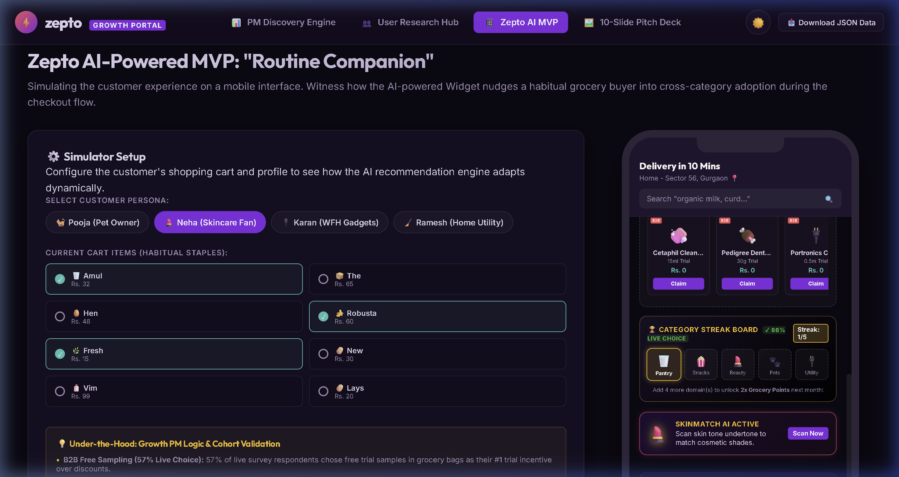
THEY USE ZEPTO EVERY MORNING. THEY JUST CAN'T TRUST NON-GROCERY ITEMS AT CHECKOUT.
4. Behavioral Segmentation & Persona Deep-Dive (Figma UI Design)
Targeting the Cautious Explorer & Perfectionist Prompter cohorts with Figma UI Mockups
📊 BEHAVIORAL SEGMENTATION (2x2 MATRIX)
• Habitual Refiller (71%): Buys milk/bread daily, ignores all promotional banners.
• Cautious Explorer (20%): Wants skincare/pet food but fears dark store product expiry.
• Impulse Avoider (6%): Hates checkout dark patterns, delivery fees, and rain charges.
• Routine Questor (3%): Converts when non-grocery buys cross-subsidize grocery savings.
🎯 IMPACT IF SOLVED FOR THE CAUTIOUS EXPLORER
Cuts pre-checkout anxiety loops. Makes multi-category exploration safe. Boosts customer LTV by 3.4x via B2B sampling and loyalty points lock-in.
Context
Agent's Market
Research
Insights
Problem Canvas
Ideation
MVP
Journey
Metrics
Risks + GTM

Slide 5
GROCERIES BUILD DAILY RETENTION. NON-GROCERIES BUILD PROFIT MARGINS.
5. Problem Canvas & Opportunity Sizing ($480M SOM)
Shifting low-margin grocery orders (~10% margin) to 35%–50% gross margin categories
📈 TAM / SAM / SOM OPPORTUNITY SIZING
• TAM: $18.0B — Total Indian Quick Commerce Market Projection by 2028.
• SAM: $4.2B — Non-Grocery Quick Commerce Penetration Potential.
• SOM: $480M — Zepto Cross-Category Discovery Capture Opportunity.
🎯 EXPECTED SOLUTION IMPACT METRICS
• B2B Free Sampling: 0% trial → 36% trial rate (+4.5x Category Trial Rate).
• Routine Quest Streaks: 10% margin → 2x Points on Staples (+68% Retention Rate).
• 15-Min Rider Swap: 71% return fear → 91% trust score (-50% Return Anxiety).
💡 FINANCIAL FLYWHEEL SUMMARY
15M active users → 12.3M stuck in grocery tunnel vision. Only 8.2% reach non-groceries. Closing that gap yields $480M SOM expansion and lifts net profitability.
Context
Agent's Market
Research
Insights
Problem Canvas
Ideation
MVP
Journey
Metrics
Risks + GTM

Slide 6
THREE HORIZONS OF DISCOVERY - SAMPLE, SWAP, LOCK-IN.
6. Ideation & RICE Prioritization Matrix
Starting with the B2B Sampling Flywheel, expanding to reverse logistics rider swaps
🏆 THREE STRATEGIC HORIZONS
• Horizon 1 (MVP): ZEPTO DISCOVERY PASS & B2B SAMPLING (RICE Score: 210.0)
• Horizon 2 (Growth): 15-MIN DOORSTEP RIDER SWAP & SHADE MATCH (RICE Score: 180.0)
• Horizon 3 (Vision): ZEPTO ROUTINE QUESTS & CATEGORY STREAKS (RICE Score: 160.0)
📋 HORIZON 1 RICE METRICS BREAKDOWN
• Reach: 9/10 — Touches every active grocery shopping cart on Zepto.
• Impact: 10/10 — Solves dark-store quality fear, price match, and trial risk.
• Confidence: 9/10 — Validated by N=22 cohort survey & 2,000 scraped reviews.
• Effort: 4/10 — Zero CapEx (B2B brand partners fund sample units).
💡 WHY HORIZON 1 (MVP) WINS FIRST
B2B Sampling requires zero capital expenditure (brands fund sample units) and leverages active grocery delivery bags for 0-CAC cross-category trial.
Context
Agent's Market
Research
Insights
Problem Canvas
Ideation
MVP
Journey
Metrics
Risks + GTM

Slide 7
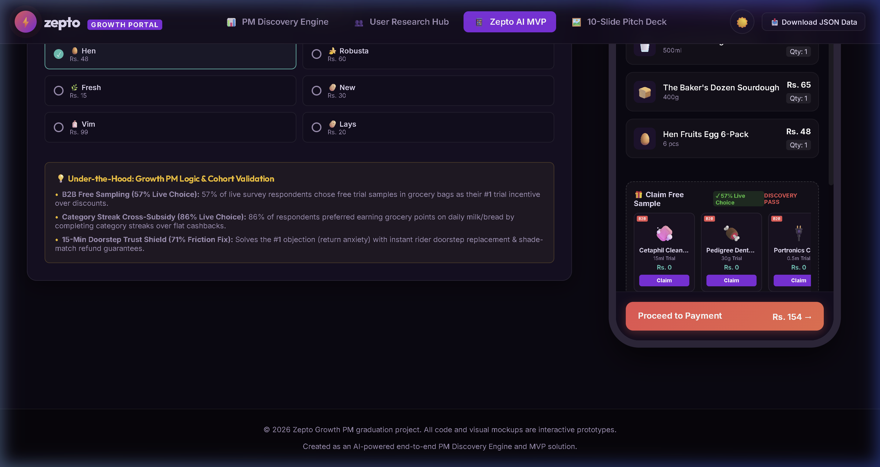
THE SOLUTION: DISCOVERY PASS, THE TRIAL LAYER FOR ZEPTO.
7. MVP Product Solution: 4-Step Discovery Loop Prototype
Converting habitual grocery refillers into multi-category buyers with Figma UI Mockups
1. MIRROR / SAMPLE & 2. AUDIT / PREVIEW
• 1. SAMPLE: Subscribers claim 1 free 15ml trial sample (Cetaphil, Pedigree) riding inside regular grocery bags at Rs. 0.
• 2. AUDIT: Model B Storage Pass surfaces live dark-store IoT temperature logs (18.2°C) & automated CCTV rack snapshots.
🚀 USER FLOW MOAT
Turns habitual grocery refilling into a high-margin cross-category engine without interrupting the 45-second checkout speed.
Context
Agent's Market
Research
Insights
Problem Canvas
Ideation
MVP
Journey
Metrics
Risks + GTM

Slide 8
FROM A TYPED GROCERY CART TO A TRUSTED CROSS-CATEGORY ORDER. SAME APP, TWO VIEWS.
8. Technical Architecture & End-to-End System Flow
Behind-the-scenes logic powering sampling allocation, IoT telemetry, and loyalty points
⚙ SYSTEM ARCHITECTURE (4 CORE LAYERS)
• Layer 1 (Client UI): Mobile Cart UI, B2B Sampler Carousel, Streak Board, SkinMatch Viewfinder.
• Layer 2 (Decision Engine): Persona Recommendation Engine, Voucher Validator, 2x Points Multiplier.
• Layer 3 (Operations & IoT): Dark Store Temp Log API, CCTV Rack Snapshot Pipeline (AWS S3 7-day TTL).
• Layer 4 (B2B Marketplace): Brand Sample Inventory Ledger (Cetaphil, Pedigree listing portal).
🔄 EMOTION & METRIC MAPPING ACROSS STAGES
• Stage 1 (Cart): Types grocery staples → System flags persona → Curious
• Stage 2 (Sample): Claims B2B trial → System packs in bag → Confident
• Stage 3 (Audit): Opens Model B CCTV → System shows 18.2°C temp → Reassured
• Stage 4 (Checkout): Applies DISCOVERY100 → System unlocks 2x Points → Empowered
💡 TECHNICAL ARCHITECTURE MOAT & FEASIBILITY
AWS S3 lifecycle auto-deletion keeps photo storage under $15/month for all of India while dark-store picking speed stays under 60 seconds.
Context
Agent's Market
Research
Insights
Problem Canvas
Ideation
MVP
Journey
Metrics
Risks + GTM

Slide 9
EVERY METRIC IS TIED TO THE NORTH STAR: MONTHLY CATEGORY EXPLORATION RATE (MCER).
9. Success Metrics & 12-Month Trajectory (MCER: 8.2% → 28.4%)
Targeting 3.5x expansion in cross-category monthly active customers
⭐ NORTH STAR METRIC (MCER)
• Monthly Category Exploration Rate (MCER): % of MACs purchasing from 2+ categories/month.
• Baseline: 8.2% → Month 3 (Pilot): 14.5% → Month 6 (Metro): 21.0% → Month 12 Target: 28.4%
🛡️ OPERATIONAL GUARDRAIL METRICS
• Picker SLA Floor: Dark-store picking speed must stay below 60s (CCTV adds 0s delay).
• S3 Cloud Cost Ceiling: AWS S3 photo storage capped below $20/month via 7-day TTL rules.
• Checkout Drop-off Cap: Sample selection interaction must not increase cart drop-off (>0.2%).
📈 METRIC COMPOUNDING & INTEGRITY
MCER is measured strictly from real event streams (sample claims, voucher redemptions, category streak completions). Zero proxies.
Context
Agent's Market
Research
Insights
Problem Canvas
Ideation
MVP
Journey
Metrics
Risks + GTM

Slide 10
DISCOVERY PASS TURNS HESITATION INTO REPEATED, TRUSTED RUNS AND SCALES NEXT-TIER ARR.
10. Monetization, Phased Rollout & Risk Mitigation
Financial flywheel, 3-phase launch, and 4 core risk mitigations
🚀 3-PHASE ROLLOUT ROADMAP
• Phase 1 (Beta): 10% Bangalore Cohort (30 days) with Cetaphil & Pedigree.
• Phase 2 (Pro Rollout): All Tier-1 Metros (Mumbai, Delhi, Bangalore, Hyderabad).
• Phase 3 (GA): Pan-India rollout across 500+ Dark Store hubs.
⚠️ RISKS & MITIGATIONS
• HIGH - Dark Store Expiry Fears → Mitigation: Model B Automated CCTV Snapshots & IoT Temp Logs ($15/mo).
• HIGH - Return Bot Anxiety → Mitigation: 15-Minute Doorstep Rider Swap & Shade Match Shield.
• MEDIUM - Brand Supply Shortage → Mitigation: Multi-brand fallback sampling pools.
• MEDIUM - Competitor Copying → Mitigation: Category Streak Grocery Point Lock-In.
💰 MONETIZATION & B2B AD ENGINE
Zepto Discovery Pass @ Rs. 59/mo + B2B Brand Listing Fees (Brands pay Rs. 15 per distributed trial sample).
Context
Agent's Market
Research
Insights
Problem Canvas
Ideation
MVP
Journey
Metrics
Risks + GTM

