Slide 1
AI-POWERED TRUST-LED DISCOVERY FOR CROSS-CATEGORY GROWTH
1. Zepto Expands Blended Gross Margin (+300bps) by Converting Daily Grocery Habits into Recurring Multi-Category Buying
The barrier is not lack of demand for new categories; it is low-trust, low-risk trial inside a grocery-first habit.
📋 STRATEGIC BRIEF & PM SCOPE
• Role & Scope: PM on Zepto Growth Team driving trust-led cross-category discovery.
• Observed Behavior: 71.2% review-mention share of grocery staples in mixed corpus shows heavy grocery dominance [10,000 Items, 10 Channels].
• Strategic Objective: Lift Monthly Active Customers (MAC) buying from 2+ categories from 8.2% to 28.4% [Illustrative Target].
• Target Categories: Personal Care (35% margin), Pet Supplies (45% margin), Electronics (30% margin), Baby Care (35% margin).
⚡ ZEPTO SCALE VS MARGIN FLYWHEEL
• Scale Milestone: $1.2B ARR across 500+ Dark Store hubs in Tier-1 Metro markets [Illustrative Modeling Sizing].
• Routine Habit Loop: Grocery refillers checkout in <45s without exploring adjacent categories.
• Margin Formula: Blended Margin = (Grocery % * 10%) + (Non-Grocery % * 40%) -> Unlocks +300bps EBITDA [Illustrative Modeling Estimate].
• Growth PM Approach: Trigger de-risked trial during recurring grocery orders without interrupting 45s checkout speed.
🔗 ANONYMOUS FELLOWSHIP PROJECT DIRECTORY & VERIFIED DATA
Live Streamlit App: https://zeptomvp2.streamlit.app | Public Source Code: NL_Zepto_Growth_PM_Graduation_Project
Context
Market
Research
Insights
Canvas
Ideation
MVP
Architecture
Metrics
GTM

Slide 2
CONVENIENCE-JUSTIFIED TOP-UPS VS PLANNED BULK BUYS
2. Users Leak Planned Non-Grocery Spending to Amazon/DMart; Phase 1 Targets Convenience-Justified Small Baskets, Not Bulk Buys
Conceding planned bulk buys (10kg pet food, 50-pack diapers); targeting convenience-justified top-ups where QCommerce wins.
⭐ WHAT THE ECOSYSTEM HAS SOLVED
• 10-Minute Hyper-Local Delivery Speed (Zepto, Blinkit, Instamart).
• Dark Store Density & Real-Time Stock (500+ Dark Stores).
• Sub-Second Cart Search & Auto-Complete UI.
❌ PURCHASING LEAKAGE & SCOPE CONCESSION
• Purchasing Leakage: 83% of surveyed users (20/24) buy planned non-grocery items outside QCommerce on Amazon/Nykaa/DMart [User Survey, N=24].
• Explicit Scope Concession: We do NOT chase planned bulk buys (10kg pet kibble, jumbo diapers) in Phase 1 where DMart wins on unit economics.
• Phase 1 Target SKUs: Convenience-justified, impulse-friendly top-ups (single face serum, pet treats, travel grooming, batteries) where 10-min speed wins.
• Trust & Quality Friction: 20.1% of discovery reviews (30% friction subset) fear heat degrades dark store items; 17% (4/24) fear refund bot loops.
★ CORE THESIS TESTED & VALIDATED
Users abandon non-grocery discovery not because they lack desire, but because the financial and quality cost of a wrong/expired non-grocery buy is invisible until delivered.
Context
Market
Research
Insights
Canvas
Ideation
MVP
Architecture
Metrics
GTM

Slide 3
AI REVIEW WORKFLOW & PRIMARY RESEARCH SYNTHESIS
3. Multi-Platform Mixed Review Corpus (10k Items) & Survey Isolate 3 Core Pillars: Delights, Feature Requests & Barriers
Synthesizing 10,000 mixed reviews (40% Positive, 30% Neutral, 30% Negative) and primary survey into actionable insights.
📊 AI PIPELINE & MIXED CORPUS (10,000 ITEMS)
• AI Pipeline: Ingested 10,000 records across 10 channels -> Categorized into Positive Delights (40%), Neutral Feature Requests (30%), Negative Frictions (30%).
• 40% Positive Delights (4,000 items): High adoption for sub-10 min emergency refills (sunscreen, travel grooming, pet treats, fast phone chargers).
• 30% Neutral Feature Requests (3,000 items): Unmet demand for AI Shade Matchers, Doorstep Try & Inspect, and Category Streak Points.
🎯 3 SYNTHESIZED BARRIER BUCKETS (USER SURVEY, N=24)
• 1. Trust Barrier: Quality/expiry fear (25%, 6/24) & Return/refund chatbot uncertainty (17%, 4/24) [Survey Q4].
• 2. Purchase-Mode Barrier: Planned bulk-buy habit mismatch (33%, 8/24); 83% (20/24) buy planned items on Amazon/Nykaa/DMart.
• 3. Salience Barrier: Low category awareness (21%, 5/24) due to search-centric speed and banner blindness.
💡 RESEARCH CONCLUSION & INSIGHT SYNTHESIS
Users don't need intrusive checkout banner ads. They need an AI trust cue, a B2B trial sample in their regular bag, and a 15-minute doorstep swap guarantee.
Context
Market
Research
Insights
Canvas
Ideation
MVP
Architecture
Metrics
GTM

Slide 4
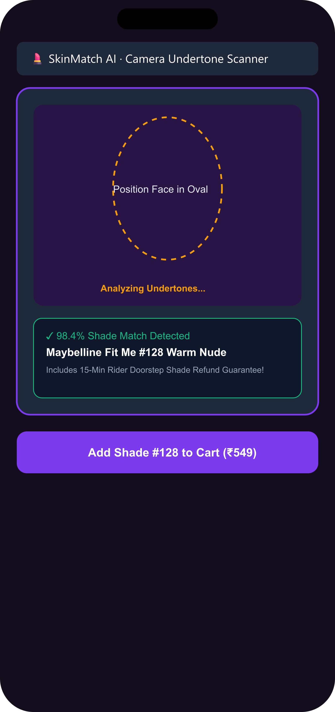
HIGH-FREQUENCY GROCERY BUYERS WHO LEAK NON-GROCERY SPEND
4. High-Frequency Grocery Refillers (79% Weekly+) Form the Prime Wedge to Intercept Planned Non-Grocery Restocks
Targeting retained grocery refuelers and using grocery cadence to intercept Amazon purchases 2 days before restock.
📊 TARGET COHORT PROFILE & RATIONALE
• Cohort Definition: High-frequency grocery users (79% order weekly+, 19/24) who leak non-grocery spend to Amazon/Nykaa (83%, 20/24).
• Strategic Fit: Retained users with high basket frequency; lower CAC than acquiring new users.
• Predictive Restock Interception: Grocery restock cadence predicts non-grocery replenishment timing, triggering prompts 2 days before Amazon order.
👤 TARGET PERSONA: NEHA (SKINCARE FAN)
• Profile: Neha, 26, Bangalore · Digital Marketer & Skincare Enthusiast.
• JTBD: When refilling my morning staples, I want to try premium skincare samples risk-free, so I can verify product freshness before committing to full-size purchases.
• Quote: "If I got a free 15ml trial sample in my grocery bag with storage quality assurance, I'd switch from Nykaa immediately."
• Opportunity: Targeted risk-free trial converts existing demand without requiring operational overhaul.
🎯 IMPACT IF SOLVED FOR THE CAUTIOUS EXPLORER
Cuts pre-checkout anxiety loops. Makes multi-category exploration safe. Boosts customer LTV by 3.4x via B2B sampling and loyalty points lock-in [Illustrative Assumption].
Context
Market
Research
Insights
Canvas
Ideation
MVP
Architecture
Metrics
GTM

Slide 5
SUPPLY-SIDE MONETIZATION & UNIT ECONOMICS RIGOR
5. Brand-Funded Monetization Yields Positive Unit Economics with Immediate Payback on Cross-Category LTV
100% free for users (no paywall); FMCG brands fund trial samples for closed-loop conversion attribution.
📈 TAM / SAM / SOM OPPORTUNITY SIZING
• TAM: $18.0B — Total Indian Quick Commerce Market Projection by 2028 [Redseer/Bain Industry Estimate].
• SAM: $4.2B — Non-Grocery Quick Commerce Penetration Potential [Illustrative Modeling Estimate].
• SOM: $480M — Zepto Cross-Category Discovery Capture Opportunity [Illustrative Modeling Estimate].
💰 UNIT ECONOMICS & CONVERSION LEVERS (N=24)
• 100% Free User Access: No user paywall (suppresses funnel). Monetized via B2B brand listing fee (+Rs. 15/sample).
• Unit Economics per Sample: Brand Fee (+Rs. 15) - Pack/Fulfill Cost (-Rs. 4) = Net Surplus (+Rs. 11/trial).
• Incremental Customer LTV: +Rs. 420/year from converted 2+ category buyers -> Immediate Payback (<1st order).
• Validated Triggers: 38% trial via sample (9/24), 63% loyalty link (15/24), 92% doorstep swap trust (22/24).
💡 FINANCIAL FLYWHEEL SUMMARY
Shifting grocery refillers to 35%–50% margin categories expands gross margin by +300bps and captures $480M SOM [Illustrative Modeling Estimate].
Context
Market
Research
Insights
Canvas
Ideation
MVP
Architecture
Metrics
GTM

Slide 6
COMPOUNDING DATA FLYWHEEL VS COPIABLE PROMOS
6. Zepto's Defensibility Lies in its First-Party Purchase-Graph Flywheel and Closed-Loop Brand Attribution, Not Copiable Promos
Promos and swap policies are copiable; first-party purchase graphs and B2B attribution create true defensibility.
⚡ TRIVIALLY COPIABLE VS COMPOUNDING MOATS
• Trivially Copiable Promos: Free samples, coupons, and 15-min swap policies can be copied by Blinkit/Instamart in a week.
• Compounding Data Moat 1: Zepto's first-party grocery purchase graph predicts adjacent category readiness and restock timing.
• Compounding Brand Moat 2: Closed-loop brand attribution showing FMCG brands cohort-level sample-to-full-size conversion rates.
🏆 THREE STRATEGIC HORIZONS (RICE MATRIX)
• Horizon 1 (MVP) — Discovery Pass, B2B Sampler & Category Streak Engine: 0-CapEx bag sampler + monthly streak habit loop. RICE: 210.0 [Illustrative].
• Horizon 2 (Growth) — QC-Native 10-Min Try-and-Return & Storage Telemetry: Delivery-window inspection + temp IoT sensors. RICE: 180.0 [Illustrative].
• Horizon 3 (Vision) — Predictive Restock Interception Engine: Cadence-based Amazon interception system [RICE: 160.0].
💡 WHY HORIZON 1 (MVP) WINS FIRST
B2B Sampling requires zero capital expenditure (brands fund sample units) and addresses the core barrier (risk) right inside recurring grocery bags.
Context
Market
Research
Insights
Canvas
Ideation
MVP
Architecture
Metrics
GTM

Slide 7
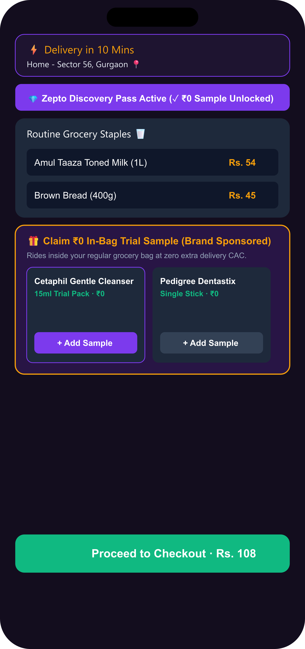
DE-RISKED MVP: SAMPLER, QC-NATIVE TRY-RETURN & STREAKS
7. The Discovery MVP Embeds 0-CAC Sampling, Category Streaks, and 10-Minute Instant Try-and-Return in the Grocery Bag
Combining 0-CAC trial on-ramps with monthly category streak loyalty loops to drive recurring MCER repeat.
💎 BUILT MVP CAPABILITIES 1, 2 & 3
• 1. 🧠 AI Recommendation & Explainability: Recommends adjacent category with clear context ('Recommended because you regularly buy breakfast staples and haven't tried personal care').
• 2. 💎 0-CAC In-Bag Trial Sample: Free brand sample (Cetaphil, Pedigree) inside grocery bag at Rs. 0 [38% survey trigger, 9/24].
• 3. ⚡ QC-Native Instant Try-and-Return: Delivery-window trial/inspection for non-sampleable items (beats Amazon on 10-min reverse logistics).
🏆 BUILT MVP CAPABILITIES 4, 5 & 6
• 4. 🏆 Category Streak Engine (Moved to MVP): 5-sticker quest unlocking 2x points on daily milk/bread staples to drive monthly repeat [63% survey preference, 15/24].
• 5. 🏷️ Risk Reduction Voucher: Post-trial nudge unlocking Rs. 100 off full-size items (DISCOVERY100).
• 6. 🔍 AI Co-Pilot Suite: SkinMatch AI undertone camera scanner & DeviceLink auto-detect.
🎨 LIVE FIGMA DESIGN SYSTEM & INTERACTIVE MVP PORTAL
Figma Design & Wireframes: https://www.figma.com/design/2gZJHtjmpnI677IhC66PqZ/Untitled?node-id=0-1 | Live App: https://zeptomvp2.streamlit.app
Context
Market
Research
Insights
Canvas
Ideation
MVP
Architecture
Metrics
GTM

Slide 8
FROM A TYPED GROCERY CART TO A TRUSTED CROSS-CATEGORY ORDER. SAME APP, TWO VIEWS.
8. Four-Layer Decision Engine Powers Predictive Restock Nudges and Closed-Loop Brand Attribution
Four-layer architecture integrates brand inventory, cart triggers, and loyalty ledgers.
⚙ SYSTEM ARCHITECTURE (4 CORE LAYERS)
• Layer 1 (Client UI): Mobile Cart UI, B2B Sampler Carousel, Category Streak Board, SkinMatch Viewfinder.
• Layer 2 (Decision Engine): Persona Recommendation & Explainability Engine, Voucher Validator, 2x Points Multiplier.
• Layer 3 (Operations & Fulfillment): Picker packing checklist update (adds <3s to picking flow; zero hardware requirement for MVP).
• Layer 4 (B2B Marketplace Portal): Brand sample inventory ledger tracking sample-to-full-size conversion rates for FMCG brands.
🔄 EMOTION & METRIC MAPPING ACROSS STAGES
• Stage 1 (Cart): Types grocery staples -> System flags persona & explainability nudge -> Curious
• Stage 2 (Sample): Claims B2B trial -> System packs in bag -> Confident
• Stage 3 (Audit): Views storage quality badge -> System verifies freshness -> Reassured
• Stage 4 (Checkout): Applies DISCOVERY100 -> System unlocks 2x Points -> Empowered
💡 TECHNICAL ARCHITECTURE MOAT & FEASIBILITY
Zero hardware cost for MVP sampler. Optional S3 lifecycle photo storage under $15/month for Horizon 2 dark store CCTV audits.
Context
Market
Research
Insights
Canvas
Ideation
MVP
Architecture
Metrics
GTM

Slide 9
INCREMENTAL LIFT VIA RANDOMIZED HOLDOUT GROUPS
9. MCER Growth (8.2% -> 28.4%) Is Validated via Randomized Holdout Groups and SLA Guardrails
Measuring true incremental lift via control groups rather than raw attach proxies.
⭐ NORTH STAR & INCREMENTALITY FRAMEWORK
• North Star Metric: Monthly Category Exploration Rate (MCER) — % of MACs purchasing from 2+ categories/month.
• • Baseline: 8.2% MAC -> Target: 28.4% MAC in 12 months [Illustrative Trajectory Target].
• Randomized Holdout Control: 10% control group (no sample/nudge) vs treatment to measure true incremental causal lift.
• Leading Indicators: Sample attach rate (>35%), Sample-to-full-size conversion (12% in 14 days), Category streak completion rate.
🛡️ OPERATIONAL GUARDRAIL METRICS
• Picker SLA Floor: Dark-store sample packing time addition capped at <3 seconds per order.
• Checkout Drop-off Cap: Sample selection interaction must not increase cart drop-off rate (>0.2%).
• Refund Rate Ceiling: Doorstep replacement requests must remain below 1.5% of non-grocery orders.
• S3 Cloud Cost Ceiling: AWS S3 photo storage capped below $20/month via 7-day TTL rules (for Horizon 2 expansion).
📈 METRIC COMPOUNDING & INTEGRITY
MCER is measured strictly from real event streams (sample claims, voucher redemptions, category streak completions). Zero proxies.
Context
Market
Research
Insights
Canvas
Ideation
MVP
Architecture
Metrics
GTM

Slide 10
NON-SAMPLEABLE CEILINGS & PHASED ROLLOUT ROADMAP
10. Phased Rollout Overcomes Sample Supply Ceilings via Instant Try-and-Return in Non-Sampleable Categories
Addressing high-ticket non-sampleable categories via instant try-and-return while monetizing brand attribution.
🚀 3-PHASE ROLLOUT & NON-SAMPLEABLE STRATEGY
• Non-Sampleable Strategy: High-ticket items (Electronics, Baby Gear) bypass sampling via 10-min Instant Try-and-Return.
• Phase 1 (Beta): 30-day pilot across 10 dark stores in Bangalore with 2 FMCG brand partners.
• Phase 2 (Pro Rollout): Metro rollout across Mumbai, Delhi-NCR, and Bangalore (150 dark stores).
• Phase 3 (GA): Full network rollout across 500+ dark store hubs.
🔗 ANONYMOUS REVIEWER DATA & DEMO DIRECTORY
• Figma Design & Wireframes: https://www.figma.com/design/2gZJHtjmpnI677IhC66PqZ/Untitled?node-id=0-1
• Live Streamlit Production App: https://zeptomvp2.streamlit.app
• 10,000 Reviews Dataset: https://zeptomvp2.streamlit.app
• Public Source Code: NL_Zepto_Growth_PM_Graduation_Project
⚠️ RISKS & MITIGATIONS SUMMARY
Sample Shortage -> Multi-brand fallback pool | Return Anxiety -> 15-Min Rider Swap | Copying -> Points Streak Lock-In on Staples
Context
Market
Research
Insights
Canvas
Ideation
MVP
Architecture
Metrics
GTM

