Slide 1


DMS System
Data Interface Specification
V1.0
June, 2012

Slide 2
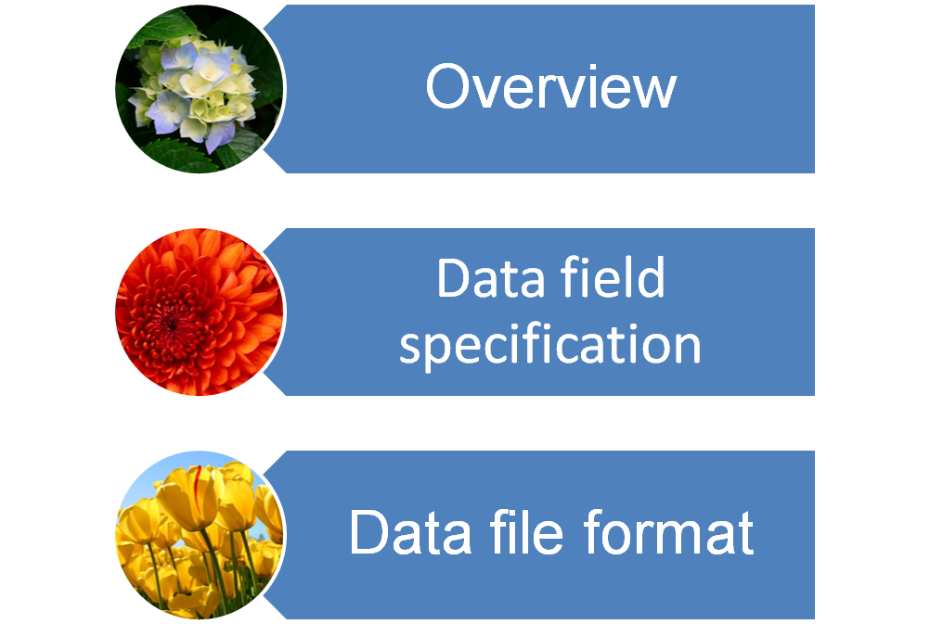
Content

Slide 3
Overview
In consideration of data security, the distributor can use interface file (XML formatted) to upload the data
The interface file should consist of the following data:
  product data, store data, sales data, purchase data, inventory data and other stock ins and outs data
See the data fields descriptions below for details
Please see attachment for detail (interface_data_sample.xml)
The data generated should meet following requirement:
  Current inventory = beginning inventory + period purchase (purchase receipt & purchase return) - period sales (sales delivery & sales return) + other stock ins & outs (postings that effect inventory)

Slide 4
Data Field Explanation
Data Field Explanation

Slide 5
Product Data
Field Name | Field Alias | Data Format | Data Sample | Data Requirement
Product Name | prodName |  |  | (Required)
Product Code | prodCode |  |  | (Required, Unique) When there is no code, can use the ID instead.
Product Bar Code | prodBarCode |  |  | If there is a bar code, need to add.
Product Specification | prodSpec
Product Price | prodPrice
Product Unit | prodUnit |  |  | (Required) Primary Unit
Product Unit1 | prodUnit1
Product Unit2 | prodUnit2
Product Unit3 | prodUnit3
Unite Conversion1 | unitRate1
Unit Conversion2 | unitRate2
Unit Conversion3 | unitRate3
Remark | remark

Slide 6
Store Data
Field Name | Field Alias | Data Layout | Data Sample | Data Requirements
Store Code | storeCode |  |  | (Required, Unique) When there is no code, can use the ID instead.
Store Name | storeName |  |  | (Required)
Store Address | storeAddr
Contact | contact
Telephone | tel
Store State | storeState
Remark | remark

Slide 7
Sales Data（sales delivery & sales return）
Field Name | Field Alias | Data Layout | Data Sample | Data Requirement
Bill Code | billCode |  | XS20100910399101 | (Required) actual bill No. in the SAP software
Bill Date | billDate | yyyy-mm-dd | 2010-09-13 | (Required) actual billing data
Bill Type | billType | typeNum-typeName | 01-sales | (Required) actual bill type
Store Name | storeName |  |  | (Required)
Store Code | storeCode |  |  | (Required) When there is no code, can use the ID instead.
Product Name | prodName |  |  | (Required)
Product Code | prodCode |  |  | (Required, Unique) When there is no code, can use the ID instead.
Product Unit | prodUnit |  |  | (Required) Unit corresponding to price and quantity
Product Quantity | prodQuantity |  |  | (Required) Sales as positive，Sales Return as negative
Product Price | prodPrice | Required, (corresponding to unit，the actual selling price will be used.)
Product Amount | prodAmount |  |  | (Required) Sales as positive，Sales Return as negative
Stock Type | stockType | stockNum-stockName | A-wh01 | (Required)
Product Number | prodNum
Bill State | billState
Remark | remark

Slide 8
Inventory Data
（actual real-time data on extracted time )
Field Name | Field Alias | Data Format | Data Sample | Data Requirement
Stock Date | stockDate | yyyy-mm-dd | 2010-09-13 | (Required) the date of the interface data generated
Product Name | prodName |  |  | (Required)
Product Code | prodCode |  |  | (Required, Unique) When there is no code, can use the ID instead.
Product Unit | prodUnit |  |  | (Required) Unit corresponding to quantity
Stock Quantity | stockQuantity |  |  | (Required) actual inventory quantity
Stock Type | stockType | stockNum-stockName | A-wh01
Product Number | prodNum
Remark | remark

Slide 9
Other Stock ins & outs
（Bills effect on inventory）
e.g.:Stock requisition, stock count, stock transfer, assembly & disassembly etc.
Field Name | Field Alias | Data Layout | Data Sample |  | Data Requirement
Bill Code | billCode |  | OT20100910399101 |  | (Required) Actual bill no. in SAP
Bill Date | billDate | yyyy-mm-dd | 2010-09-13 |  | (Required) Actual billing date
Bill Type | billType | typeNum-typeName | 01-assembly |  | (Required)Actual transaction bill type
Product Name | prodName |  |  |  | (Required)
Product Code | prodCode |  |  |  | (Required, Unique) When there is no code, can use the ID instead.
Product Unit | prodUnit |  |  |  | (Required) Unit corresponding to unit price and quantity
Product Quantity | prodQuantity |  |  |  | (Required) entry as positive，warehouse-out as negative
Product Price | prodPrice | (Required) corresponding to unit
Product Amount | prodAmount |  |  |  | (Required)warehouse entry as positive，warehouse-out as negative
Stock Type | stockType | stockNum-stockName |  | A-wh01
Product Number | prodNum
Bill State | billState
Remark | remark

Slide 10
Purchase Data
（Bills effect on purchase receipt & return）
Field Name | Field Alias | Data Layout | Data Sample | Data Requirement
Bill Code | billCode |  | JH20100910400001 | (Required) Actual bill no. in SAP
Bill Date | billDate | yyyy-mm-dd | 2010-09-13 | (Required) Actual billing date
Bill Type | billType | typeNum-typeName | 01-purchase | (Required)Actual transaction bill type
Supplier Name | supplierName |  |  | (Required)
Supplier Code | supplierCode |  |  | (Required, Unique) When there is no code, can use the ID instead.
Product Name | prodName |  |  | (Required)
Product Code | prodCode |  |  | (Required, Unique) When there is no code, can use the ID instead.
Product Unit | prodUnit |  |  | (Required) Unit corresponding to unit price and quantity
Product Quantity | prodQuantity |  |  | (Required)purchase as positive，purchase return as negative
Product Price | prodPrice |  |  | (Required) product unit price, corresponding to unit
Product Amount | prodAmount |  |  | (Required)purchase as positive，purchase return as negative
Stock Type | stockType | stockNum-stockName | A-wh01
Product Num | prodNum
Bill State | billState
Remark | remark

Slide 11
Data File Format
Data File Format

Slide 12
Data File Format
Format | Explanation
<?xml version="1.0" encoding="GBK" ?> <data clientCode="mmmhps"> <params> <param code="startDate">2010-08-30</param> <param code="endDate">2010-11-03 23:59:59</param> <param code="stockDate">2010-11-03</param> </params> </data> | Xml file header, includes version, code massage (current version is 1.0, code is GBK), it is fixed format <data> tag clientCode:client code, Winchannel informs startDate:start date inquiry (Date format:yyyy-mm-dd) endDate:end date inquiry ,need to second level (date format:yyyy-mm-dd HH:mm:ss) stockDate: inventory date(date format:yyyy-mm-dd)

Slide 13
Data File Format
Format | Explanation
<table code="DmsDataSale" name=“sales"> <row BILLCODE=“bill No." BILLDATE=“billing date" BILLTYPE=“bill type" STORENAME=“store name" STORECODE=“store code" PRODCODE=“product code" PRODNAME=“product name" PRODUNIT=“unit" PRODQUANTITY=“sales volume" PRODPRICE=“sales unit price" PRODAMOUNT=“total amount" PRODNUM=“product batch number" BILLSTATE=“bills status" STOCKTYPE=“warehouse type" REMARK=“remark" /> </table> | Sales data <table>data tag <row>tag Specific transaction data, please see sales data explanation part for detailed field explanation Bill date:(date format:yyyy-mm-dd)

Slide 14
Data File Format
Format | Explanation
<table code="DmsDataPurchase" name=“purchase"> <row BILLCODE=“bill code" BILLDATE=“bill date" BILLTYPE=“bill type" SUPPLIERNAME=“supplier name" SUPPLIERCODE=“supplier code" PRODCODE=“product code" PRODNAME=“product name " PRODUNIT=“unit" PRODQUANTITY="purchase quantity " PRODPRICE=“purchase unit price" PRODAMOUNT=“total amount" PRODNUM=“product batch number" BILLSTATE=“bill status" STOCKTYPE=“warehouse type" REMARK=“remark" /> </table> | purchase data <table>data tag <row>tag bill date:(date format:yyyy-mm-dd)

Slide 15
Data File Format
Format | Explanation
<table code="DmsDataStock" name=“inventory"> <row STOCKDATE=“inventory date" STOCKTYPE=“inventory type" PRODCODE=“product code" PRODNAME=“product name" PRODUNIT=“unit" PRODQUANTITY=“product quantity" PRODNUM=“product batch number" REMARK=“remark" /> </table> | Inventory data <table>data tag <row>tag Specific transaction data, please see inventory data explanation part for detailed field explanation Inventory date:(date format:yyyy-mm-dd)

Slide 16
Data File Format
Format | Explanation
<table code="DmsDataInout" name=“other stock"> <row BILLCODE=“bill code" BILLDATE=“bill date" BILLTYPE=“bill type" PRODCODE=“product code" PRODNAME=“product name" PRODUNIT=“unit" PRODQUANTITY=“product quantity" PRODPRICE=“product price" PRODAMOUNT=“total amount" PRODNUM=“product batch number" STOCKTYPE=“inventory type" REMARK=“remark" /> </table> | Other stock ins &outs data <table>data tag <row>tag Specific transaction data, please see other stock ins &outs data explanation part for detailed field explanation bill date:(date format:yyyy-mm-dd)

Slide 17
Data File Format
Format | Explanation
<table code="DmsDataProduct" name=“product"> <row PRODCODE=“product code" PRODBARCODE=“product bar code" PRODNAME=“product name" PRODSPEC=“product specification" PRODUNIT=“product primary unit" PRODPRICE=“product unit price" PRODNUM="product pc bar code" PRODUNIT1=“other unit1" UNITRATE1=“conversion rate1" PRODUNIT2=“other unit2" UNITRATE2=“conversion rate2" PRODUNIT3=“other unit 3" UNITRATE3=“conversion rate3" PRODSTATE=“product status" REMARK=“remark" /> </table> | Product data <table>data tag <row>tag Specific transaction data, please see product data explanation part for detailed field explanation

Slide 18
Data File Format
Format | Explanation
<table code="DmsDataStore" name=“store"> <row STORECODE=“store code" STORENAME=“store name" STOREADDR=“store address" CONTACT=“contact" TEL=“telephone" STORESTATE=“store status" REMARK=“remark" /> </table> | Store data <table>data tag <row>tag Specific transaction data, please see store data explanation part for detailed field explanation

Slide 19
Data File Format
Any key words in data file must be case-sensitive (parameters, tags).
If there are some special characters in your business data, please replace them following the rules below:
  & &amp;
  < &lt;
  > &gt;
  ‘ &apos;
  “ &quot;

Slide 20


Please Contact Us For More Information
Phone：010-82144868 13801016558
Email：info@winchannel.net
Website：www.winchannel.net

