Slide 1

University of Luxembourg
Interdisciplinary Centre for Security, Reliability and Trust
ConFuzzius: A Data Dependency-Aware Hybrid
Fuzzer for Smart Contracts
Christof Ferreira Torres, Antonio Ken Iannillo, Arthur Gervais and Radu State

Slide 2

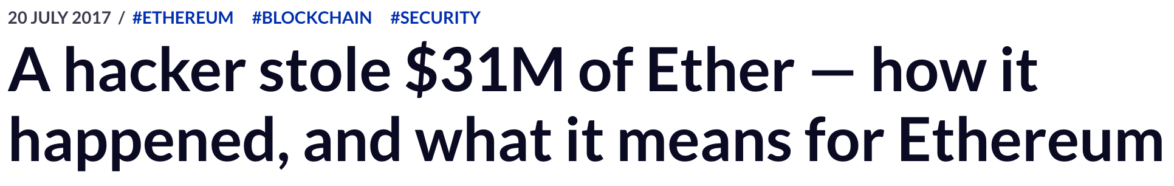
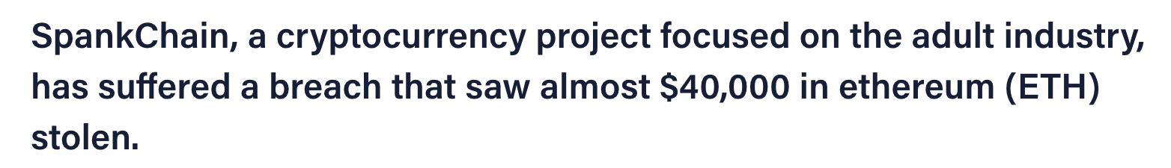
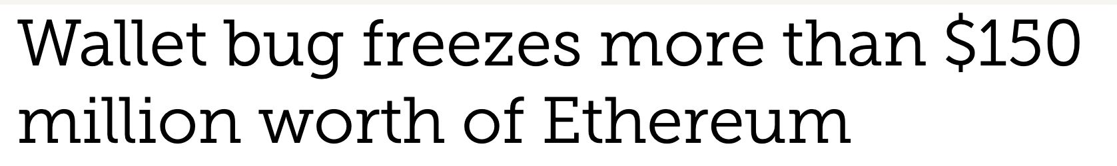
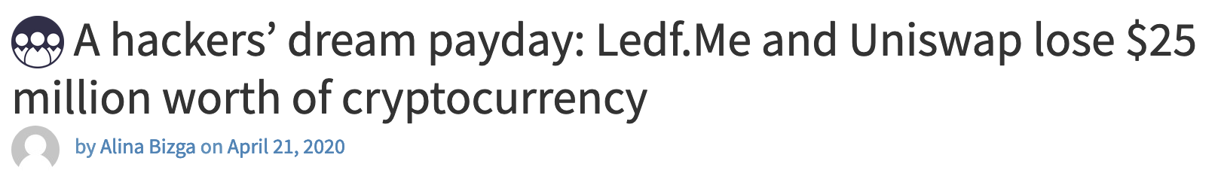
Attacks on Smart Contracts
2

Slide 3
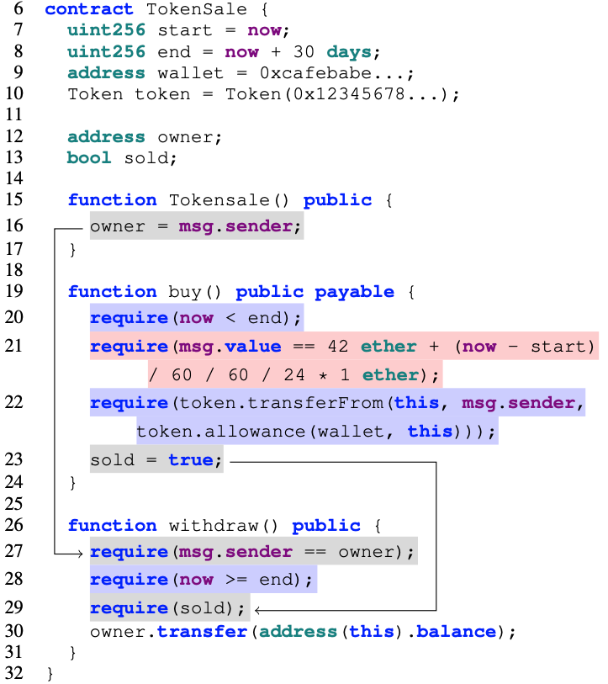
Smart Contract Security Challenges
Stateful exploration
Solution: read-after-write data dependency
Input generation
Solution: Input generation via symbolic execution
Environmental dependency
Solution: Model and fuzz environmental inputs
3

Slide 4
ConFuzzius

Slide 5
Architecture
5

Slide 6
Encoding Individuals
6

Slide 7
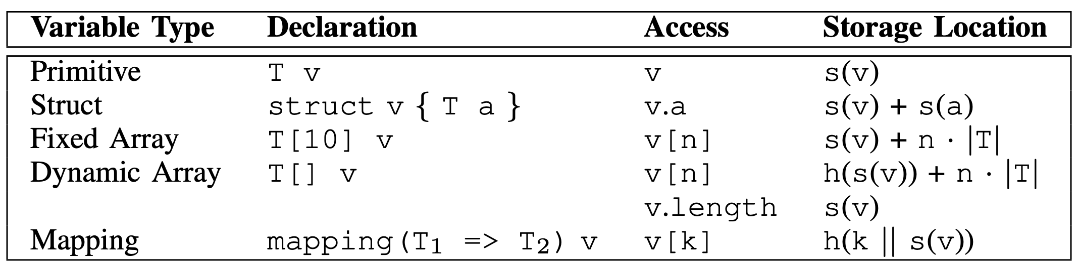
Data Dependency Analysis
Access to state variables is retrieved dynamically via SLOAD and SSTORE instructions.
Retrieve storage variable from storage location:
  Statically-sized:
    Includes: primitives, structs, and fixed arrays.
    Pop first element from stack.
  Dynamically-sized:
    Mappings: Map result of SHA3 instruction to memory contents and only extract the last 32
    bytes (concatenation).
    Dynamic Arrays: keep track of arithmetic additions of SHA3 hashes.
7

Slide 8
Evaluation

Slide 9
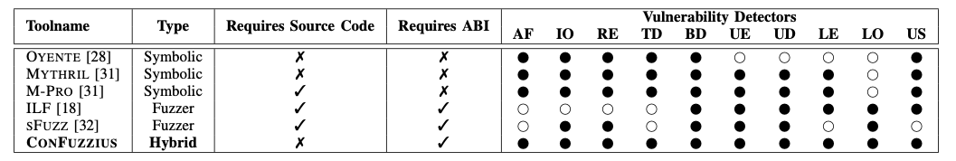
Datasets, Baselines, and Experimental Setup
Datasets
  Real-World dataset
    21,147 contracts with source code from Etherscan.
    Clustered using k-means into a large cluster (3,344 contracts) and small cluster (17,803 contracts).
  Curated dataset
    Based on SmartBugs by Durieux et al. and extended with 5 additional types from SWC registry.
    128 contracts with 148 annotated vulnerabilities across 10 different types.
Baselines
Experimental Setup
10 runs with independent seeds with 10 min for small contracts and 1 hour for large contracts.
9

Slide 10
1st Research Question
RQ1: Does ConFuzzius achieve higher code coverage than current state-of-the art symbolic execution and fuzzing tools for smart contracts?
10

Slide 11
Code Coverage
ConFuzzius achieves highest code coverage:
  91% small contracts and 81% large contracts
  Every tool struggles with large contracts
  10% difference between small and large for ConFuzzius vs. 31% difference for symbolic execution tools (Mythril)
11

Slide 12
Code Coverage Over Time
ConFuzzius outperforms state-of-the art fuzzers:
  66% after 1 second on small contracts vs. 12% ILF and 15% sFuzz
  46% after 1 second on large contracts vs. 10% ILF and 11% sFuzz
12

Slide 13
2nd Research Question
RQ2: Does ConFuzzius discover more vulnerabilities than current state-of-the art symbolic execution and fuzzing tools for smart contracts?
13

Slide 14
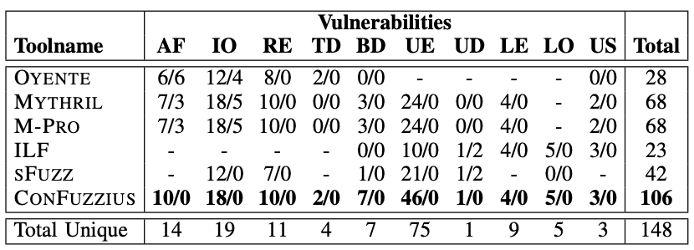
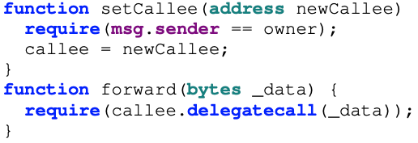
Vulnerability Detection
ConFuzzius detected most vulnerabilities (106/148).
All symbolic execution tools reported false positives, especially for integer overflows.
ConFuzzius does not report false positives.
ILF and sFuzz reported false positives for unsafe delegatecalls due to the imprecision of their detectors:
14

Slide 15
3rd Research Question
RQ3: How relevant are ConFuzzius’s individual components in terms of code coverage and vulnerability detection?
15

Slide 16
Component Evaluation
We randomly selected 100 contracts from each cluster and disabled each component separately.
Each component is an added value.
Constraint solving plays an essential part in coverage and vulnerability detection.
Environmental instrumentation is more relevant for detecting vulnerabilities.
Data dependency analysis allows to find 10% and 18% more vulnerabilities in small and large contracts, respectively.
16

Slide 17
Conclusion

Slide 18
Conclusion
We presented ConFuzzius – the first data dependency-aware hybrid fuzzer for smart contracts that tackles the following three challenges:
  Input generation: evolutionary fuzzing + constraint solving.
  Stateful exploration: read-after-write access patterns across state variables.
  Environmental dependencies: modelling block and contract information as fuzzable inputs.
We compared ConFuzzius against 2 fuzzers and 3 symbolic execution tools using a curated dataset of 128 contracts and a dataset of 21K real-world contracts.
ConFuzzius detects more bugs (up to 23%) and achieves higher code coverage (up to 69%).
Our data dependency analysis can boost the detection of bugs (up to 18%).
18

Slide 19


Questions?
All code & data is available on GitHub:
https://github.com/christoftorres/ConFuzzius
Contact information:
christof.torres@uni.lu
Supported by:

