Slide 1

Timely Identification of Victim Addresses in DeFi Attacks
Speaker:
  Bahareh Parhizkari (University of Luxembourg)
Co Authors:
  Antonio Ken Iannillo (University of Luxembourg), Christof Ferreira Torres (ETH Zurich), Joseph Xu (Quantstamp), Sebastian Banescu (Quantstamp), Radu State (University of Luxembourg)
Notes:
Thanks for coming to my presentation
I’m presenting my paper titled …

Slide 2
Objective
In this project, we’re analyzing malicious smart contracts of attacks on EVM-based DeFi protocols, and we aim to propose a solution to identify the victims before the execution of attack transactions.
What is DeFi?
  DeFi refers to financial projects based on decentralized blockchain and smart contracts, such as Decentralized exchanges, and lending and borrowing protocols.
What is EVM?
  Ethereum Virtual Machine (EVM) has been used in several blockchains, such as Ethereum for the execution of smart contracts, which are compiled to EVM bytecode.
Immunefi’s Reports: https://immunefi.com/research
Notes:
Let’s start with the final objective of our research
Just to clear up some terms,

Slide 3
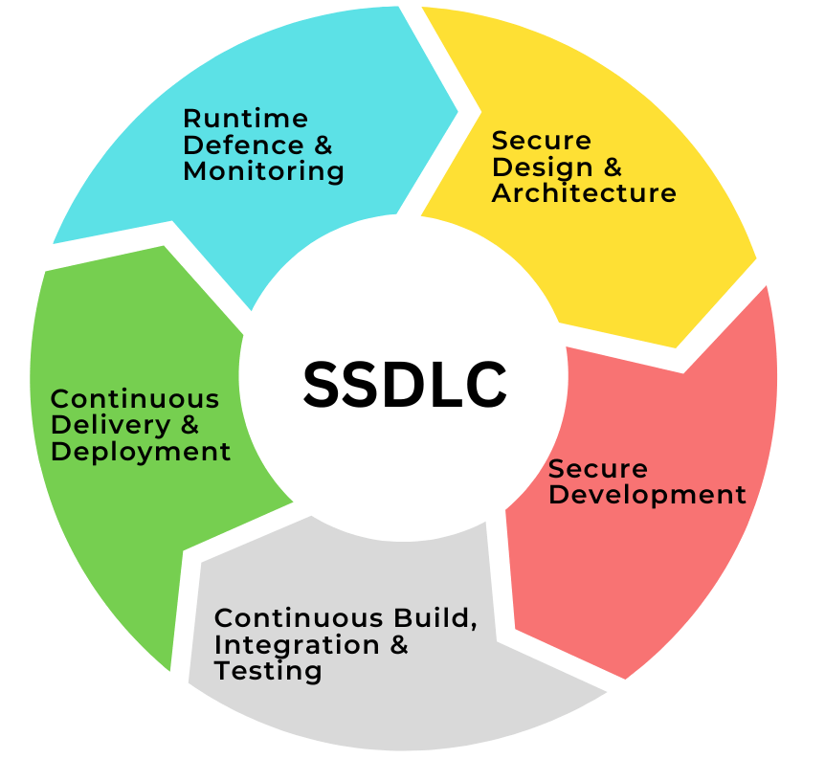


DeFi attacks and current countermeasures
There’s an exponential growth in the number of attacks on DeFi protocols.
  According to Immunefi’s crypto loss report, $3,773,906,837 was lost to hacks on Web3 Ecosystem in 2022.
Companies are currently employing several strategies to protect their products against these hacks, such as:
Achieving 100% security can never be guaranteed.
Secure development
practices
Security audits
  Bug bounties
Immunefi’s Reports: https://immunefi.com/research
Notes:
Let’s keep on with some backgrounds on Defi Attacks

Slide 4
DeFi attacks
We need to detect ongoing attacks and inform the victims as early as possible to take necessary actions for minimizing the financial damage.
When is the earliest time that we can detect an ongoing attack?
Notes:
This background shows the need for identifying

Slide 5
DeFi Attack Stages
The process of most attacks on DeFi can be divided into three main stages:
Deployment of malicious contract
Attack execution
Funds extraction
This stage is the earliest time we can
detect and stop the attack’s process.
Notes:
Let’s take a look at
Normally, an attacker perform the attack in …
An attack starts with…

Slide 6
Research Question: Identifying victim addresses
To confront attacks as early as possible, we need to:
Detect malicious smart contracts in the contract creation phase
Identify the victim’s address
Inform the victim
about the ongoing attack
There already exists some ongoing works and tools for this stage, such as Forta’s ML bot.
  RQ1: Can we identify Victim’s address before attack execution?
  RQ2: How?
In this research, we seek to find an answer for this question
Notes:
It’s time to explain our RQ…

Slide 7
How victim addresses are communicated
Attackers communicate victims’ addresses to attack contracts through one of these methods:
  Contract Creation:
    Hardcoding in the deployment bytecode.
    Importing them as the constructor’s input.
  Attack Execution:
    Sending as parameters of attack transaction.
In almost 80% of analyzed attacks, the attackers hardcoded the victim’s address in contract creation.
Notes:
To answer this question, we need to know how …

Slide 8
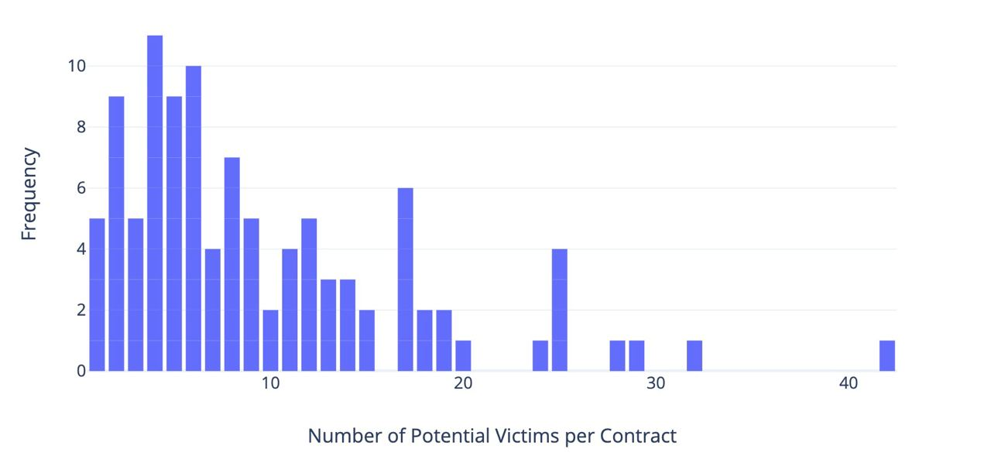
Number of potential victims in malicious smart contracts
Research Question: How can we identify the actual victim address among all hardcoded addresses?
Notes:
There’s som ething missing with this approach, assuming every hardcoded address as a potential victim
We should rephrase our rq:

Slide 9
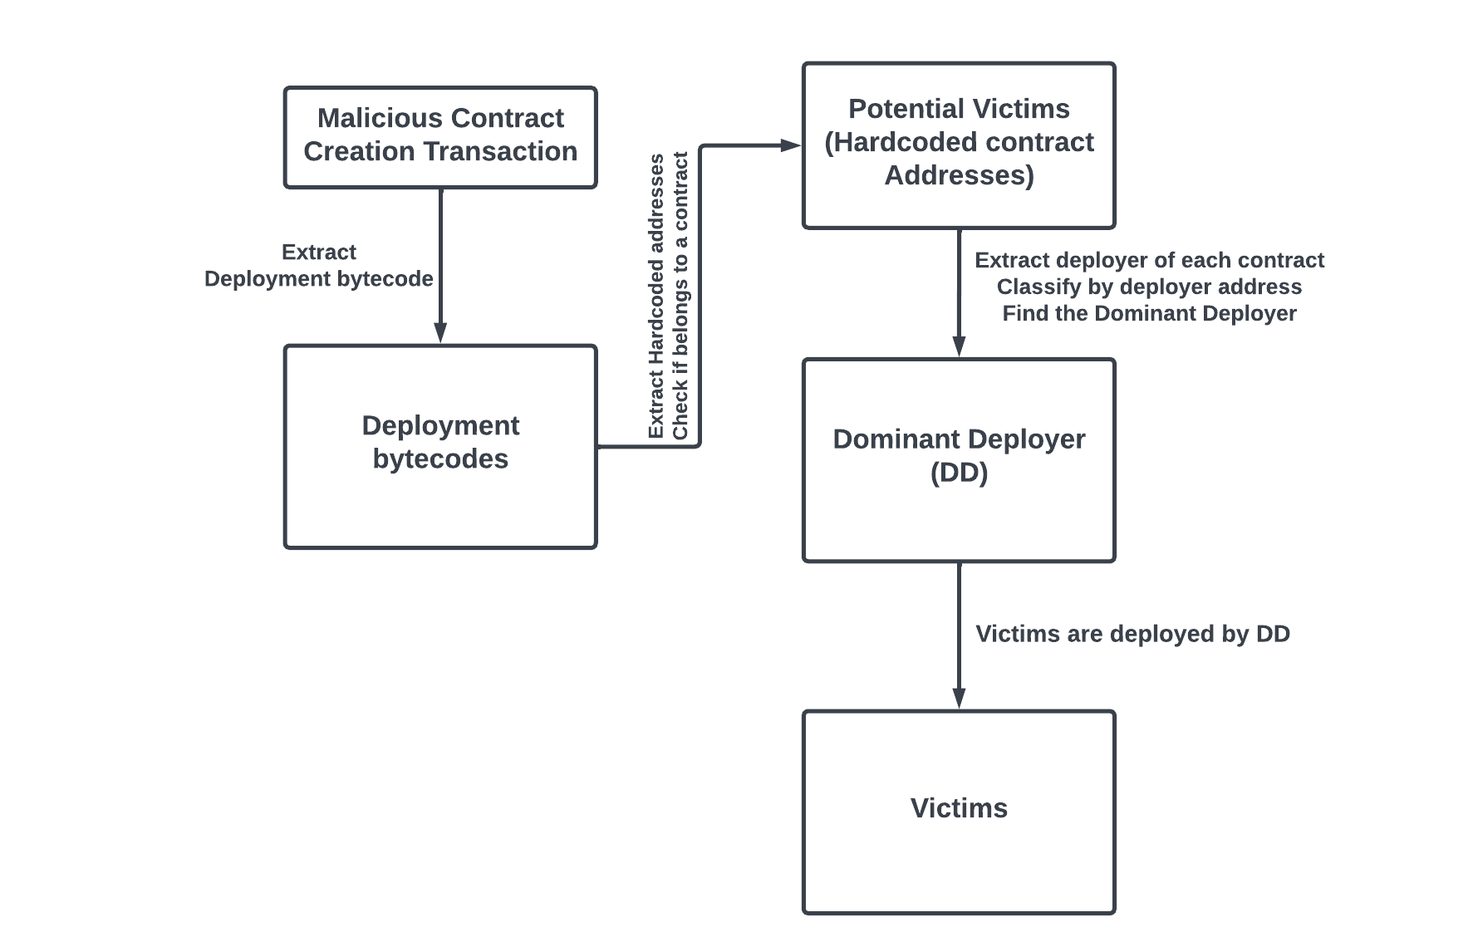
Methodology: Dominant Deployer Identification (DDI)
The DDI method focuses on the number of smart contracts deployed by each deployer.
Steps:
  Extract deployment bytecode of malicious smart contracts.
  Find all Potential Victims.
  Extract the deployer of each potential victim.
  Identifying the deployer associated with the highest number of deployed contracts (the Dominant Deployer).
  Designate all of these contracts as victims.
Notes:
To answer this question, we introduced a methodology and we named it

Slide 10
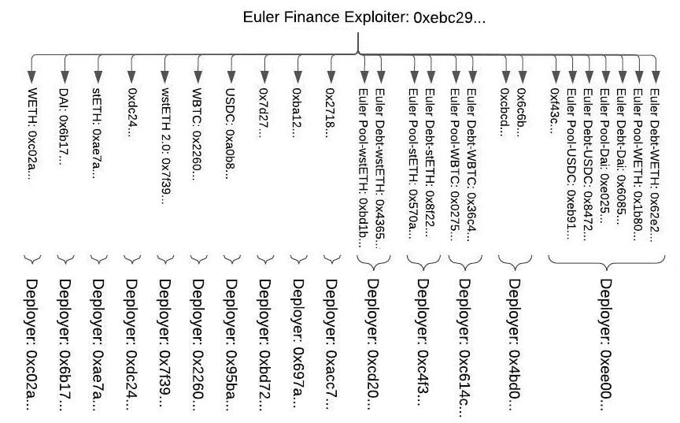
Sample Attack: Executing DDI on Euler Finance’s Exploiter Contract
Euler Finance is an Ethereum-based borrowing and lending platform.
It suffered from a Flash loan attack on 13th March 2023, resulting in a substantial loss of $196,000,000.
We analyzed Exploiter’s Smart Contract and extracted all potential victims.
Euler Finance Exploiter Smart Contract: 0xebc29…
Victims
We extracted 25 distinct potential victims.
Then we extracted the Deployer address of each potential victim.
Out of all these potential victims, only 5 unique deployers deployed 15.
7 potential victims are deployed by the same deployer address, all belonging to the victim project.
The Dominant Deployer
with 7 deployed contracts
Notes:
Let explain it a little bit more with an example

Slide 11
Methodology: Limitation of DDI
In cases where there is a tie between two or more different deployers for the highest number of deployed contracts, the method does not label any deployer as DD.
Example:
  The attack on Inverse Finance on 16.6.2022, where $1.2 million was drained.
  In this attack, we had 2 Dominant Deployers.
Deployer | Deployed Potential Victims | Is victim
0x3fcb35a1cbfb6007f9bc638d388958bc4550cb28 | 7fcb7dac61ee35b3d4a51117a7c58d53f0a8a670, 4dcf7407ae5c07f8681e1659f626e114a7667339, 865377367054516e17014ccded1e7d814edc9ce4, aa5a67c256e27a5d80712c51971408db3370927d | Yes
0xbabe61887f1de2713c6f97e567623453d3c79f67 | 6c3f90f043a72fa612cbac8115ee7e52bde6e490, c4ad29ba4b3c580e6d59105fff484999997675ff, d51a44d3fae010294c616388b506acda1bfaae46, bebc44782c7db0a1a60cb6fe97d0b483032ff1c7 | No
Notes:
But anyway, our methodology have a major limitation
Add an example for tie
$1.2 million by an attacker utilizing an oracle manipulation through a flash loan attack.

Slide 12
Methodology: DDI method with the ERC20 exclusion criterion
What is ERC20 exclusion Criterion?
  This method filter out ERC20 token contracts from the pool of potential victims associated with deployers.
Why?
  ERC20 tokens often use well-audited Libraries.
  They are more robust and secure.
  This filtering process assumes that reusing well-audited smart contract libraries reduces the risk of exploitation.
Deployer | Deployed Potential Victims | Is victim
0x3fcb35a1cbfb6007f9bc638d388958bc4550cb28 | 7fcb7dac61ee35b3d4a51117a7c58d53f0a8a670, 4dcf7407ae5c07f8681e1659f626e114a7667339, 865377367054516e17014ccded1e7d814edc9ce4, aa5a67c256e27a5d80712c51971408db3370927d | Yes
0xbabe61887f1de2713c6f97e567623453d3c79f67 | 6c3f90f043a72fa612cbac8115ee7e52bde6e490, c4ad29ba4b3c580e6d59105fff484999997675ff, d51a44d3fae010294c616388b506acda1bfaae46, bebc44782c7db0a1a60cb6fe97d0b483032ff1c7 | No
Notes:
The advantage of adding this filtering is
that it introduces an additional layer of consideration by prioritizing contracts
that are more likely to be secure. By excluding ERC20 tokens, the method focuses
on contracts with a higher likelihood of being victims. However, it is essential to
acknowledge that this method assumes ERC20 token contracts are more secure
due to extensive code audits. While this assumption is generally valid, it does
not guarantee absolute certainty

Slide 13
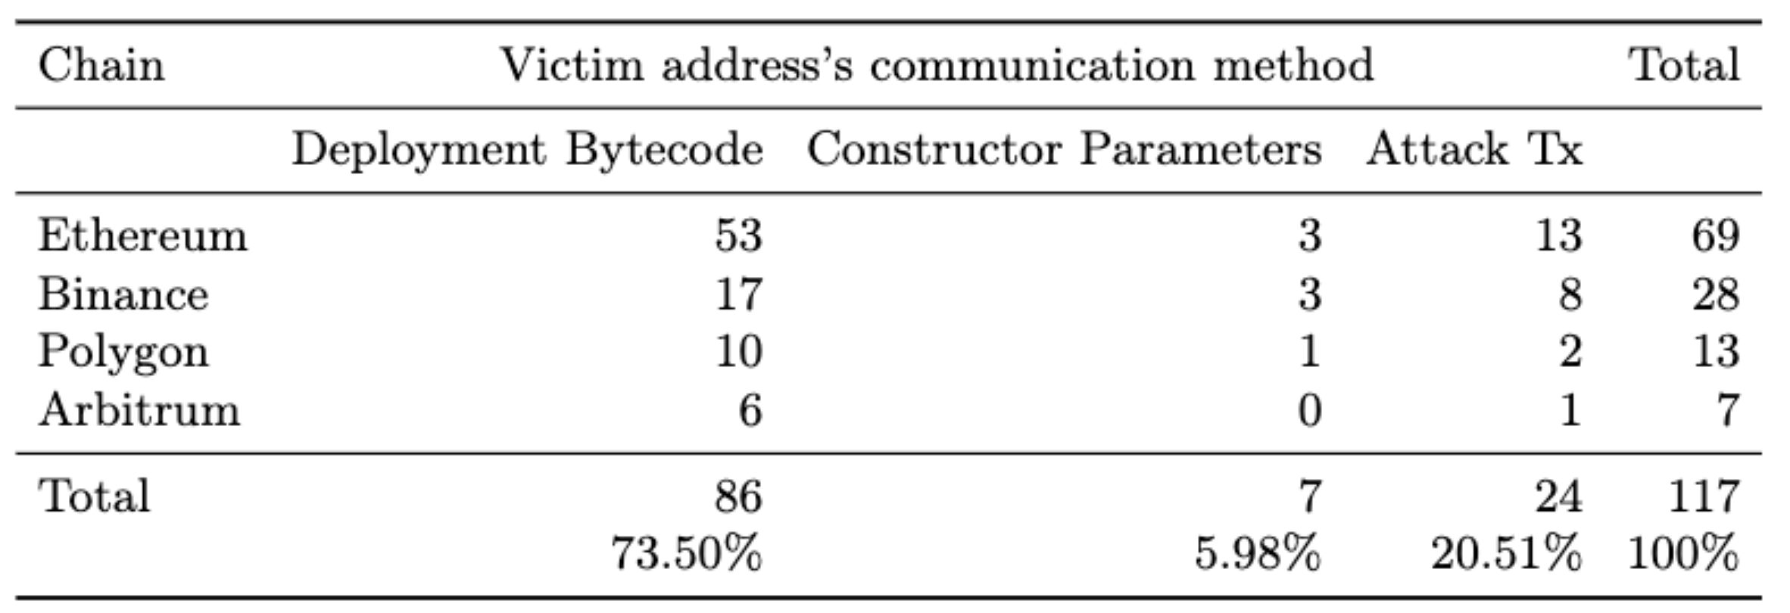
Dataset: Number and source of attack smart contracts in our Dataset
We manually collected a dataset of 117 attacks, occurred between 2020-2023.
We analyzed the attacks on DeFi, documented in the DeFiYield’s Rekt database.
Rekt Database: https://de.fi/rekt-database
Notes:
For evaluating our methodology, we first needed a dataset

Slide 14
Dataset: Number and source of attack smart contracts in our Dataset
Deployment of malicious contract
Attack execution
Funds extraction
In almost 80% of attacks, victim address
is communicated in this stage
In the remaining 20% of attacks, victim address
Remains unknown until this stage.
Notes:
In the deployment stage, the attacker deploys a malicious smart contract onto
the blockchain. The smart contract contains the logic and instructions required
to exploit vulnerabilities contained within the victim’s smart contract.
After deployment, the attacker executes the attack by triggering the logic
contained in the malicious smart contract. This can be performed either at de-
ployment time via the constructor or via a separate transaction. The constructor
embeds code that is executed only once, namely during deployment. Attackers
might embed the attack logic within the constructor itself to execute the attack
during deployment. Alternatively, the attacker embeds the attack logic into a
normal function and invokes it via a separate transaction after the malicious
contract has been deployed. This method gives the attacker more control over
the timing of the attack. It may be used to exploit more complex vulnerabilities
or to coordinate with other events on the blockchain. During the attack execu-
tion, the malicious contract may interact with the victim contracts in various
ways, such as by manipulating oracle data, performing reentrancy attacks, or
exploiting flaws in the business logic of the contract to bypass access control
checks, all aiming to create an illicit advantage for the attacker.
After the successful exploitation, the attacker seeks ways to extract the il-
legally obtained funds or assets. This might involve: extracting funds directly
to the attacker’s wallet address, using additional smart contracts to obscure
the source of the transactions to make tracing more difficult, or converting the
stolen assets through decentralized exchanges and mixing services to obfuscate
the traces further

Slide 15
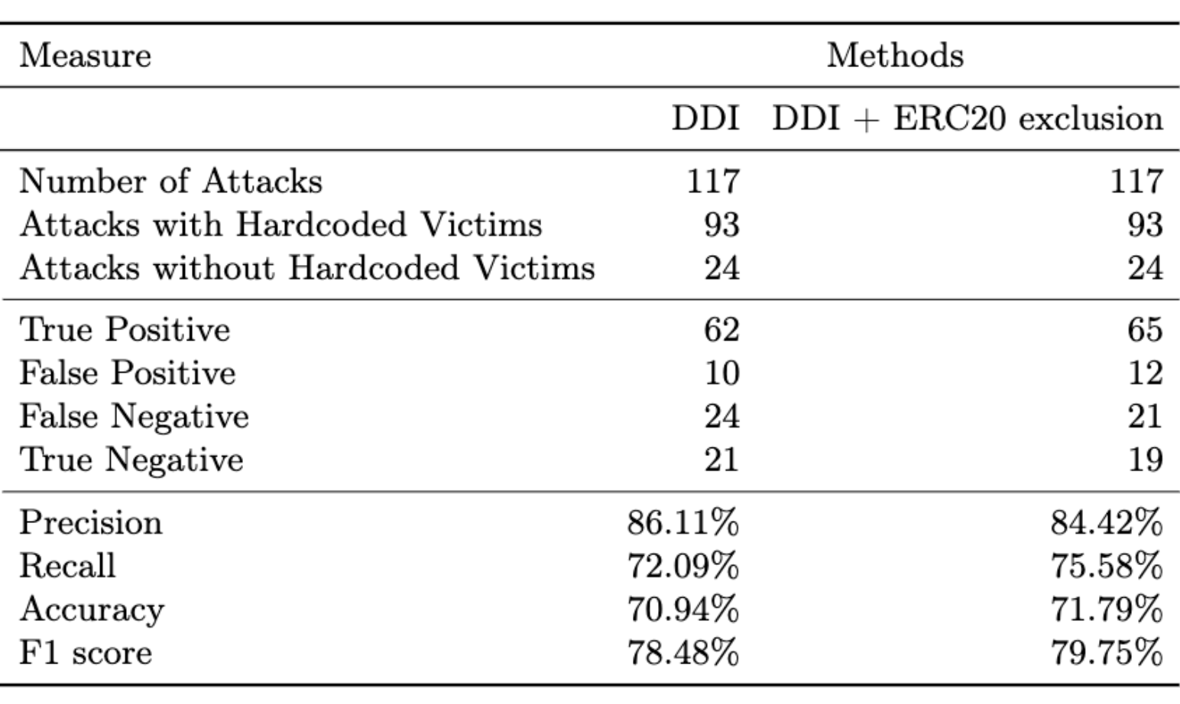
Results
Definitions:
True Positive: We successfully identified the victim.
False Positive: We identified an address, but it’s not the actual victim.
False Negative: We didn’t identify any victim, but the victim address was present.
True Negative: We didn’t identify any victim, and the victim address was not present.

Slide 16
Conclusion
We investigated whether we can identify victims of attacks by analyzing the deployment bytecode of malicious smart contracts.
In our future research, we aim to identify the victim’s address in attacks where the victim’s address is not available before executing the attack transaction.

Slide 17
Thank you
Bahareh Parhizkari
Email: bahareh.parhizkari@uni.lu
Notes:
quantstamp-h.jpg

Slide 18
Private pools: Definition
Maximal Extractable Value (MEV)
  This concept refers to the profit a block producer can make through their ability to include, exclude, or reorder transactions within certain blocks.
Private pools (such as Flashbots)
  It aim to mitigate the negative externalities of MEV.
  Private pools allow users to send their transactions directly to block producers without broadcasting them via the public mempool.
Attackers can leverage private pools to conduct their malicious activities with more privacy and precision.
Notes:
Maximal Extractable Value (MEV) is a concept that refers to the profit a user
can make through their ability to include, exclude, or reorder transactions within
certain blocks [22]. For instance, users can engage in practices like front-running,
where they observe a profitable transaction in the mempool and create another
transaction with a higher gas price to benefit from the knowledge of the pend-
ing transaction[31]. MEV has implications for blockchain security, fairness, and
transaction finality.
Flashbots [15] is a research and development organization aiming to miti-
gate the negative externalities of MEV. It provides a communication channel
called Flashbots Relay, through which users can send their transactions directly
to block producers without broadcasting them via the public mempool. This
mechanism allows for a more efficient way to capture MEV. In 2022, more than
80% of MEV extraction was happening via Flashbots and 13.2% was coming
from other private pools [31].
Attackers can also leverage private pools and transaction relay systems to
conduct their malicious activities with more privacy and precision [21]. Indeed,
private pools allow transactions to be executed privately before being broadcast
to the public blockchain. Thus, attackers can hide their activities until the attack
has been completed, obscuring the malicious contract’s interactions from any
tools that monitor the public mempool. Some private transaction pool providers,
such as Flashbots and Eden Networks are already operating on Ethereum, and
we expect this trend to grow in other chains, either

Slide 19
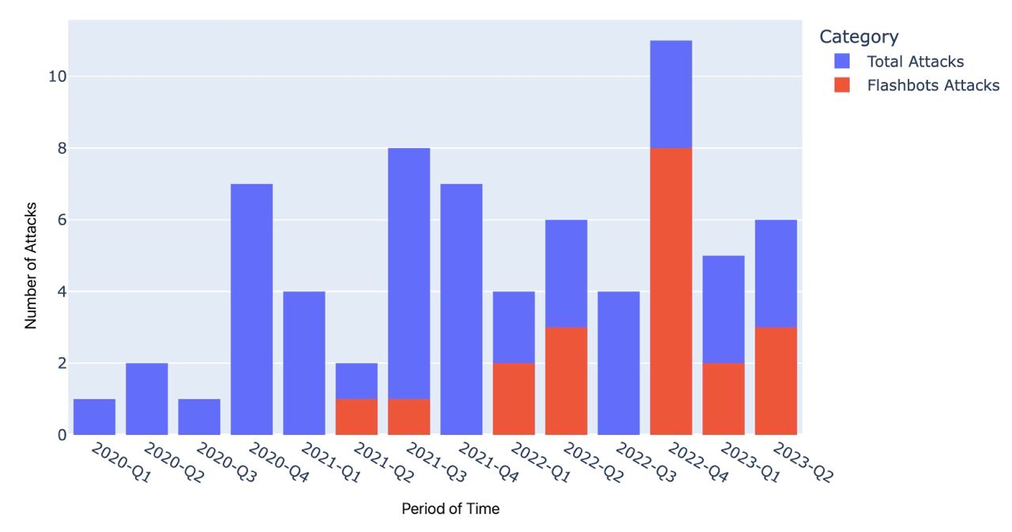
Trend of Attacks on Private Pools
The progression of attacks performed through private pools and on Ethereum over time, compared to the total number of attacks.
Each bar represents the number of attacks that occurred within one quarter of the year.

