Slide 1


Network Function Virtualization: Challenges and
Directions for Reliability Assurance
D. Cotroneo, L. De Simone, A.K. Iannillo, A. Lanzaro, R. Natella
Jiang Fan, Wang Ping
Università degli Studi di Napoli Federico II, Italy
Huawei Technologies Co., China

Slide 2
Outline
Introduction
Market’s trend
NFV: Opportunities and Challanges
Reliability Evaluation Project
Future Directions

Slide 3
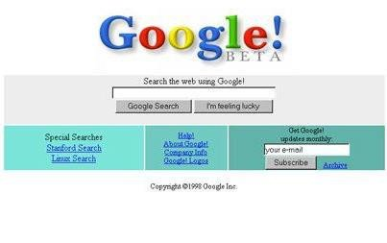
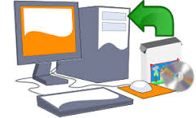
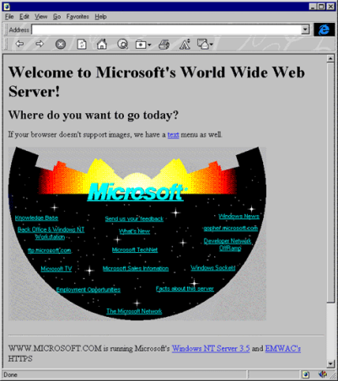

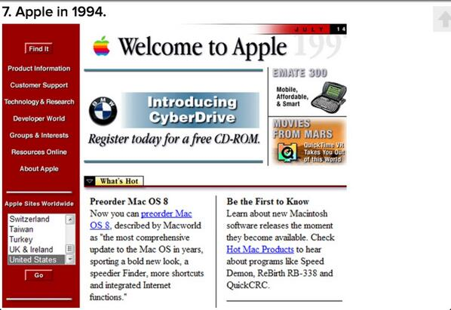

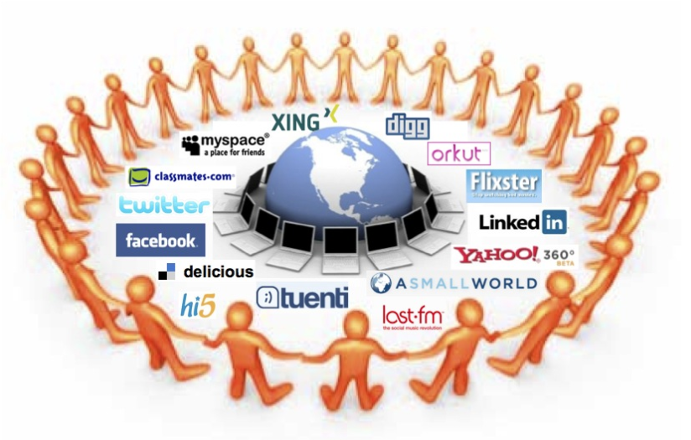


New scenario in telecom world
Some years ago…
Today…
How do Telco operators meet new traffic demands?
Notes:
More and more etherogeneus devices connected to the network
Tablets, smartphones, PCs
Demanding services
Video streaming, IPTV, VoiceOverIP
performance, space, consumption
Needs of reducing time-to-market

Slide 4
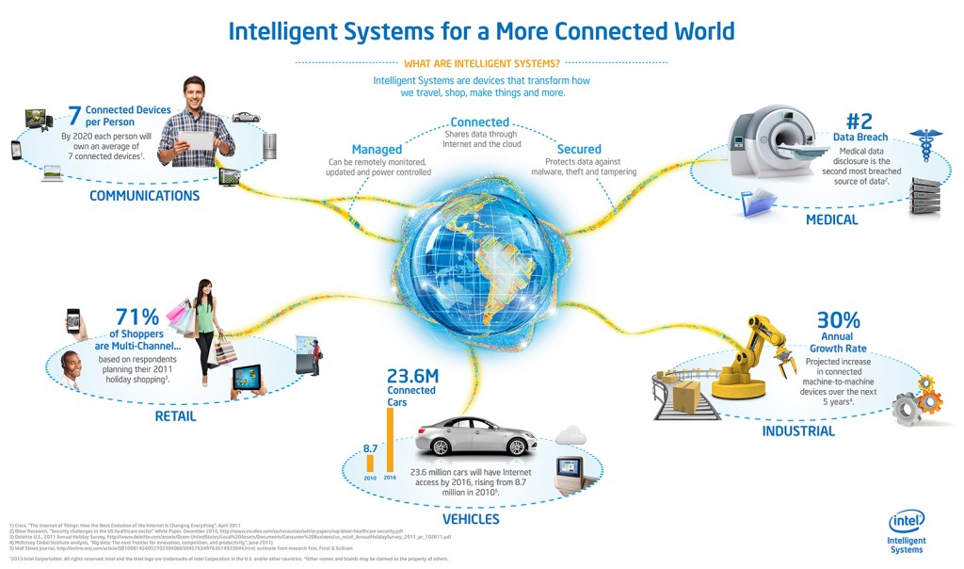

Slide 5
Rethink network architecture
Lower acquisition and mantainance costs
Reduce software dependency on expensive proprietary hardware
  routers, firewall, gateway, content delivery network, intrusion detection systems
Reduce capital and operational expenses (CAPEX and OPEX)
Increasing the agility of the network to respond to dynamic requirements
Faster development cycles
Notes:
Reduced operator CAPEX and OPEX through reduced equipment costs and reduced power consumption
Reduced time-to-market to deploy new network services
Improved return on investment from new services
Greater flexibility to scale up, scale down or evolve services
Openness to the virtual appliance market and pure software entrants
Opportunities to trial and deploy new innovative services at lower risk

Slide 6
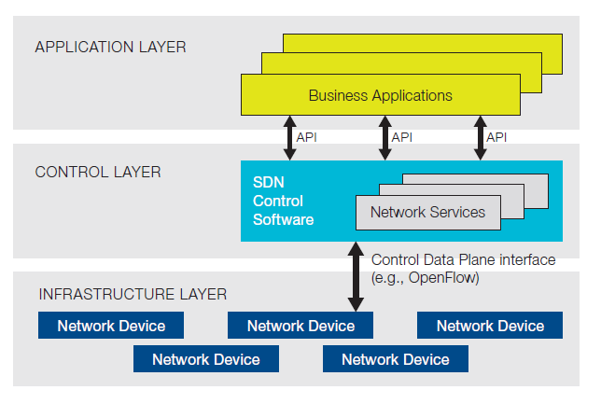
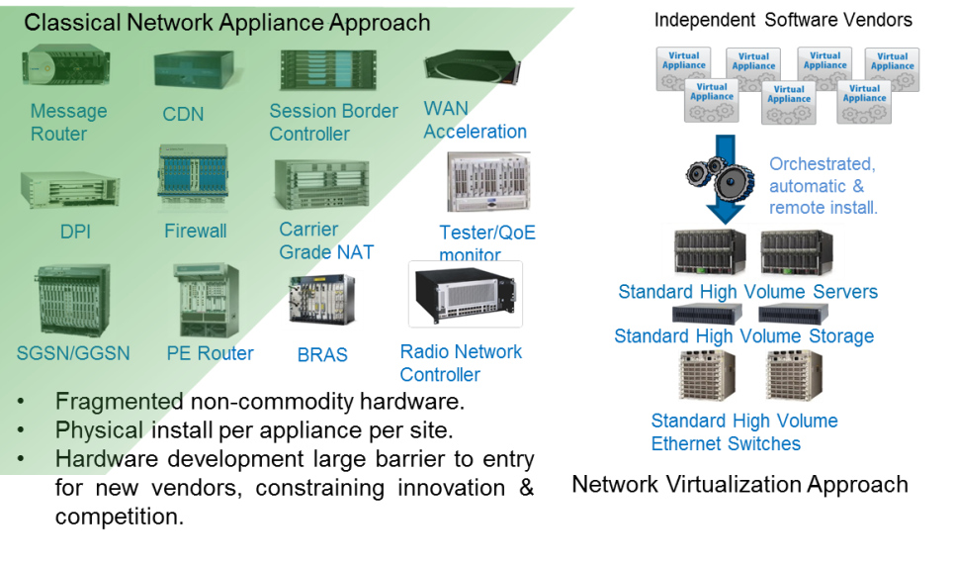
Emerging technologies
SDN: separation of Software (e.g., control plane) from Hardware (e.g. data plane, packets forwarding)
NFV: virtualization of network functions (e.g. middle-boxes) for a dynamic allocation and execution on general purpose Hardware.
6

Slide 7
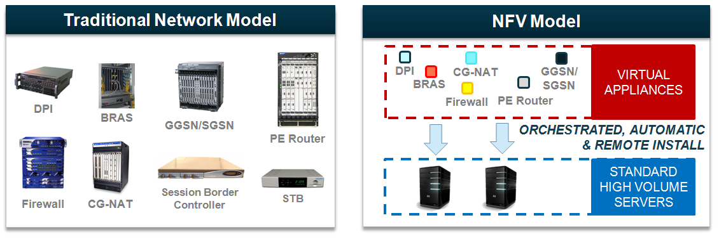
Softwarization of Network Functions
Virtualization technologies enable network virtualization decoupling network function’s software from underlying hardware

Slide 8





Web Cloud is Easier Than Telco Cloud
Commercial Virtualization Technologies Were Not Made for RTC
Web Cloud
Telco Cloud
Stateless
Light uplink, heavy downlink
TCP
TLS
Processing bursts
Queued
Cached content
Layers 5-7
Stateful
Heavy uplink & downlink
UDP
IPsec
Continuous processing
Instantaneous
Real time streams
Layers 3-7
Notes:
But, NFV is not that easy..

Slide 9

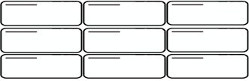
Virtualization comes at a cost for RTC
Latency and Jitter increase with each additional layer
Reduced media handling capacity vs. purpose-built platforms
Requires new optimization, streamlining
Forwarding Plane
Interface Drivers
Forwarding Plane
Hypervisor
Forwarding Plane
Interface Drivers
Hypervisor Drivers
AP6300
Generic CPU
Purpose-built
COTS
VM
Notes:
Adds complexity and demands optimization
IT ecosystem is just starting to consider RTC requirements
Media-based functions are the hardest to virtualize
Telco-specific benefits will take time to realize
Purpose-built hardware will continue to play a significant role for the foreseeable future

Slide 10

































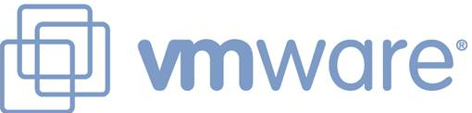



ETSI NVF-ISG
Global operators-led Industry Specification Group (ISG) under the auspices of ETSI

Slide 11
ETSI NFV Working Groups
Infrastructure Architecture
Management
& Orchestration
Performance
&
Portability
Security
Software Architecture
ETSI NFV ISG
Reliability
&
Availability

Slide 12
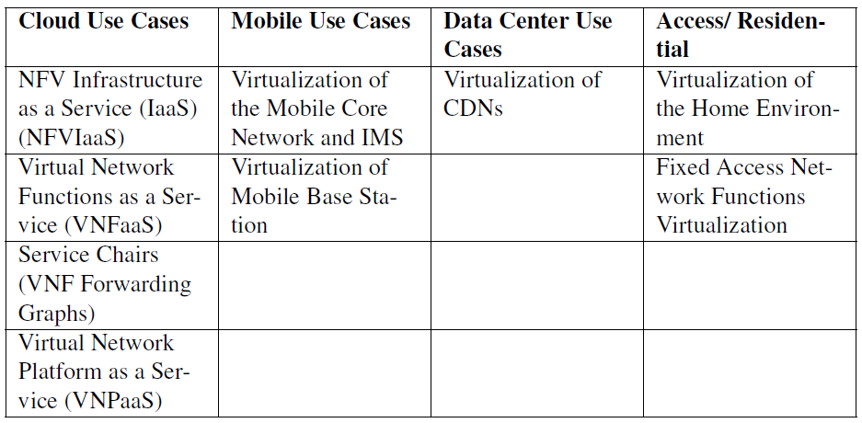
NFV Scenarios

Slide 13
NFVI Architecture

Slide 14
NFVI Reliability Requirements

Slide 15
Dependability Threats

Slide 16
Our Objective
Reliability Evaluation
What are the risks of leveraging on virtualization technologies in NFV infrastructures?
How can we predict and mitigate the impact of faults arising from virtualization technologies?

Slide 17
System Concept
System Design
System Development
System Verification
System Deployment and Operation
Establish Reliability Requirements
Requirements and analysis drive reliability test planning
Product release
Qualitative/quantitative Reliability Modeling and Analysis
System design, development, and test
Fault Injection Testing
Reliability improvement over releases
Reliability Monitoring
Performance and Stress Testing

Slide 18
Fault Injection
VM
Hypervisor
Cloud
?

Slide 19
Challenges of injecting fault in NFVI
Black-box and complex nature of virtualization technologies
Lack of well-established reliability evaluation criteria for NFVIs
Integration and interoperability

Slide 20
Discussion

Slide 21
Future Directions
FMEA of virtualization technologies in NFVIs
  hardware failures, software and configuration faults that can impact on virtualized resources
Definition of Key Performance Indicators and Methodologies for NFVI reliability
  measures for fault tolerance and performance, and provide guidelines to systematically assess reliability
Design of novel Fault Injection Techniques
Validation using NFV products and technologies

