Slide 1
The Software Aging and Rejuvenation Repository
http://openscience.us/repo/software-aging/
Domenico Cotroneo, Antonio Ken Iannillo,
Roberto Natella, Roberto Pietrantuono, Stefano Russo

Slide 2
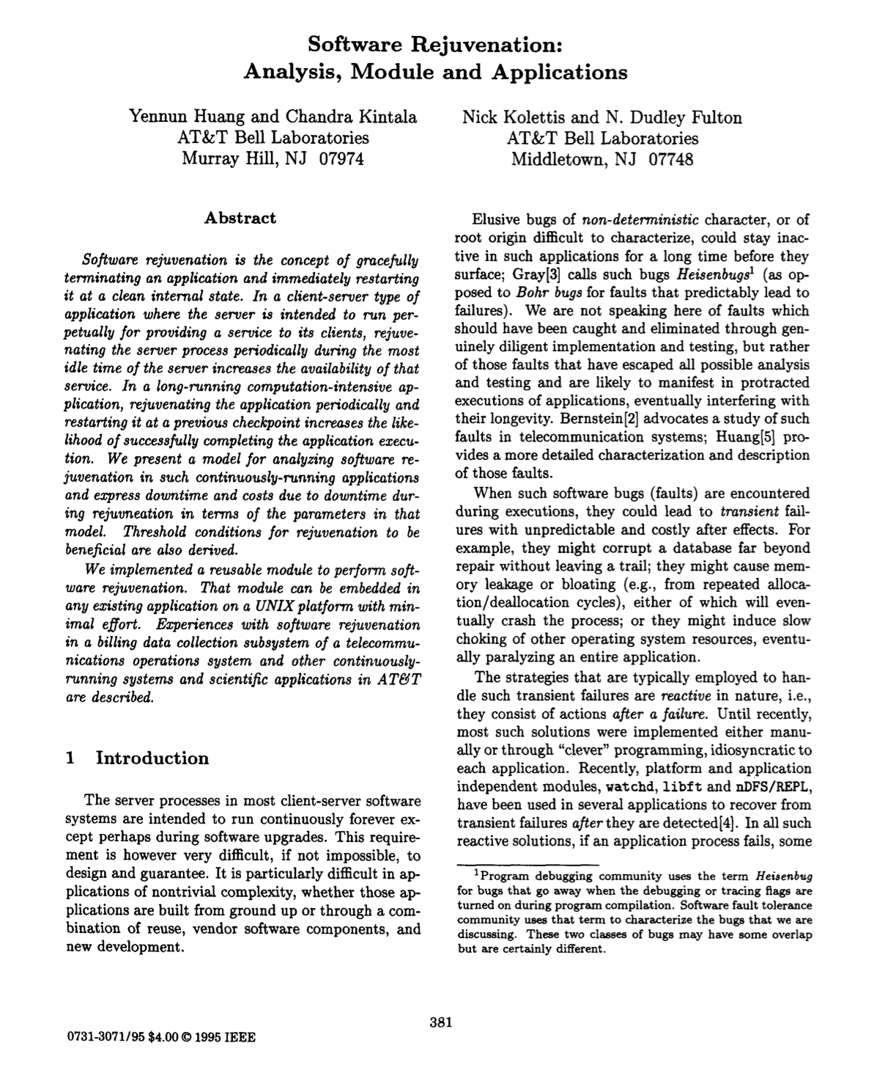
Software Aging and Rejuvenation (SAR)
Since the seminal paper by Huang et al., many people worked on SAR
  Several conference and journal papers
  WoSAR workshop series
  rejuvenation solutions in commercial IT products
  …

Slide 3
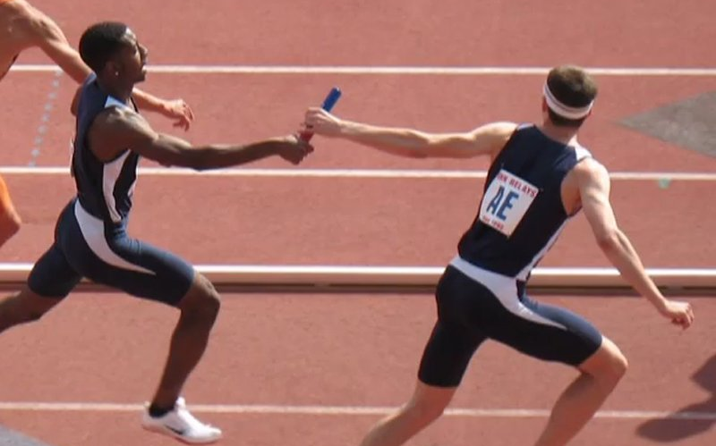
Science is a relay race
How do we let other researchers and IT practitioners to
  learn more about SAR when entering this field?
  reproduce and validate SAR research results?
  improve over existing SAR solutions?
Papers, papers, and more papers …

Slide 4
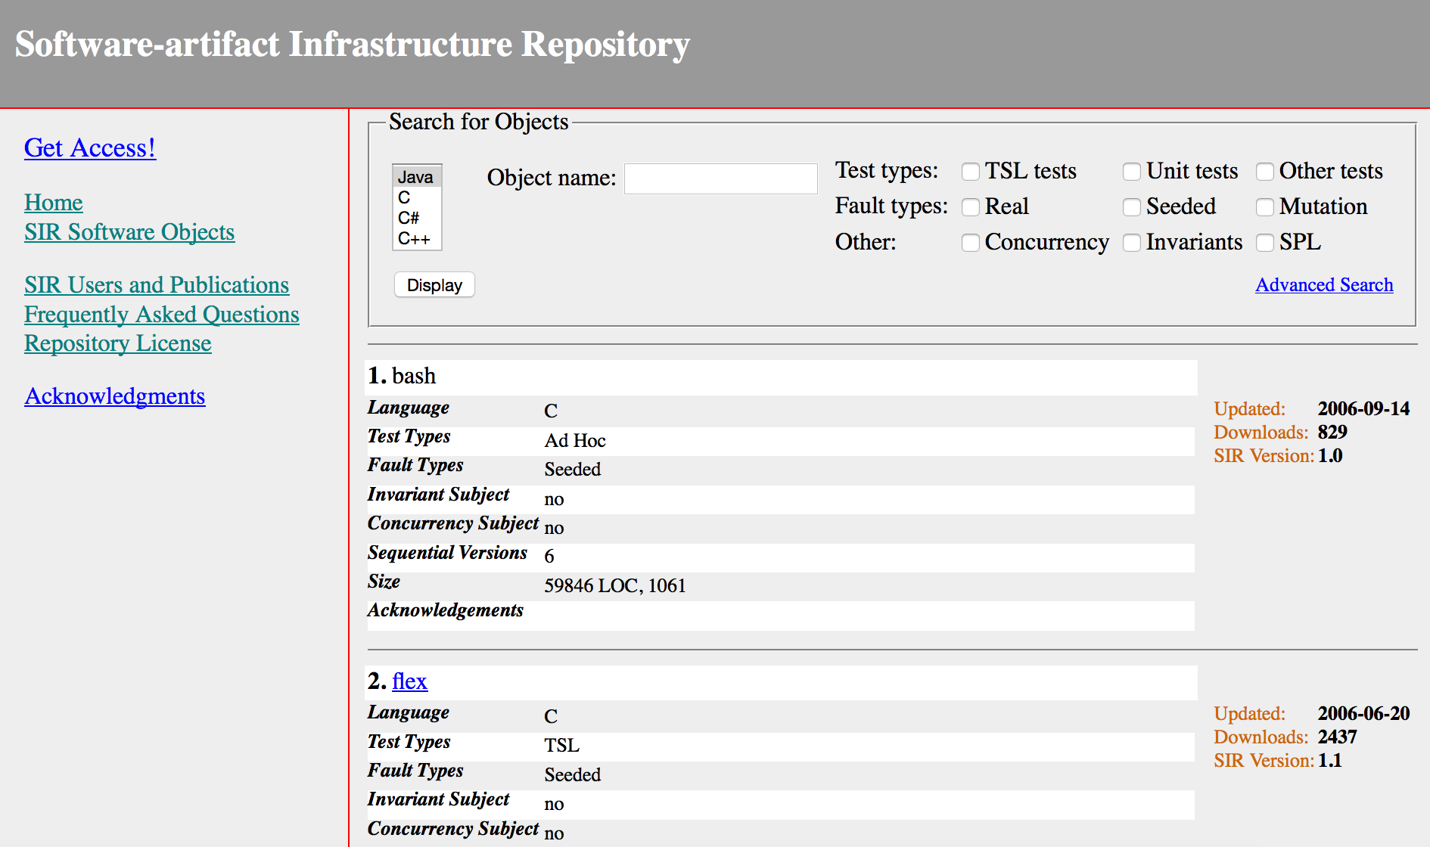
Sharing Artifacts - SIR
Software-artifacts Infrastructure Repository (SIR):
Small/medium size programs
Test cases
Real and seeded bugs
600+ citing publications

Slide 5

Sharing Artifacts - AMBER
The AMBER data repository:
Fault injection experiments in embedded systems, DBMS, and networks
Field failure data analysis
Support and tools in the back-end for data sanitization and mining

Slide 6
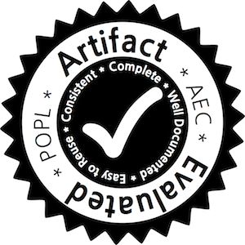
Sharing Artifacts - AECs
Artifact Evaluation Committees (AECs):
Special track of top CS conferences
Authors can submit artifacts related to their papers (experimental data, test suites, or tools, …)
Artifacts are evaluated by a committee and published

Slide 7

Sharing Artifacts - PROMISE
The Promise Repository of Empirical Software Engineering Data (PROMISE):
Born from the NASA MDP dataset for research on software metrics and defect prediction
Quickly grew to cover many SE topics (effort estimation, search-based SE, SE social analysis, …)

Slide 8
The Software Aging and Rejuvenation RepositorY (SARRY)
SARRY is an open-access repository for the SAR community
Sharing is a valuable opportunity to improve the visibility and the impact of SAR research
In this talk, we would like to discuss with you:
  What is a SAR research artifact?
  How other people can leverage on these artifacts?
  How we can disseminate artifacts to the community?

Slide 9
SAR research artifacts
Performance, resource, and failure measurements from deployed software systems
Performance, resource, and failure measurements from stress tests
Software complexity metrics of complex systems, and their aging-related bugs
Models for software rejuvenation scheduling

Slide 10
Performance, resource, and failure measurements from deployed software systems
Related Studies
Garg et al. [12] collected data using SNMP from a LAN of UNIX workstations for 53 days
Derived Studies
Vaidyanathan et al. [13] proposed a workload-based TTE forecasting
Validated on data from Garg et al. [12]
Artifact Nature
Time series (in CSV format) of resource consumption, response time, workload indicators, and failures
Aging trends and failures
[12] S. Garg, et al., “A methodology for detection and estimation of software aging,” ISSRE 1998
[13] K. Vaidyanathan and K. S. Trivedi, “A measurement-based model for estimation of resource exhaustion in operational software systems,” ISSRE 1999

Slide 11
Performance, resource, and failure measurements from stress tests
Related Studies
Derived Studies
El-Shishiny et al. [16] used neural networks for TTE forecasting
Artifact Nature
Time series (in CSV format) with a rich set of system metrics
Grottke et al. [14] studied resource consumption trends in the Apache web server, stressed for 25 days
Workload is a controllable factor
Data from Grottke et al. [14] for training and evaluating the prediction
[14] M. Grottke et al., “Analysis of software aging in a web server,” IEEE Transactions on Reliability, vol. 55, no. 3, 2006
[16] H. El-Shishiny et al., “Mining software aging patterns by artificial neural networks,” ANNPR 2008

Slide 12
Software complexity metrics of complex systems, and their aging-related bugs
Related Studies
Derived Studies
Xia et al. [20] used a text mining algorithm to automatically classify bug reports into Mandel/Bohrbugs
Artifact Nature
List of Mandelbugs, and attributes (e.g., complexity metrics) of their source code (in CSV format)
Cotroneo et al. [19] collected bug reports from OSS project, classified them into Mandel/Bohrbugs, and related them to complexity metrics
[19] D. Cotroneo et al., “Fault triggers in open-source software: An experience report,” ISSRE 2013
[20] X. Xia et al., “Automatic defect categorization based on fault triggering conditions,” ICECCS 2014

Slide 13
Models for software rejuvenation scheduling
Related Studies
Derived Studies
Castelli et al. [26] designed a rejuvenation agent for clusters managed with IBM Director
Artifact Nature
Models of a system (Markov chains, Petri nets, …) under software aging and rejuvenation
Vaidyanathan et al. [25] proposed an SRN model of cluster systems with software rejuvenation
The analysis can be replicated with tools such as SHARPE and GreatSPN
[25] K. Vaidyanathan et al., “Analysis and implementation of software rejuvenation in cluster systems,” ACM SIGMETRICS 2001
[26] V. Castelli et al., “Proactive management of software aging,” IBM Journal of Research and Development, vol. 45, no. 2, 2001

Slide 14
SARRY on PROMISE
SARRY joined the Openscience tera-PROMISE, a big and well-established repository for SE artifacts
  a network of researchers, with the financial and technical support of their institutions
We wanted to assure the long-term availability of SAR artifacts
We worked with the maintainers of PROMISE to add a new category for SAR research
  with sub-categories for different types of SAR artifacts

Slide 15
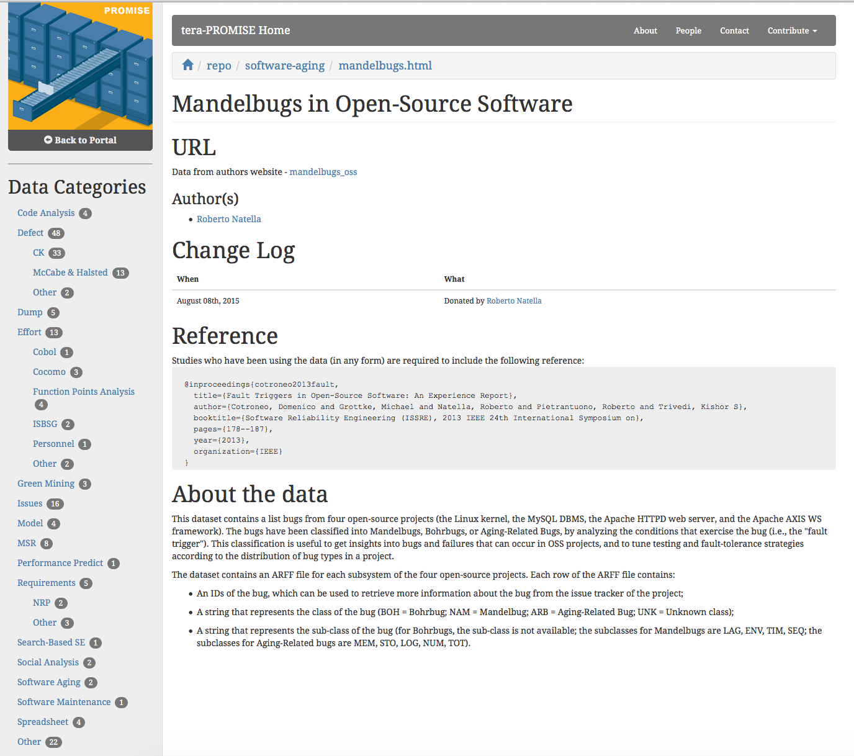
http://openscience.us/repo/software-aging

Slide 16
Submitting an artifact to SARRY
The repository is open to researchers that want to contribute with new artifacts, by providing:
  Files with the raw data or models
  The category of the artifact
  Description of the structure of the file, and of possible uses
  A bibliographic reference
You can either fill the online form on the website (specifying the “Software Aging” category), or contact us for support

Slide 17
Conclusion
SAR is a well-established research area, but still lacks a “sharing culture” to let people benefit from SAR studies
To promote sharing, we created SARRY and proposed a set of SAR artifacts
We invite SAR researchers to join us in populating SARRY!
Acknowledgments:
  Rahul Krishna and Tim Menzies for their support with PROMISE
  Michael Grottke and Kishor Trivedi for agreeing to share initial SAR artifacts

Slide 18
QUESTIONS?
Other ideas for possible SAR artifacts to share?
Other dissemination channels to consider?
Possible synergies with traditional papers?
How to promote sharing in the SAR community?

