Slide 1
Auto-encoding Robot State
against Sensor Spoofing Attacks
Sean Rivera, Sofiane Lagraa, Antonio Ken Iannillo, Radu State
SnT, University of Luxembourg, Luxembourg
sean.rivera, sofiane.lagraa, antonioken.iannillo, radu.state@uni.lu

Slide 2
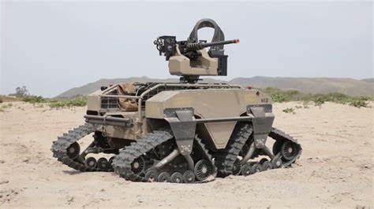

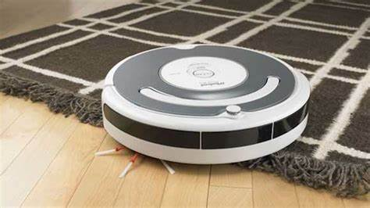
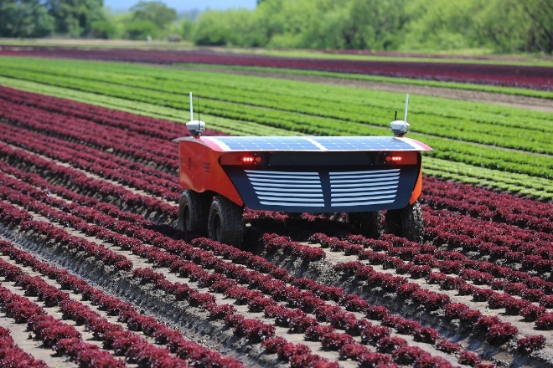
Context and Motivation – Problem Statement (1/2)
Robotic systems are proliferating in the world
  Military
  Industrial
  agricultural
  domestic robots
LIDAR is a common sensor type used by many different robotic systems
Notes:
1st, robots are used here and there
2nd, LIDAR sensors in most robots

Slide 3
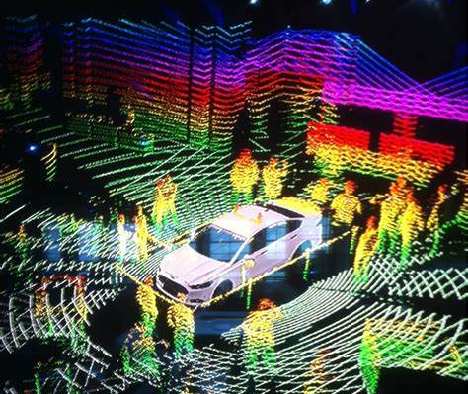
Context and Motivation – Problem Statement (2/2)
Robots depend on what they sense to make accurate predictions of the world.
  False LIDAR data confuse spatial markers
LIDAR is easy to confuse, and hard to detect
  Consider a mirror
  Purely timing based responses do not allow for cryptography
Notes:
1st, what is LIDAR (help with image)
2nd, false LIDAR data

Slide 4
Context and Motivation – Objective
Embedded systems have limited processing capability
  Any solutions must not be computationally heavy
The system must support multiple robots
Robots should be able to request information to validate potential spoofing

Slide 5
Context and Motivation – Solution
  We built an anomaly detection system on top of an autoencoder
    We encode both spatial and temporal position
    Encoded data can be shared between robots as it is compressed
  We created a sample dataset for LIDAR spoofing for future evaluations
    Better potential solutions going forward.

Slide 6
Spatial Correlations
Temporal Correlations
Assume that data is related in time
  Current points predictably follow from previous points
  Objects don’t teleport
We look at 100 samples of data
  Sampling rate of 6hrtz
Taking information from within a dataset.
  Relative Intensity of things and assumes objects are consistent in space
LiDaR data – objects assume to take more than one sample
  No nearby point

Slide 7
LIDAR Attacks
Percentage Spoofing | All input data shifted by a set %
Value Spoofing | All input data shifted by a set constant
Repeated Data Attack | A single frame of data is repeated constantly. New noise is added to mimic normal sensor noise
Repeated Data Window Attack | Data is repeated in a sliding window, creating a ‘lag’ effect
Sector Spoofing Attack | Online one part of the LIDAR data is interfered with. Broadcaster in space
Real World Spoofing Attack | A physical object generates the interference and doesn’t move with the robot
Frog Boiling Attack | A spoofing attack with very gradual changes, often below noise. Lead to large divergences eventually
Rotation Attack | Samples are rebroadcast from different sources. Similar to spinning the robot
Zero Replacement Attack | All samples replaced with 0, identical to blocking the LIDAR completely
NaN Replacement Attack | All samples replaced with NaN, identical to absorbing all emitted LIDAR
Table
External Internal
Internal Only
Notes:
Small text box, green both blue internal only

Slide 8
Autoencoder Architecture
Autoencoder: Uses Neural network to compress arbitrary data
Approach:
  3 encoders
    10, 20, 100 samples
  1 decoder
    Uses convolved input of encoders
    Creates greater weight for immediate data

Slide 9
Autoencoder Architecture
Input circular buffer of past 100 samples
  Buffer is zeroed out initially
Different compression ratios tested for encoder output

Slide 10
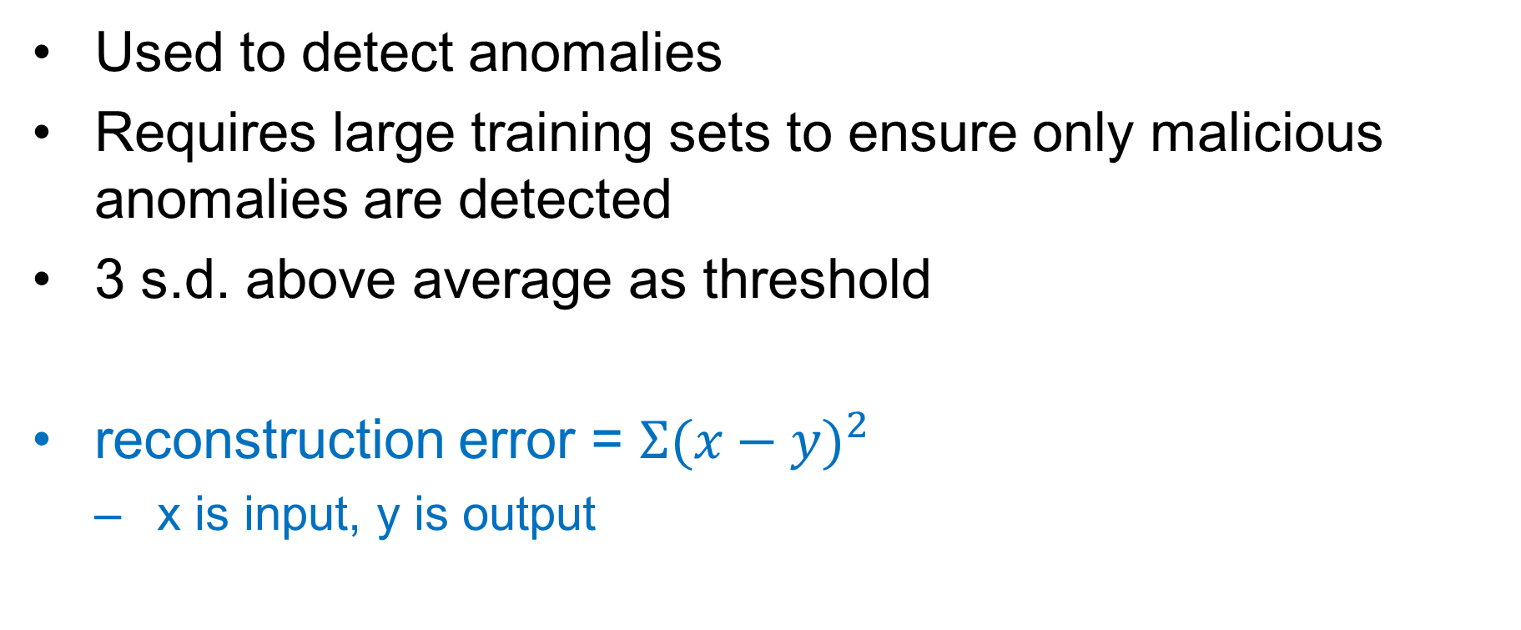
Reconstruction Error
Used to detect anomalies
Requires large training sets to ensure only malicious anomalies are detected
3 s.d. above average as threshold
reconstruction error = $Σ{(x−y)}^{2}$
  x is input, y is output

Slide 11
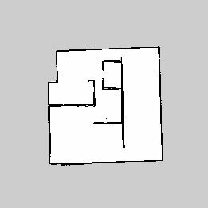
First Simulation
Built using Gazebo
3 simulated robots tasked to make a map
LIDAR data collected
Formed training data for experiment

Slide 12
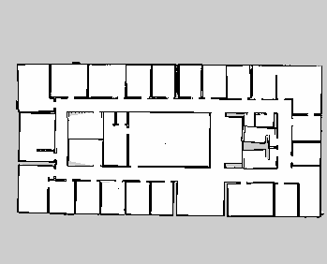
Second Simulation
Increase complexity
Test data for attacks
  All attacks inserted in middle
  Random location to confirm no detection
Additional robots added to allow for new situations

Slide 13
Model Training
Model fed with a single unattacked data set
  80/20 training test split
  100 sample buffers created with no consistent time
  5 different robots LIDAR data
Each different compression model was trained on the same data

Slide 14
Model Evaluation
Once the model has been fully trained we calculated the mean and standard deviation of the reconstruction error
These were stored along with the models for calibration
The models were logged and loaded onto the test robots

Slide 15
Experiments
All potential attacks applied to test data once at a time
Run through models and reconstruction error was recorded
Once a 3 s.d. reconstruction error was found, flag was raised and current sample number was recorded
Compared with truth reference to determine length of time for attack detection

Slide 16
Results
Dataset | First Simulation |  |  |  | Second Simulation
Compressed Data Size (from 720) | 80 | 150 | 300 | 600 | 80 | 150 | 300 | 600
State Space Saving | 89% | 79% | 58% | 17% | 89% | 79% | 58% | 17%
Percentage Spoofing | ND | 50 | 25 | 25 | ND | 75 | 25 | 25
Value Spoofing | 50 | 25 | 15 | 20 | 50 | 25 | 15 | 20
Rotation Attack | 10 | 10 | 5 | 5 | 20 | 10 | 10 | 5
Zero Replacement Attack | 10 | 10 | 10 | 10 | 10 | 10 | 10 | 10
NaN Replacement Attack | 0 | 0 | 0 | 0 | 5 | 5 | 0 | 0
Repeated Data Attack | ND | ND | ND | ND | ND | ND | ND | ND
Repeated Data Window Attack | ND | ND | 45 | 35 | ND | 45 | 35 | 25
Sector Spoofing Attack | 10 | 10 | 5 | 5 | 50 | 20 | 20 | 10
Real World Spoofing Attack | ND | 20 | 20 | 20 | ND | 50 | 20 | 20
Frog Boiling Attack | ND | ND | ND | 85 | ND | ND | ND | 90

Slide 17
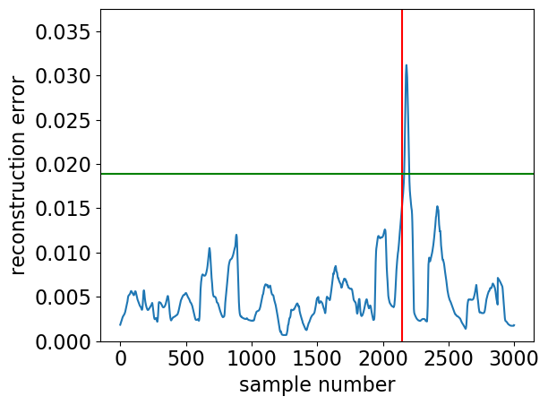
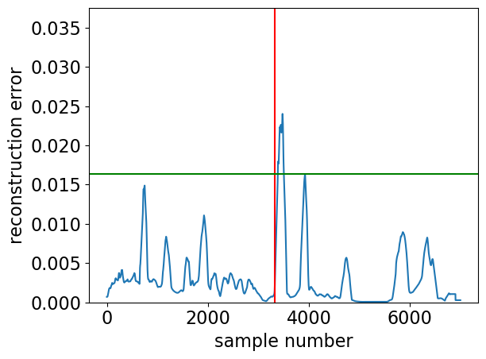
Results Real World Spoofing
Second Simulation
First Simulation
Compression 58%

Slide 18
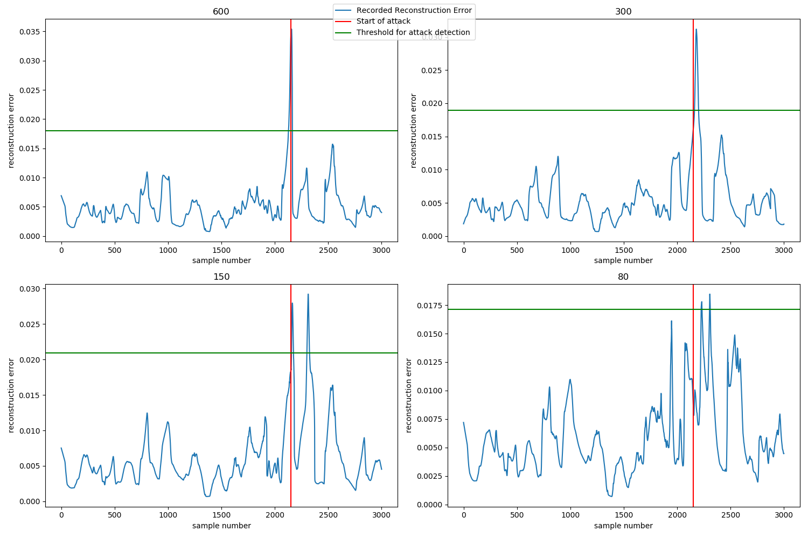
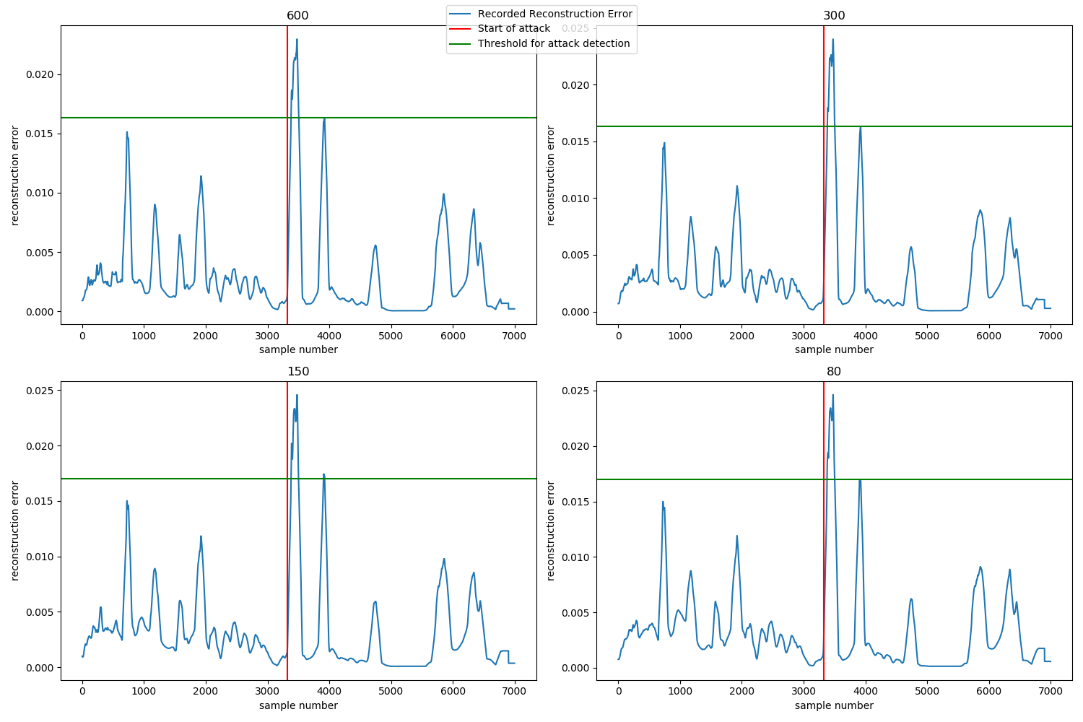
Results Real World Spoofing 2
Second Simulation
First Simulation
Notes:
Split them in some way.
For example, shw only one compression rate and explain the plot.
Then move to all the other plots.

Slide 19
Conclusion and Future works
  Autoencoders are a low overhead, efficient way to detect sensor spoofing
    Reconstruction error is an effective measure for issue detection
  In future we plan use autoencoder as hash function for sensor data.
    Distributed groups of robots can find issues and route around them
    Build a framework for detecting issues across heterogeneous groups

Slide 20
THANK YOU
sean.rivera@uni.lu

