Slide 1

A Fault Injection Tool for Java Software Applications
tesi di laurea magistrale a.a. 2012/2013
Antonio Ken Iannillo
M63000242
Relatore
Ch.mo Prof. Domenico Cotroneo
Relatore
Dott. Roberto Natella
Correlatore
Dott. Santonu Sarkar

Slide 2




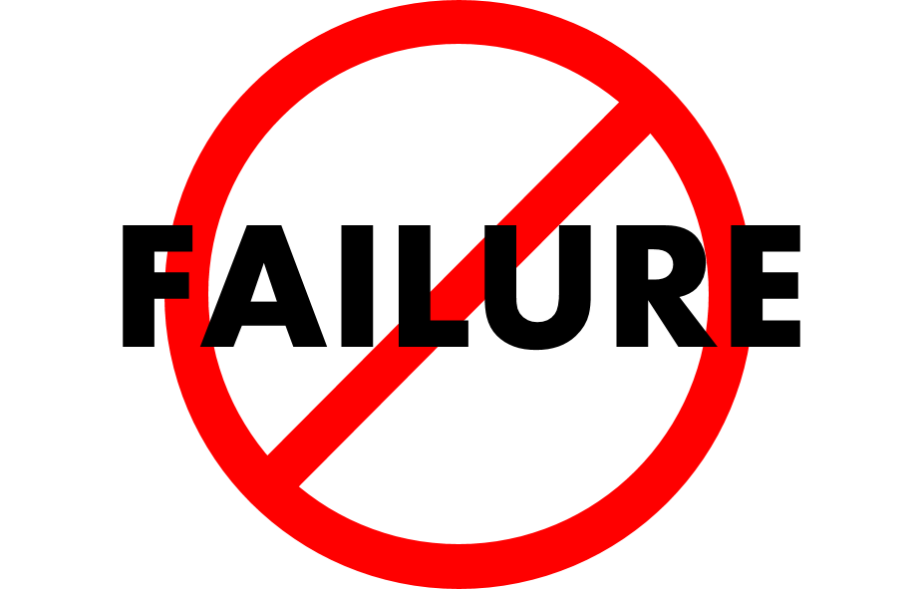






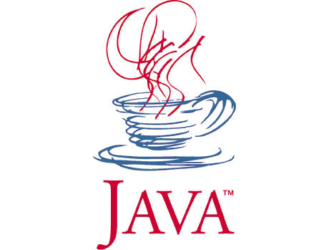

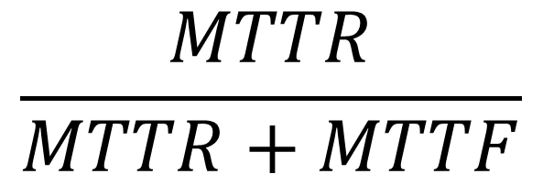
Business-critical Systems
Availability
$$\frac{MTTR}{MTTR+MTTF}$$
Un
Fault Tolerance
Notes:
Business-critical applications and why java:
The Business Critical Systems are systems whose accuracy (correctness) and integrity are essential to the successful operation of market or enterprise.
Java has an vast array of excellent libraries for solving most of the common problems one needs to solve when developing enterprise applications. In many cases, there is more than one good choice for addressing a particular need, and oftentimes those libraries are free and open source under a business-friendly license.
Availability:
Simply put, availability is the proportion of time a system is in a functioning condition. Actually, it is more convenient to use the complement measure of availability, namely, unavailability. Unavailability is the probability that an item will not operate correctly at a given time and under specified conditions. It can be calculated by the ratio MTTR/(MTTR+MTTF). For an enterprise, higher is the unavailability of its system, greater is the loss of money.
Fault tolerance:
A fault-tolerant design enables a system to continue its intended operation, possibly at a reduced level, rather than failing completely, when some part of the system fails. Fault Tolerant Algorithms and
Mechanisms (FTAM) give the confidence that the system will be able to deliver a proper service and can be both evaluated and improved by a campaign of fault injections experiments. The software fault injection, thus, reveals and improve the ability of the software to handle faults.

Slide 3





110100100101010001010101010101010000111101001110101010101110100101001010101011
110100100101010001010101010101010000111101001110101010101110100101001010101010
Fault Injection Tool
Injection
Fault Load
Utilities
Notes:
Tool
The goal of this work is to build a fault injector for Java programs. The tool gets as input the code of a Java software component, analyzes the input and extract all the information needed to profile the application and then create a copy of the archive file with a fault inside. It works with the bytecode, i.e. the binary executable on a JVM. It’s not necessary to have source code in order to inject faults. Faults can be injected in third party library or COTS. Faults are injected in a given component to evaluate the behavior of the overall system in the presence of that faulty component.
Fault Load
What is actually injected is called fault load, i.e. rules and operators for the simulation of the software faults. The design of operators is based on a previous work (Duraes and Madeira’s G-SWFIT) for C programs and extended for java technologies.
Utilities
The faults are injected at the bytecode level. The Java bytecode is the binary executable on a Java Virtual Machine (JVM). In order to understand and manipulate the byte code in a easier way, I developed some utilities upon a thir-party library called BCEL.

Slide 4


External Faults
Software Defects
Notes:
Faults to emulate
Internal faults represent the residual software faults, those that eluded all software test with the unawareness of where they are, when they will reveal, what could be the consequences. Bugs inside the code of a particular component, sometimes called software defects (these are persistent faults activated by particular sequence of inputs and use condition of the component); An example of bug can be a wrong condition on a portion of code, or a not implemented method or still a missing if around some statement.
External faults are caused by the failure of an external system. Service failure of a system causes a permanent or transient external fault for the other system(s) that receive service from the given system. External faults generated outside the component and that induce the failure of the component (they include the unavailability or exhaustion of physical resources such as memory, connectivity etc., or they include delays or interaction errors with other components such as operating system, database, remote system etc.. They typically are transient).
The difference between internal and external fault. The first originates inside the system boundary, the latter originates outside and propagates errors into the system by interaction or interference.
A permanent fault is the one of which presence is assumed to be continuous in time and a transient fault has a presence bounded in time.

Slide 5

Programmer Mistakes
Code Changes
Exceptions
Notes:
How to emulate
The injection of faults into a software component depends on the kind of fault we want to emulate.
Software defects are emulated reproducing those kinds of error that programmers usually make, taking this information from some works such as Duraes and Madeira and Basso et al..
The external faults, instead, are reproduced injecting (with the technique of dead code to modify the persistence) errors and exceptions of the same kind of those the code could actually throws.
The approach of code changes allows us to accomplish these tasks. It consists of changing those lines of the code that will activate an error. The injection of code changes for emulating the effects of real software faults is based on the empirical observation that code changes produce errors and failures that are similar to the ones produced by real software fault.

Slide 6
Notes:
Architettura del tool (non metterei semplicemente la figura 2.1, ma userei una vista dinamica come ad esempio un collaboration diagram, per mostrare le fasi del processo sperimentale)

Slide 7
Java Operator
- Missing Method Call
public static void main(String[] args) {
…
…
…
list.add(a);
list.add(b);
list.add(c);
…
…
…
}
public static void main(String[] args) {
…
…
…
list.add(a);
list.add(b);
list.add(c);
…
…
…
}
…
10 aload_0;
12 invokevirtual 12;
15 aload_1;
17 invokevirtual 12;
20 aload_2;
12 invokevirtual 12;
…
…
10 aload_0;
12 invokevirtual 12;
15 aload_1;
17 invokevirtual 12;
20 aload_2;
12 invokevirtual 12;
…
Search pattern
Code changes
Constraints
C1
Return value of the function must not be used
C2
Call must not be the only statement in the block
C3
Call must not be referred to a constructor
Notes:
Operators
Operators are the entities that care about the injection of a specific fault. Thus, there are operators for software defects and operators for exceptions.
Software Fault Operators
We have chosen nine among the most common defect types, covering all the ODC classes, that could represent either missing or wrong constructs, and I designed as many operators. Each operator is described according to the rules that define the search pattern and the code change to apply to the locations identified by the search pattern. The search is bound by constraints that help to avoid locations where the code change would not emulate a realistic fault.
JOMMC
This injection hypothesizes the case in which a programmer forgets to insert a call to a method. This could happen when the programm is very large and complex, and the programmer must take into account several aspects. The search pattern consists of all those opcodes for the method invocations, such as INVOKEINTERFACE, INVOKESPECIAL, INVOKESTATIC and INVOKEVIRTUAL. The code change to apply is the deletion of all the bytecode instruction related to the method invocation, including the parameters preparation.
C2 because it’s improbable that a programmer forgot a method call in a block where only that method call should be part of. Other cases are cared by other operators.
Operators work on byte code, so we logically locate the instruction in the higher lever language but we apply the change code to the bytecode.

Slide 8
- IO Exception
Java Operator
try {
0 invokestatic 47;
3 ifeq 11;
6 new 49;
9 dup;
10 invokespecial 50;
13 athrow;
14 new 15;
17 dup;
18 ldc 17;
20 invokespecial 19;
23 astore_1;
24 aload_1;
25 ldc 22;
27 invokevirtual 24;
30 aload_1;
31 invokevirtual 27;
}
34 goto 8;
catch (java.io.IOException) {
37 astore_1;
38 aload_1;
39 invokevirtual 30;
}
try {
0 new 15;
3 dup;
4 ldc 17;
6 invokespecial 19;
9 astore_1;
10 aload_1;
11 ldc 22;
13 invokevirtual 24;
16 aload_1;
17 invokevirtual 27;
}
20 goto 8;
catch (java.io.IOException) {
23 astore_1;
24 aload_1;
25 invokevirtual 30
}
try {
if (ErrorActivator.isActivated())
throw new IOException();
else{
FileWriter fw = new FileWriter(“ken.txt");
fw.write (“I was here");
fw.close();
}
} catch (IOException e) {
e.printStackTrace();
}
try {
FileWriter fw = new FileWriter(“ken.txt");
fw.write (“I was here");
fw.close();
} catch (IOException e) {
e.printStackTrace();
}
External Failure
Internal Exception
Throwing Method
Notes:
Exception Operators
Exception operators are built upon a specific application but lots are for exceptions from java libraries used by all the java applications. Each operator has an external failure to emulate, injecting an internal exception that reflects the failure. Identified the exceptions, the operators also need to know which method throws that exception.
IOException Operator
This operator want to simulate a IO failure, e.g. a disconnected disk, injecting the exception IOException on the throwing methods. This exception can be thrown by these instructions that are surrounded by an if-then-else construct. This situation is called dead code because, until the condition is not verified, the application work without any difference.

Slide 9

Case Study: Duke’s Forest
Notes:
Case study
In order to understand the capability of the tool, we set up a case study, a project representative of the type of system the tool has been developed for. Duke’s Forest is a simple e-commerce application that consists of three sub-systems:
Duke’s Store: a web application that provides a product catalog, customer self-registration, and a shopping cart. It also has an administration interface for product, category and user management.
Duke’s Shipment: A web application that provides an interface for order shipment management.
Duke’s Payment: A web service application that has a RESTful web service for order payment.
Experimental Design
The core application, duke’s store, has been injected with exceptions in order to emulate a database connection loss; the duke’s payment and shipments projects have been injected with software defects because they represent third-party or minor applications not adequately tested. The duke’s payment application is a really small
application, so the profiling filter was deactivated during the injection process to have more faults for the experiments.

Slide 10

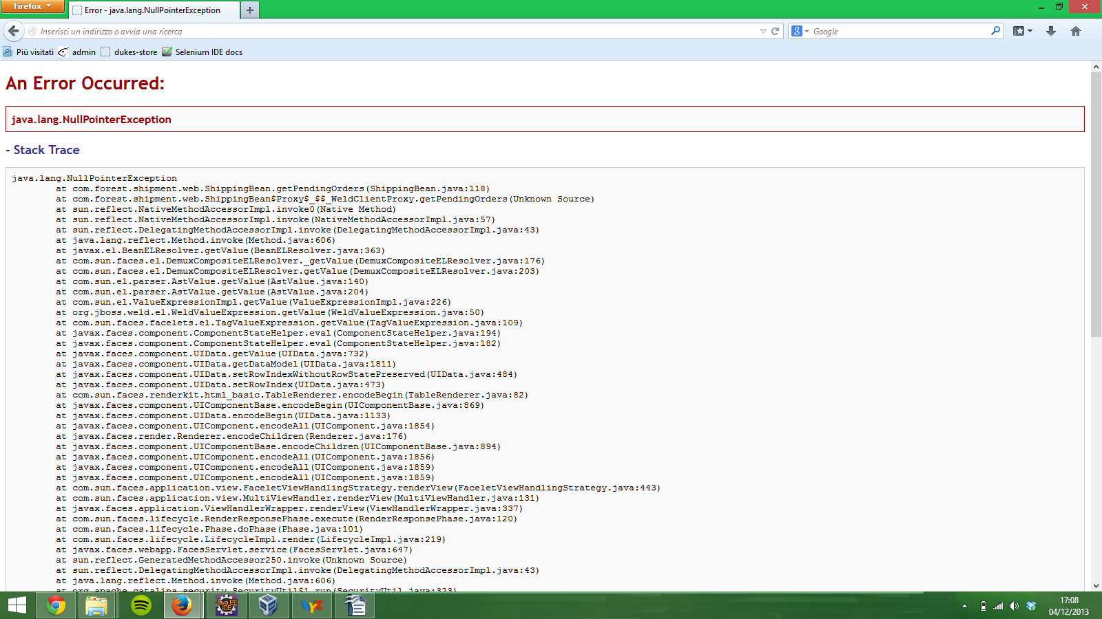
Changed method: com.forest.shipment.web.ShippingBean.getPendingOrders
Used Operator: Java Operator – Missing Method Call
Null Pointer Exception
Error Masking
Notes:
Experiment D
faulty component dukes-shipment.war
changed method com.forest.shipment.web.ShippingBean.getPendingOrders
line 16
operator Java Operator Missing Method Call
With this injection we are touching the duke’s shipment application, that also manages the payed orders. Running the test RobertBuys it seems everything goes without any problem at client-side, but when the administrator checks the pending orders we have an error with an incomprehensible stack trace for the duke’s shipment user, i.e. the administrator. The missing method turned the application in a erroneous state. A NullPointerException has been generated and not caught by the application and propagates to the interface of the application, showing up in this page.
Experiment D show the problem of unhandled exceptions, common for languages of new generation as Java, that introduces a mechanism called error masking. When an exception is raised, the application should have a handler for it in order to give the user an appropriate error message instead of the stack trace of the application. Locate where to add and implement carefully the try-catch blocks, guided by fault injection experiment like this, is an useful maintenance operation.

Slide 11

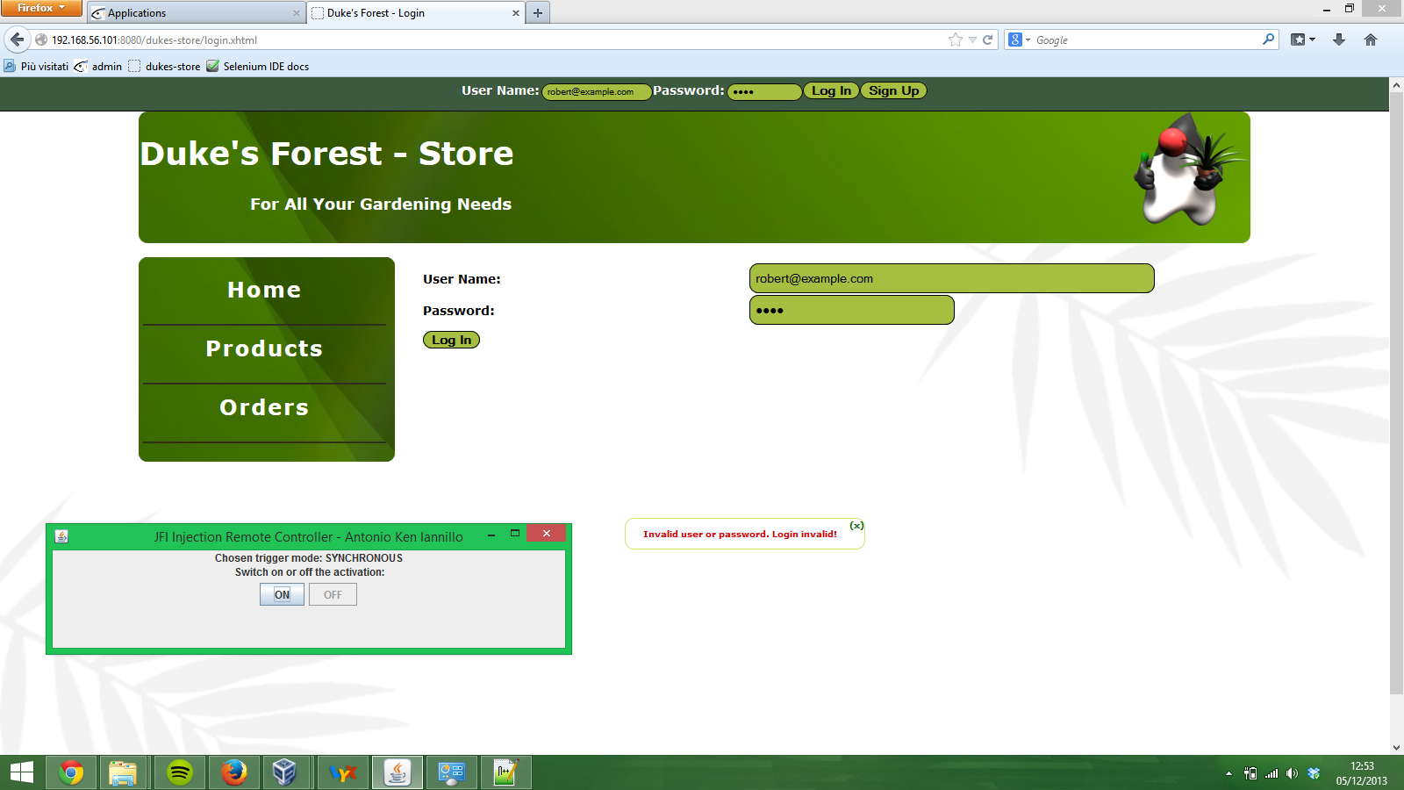
Changed method: com.forest.ejb.UserBean.getUserByEmail
Used Operator: Java Operator - No Result Exception
Log-in Problems, even after the fault de-activation
Need for a session restart mechanism
Notes:
Experiment F
faulty component dukes-store.war
changed method com.forest.ejb.UserBean.getUserByEmail
line 23
operator Java Operator No Result Exception
This injection affects the whole test suite because the consequence is that neither the users nor the administrator can log in the application. A further anomaly could be the visualized page when we first try to log in. Here there is both an error message with the java exception written in bold red, and the little pop up message that ensure the user to be logged in.
In order to understand the transient nature of this failure, the component has been injected again with the same operator in the same location but with the remote option. The trigger mode chosen is user-triggered in order to activate and deactivate the fault as needed. A new test case has been executed. When the user logs in again the fault is switched on and, as expected, the exceptions are recorded in the similar way to the previous case. Since the user did not succeed in logging in, remotely the fault is deactivated and the user tries to log in again. Although the fault is off, the session keeps memory of the failed trial and does not even try to query the database and logs the user. The unhandled exception in this case is a ServletException, caused by the inconsistent state of the session.
The need of a more complex recovery mechanism is discovered by Experiment F. The detection could be simply done catching the related exceptions of the failure for the inconsistent state of the application. Thus, the application should be able to reset the session, taking in count also the database entries for that session. Thus, the fault tolerance should mask the failure to the user, revert the system state back to some earlier correct version and try the queries again. As said before, a spatial redundancy of the database can reduce the waiting time.

Slide 12
Conclusion
Why to inject?
Availability in Business-Critical Application
Evaluation and Improvement of FTAM
What to inject?
Software defects and exception
Where to inject?
Java bytecode, no source code
Fault-prone locations
How to inject?
Operators with utilities
Is it useful?
Case study
Future developments?
New operators
New remote activation based on stack trace
Exception Inspection
Notes:
Conclusioni

Slide 13
thank you!
I am enough of an artist to draw freely upon my imagination – A. Einstein

