Slide 1
Leveraging eBPF to preserve user privacy for DNS, DoT, and DoH queries
Sean Rivera, Sofiane Lagraa, Antonio Ken Iannillo, Radu State
SnT, University of Luxembourg, Luxembourg
firstname.lastname@uni.lu
Vijay K. Gurbani
Illinois Institute of Technology
Vail Systems, Inc.
vkg@{iit.edu,vailsys.com}

Slide 2

About me
Sean Rivera Sean.Rivera@uni.lu
Ph.D. Candidate University of Luxembourg

Slide 3
Context and Motivation – Problem Statement
Most applications for DNS privacy are designed to protect against third party eavesdroppers
  Not many applications for users concerned about monitoring at the resolver level
  Users who wish to avoid being fingerprinted by their DNS provider must manually change their system resolver,
There should be a system which allows users to control how much information their provider receives

Slide 4
Context and Motivation – Objective
Provide users with more control over their privacy
  Application-specific DNS
  Monitoring anything that cannot be directly filtered.
Support alternate DNS systems
  DoH (DNS over HTTPS)
  DoT (DNS over TLS)

Slide 5
Context and Motivation – Solution
The extended Berkeley Packet Filter (eBPF) is a new technology for kernel-space monitoring and network traffic shaping.
Has been used for security and performance apps
Can be used to secure DNS and DoT communications
  Cannot secure DoH but can monitor

Slide 6
DNS Security
Base DNS implementation has no security
  Fake responses are difficult to detect
  Attackers can observe all requests
Machine learning opens a new attack vector
  De-anonymization and user profiling are both threats

Slide 7
DNS over HTTPS and DNS over TLS
DNS over TLS (DoT)
  Specified in RFC 7858 [1]
  Uses DNS over TCP and TLS
  Increases user privacy and security by preventing Man-in-the-Middle attacks.
  Well suited for a system-wide DNS service
DNS over HTTPS (DoH)
  Specified in RFC 8484 [2].
  Two different approaches, based on the HTTP GET and POST methods.
  DoH is easier to integrate with application development
  Requires users to place more trust in their browsers

Slide 8
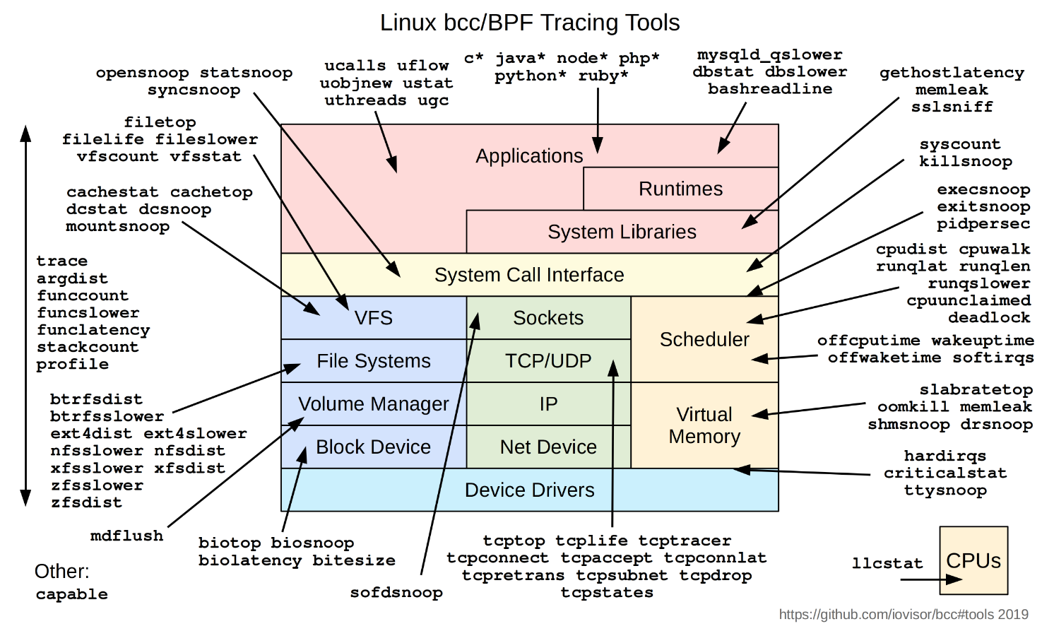
eBPF/XDP
eBPF
  Virtual machine built into the linux kernel
  Allows access to the network stack
XDP
  High performance to eBPF

Slide 9
Adversarial models (1/2) – Adversaries
The ISP:
  Most significant concern to user privacy due to the amount of control it has over a user’s data
  Controls the stub resolver for the host, monitor any traffic that the host publishes, and even monitor the sites the user visits
  Most complicated adversary to address
  DoH and DoT are assumed to provide protection if an alternative resolver is used
The browser vendor (e.g. Google, Mozilla, Apple, Microsoft):
  Has access to all traffic conducted by the user in the browser.
  Only considered concerning DNS privacy when users utilize DoH
  Focus is when the browser vendor provides DoH as well
Network Eavesdroppers:
  DNS requests may be accessed by other users due to traffic monitoring or flaws in encryption.
  Most common type of attacker, and therefore their capabilities are the best understood
Server Eavesdroppers:
  More advanced than network eavesdropping
  Requires the attacker to be on the same system as the user
  Possible on cloud environments
  Any solution must be conducted in a more privileged ring of escalation

Slide 10
Adversarial models (2/2) - Attacks
De-anonymization:
  Allows leakage of personal information
  Connects users to queries or creates profiles of users based on their queries.
  Mostly observed on the ISP or the browser vendor
DNS Query Leakage:
  Occurs when any part of the DNS query is leaked to any observer aside from the resolver
  Can be caused by lack of encryption, timing attacks, or other similar attacks.
Man-in-the-Middle:
  Occurs if an attacker can intercept DNS communications
Malicious Resolver:
  DNS resolvers that return incorrect IP addresses though the error response mechanism
DNS spoofing:
  Also return incorrect IP addresses,
  Caused by a server downstream from a DNS resolver

Slide 11
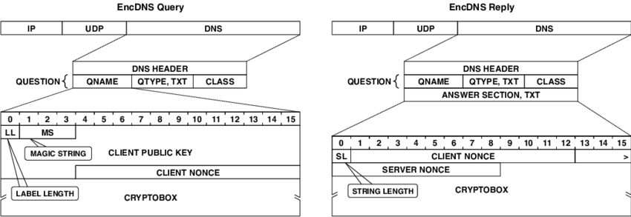
EncDNS
Herrmann et al. [3] proposed EncDNS,
  Encryption service for DNS that provides user privacy
  Leverages the privatization provided by the communication between a recursive resolver and an authoritative name server,
  Ensures that no single server knows both the source address and requested lookup address.
EncDNS was extended in structure by Oblivious DNS [4];
  Cleaner way to interact with the encrypted server and the recursive resolver.
  Addressed some issues with the EncDNS key propagation

Slide 12
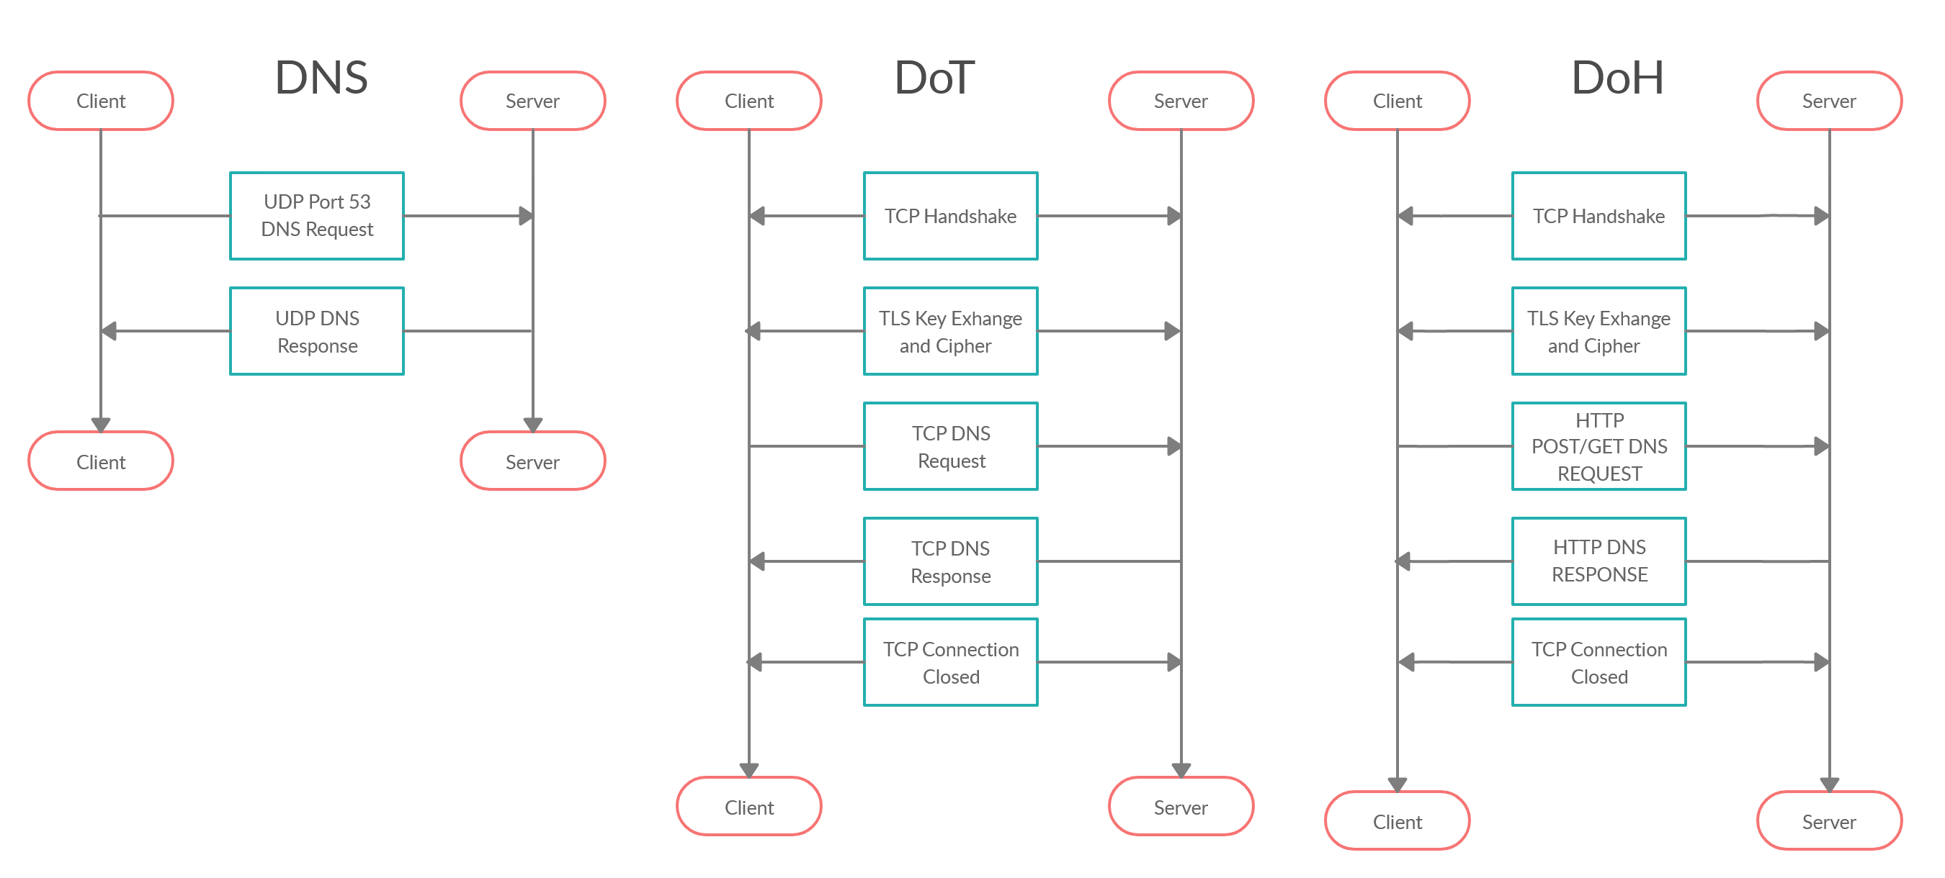
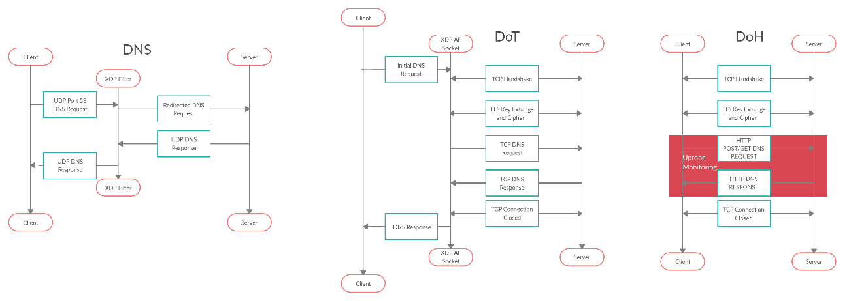
eBPF for DNS

Slide 13
eBPF for DoT

Slide 14
eBPF for DoH

Slide 15
Privacy Evaluation
Threat | Attack Strategy | DNS | DoT | DoH | EncDNS | eBPF + DoT | eBPF + DoH
ISP | De-anonymization DNS Query Leakage Malicious Resolver | Vulnerable Vulnerable Vulnerable | Vulnerable Only if Allowed Vulnerable | N/A Protected Protected | Partially Protected Protected Vulnerable | Protected Only if Allowed Partially Protected | N/A Protected Protected
Browser Vender | De-anonymization Man-in-the-Middle | N/A N/A | N/A N/A | Vulnerable Vulnerable | Vulnerable Protected | N/A N/A | User Given Warnings Protected with User Support
Network Eavesdroppers | De-anonymization DNS Query Leakage Man-in-the-Middle Malicious Resolver DNS spoofing | Vulnerable Vulnerable Vulnerable Vulnerable Vulnerable | Protected Protected Protected Vulnerable Vulnerable | Protected Protected Protected Protected Protected | Protected Protected Protected Partially Protected Protected | Protected Protected Protected Protected Protected | Protected Protected Protected Protected Protected
Server Eavesdroppers | De-anonymization DNS Query Leakage Man-in-the-Middle Malicious Resolver DNS spoofing | Vulnerable Vulnerable’ Vulnerable Vulnerable Vulnerable | Protected Vulnerable Protected Vulnerable Vulnerable | Protected Protected Protected Protected Protected | Vulnerable Vulnerable Protected Partially Protected Protected | Protected Protected Protected Protected Protected | Protected Protected Protected Protected Protected

Slide 16
Experiments

Slide 17
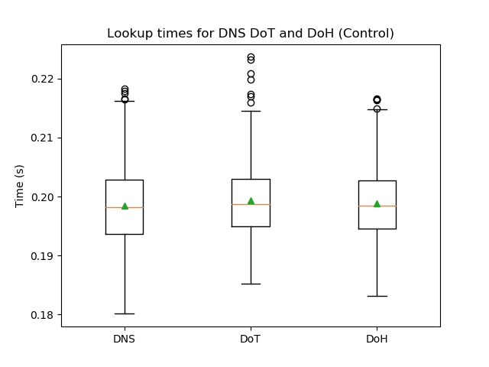
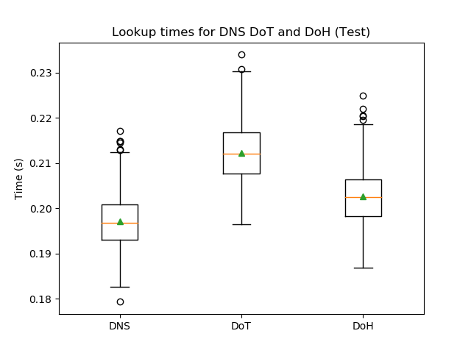
Experimental Results

Slide 18
Conclusion and Future works
We demonstrate a new way to help provide DNS privacy to users, though the use of eBPF
We demonstrate that it can be done without heavily impacting the performance of the applications.
While eBPF is unable to invisibly interact with encrypted communications such as DoH, we instead provide monitoring and verification of the contents of the lookup.
For privacy-conscious users, we recommended that they regularly change their DoH providers to lessen the impact of fingerprinting.
We plan to expand our eBPF framework across additional DNS options
We hope to develop new techniques to analyze encrypted DNS traffic before transmission and potentially provide both filtering and alterations.
Additionally, we aim to allow network administrators to recreate the functionality currently provided by passive DNS for DoH and DoT

Slide 19
Bibliography
J. Heidemann A. Mankin D. Wessels Z. Hu, L. Zhu and P. E. Hoffman. 2016. Specification for DNS over Transport Layer Security (TLS). https://www. rfc-editor.org/rfc/rfc7858.txt [Online; accessed 01-October-2019].
P. E. Hoffman and P. McManus. 2018. DNS Queries over HTTPS (DoH). https://www.rfc-editor.org/rfc/rfc8484.txt [Online; accessed 01-October-2019]
Dominik Herrmann, Karl-Peter Fuchs, Jens Lindemann, and Hannes Federrath. 2014. Encdns: A lightweight privacy-preserving name resolution service. In European Symposium on Research in Computer Security. Springer, 37–55.
Paul Schmitt, Anne Edmundson, Allison Mankin, and Nick Feamster. 2019. Oblivious DNS: Practical privacy for DNS queries. Proceedings on Privacy Enhancing Technologies 2019, 2 (2019), 228–244.

