Slide 1

SecureWhistle
Enabling whistleblowing services for everyone
Notes:
Good [morning/afternoon], everyone.
Thank you for taking the time to meet us today.
My name is Antonio Ken IANNILLO.
Today, I’m excited to introduce you to SecureWhistle, a revolutionary whistleblowing platform that provide secure, anonymous reporting for small and medium enterprises (SMEs)."

Slide 2
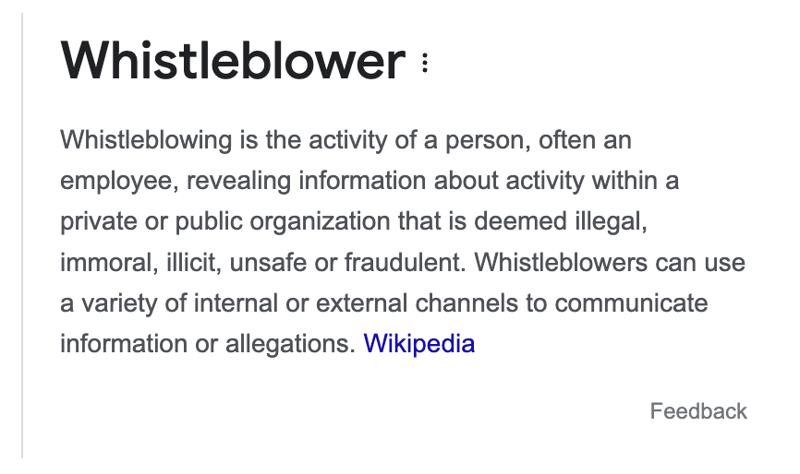


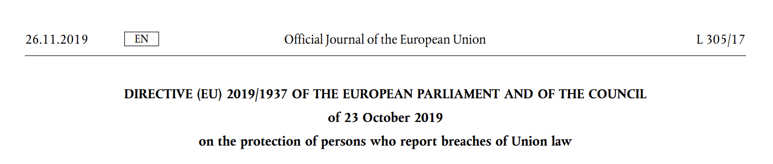
Introduction
Notes:
Whistleblowing is critical for maintaining transparency and accountability.
However, many organizations, especially SMEs, face significant challenges in establishing and maintaining compliant whistleblowing mechanisms.
SecureWhistle addresses these challenges with an innovative solution that is both efficient and user-friendly, ensuring full compliance with EU Directive 2019/1937.

Slide 3



The Problem
LE: Outsourcing Processes
Stringent Regulatory Requirements
SME: Limited Resources
Notes:
SMEs often struggle with limited resources, making it difficult to comply with stringent regulatory requirements. Non-compliance can lead to legal repercussions and damage to their reputation. These organizations need a cost-effective solution that guarantees compliance and protects whistleblowers

Slide 4
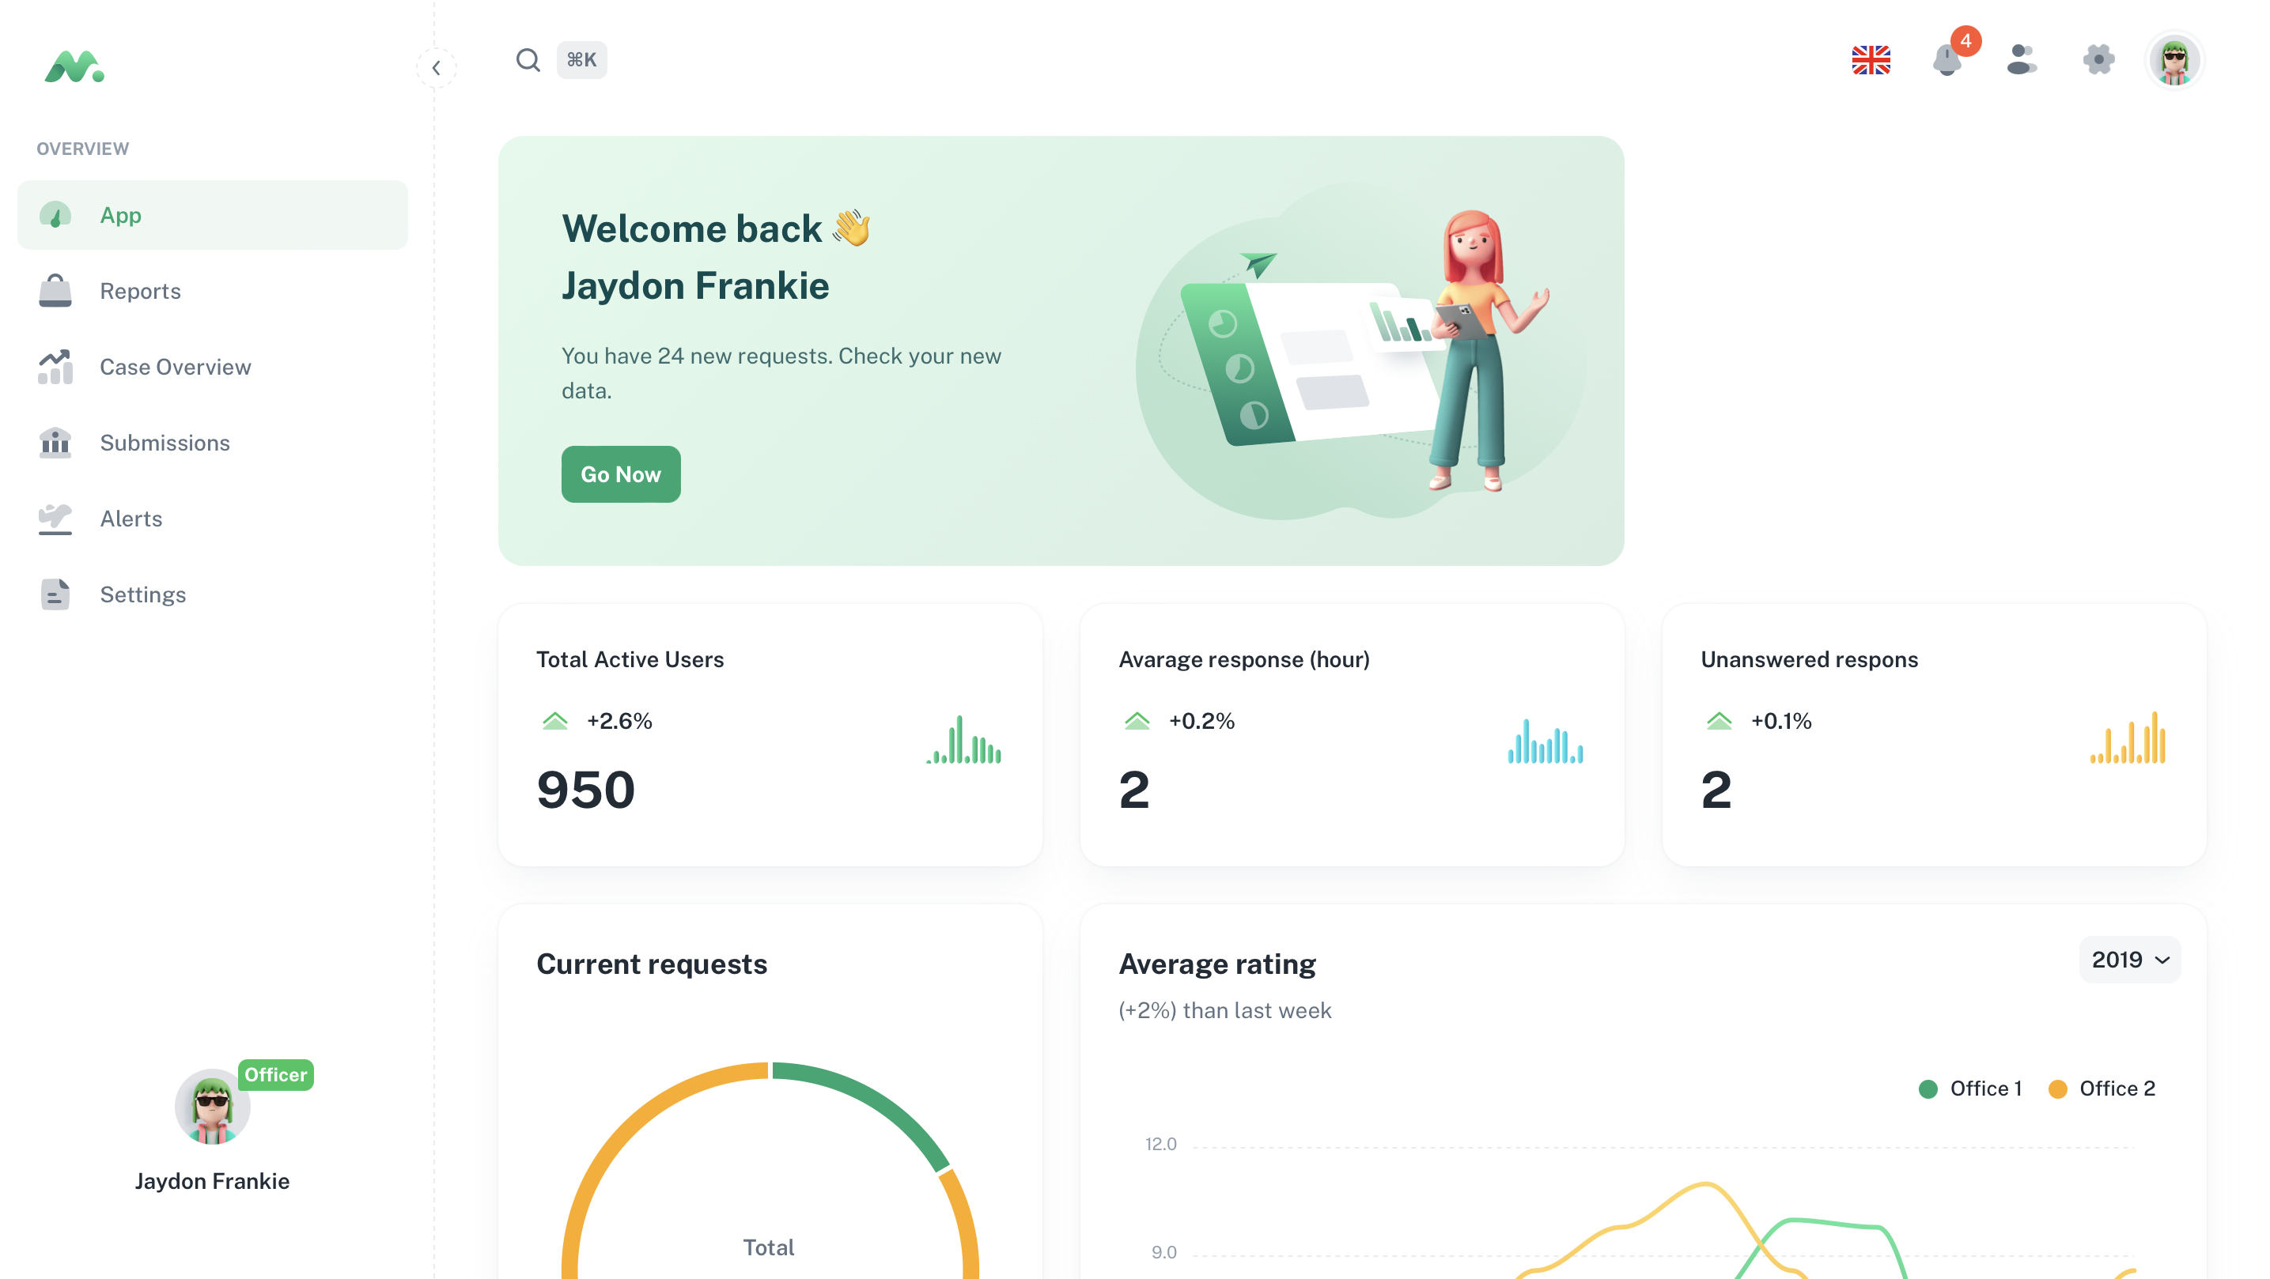


The Solution: SecureWhistle
Notes:
SecureWhistle is designed specifically to meet the needs of SMEs. It's cost-effective, easy to use, and ensures the anonymity and protection of whistleblowers. Our platform automates report handling, provides a secure reporting mechanism, and ensures SMEs can maintain compliance with EU regulations without extensive resources

Slide 5
Key Features of SecureWhistle
Automated Reporting Mechanism
AI (LLM-based) triage
Anonymity of reporters
Auditable Terms of Acknowledgement
Compliance Monitoring
Notes:
Let me walk you through the key features of SecureWhistle.
First, we have an Automated Reporting Mechanism, a simple and secure web-based interface for whistleblowers.
Second, our Machine Learning Triage prioritizes cases based on severity, ensuring timely responses.
We also utilize XRPL blockchain to safeguard identities, ensuring complete anonymity. Additionally, we offer Auditable Terms of Acknowledgment stored on the blockchain for full transparency. Finally, our Compliance Dashboard allows real-time tracking and management of all reports, facilitating proactive compliance monitoring.

Slide 6
Leveraging
robust security and advanced encryption
secure and transparent audit trail
cost-effective and scalable
Notes:
Why did we choose XRPL technology?
XRPL provides robust security and advanced encryption, which are crucial for protecting sensitive whistleblower information.
The immutable nature of blockchain creates a secure and transparent audit trail, ensuring accountability.
Additionally, XRPL is cost-effective and scalable, making it the ideal choice for a platform designed to support SMEs

Slide 7
Benefits of SecureWhistle for SMEs
Cost-effective
Enhanced Security
Efficient Report Handling
Legal Protection
Reputational Safeguarding
Notes:
Our platform offers numerous benefits for SMEs.
First and foremost, it's Cost-Effective, providing an affordable compliance solution.
Enhanced Security is guaranteed through XRPL technology.
Efficient Report Handling is facilitated by automated processes and machine learning triage.
Legal Protection is strengthened by better compliance, reducing risks of legal consequences.
Finally, Reputational Safeguarding is ensured through maintained transparency and trust within the organization.

Slide 8
How Ripple benefits
Expanding its use-case beyond financial settlements
Promoting global transparency and accountability
Notes:
For Ripple, supporting SecureWhistle strengthens the XRPL ecosystem by expanding its use-case beyond financial settlements.
It also aligns Ripple with corporate responsibility, promoting global transparency and accountability.
Backing this innovation positions Ripple as a leader in blockchain technology applications.
We are seeking Ripple's support in further developing SecureWhistle. We believe there are numerous collaboration opportunities that can drive mutual growth. I'd be happy to provide a demonstration of our platform's capabilities and discuss how we can work together to further innovate in this space

Slide 9

Q&A
Notes:
Thank you for your attention. I now open the floor to any questions or discussions you may have about SecureWhistle and its benefits. Your feedback and insights would be invaluable as we aim to revolutionize whistleblowing mechanisms with XRPL technology

