Slide 1
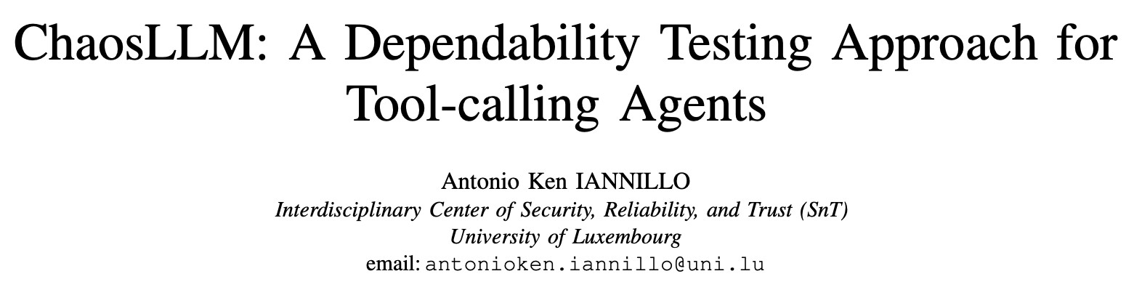
Notes:
Hello everyone, my name is …
I’ll present ChaosLLM, a lightweight framework for fault-injecting tool-calling LLM agents, so we can evaluate their dependability under realistic system-level failures, not just adversarial prompts

Slide 2
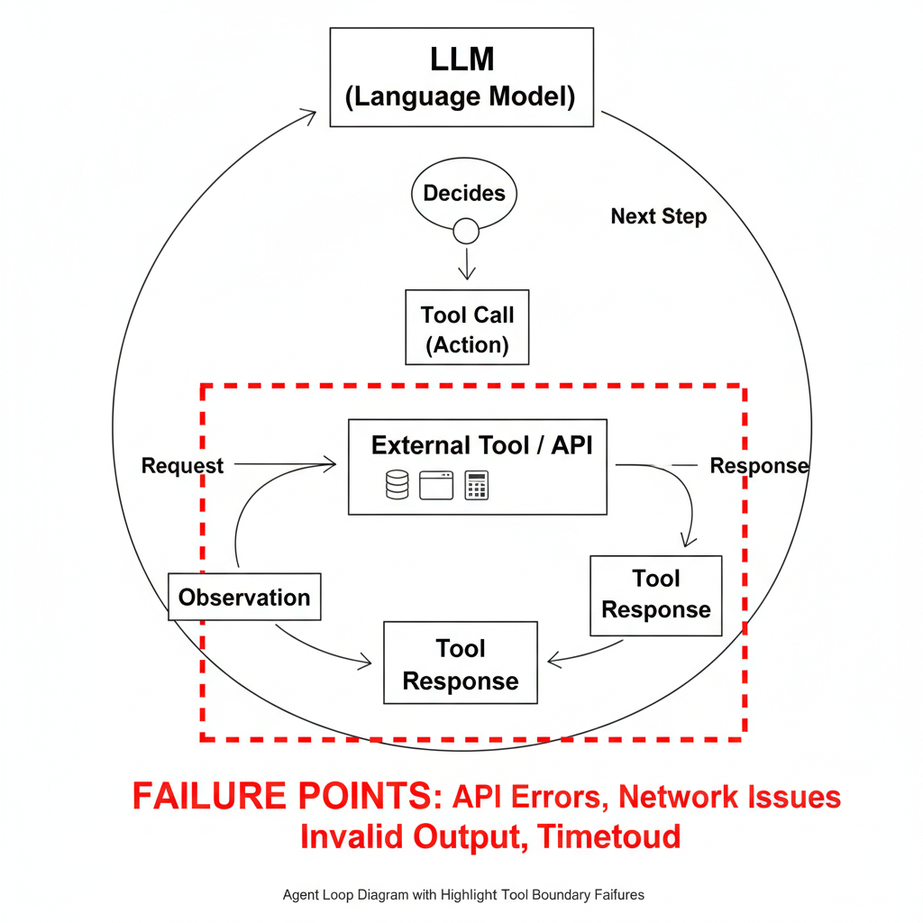
Motivation
Gap
Goal
Agents orchestrate tools, APIs, memory, and planning — real deployments face system-level faults
Existing robustness tests focus on prompt-level attacks; chaos engineering targets infra, not tool-call semantics
Emulate realistic tool faults and quantify task success and recovery behavior
Notes:
Modern agents are multi-step systems relying on external tools.
Failures often come from tooling, not prompts. Current testing leaves this uncovered.
ChaosLLM aims to emulate those tool-level faults and measure how well agents cope

Slide 3
Contribution
Taxonomy of non-adversarial tool-level faults
Middleware injector: no changes to agent or tool code
Experimental protocol on a LangChain ReAct agent
Preliminary results across 3 OpenAI models and 5 micro-workloads
Notes:
We contribute a tool-level fault taxonomy, a middleware-based injector requiring zero code changes, and a protocol with preliminary results over multiple tasks and models

Slide 4
Fault Model
At the tool interface
Unreachable: immediate refusal
missing dependency, network error
Slow Response
correct, but late output
Non-Responsive (Hang)
no response, no return
Incorrect Response
syntactically well-formed, semantically wrong
delta (subtle drift) or incorrect (obviously garbled)
Notes:
We focus on four common tool-level failures mapped from distributed systems. Incorrect responses come in two flavors: subtle drifts that look plausible, and obviously garbled yet well-formed outputs

Slide 5
ChaosLLM
Sits between the LLM’s action and tool.run() — decorator-based interception
Injects per-call fault effects without modifying agent or tools
Incorrect response via output transformer: numeric nudges or micro-edits
Compatible with vanilla LangChain ReAct agents
LLM
ChaosLLM
Tools
Notes:
ChaosLLM is a thin middleware layer that wraps the tool call boundary. It can throw early exceptions, delay, hang, or subtly corrupt outputs, all without changing agent or tool code

Slide 6
Experimental Setup
  5 micro-workloads
    arithmetic, orchestration, temporal reasoning
  3 models: gpt-4, gpt-4-mini, o3
  225 runs total: 5 tasks × 5 faults × 3 seeds × 3 models; 60s budget
  Outcomes: CORRECT, SILENT-DIFF, TIMEOUT, CRASH, ERROR
  Metrics: Task Success Rate (TSR), Hallucination Rate (HR), Timeout Ratio (TR)"
Notes:
We tested five single-step tasks with minimal tools across three models. Each run is isolated with fixed seeds, and we classify outcomes into five categories, aggregating them into TSR, HR, and TR

Slide 7
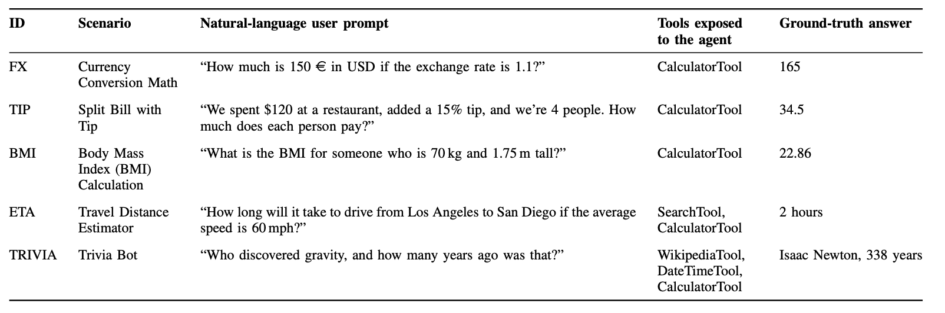

Slide 8
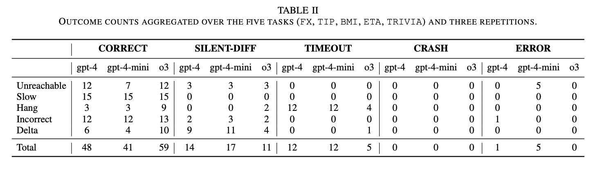
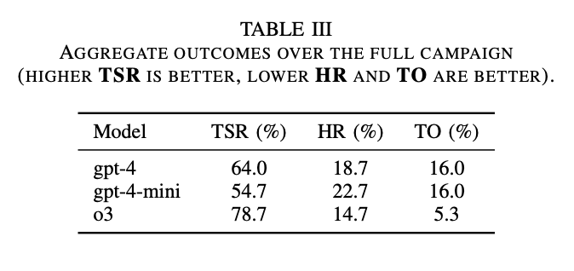
Notes:
Overall, o3 leads in success and has fewer timeouts. The identical timeout ratios of gpt-4 and gpt-4-mini suggest differences are largely due to semantic failures rather than time budgeting

Slide 9
Insights
Slow
Hang
Unreachable
Incorrect (garbled)
Delta (plausible wrong)
negligible impact under a 60s budget — agents wait and proceed
most disruptive — dominates timeouts; larger backbones sometimes avoid tools and still solve
frequent recovery via alternative plans; gpt-4-mini exposes raw exceptions in some runs
agents often reject and reason without the tool
primary source of silent errors — confident but wrong answers
Notes:
Slow faults didn’t matter at this timeout. Hangs are the main cause of timeouts. Garbled results are often discarded, but small plausible drifts are dangerous—agents quietly adopt them and answer incorrectly

Slide 10
Takeaways
Add external watchdogs for hangs; calibrate per-tool timeouts
01
Prefer 'tool-use only if needed' gating; stronger models can skip simple tools
02
Validate tool outputs: coarse plausibility filters and fine-grained sanity checks
03
Plan for unreachable tools: structured retries and fallback strategies
04
Notes:
To harden agents: enforce timeouts and watchdogs, reduce unnecessary tool calls, validate outputs at two levels, and handle unreachable tools with structured fallbacks and retries

Slide 11
Limitations and Future Work
Persistent faults only and synthetic micro-benchmark
Next
port to Model Context Protocol (MCP) for typed schemas and streaming"
Transient fault schedules to stress retries and self-healing
Multi-agent settings and agent-to-agent protocol awareness
Toward realistic workloads with off-the-shelf services and conversations
Notes:
This is a first step. We’ll move to MCP, add transient schedules, and test multi-agent protocols with more realistic workloads. We welcome contributions of workloads, adapters, and validators

