Slide 1

On-Chain Risk Signals:
Predicting Security Threats in DeFi Projects
Speaker:
  Bahareh Parhizkari (University of Luxembourg)
Co Authors:
  Antonio Ken Iannillo (University of Luxembourg),
  Ed Zulkoski (Quantstamp),
  Christof Ferreira Torres (INESC-ID / IST, University of Lisbon),
  Radu State (University of Luxembourg)
Conference: IEEE TrustCom, 14-17 November 2025, Guiyang, China
Notes:
Thanks for coming to my presentation
I’m presenting my paper titled …

Slide 2
Introduction
DeFi (Decentralized Finance):
  Financial services built on blockchain using smart contracts.
  Enables open, transparent finance by removing intermediaries.
But:
  Security incidents remain a major barrier to adoption.
We aim to provide the Risk-Score of DeFi projects for investors and insurances.
Notes:
Slide 3: Motivation
DeFi Vulnerabilities: Smart Contracts:

Slide 3
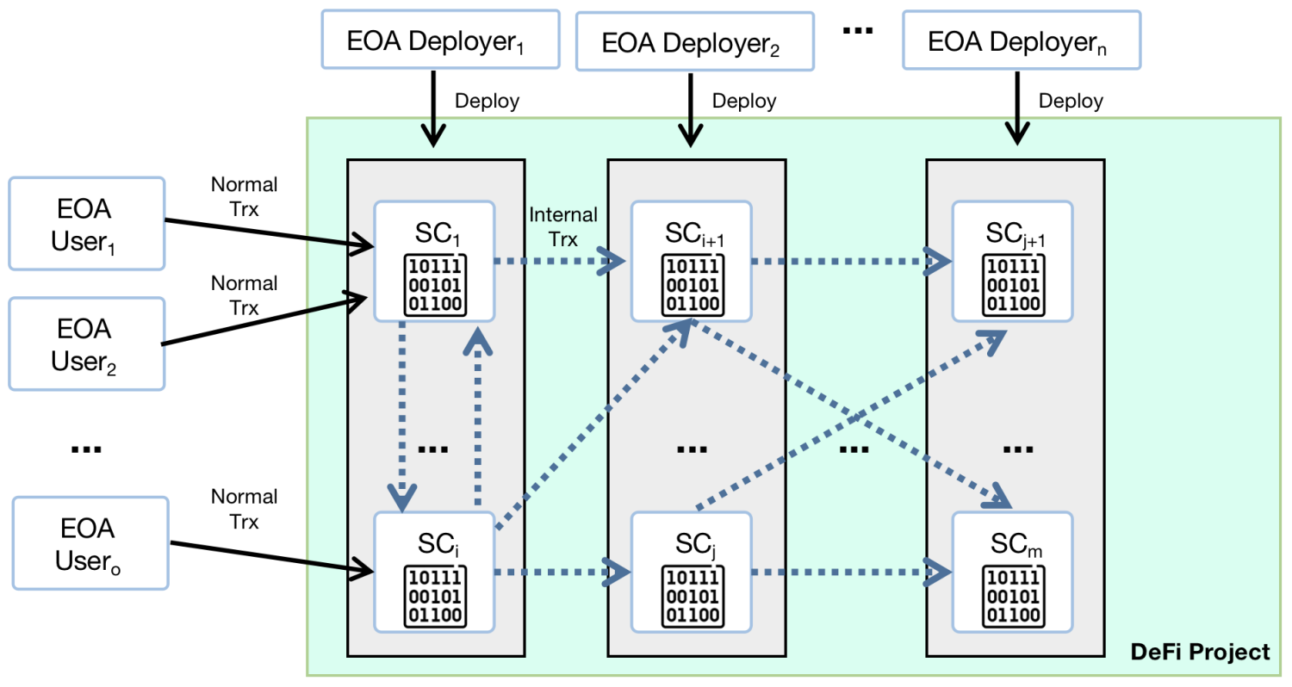
Introduction: DeFi Project
Notes:
This background shows the need for identifying

Slide 4
Objectives of the Study
Assess and quantify security risks in DeFi projects automatically.
Rely solely on on-chain data, ensuring objectivity and tamper-resistance.
Translate blockchain interactions into measurable risk indicators.
Provide early warnings for projects likely to be attacked.
Notes:
Slide 3: Motivation
DeFi Vulnerabilities: Smart Contracts:

Slide 5
Key Contributions
Automated On-Chain Risk Assessment:
  A novel methodology to evaluate DeFi security without off-chain input.
Four New Risk Metrics:
  Capturing on-chain behaviors that signal malicious or vulnerable activity.
Robust Empirical Validation:
  Tested on 420 projects (220 attacked, 200 unaffected) with 86% recall and 78% precision.
Notes:
Slide 3: Motivation
DeFi Vulnerabilities: Smart Contracts:

Slide 6
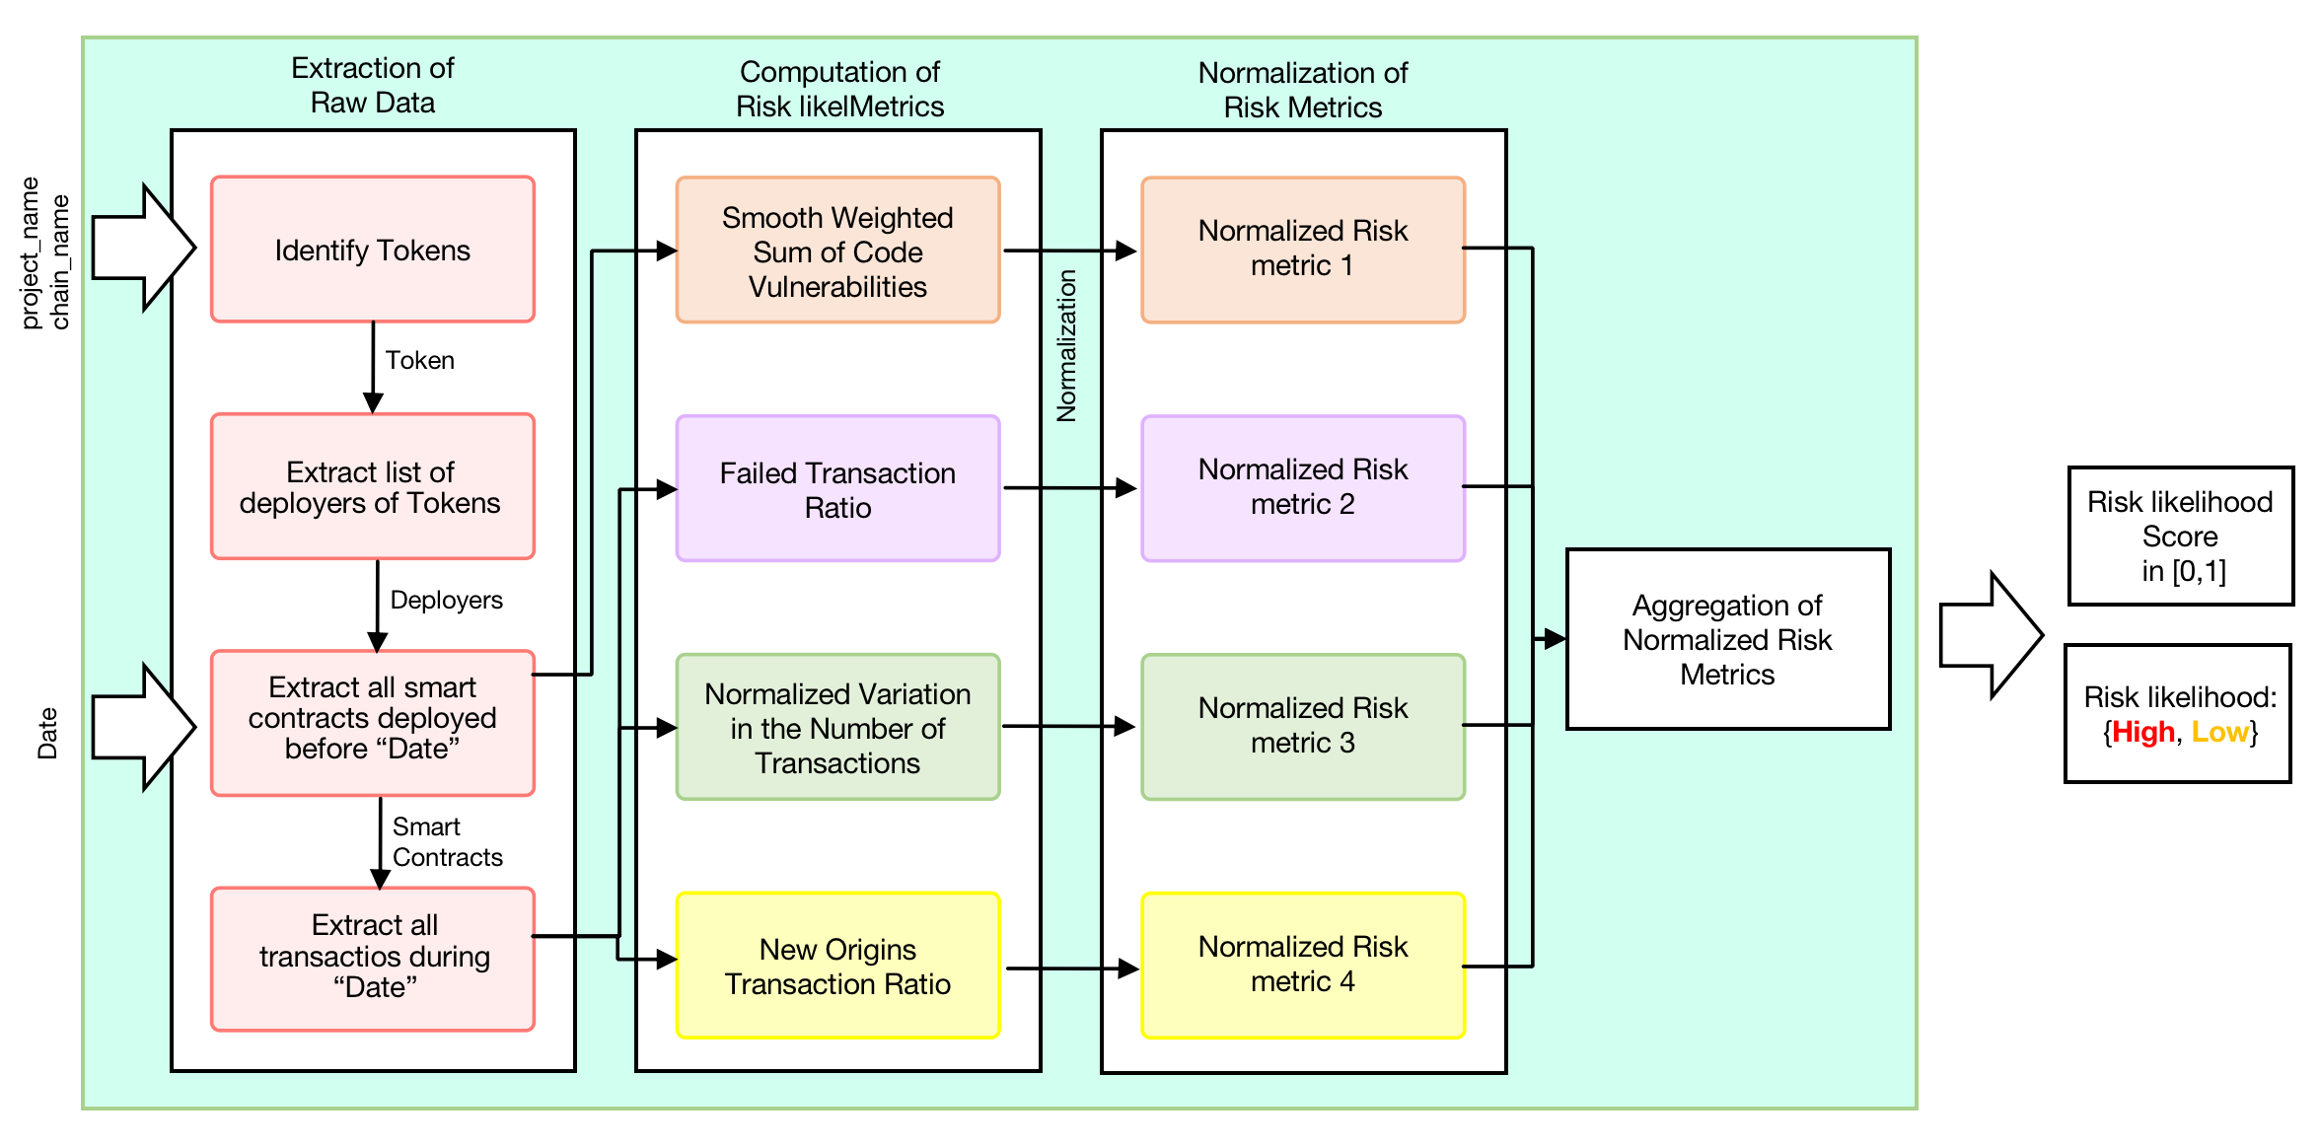
Methodology: Pipeline
Notes:
Data Extraction: Collect smart contract code and transaction data from blockchain.
Metric Computation: Calculate four risk metrics based on on-chain behavior.
Normalization: Smooth and scale metrics to comparable values.
Aggregation: Combine metrics into a single risk likelihood score.

Slide 7
Methodology: Risk Metrics
Smooth Weighted Sum of Code Vulnerabilities
  Evaluates severity and age of smart contract vulnerabilities.
Failed Transaction Ratio
  Fraction of failed incoming transactions. High ratio may indicate probing or exploit attempts.
Normalized Variation in Transaction Count
  Detects day-to-day changes in user activity. Large fluctuations can signal abnormal or malicious behavior.
New-Origin Transaction Ratio
  Measures how many transactions come from new Origins. Attackers often use new wallets to hide identity.
Notes:
Slide 3: Motivation
DeFi Vulnerabilities: Smart Contracts:

Slide 8
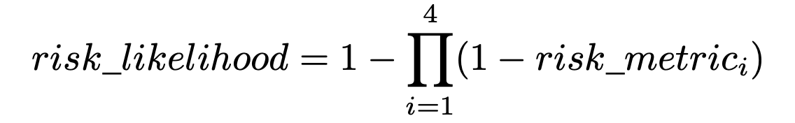
Methodology: Normalization and Aggregation of Risk Metrics
Normalization:
Aggregation:
Moving Average Smoothing
Winsorization
Min-Max Scaler
Notes:
After extracting the metrics, the next step is normalization
and standardization of them. Our methodology first considers applying smoothing techniques to reduce the impact
of fluctuations and noise over time. We apply the Moving
Averages smoothing technique [17]. This method involves
calculating the average of metrics over a defined time window.
This approach can minimize the impact of short-term spikes,
allowing the impact of high-risk behaviors to last longer. For
this purpose, the proposed methodology uses the five-day time
windows mentioned in Subsection IV-B.
Unlike simple truncation, winsorization limits extreme
values while preserving the data distribution, an important
property since large spikes in DeFi activity may reflect genuine
behavior rather than noise.

Slide 9
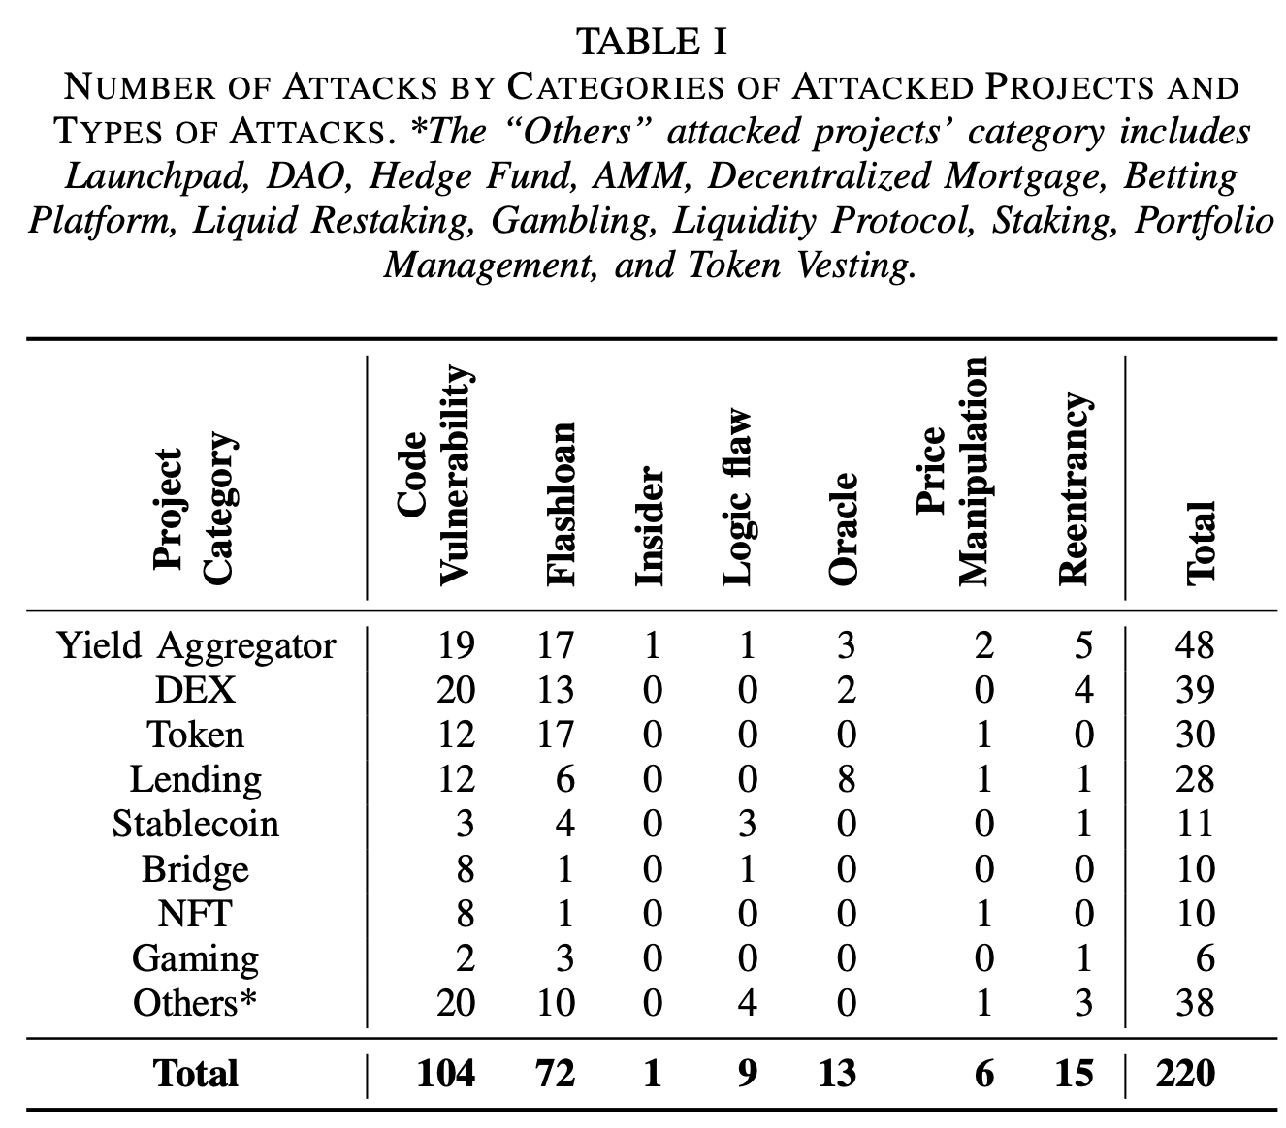
Validation: Dataset and Experimental Setup
Dataset: 220 attacked DeFi Projects
Control Group: 200 non-attacked
Chains: Ethereum, BSC, Polygon, Arbitrum, Optimist, Fantom, Base
Goal: Test whether the model can distinguish risky projects before incidents occur

Slide 10
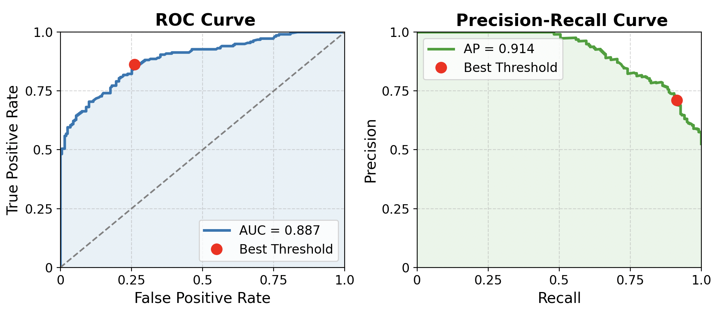
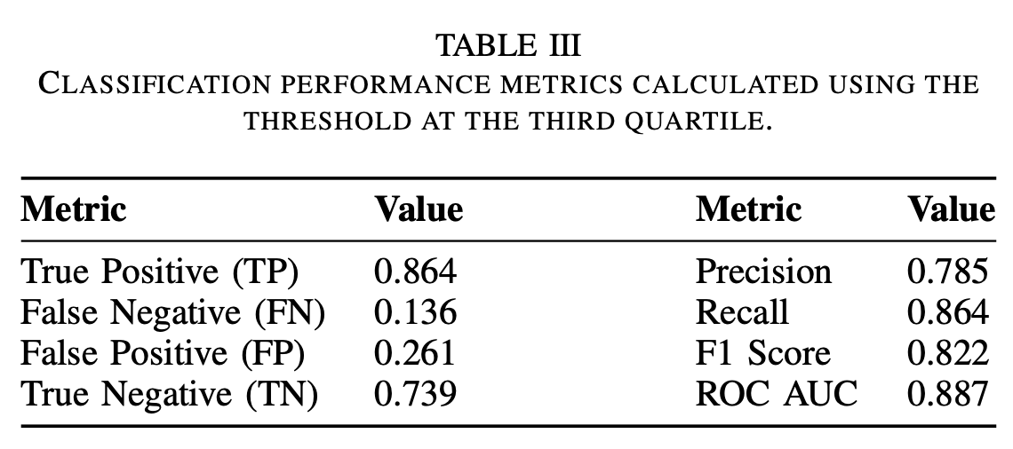
Validation: Results
Observation: Strong differentiation between attacked and non-attacked projects.
Notes:
Feature Selection: 465 features were reduced to 45 through feature selection methods.
Models Evaluated: Logistic Regression, SVM, Random Forest, XGBoost, and Multi-Layer Perceptron (MLP).
Best Model: MLP was found to have the best balance between True Positive Rate (79%) and False Positive Rate (<1.8%).

Slide 11
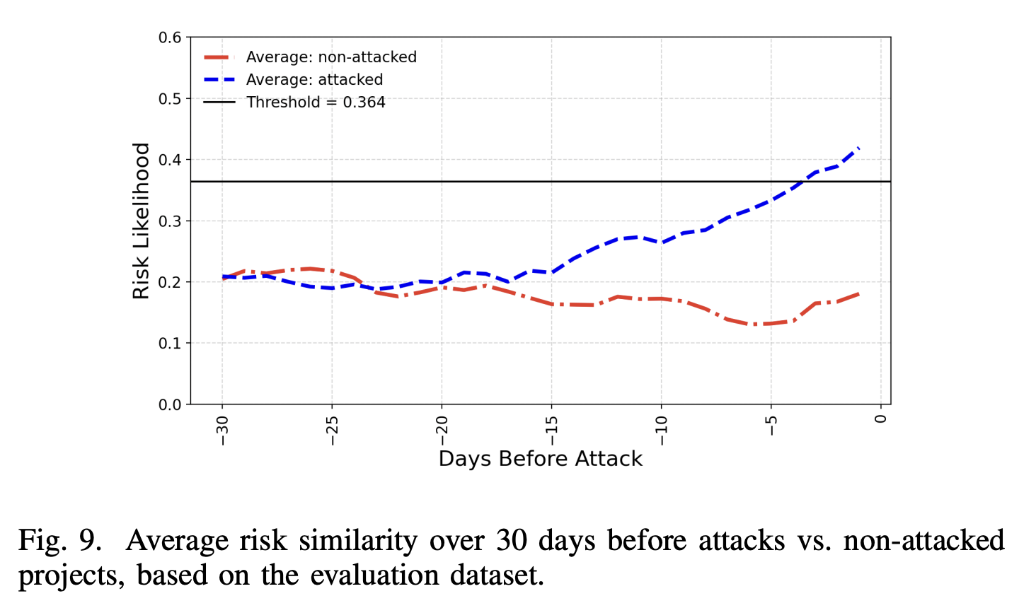
Evaluation: Results
Notes:
Feature Selection: 465 features were reduced to 45 through feature selection methods.
Models Evaluated: Logistic Regression, SVM, Random Forest, XGBoost, and Multi-Layer Perceptron (MLP).
Best Model: MLP was found to have the best balance between True Positive Rate (79%) and False Positive Rate (<1.8%).

Slide 12
Practical Applications
Early Warning System:
  Detect abnormal behaviors days before attacks.
Insurance & Risk Pricing:
  Adjust DeFi insurance premiums dynamically.
Investor Decision Support:
  Guide investment choices using objective on-chain risk scores.
Complementary Tool:
  Integrates with existing DeFi monitoring and security stacks.
Notes:
Slide 3: Motivation
DeFi Vulnerabilities: Smart Contracts:

Slide 13
Conclusion:
Future Works:
  Combine on-chain and off-chain data sources.
  Improve real-time risk detection.
  Expand dataset with new attack patterns.
Key Takeaways:
  First fully automated on-chain risk scoring for DeFi.
  Predicts 86% of attacks before they occur.
  Provides actionable, data-driven insights for investors and auditors.

Slide 14
Thank you
Bahareh Parhizkari
Email: bahareh.parhizkari@uni.lu
Notes:
quantstamp-h.jpg

Slide 15
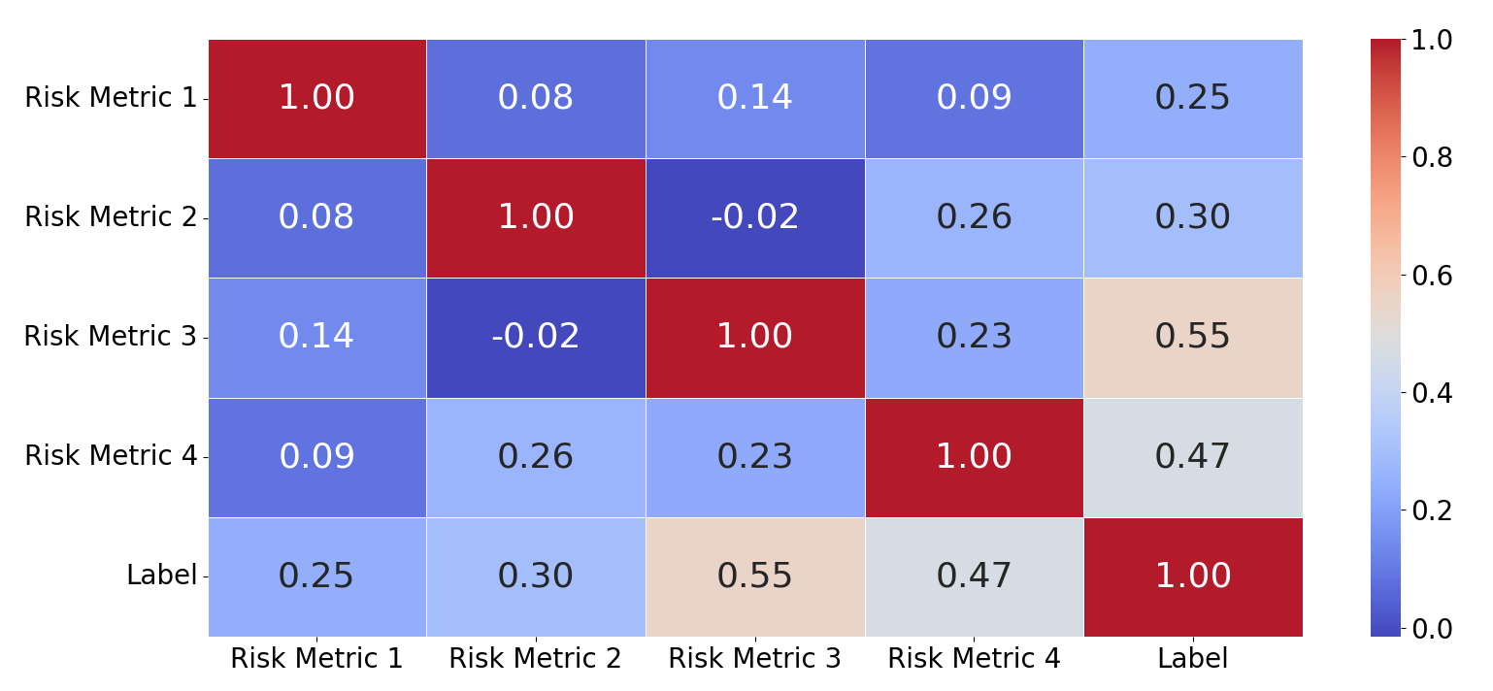
Methodology: Risk Metrics’ Sensitivity
Notes:
To answer this question, we introduced a methodology and we named it

Slide 16
Challenges
Lack of Regulation:
  No unified standards or oversight unlike traditional finance.
High System Complexity:
  DeFi projects depend on multiple interlinked smart contracts.
Open-Source Exposure:
  Public code enables attackers to easily find and exploit vulnerabilities.

Slide 17
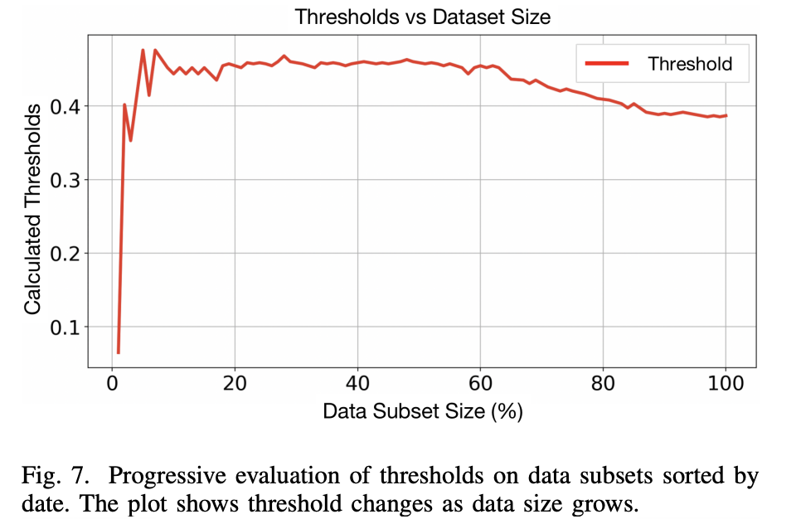
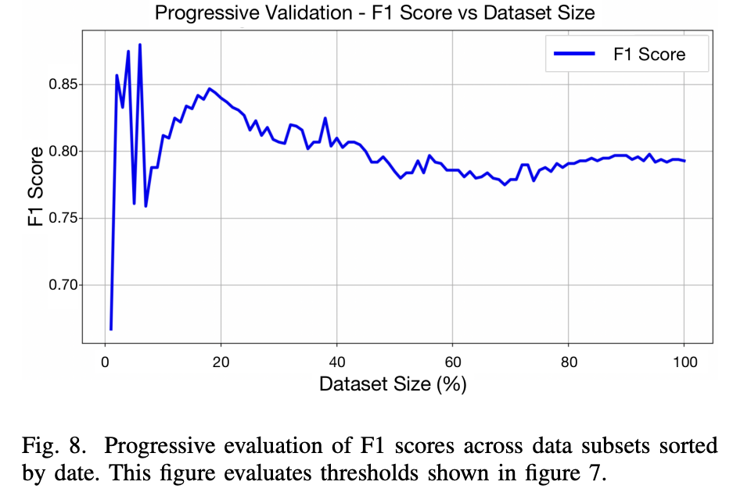
Validation: Threshold Analysis
Notes:
Optimal risk threshold = 0.364 (maximizes F1 score).
Ensures balance between precision and recall.
Threshold remains stable as dataset grows — shows robustness.
High-risk label accurately identifies projects with imminent attacks.
Flexible: threshold can be adjusted based on tolerance for false alarms.

