Slide 1



ROS-FM: Fast Monitoring for the Robotic Operating System
Sean Rivera

Slide 2

About Me
About Me
Post-Doctoral Researcher at the University of Luxembourg
Ph.D. Computer Science and Computer Engineering, University of Luxembourg
Robotic Operating System (ROS) security and development

Slide 3
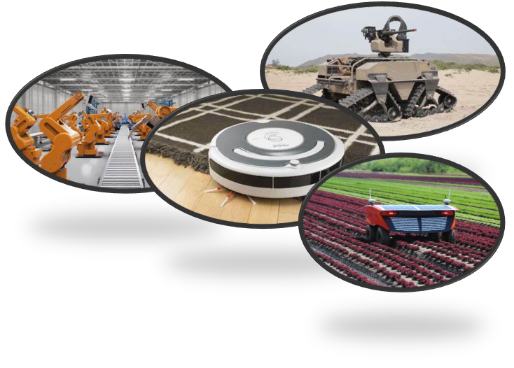
Introduction
Robotics
Cyber-Physical Systems
Devices with a physical component controlled by a digital component
Translate the digital into the physical
Robots characterized by degree of movement and autonomy
  Assist humans with a variety of tasks
Robots must have Sensors and Manipulators
  Cameras, RFID scanners, LiDAR, microphones
  Arms, Prongs, Wheels, Magnets
Notes:
Example: Physical component would be mechanical arm or vehicles with software that controls the movement

Slide 4
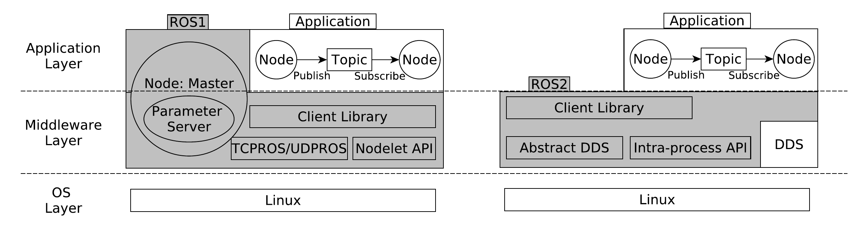
Introduction
Robotic Operating System (ROS)
Collection of Software Libraries
Enables communication of both hardware and software components
Packages extend ROS core functionality with software modules: hardware drivers, robot models, data types, planning, perception, localization, simulation tools, and other algorithms
Predicted that ROS systems will make up majority of systems within 5 years
Open-source project with thousands of developers
ROS-Industrial: 78 International Industries utilizing ROS

Slide 5
Introduction
ROS Architecture
Nodes: Independent Computing Processes
Topics: Unidirectional communication between processes
Services: Bidirectional communication between processes
Messages: Method for node communication
Application Layer:
  Master Node: Global Namespace
Middleware Layer: Set of interfaces for software development and hardware
  Parameter Server: Repository of globally shared data
  All processes as nodes in this layer
OS Layer: Linux
Notes:
Make sure to mention Publish/Subscribe
Mention ROS2

Slide 6
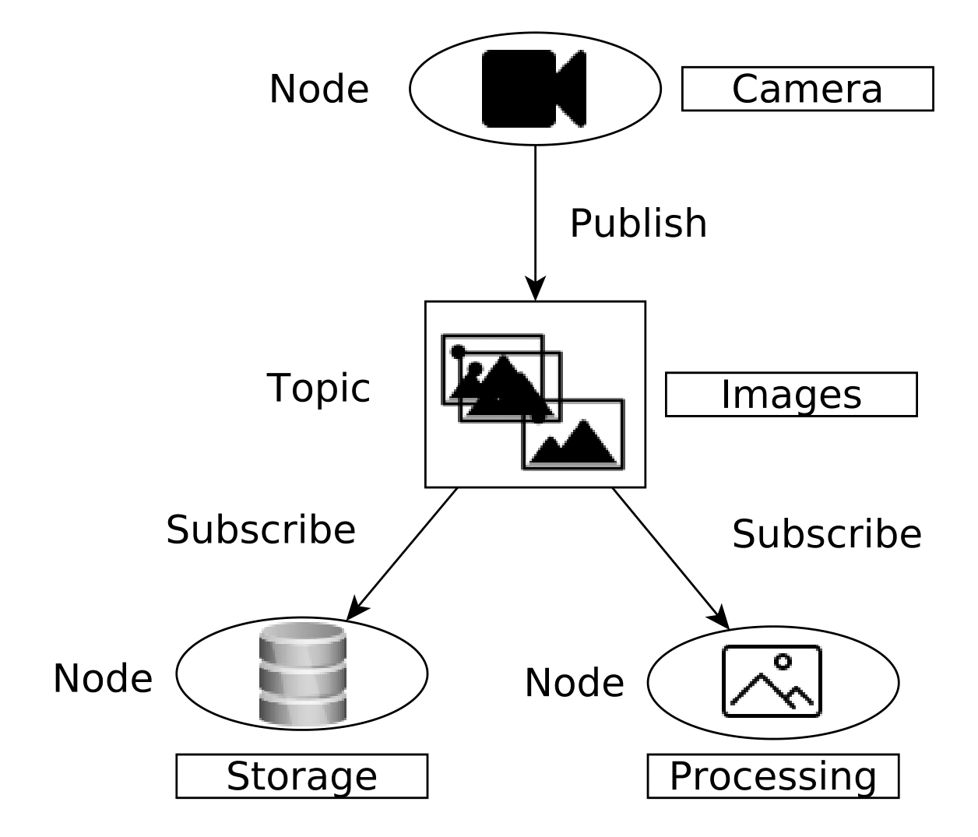
Introduction
ROS Systems Designs
Typical ROS System
Multiple packages per robot, dependent upon use
  Each package contains ~3.8 nodes [1] communicating on 5-8 topics [2]
Example:
  “Camera” node sends messages to the ”Images” topic
  Messages received by the ”Processing” node and ”Storage” node
  ”Processing” node performs a standard image processing task -- simple object recognition
  ”Storage” node keeps data log
1) Andre Santos, Alcino Cunha, and Nuno Macedo. “Static-time extraction and analysis of the ROS computation graph”. In:2019 Third IEEE International Conference on Robotic Computing (IRC). IEEE. 2019, pp. 62–69.
2) Andre Santos et al. “Mining the usage patterns of ROS primitives”. In:2017 IEEE/RSJ International Conference on Intelligent Robots and Systems (IROS). IEEE. 2017,pp. 3855–3860

Slide 7
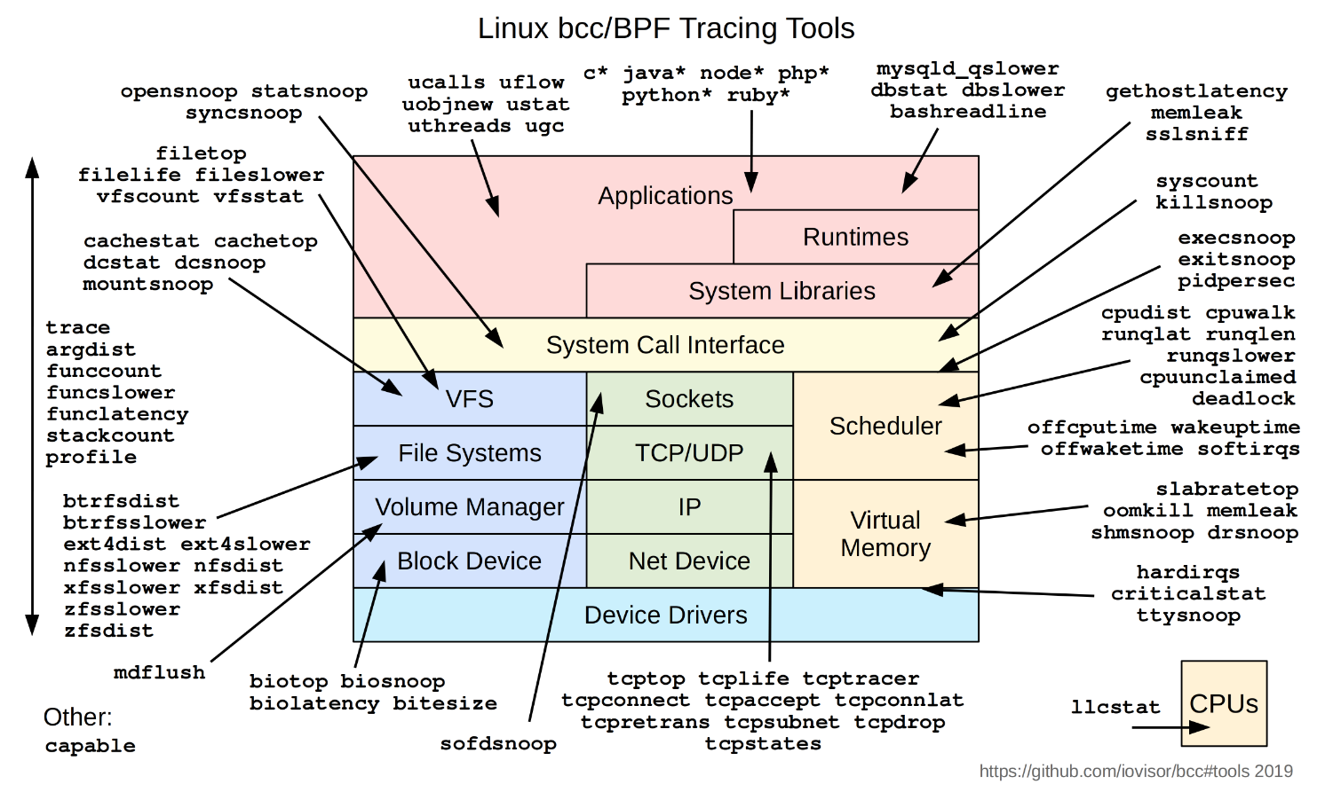
Introduction
eBPF & XDP
extended Berkeley Packet Filter (eBPF)
Virtual machine built into the linux kernel
Allows access to the the entire kernel for users
High performance packet filtering for eBPF
Allows packet processing from the NIC
eXpress Data Path (XDP)

Slide 8
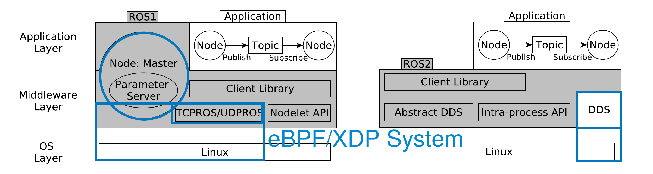
ROS-FM Architecture
ROS-FM Architecture
ROS-FM encapsulates all communications between various ROS nodes
Checks all incoming and outgoing messages
Prevents network attacks
Does not require specialized hardware or software components
Each robot needs to run their own version

Slide 9
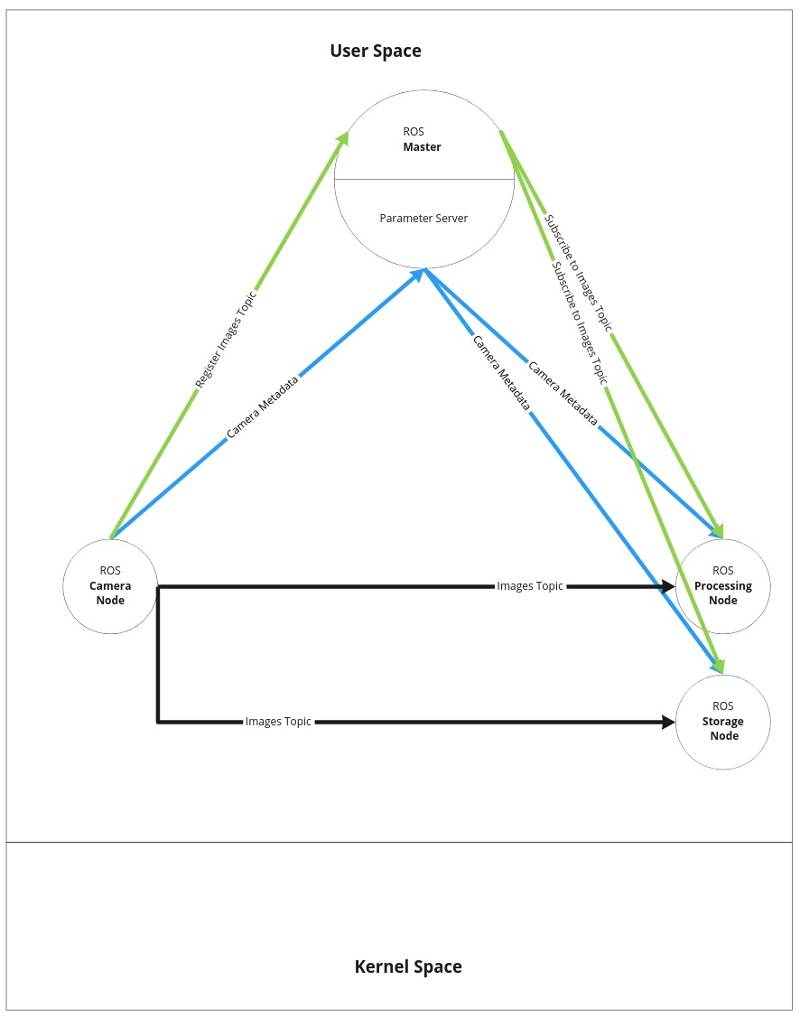
ROS-FM Architecture
ROS-FM Usage Model
ROS Master acts as the keystone for the system
Any changes to ROS middleware have potential to break many packages
Attackers may try to attack the ROS middleware or specific nodes
ROS users also need metrics about robotic functionality

Slide 10
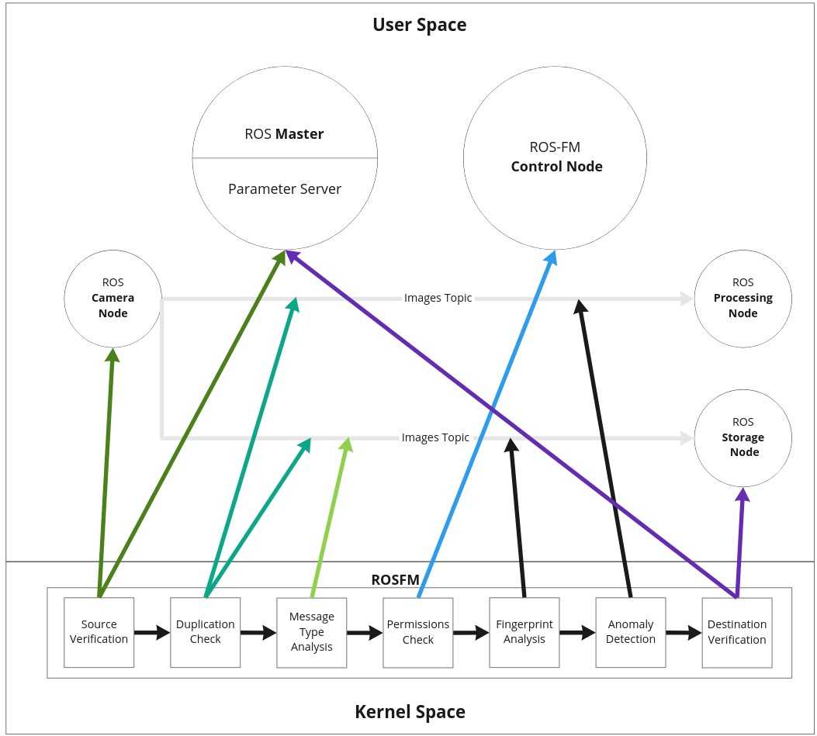
ROS-FM Architecture
ROS-FM Architecture
ROS-FM must identify the source of a given message
  When not using cryptographic libraries must look at configuration files instead
Acts to enforce the expected behavior for node communication
Each new message is scanned for known vulnerabilities, and to ensure that only certain nodes can receive the information
Metrics about the message are compiled together and stored so that users have a clear view of what is happening

Slide 11
ROS-FM Architecture
Rule:
(Module ':' Expression ';')+
;
Module:
'Filter' | 'Monitor' | 'Display'
;
Expression:
SimpleExpression '&&' Expression
| SimpleExpression
;
SimpleExpression:
LeftOperand op RightOperand
;
LeftOperand:
'TOPIC'
| 'NODE'
| 'MESSAGE'
| 'FIELD(' message_field=STRING ')'
| '{CUSTOM}'
;
op:
Equal
| NotEqual
| Contains
| ContainedIn
| Matches
;
Equal: '==';
NotEqual: '!=';
Contains: 'CONTAINS';
ContainedIn: 'IN';
Matches: 'MATCHES';
RightOperand:
STRING
| '[' (STRING)+ ']'
ROS-FM DSL
ROS is highly modular, requires a modular approach to provide protection
Users can write configuration files to provide various protections
Rules allow fine grained control from full topic enforcement all the way to individual bits

Slide 12
ROS-FM Architecture
ROS-FM Structure
eBPF Socket
Layer 7
Topic/ Service Table
Layer 6
User Input
ROS Rules Table
Layer 5
Filtering Table
TCPROS & DDS
XDP
Layer 4
Flow Metrics
Table
Layer 3
Layer 2
Layer 1

Slide 13
Results
Experiments
In order to test ROS-FM both ROS1 and ROS2 based systems were deployed
We set up several different test scenarios with different numbers of nodes and topics
In order to compare, we tested the overhead of the traditional ROS tools vs our own
Security was evaluated against two standard testing tools ROSPenTo and ROS2-SecTest

Slide 14
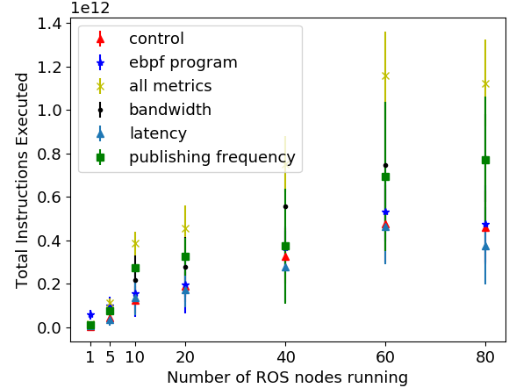
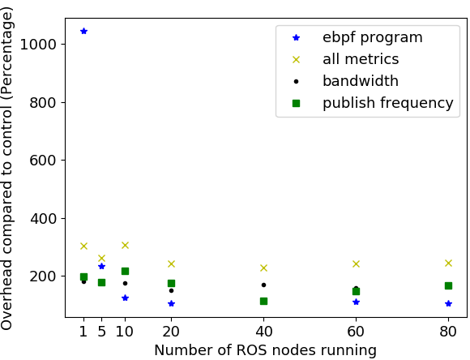
Results
ROS-FM Results

Slide 15
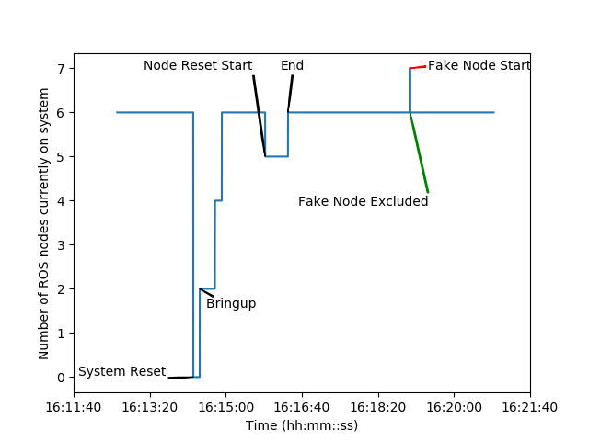
Results
ROS-FM Monitoring Results

Slide 16
Results
ROS-FM Monitoring Results
Attack | Result
Add publisher | Negated
Replace publisher List | Negated
Remove publisher | Negated
Isolate Service | Negated
Unsubscribe Node from Parameter | Limited
Update parameter | Limited
Attack | Result
CPU Exhaustion | Successful
Network Exhaustion | Negated
Disk Exhaustion | Successful
Memory Exhaustion | Successful
AWS ROS2 SEC Test Node
ROSPenTo

Slide 17
Conclusion
Conclusion & Future Work
Monitoring: An eBPF monitoring framework for robotic systems with very low overhead.
Security: A network layer security add-on to extend the core ROS security model.
Usability: A PCP plugin to export and easily visualize robotic statistics.
Reproducibility: Our code and data are publicly available. https://github.com/seanrivera/ROS_FM

Slide 18
Thank You!

