Slide 1

Improving Usability of
Fault Injection
Università degli Studi di Napoli Federico II
Italy
D. Cotroneo, L. De Simone, A.K. Iannillo, A. Lanzaro, R. Natella

Slide 2
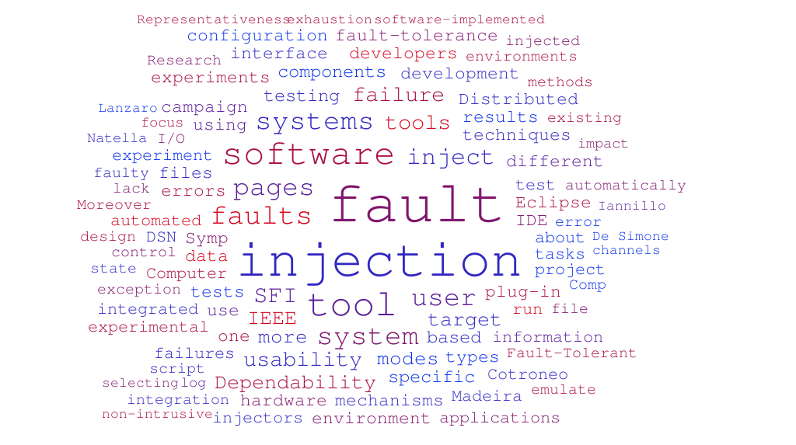
Outline
Introduction
Fault Injection Tools
Key Features
Demo

Slide 3
Introduction
Notes:
I’ll first show you a brief introduction of the topic

Slide 4

Software Fault Injection
an approach for gaining confidence about fault-tolerance properties of a software system, by deliberately injecting perturbations in the software to emulate faulty components and stressful conditions.
Validating fault-tolerance mechanisms
Aiding FMECAs (Failure Mode, Effects, and Criticality Analysis)
Dependability benchmarking
Notes:
I’d like to give you first a definition of what I mean for SFI (definition)
The application of SFI are several and can be classified in (click)
SFI can evaluate error detection and handling mechanisms (such as assertions and exception handlers) against faulty hardware and software components, and to improve such mechanisms if needed
Developers can quantify the impact of a faulty component on the overall system (e.g., in terms of catastrophic system failures), and mitigate risks by testing the most critical components and by revising the system design
SFI helps developers to choose among alternative systems or components the one that provides the best dependability and/or performance in the presence of faults

Slide 5
Fault Injection Process
Test Case Generation
Definition of workload
Definition of faultload (what, where and when to inject)
Test Execution
Build project
Run project
Result Analysis
Gather information
Failure analysis
Inject faults
Notes:
The steps a practitioner should follow are generally three (click)
First, he/she should generate the test case through the definition of workload and fault load (click)
Then the tests should be executed, that is: - (click)
Finally, the result should be analysed. In order to do that we should retrieve the some information from the execution and analyse the failures.

Slide 6
Usability
Fault Injection Portability
Fault Injection Integration
Fault Injection Flexibility
Efficiency
Effectiveness
Satisfaction
"The extent to which a product can be used by specified users to achieve specified goals with effectiveness, efficiency, and satisfaction in a specified context of use.“
[ISO definition]
Non Instrusiveness
Notes:
Our work is focused on the usability of fault injection. But what is usability? According to the ISO, usability is (definition)
In the topic of fault injection, usability requires to take care of several aspects, such as:
Integration, the possibility to use the FI inside the software development process without efforts
Portability, the ability to reuse a fault injection tool for different target system
Flexibility, the ability to use different fault models and to extend them
Non-Intrusiveness, the ability of a fault injector to not introduce significant perturbations that would distort the results of experiments
http://www.w3.org/2002/Talks/0104-usabilityprocess/slide3-0.html

Slide 7
Usability features
effectiveness: the accuracy and completeness with which specified users can achieve specified goals in particular environments
efficiency: the resources expended in relation to the accuracy and completeness of goals achieved
satisfaction: the comfort and acceptability of the work system to its users and other people affected by its use

Slide 8
Fault Injection Tools
Notes:
Let’s have a glance at some (very few) fault injection tools

Slide 9
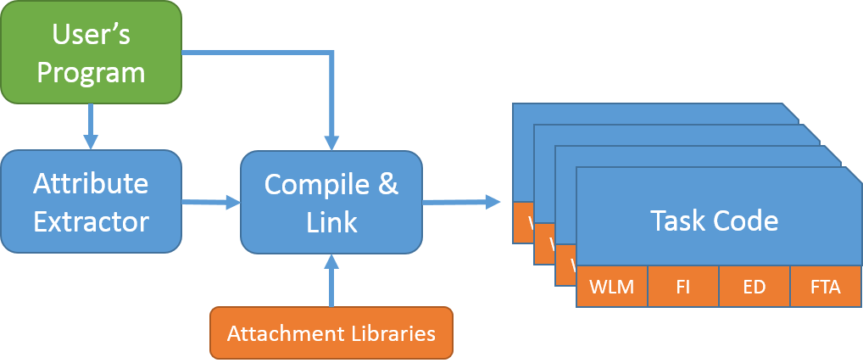
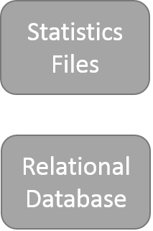
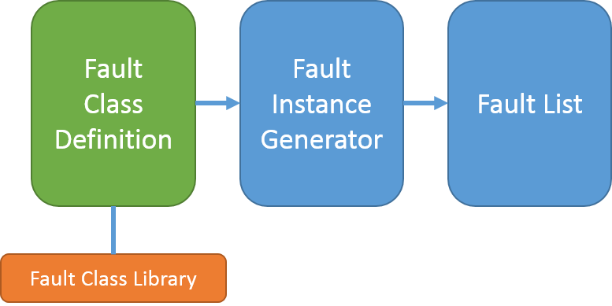
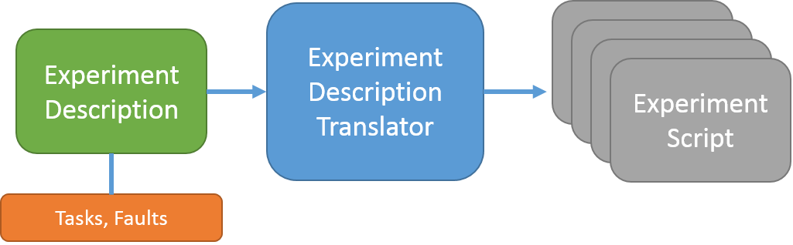
Fault Injection-based Automated Testing environment (FIAT)
Extraction of real-time communication Tasks
User-provided Fault Class Definition
User-provided Experiment Description
Results (coverage and latency measures, raw data)
Notes:
the FIAT environment has been designed for the injection of error patterns into executing software that are representative of errors that are likely to be generated by software and hardware. FIAT software can fault inject user application code and data.
A workload is an observable set of real-time communicating tasks. Analysis with a attribute extractors (tool), that returns task tables.
Fault Class definition is a template describing a set of workload or system modifications, which are representative of a group of physical/logical faults having common properties. As in any abstract type, the fault class can be instantiated, meaning that each method is applied to the associated domain and a specific fault (fault instance) is generated automatically by a fault instance generator.
The experiment description is a high level description of an experiment flow, which includes workload, fault injection and data collection commands (In a specific format).
In FIAT two types of data analysis are available: a set of predefined functions such as workload profiling and error coverage statistics; and a relational data base query language which enables the users to define their own analysis goals.
The fault injection manager provides experiment interface to assist the library preparation, experiment definition, experiment execution and data analyzer.
---------------------------
Link of 4 program attachment (workload monitor, fault injector, error detection/reporting, fault tolerant arch).

Slide 10
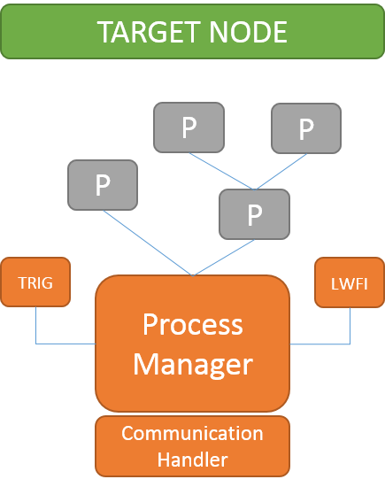
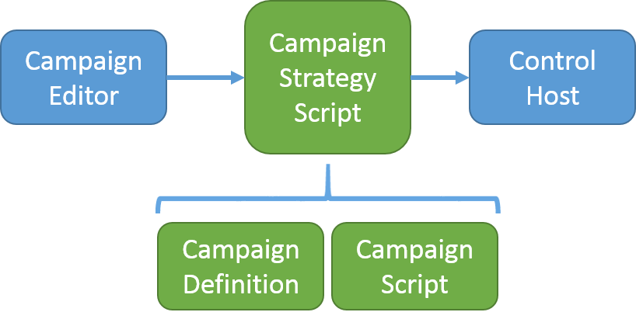
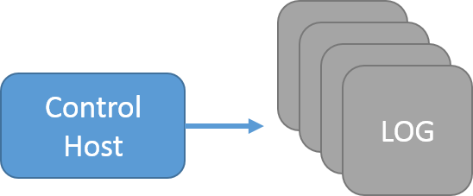
NFTAPE
User-provided Campaign Strategy Scripts
Lightweight Fault Injectors
Results (system logs)
Notes:
NFTAPE is an automated fault injection tool that support, among others, Multiple Fault Models, Multiple Fault Triggers, Multiple Targets.
The user should provide the campaign strategy (where, what and when to inject) specifying triggers and LWFI.
These two are loaded in the target node as process, controlled through a communication handler.
During the experiments, the target logs are retrieved for further analysis.
-------------------------------------------------------------
A motivating factor for developing NFTAPE came from failing to find an automated fault injection tool that would support the set of features needed to evaluate a computer system developed to run scientific experiments in space. A partial list of the requirements includes: Multiple Fault Models, Multiple Fault Triggers, Multiple Targets, Versatile Error Reporting Model.
NFTAPE also provides an API to further facilitate development of fault injectors (fault model).
Distributed fault injection based analyzes need to manage several cooperating processes (e.g., workload generators, monitors or heartbeats, target applications, loggers,triggers, acceptance tests, and LWFI processes). Managing them entails providing parameters for the process, starting the process, recognizing error conditions (such as invalid filename or arguments), processing data from the process, and capturing the process termination. In order to provide these services, we require the Process Manager to be a parent of all processes involved in a given fault injection campaign (e.g., injectors, monitors, application).

Slide 11
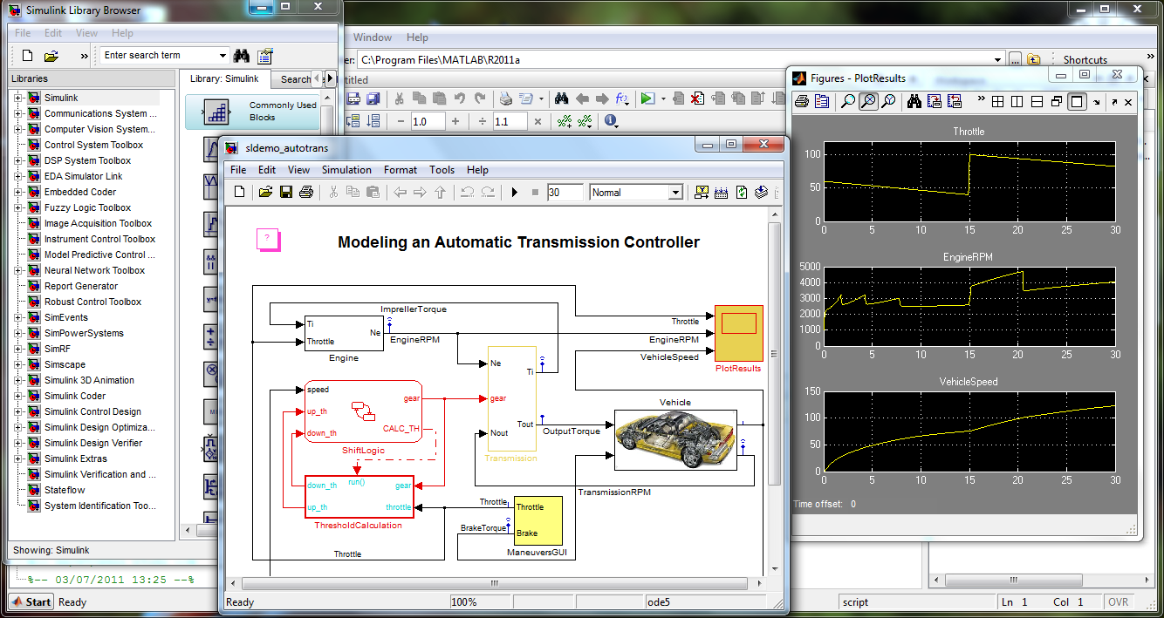

Model-Implemented Fault Injection tool (MODIFI)
Notes:
MODIFI targets behaviour models in Simulink, adata flow graphical programming language tool for modeling, simulating and analyzing multi domain dynamic systems.
The first step for a user of MODIFI is to supply a Simulink model as target for the fault injection and a corresponding stimuli file.
The next step is to select fault models, which are implemented as failure mode functions (FMF) in MODIFI, for each of the signals in the behavior model that shall be subject to fault injection.
The third step during configuration of fault-injection experiments is to define safety requirements (failure detectors).
The fourth and final configuration step is related to different aspects of time. The user can define when to observe the system behavior and when to inject fault.
--------------------------------------------
The stimuli file serves two purposes: to define the simulation time (time step and length) and provide signal values for all input ports in the entire system for the duration of the simulation.
The FMFs available are derived from the XML description supplied during the first configuration step.

Slide 12
Key Features
Notes:
Now I’ll show you step by step how we would like to implement the fault injection process

Slide 13
Generate Fault Injection Tests
What to inject?
Where to inject?
When to inject?
gather information about the project from an IDE
a wizard guides the user in selecting what/where/when to inject (based on project info)
possibility to choose among several injectors and fault models
Notes:
The first issue is how to generate fault injection tests. We have to define…
In order to get the information about the project, we can rely on the IDE, the environment where the software has been created and developed.
Then a wizard…
We can also dynamically choose among…

Slide 14
Wizard
Also called setup assistant
It is a user interface type that presents a user with a sequence of dialog boxes that lead the user through a series of well-defined steps
Tasks that are complex, infrequently performed, or unfamiliar may be easier to perform using a wizard

Slide 15
Execute Tests
reuse of the builder and launcher provided by the IDE (for the build and launch steps of fault injection)
the IDE allows to access and to instrument/modify the code and configuration of the target project
Inject faults
Build the project
Run the project
Notes:
In order to execute tests, we should be able to…
Thanks to the IDE, we can reuse its builder and launcher (that have been already configured previously during the development process) for the execution of tests.
Furthermore, the IDE…

Slide 16
Analyse Results
Gather the measurements of the launch
Define failure modes
Present the results
use IDE facilities for retrieving launch information and outputs
use of Wizard to set up (application-dependant) failure detectors
an integrated analyser presents results through graphical interfaces.
Notes:
Finally, an import issue is to analyse the results. We must…
For this purpose, we can use the IDE facilities for… (that’s because we are using the IDE launcher)
In order to detect the failure mode of the software, we can use a wizard… We’ll see this later in the next slide
In addiction to these, an integrated…

Slide 17
Application-Dependent Failure Detectors
Selection of the I/O channels to be monitored during the execution
  Output files, standard output, standard error…
Configuration of criteria for correlating failure modes with the I/O channels
  Find patterns in output files (e.g., keywords)
  Compare faulty traces to fault-free trace
Notes:
We consider two kinds of failure mode, and so, detector: dependant and not.
Not dependant are failures such as crash or hang.
For the dependant failure detection, we should follow two separate steps.

Slide 18
Demo
Notes:
Now we’re moving to the most interesting part of the presentation the demo. But first few information.

Slide 19

Eclipse Plug-in
Extends the workbench UI with wizards and dialogs
Uses the JFace UI framework to present data and information
Uses the Resource plugin to control the project files and related eclipse configuration files
Uses of Program Debug and Launch support
Notes:
We implemented the FIT as an Eclipse plug-in. Eclipse is an integrated development environment (IDE). It contains a base workspace and an extensible plug-in system for customizing the environment. A software component in Eclipse is called a plug-in, that allows to extend the IDE functionality.
The JFace UI framework provides several standard dialogs and a framework for building your own dialogs and wizards. We'll look at the different kinds of dialogs and wizards and how to build them.
An essential plug-in for Eclipse IDE applications is the resources plug-in (named org.eclipse.core.resources). The resources plug-in provides services for accessing the projects, folders, and files that a user is working with.
The resources plug-in in the Eclipse platform allows you to manage a set of source files for a program and compile them using an incremental project builder.

Slide 20
Demo Experiment
Use of the Eclipse Plug-in for a Java Standalone Application
  Traffic Collision Avoidance System (TCAS) algorithm implemented in Java
We will go through the three phases of Fault Injection Testing in order to see how the plugin handles them
  Creation of Fault Injection Campaign
  Run Experiments
  Crash Failure Detector
  Application-Dependent Failure Detector

