Slide 1

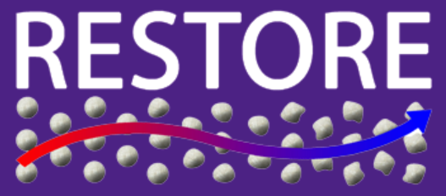


Non-Credit Graduate Course:
The Thermochemistry of Smouldering Combustion.
by Márcio Ferreira Martins
Seminar II – June 28, 2017

Slide 2
Seminar III – Kinetics of solid reactions
Step 1. Proximate analysis
Composition (wt.%) | Non-standard (170 K/min)
FC | 4.7
VM | 17.2
Minerals | 34.6
Inert matter | 43.5

Slide 3
Seminar III – Kinetics of solid reactions
Step 1. Proximate analysis: Strategy

Slide 4
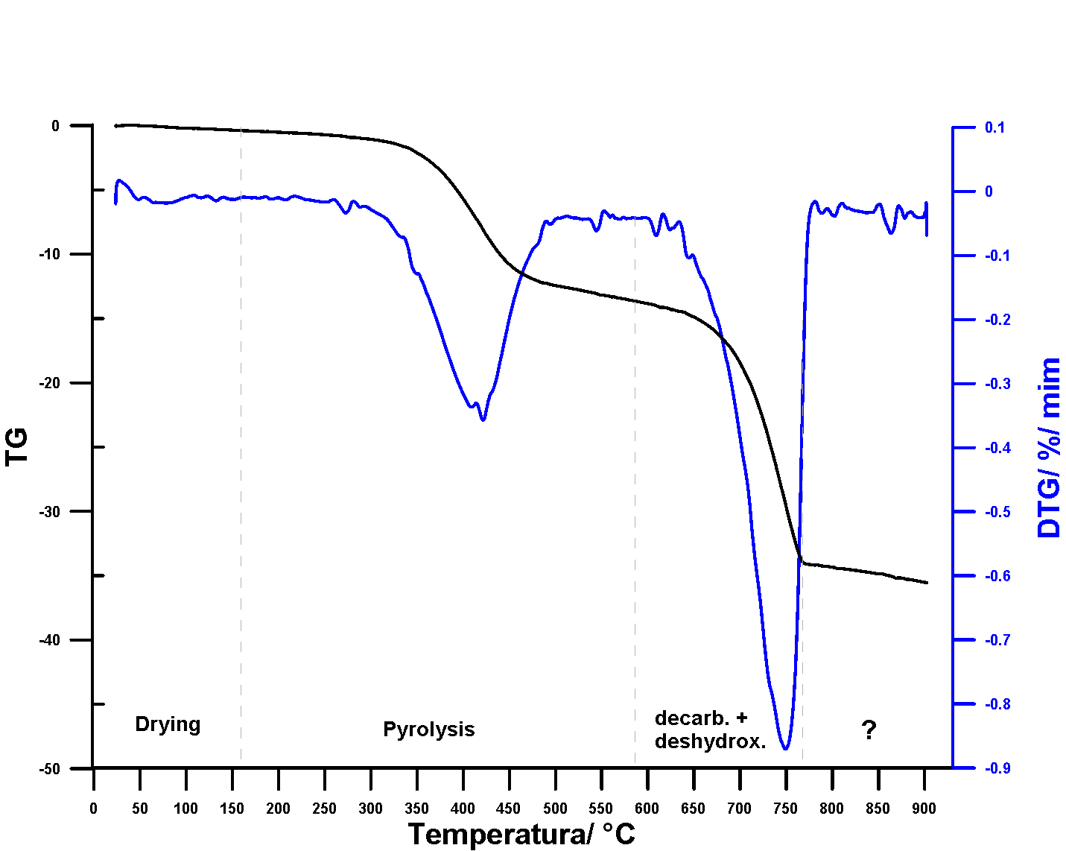
Seminar III – Kinetics of solid reactions
Step 2. TG/DTG – N2

Slide 5
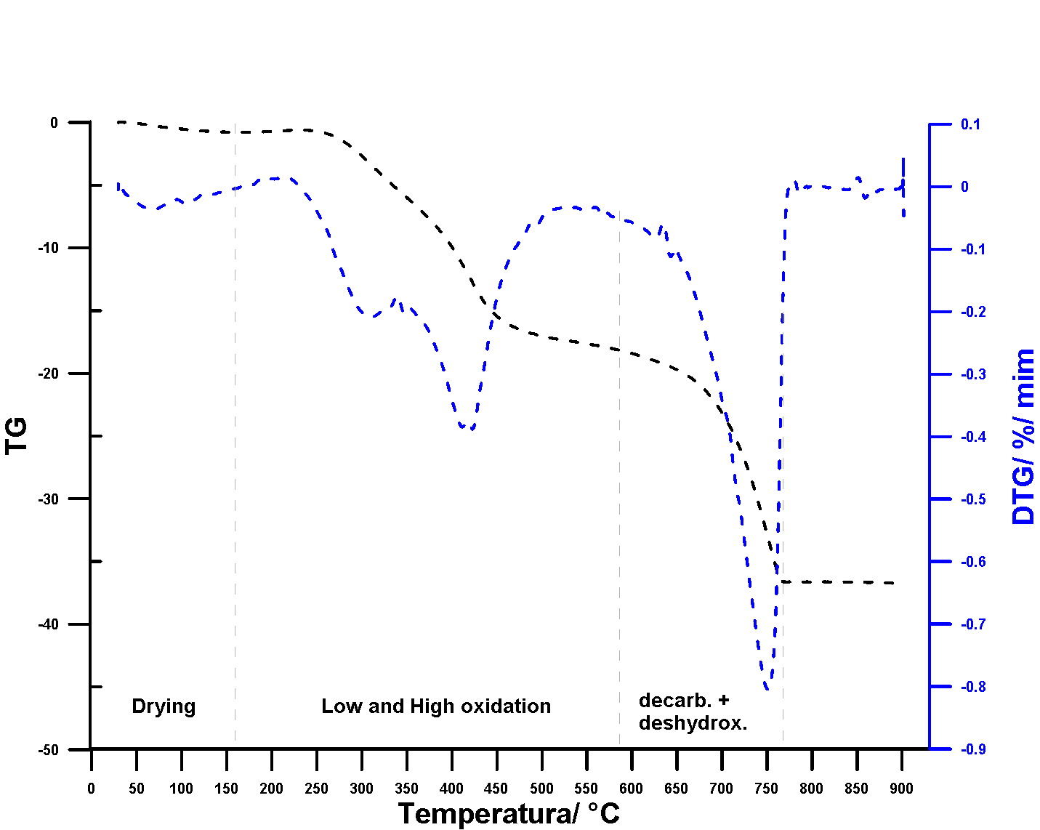
Seminar III – Kinetics of solid reactions
Step 2. TG/DTG – Air

Slide 6
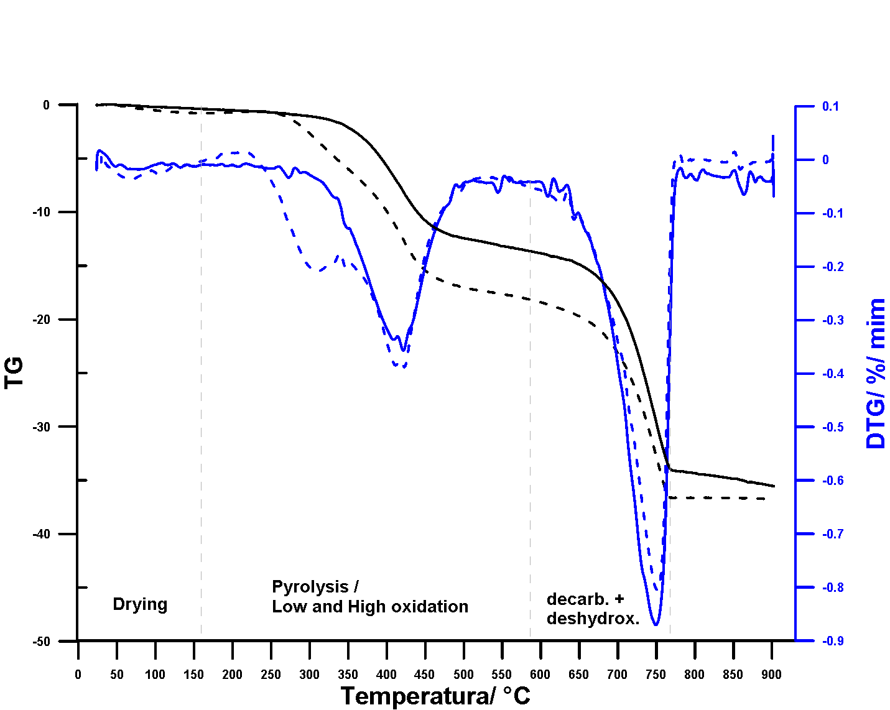
Seminar III – Kinetics of solid reactions
Step 2. TG/DTG – Air x N2

Slide 7
Seminar III – Kinetics of solid reactions
Step 3. TG/DTG vs. Non-standard
Composition (wt.%) | Non-standard (170 K/min) | TGA (3K/min)
FC | 4.7 | -
VM | 17.2 | 18.0
Carbonates (CaCO₃) | 34.6 | 42.3
Inert matter | 43.5 | 39.7

Slide 8
Seminar III – Kinetics of solid reactions
Step 4. According to the temperature ranges
From pyrolysis:
Water evaporation: 50 - 150 °C
OM → FC + VM: 150–550 °C
Minerals → Minerals + gas: 550–770 °C
IM → IM

Slide 9
Seminar III – Kinetics of solid reactions
Step 4. According to the temperature ranges
From combustion:
Water evaporation: 50 - 150 °C
OM → FC + VM
FC + O₂ : → gas
Minerals → Minerals + gas: 550–770 °C
IM → IM
150–550 °C

Slide 10

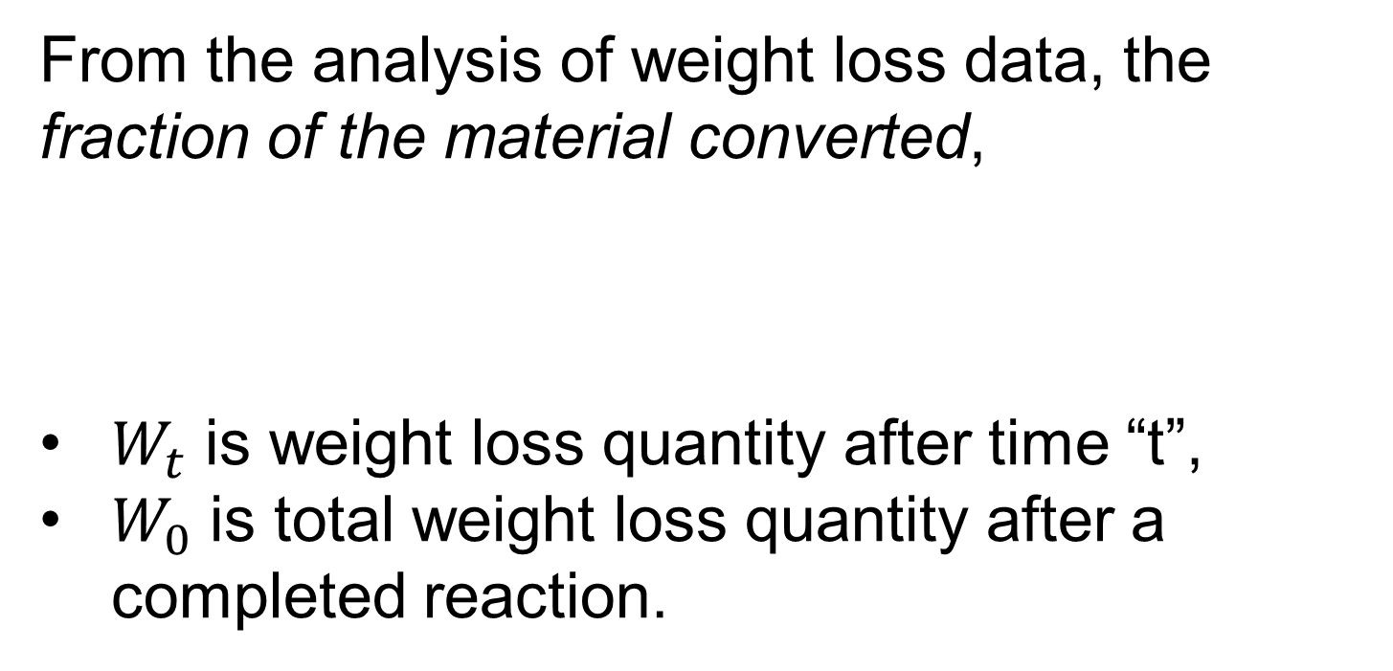
Seminar III – Kinetics of solid reactions
Step 5. Mathematic models
From the analysis of weight loss data, the fraction of the material converted,
$W_{t}$ is weight loss quantity after time “t”,
$W_{0}$ is total weight loss quantity after a completed reaction.
$$α=\frac{W_{t}}{W_{0}}$$
(1)

Slide 11
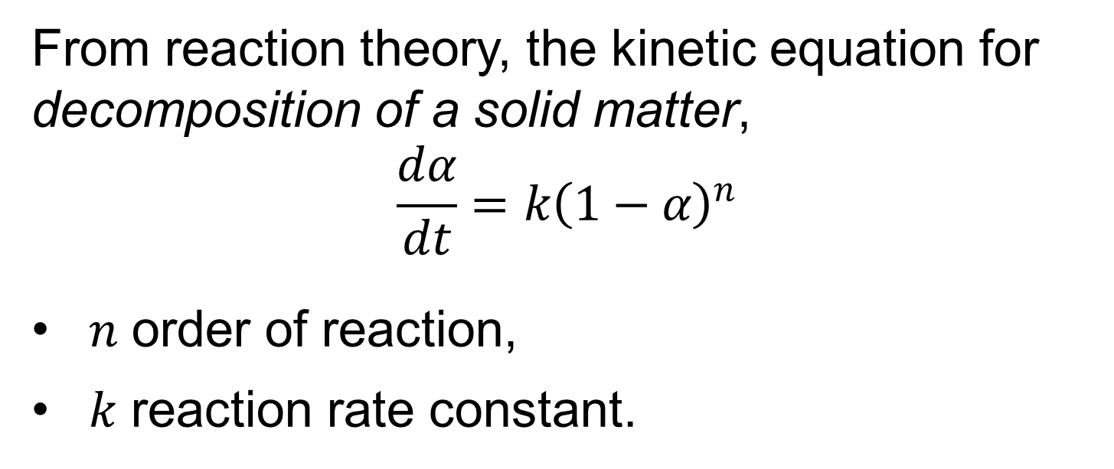
Seminar III – Kinetics of solid reactions
Step 5. Mathematic models
From reaction theory, the kinetic equation for decomposition of a solid matter,
$$\frac{dα}{dt}=k{\left(1−α\right)}^{n}$$
$n$ order of reaction,
$k$ reaction rate constant.
(2)

Slide 12
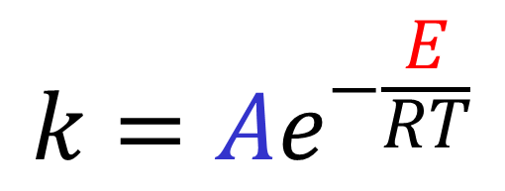
Seminar III – Kinetics of solid reactions
Step 5. Mathematic models
Assuming an Arrhenius governed problem
$$k=Ae^{−\frac{E}{RT}}$$
Apparent activation energy
(3)
Temperature
Pre-exponential factor
Pay attention to the units!

Slide 13
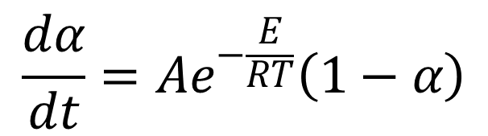
Seminar III – Kinetics of solid reactions
Step 5. Mathematic models
Combining Eq. (2) and (3) and considering a first-order reaction:
$$\frac{dα}{dt}=Ae^{−\frac{E}{RT}}\left(1−α\right)$$
(4)
Non-isothermal analysis
Isothermal analysis

Slide 14
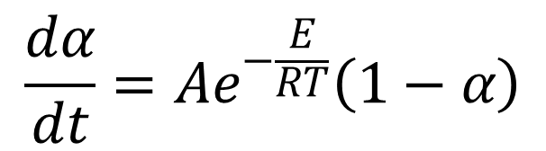
Seminar III – Kinetics of solid reactions
Step 5. Mathematic models
$$\frac{dα}{dt}=Ae^{−\frac{E}{RT}}\left(1−α\right)$$
(4)
Non-isothermal analysis
Isothermal analysis
Direct Arrhenius plot method
Differential method of Friedman
Integral methods of Ozawa.
…
Model-fitting approach

Slide 15
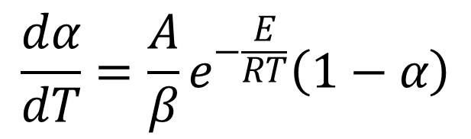
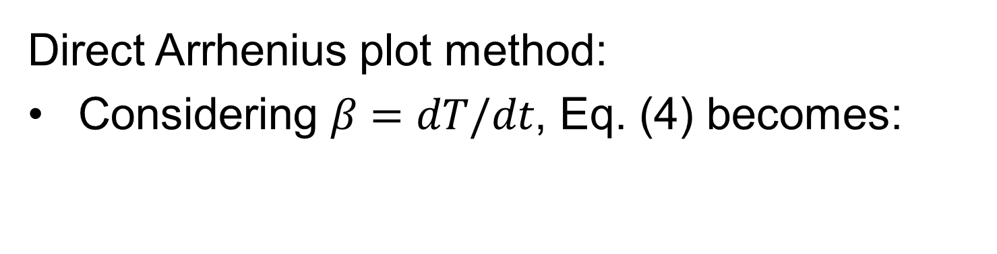
Seminar III – Kinetics of solid reactions
Step 5. Mathematic models
Direct Arrhenius plot method:
Considering $β=dT/dt$, Eq. (4) becomes:
$$\frac{dα}{dT}=\frac{A}{β}e^{−\frac{E}{RT}}\left(1−α\right)$$
(5)

Slide 16
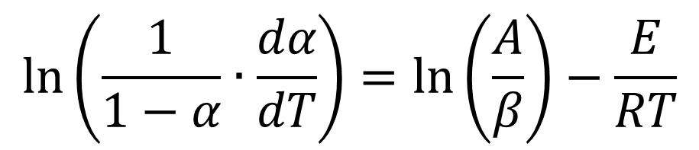
Seminar III – Kinetics of solid reactions
Step 5. Mathematic models
Direct Arrhenius plot method:
Taking the logarithm of both sides of Eq. (5)
$$\ln\left(\frac{1}{1−α}∙\frac{dα}{dT}\right)=\ln\left(\frac{A}{β}\right)−\frac{E}{RT}$$
(6)

Slide 17

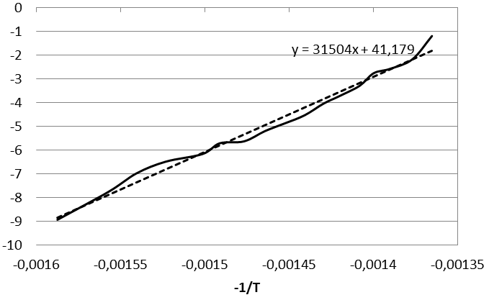
Seminar III – Kinetics of solid reactions
Step 6. Direct Arrhenius plot method

