Slide 1

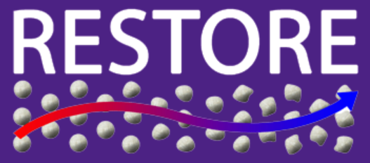


Non-Credit Graduate Course:
The Thermochemistry of Smouldering Combustion.
by Márcio Ferreira Martins
Seminar I – June 21 2017

Slide 2
Seminar I – Unconventional fuel
Goals:
How to characterise these fuels?
What kind of techniques are the best?
The best = relatively cheap
The role of the Standard Practices

Slide 3
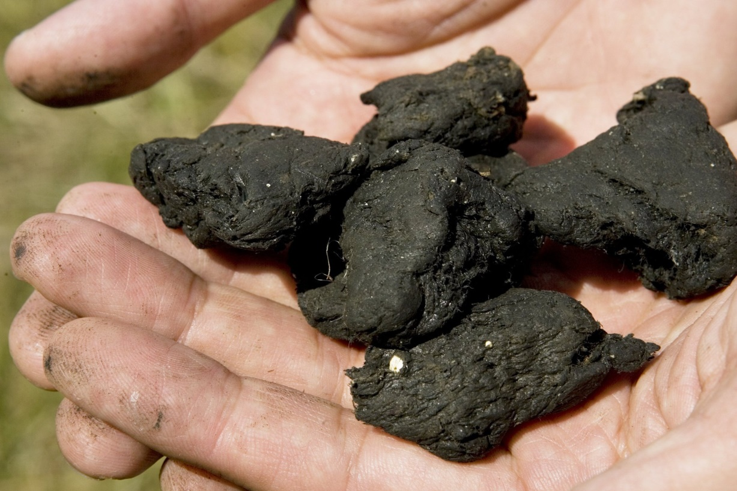

Seminar I – Unconventional fuel
Scenario A
Guys we have to characterise this…

Slide 4
Suggestions:
?
Hypothesis:
?
Practice:
?

Slide 5
Seminar I – Unconventional fuel
The role of the Standard Practices
Standard Practice for
Proximate Analysis of Coal and Coke
Test Methods:
Moisture — Test Methods D3173 and D7582.
Ash — Test Methods D3174 and D7582.
Volatile Matter —Test Methods D3175 and D7582 .If the modified procedure of D3175 is required, the report should show that the modified procedure was used.
Fixed Carbon — The fixed carbon is a calculated value. It is the resultant of the summation of percentage moisture, ash, and volatile matter subtracted from 100. All percentages shall be on the same moisture reference base.

Slide 6
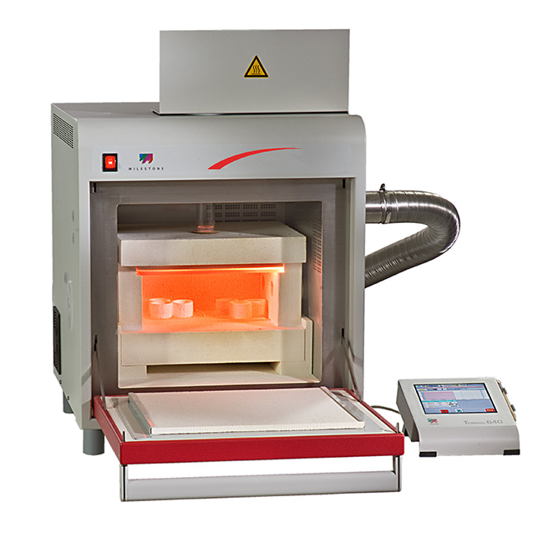
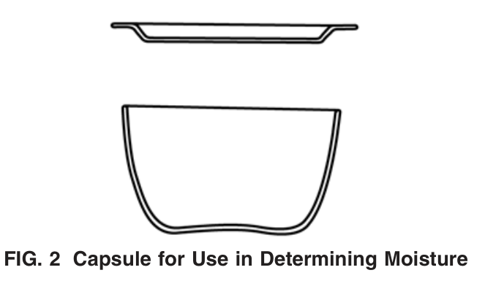
Seminar I – Unconventional fuel
The role of the Standard Practices
Moisture — Test Methods D3173 and D7582.
Apparatus:
Porcelain or fused silica

Slide 7
Seminar I – Unconventional fuel
The role of the Standard Practices
Moisture — Test Methods D3173 and D7582.
Procedure:
Sample Passing a 250-µm
Preheated oven (at 104 to 110°C)
Close the oven at once and heat for 1 h
cool in a desiccator
weigh as soon as the capsules have reached
room temperature.

Slide 8
Seminar I – Unconventional fuel
The role of the Standard Practices
Ash — Test Methods D3174 and D7582.
Apparatus:
Porcelain or fused silica

Slide 9
Seminar I – Unconventional fuel
The role of the Standard Practices
Ash — Test Methods D3174 and D7582.
Procedure:
Sample Passing a 250-µm
Transfer approximately 1 g
From 500 ± 10°C to 750 ± 15°C at the end of 1 hour.
Heat at the final temperature (750°C or 950°C) for
an additional 2 h.
Remove the capsule from the muffle and place the
cover on the capsule, cool and weigh.

Slide 10
Seminar I – Unconventional fuel
The role of the Standard Practices
Volatile Matter —Test Methods D3175 and D7582
Apparatus:
Porcelain or fused silica

Slide 11
Seminar I – Unconventional fuel
The role of the Standard Practices
Volatile Matter —Test Methods D3175 and D7582
Procedure:
Sample Passing a 250-µm
Carry out a moisture determination
Place 1 g of the sample in a platinum crucible, place the cover.
Insert directly into the furnace chamber at a
temperature of 950 ± 20°C for a total of exactly 7 min. ….. Weigh as soon as cold.

Slide 12
Seminar I – Unconventional fuel
The role of the Standard Practices
Fixed Carbon : a calculated value
Procedure:
Fixed carbon,% =
100 – (moisture,% + ash,% + volatile matter,%)

Slide 13
Suggestions:
xx
Hypothesis:
xx
Practice:
xx

Slide 14
Seminar I – Unconventional fuel
The problem concerning the size of the sample
Why in the standard practice is highlighted a specific size for the sample?

Slide 15
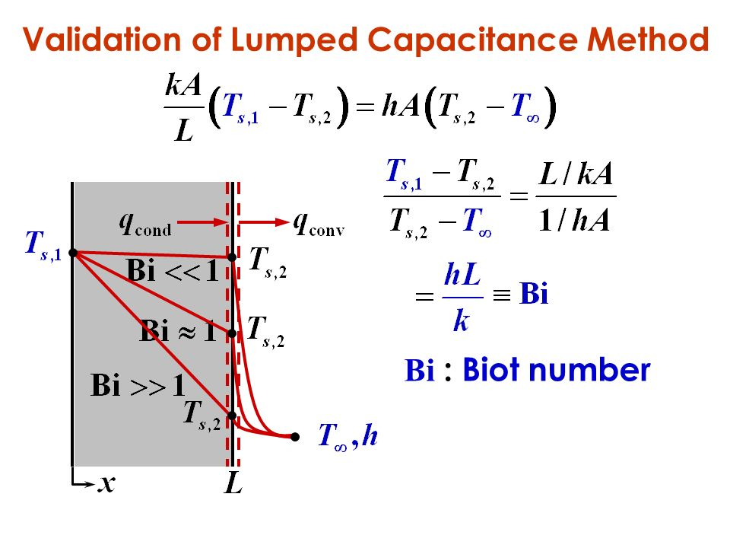
Seminar I – Unconventional fuel
The problem concerning the size of the sample

Slide 16
Suggestions:
xx
Hypothesis:
xx
Practice:
xx

Slide 17
Seminar I – Unconventional fuel
Thermogravimetry (TG) is a technique in which the mass of the sample is monitored against time or temperature, while the temperature of the sample, in a specified atmosphere, is programmed.

Slide 18
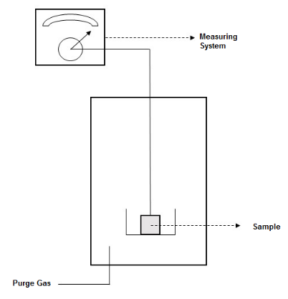
Seminar I – Unconventional fuel
Thermogravimetry (TG)

Slide 19
Seminar I – Unconventional fuel
Thermogravimetry (TG): It is also possible:
to control the atmosphere around the sample. The purge gas can be active (O₂) or inert (N₂).
to control Gas flow rate
to choise the sample-size (mg)

Slide 20
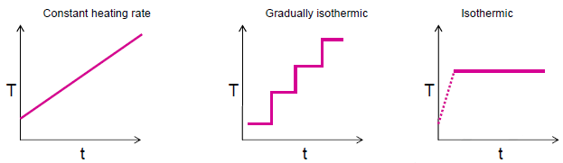
Seminar I – Unconventional fuel
Thermogravimetry (TG): It is also possible:
to program the temperature-time evolution.
β = dT/dt.

Slide 21
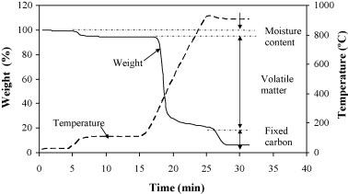
Seminar I – Unconventional fuel
Thermogravimetry (TG): Typical curve

Slide 22
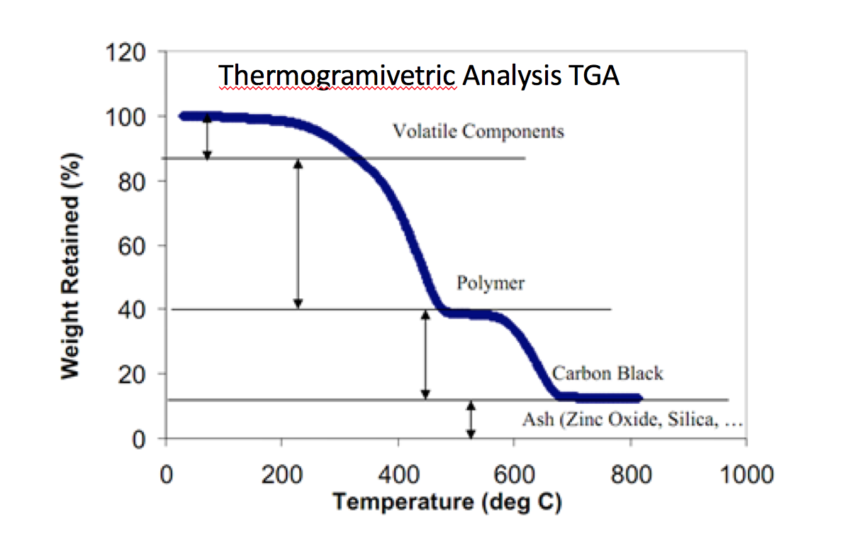
Seminar I – Unconventional fuel
Thermogravimetry (TG): Typical curve

Slide 23
Seminar I – Unconventional fuel
Thermogravimetry (TG): Its first derivative/ DTG
The DTG represents the first derivate of the TG curve, dm/dt, plotted against temperature.
It has the beneficial effect of producing peaks of the transitions from the mass loss curves.

Slide 24
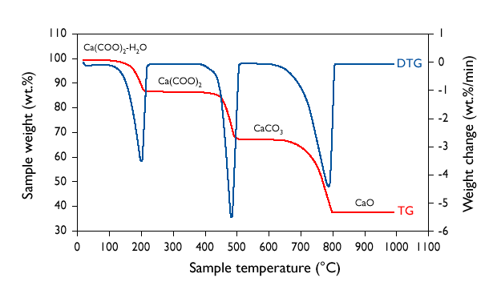
Seminar I – Unconventional fuel
Thermogravimetry (TG): Its first derivative/ DTG

Slide 25
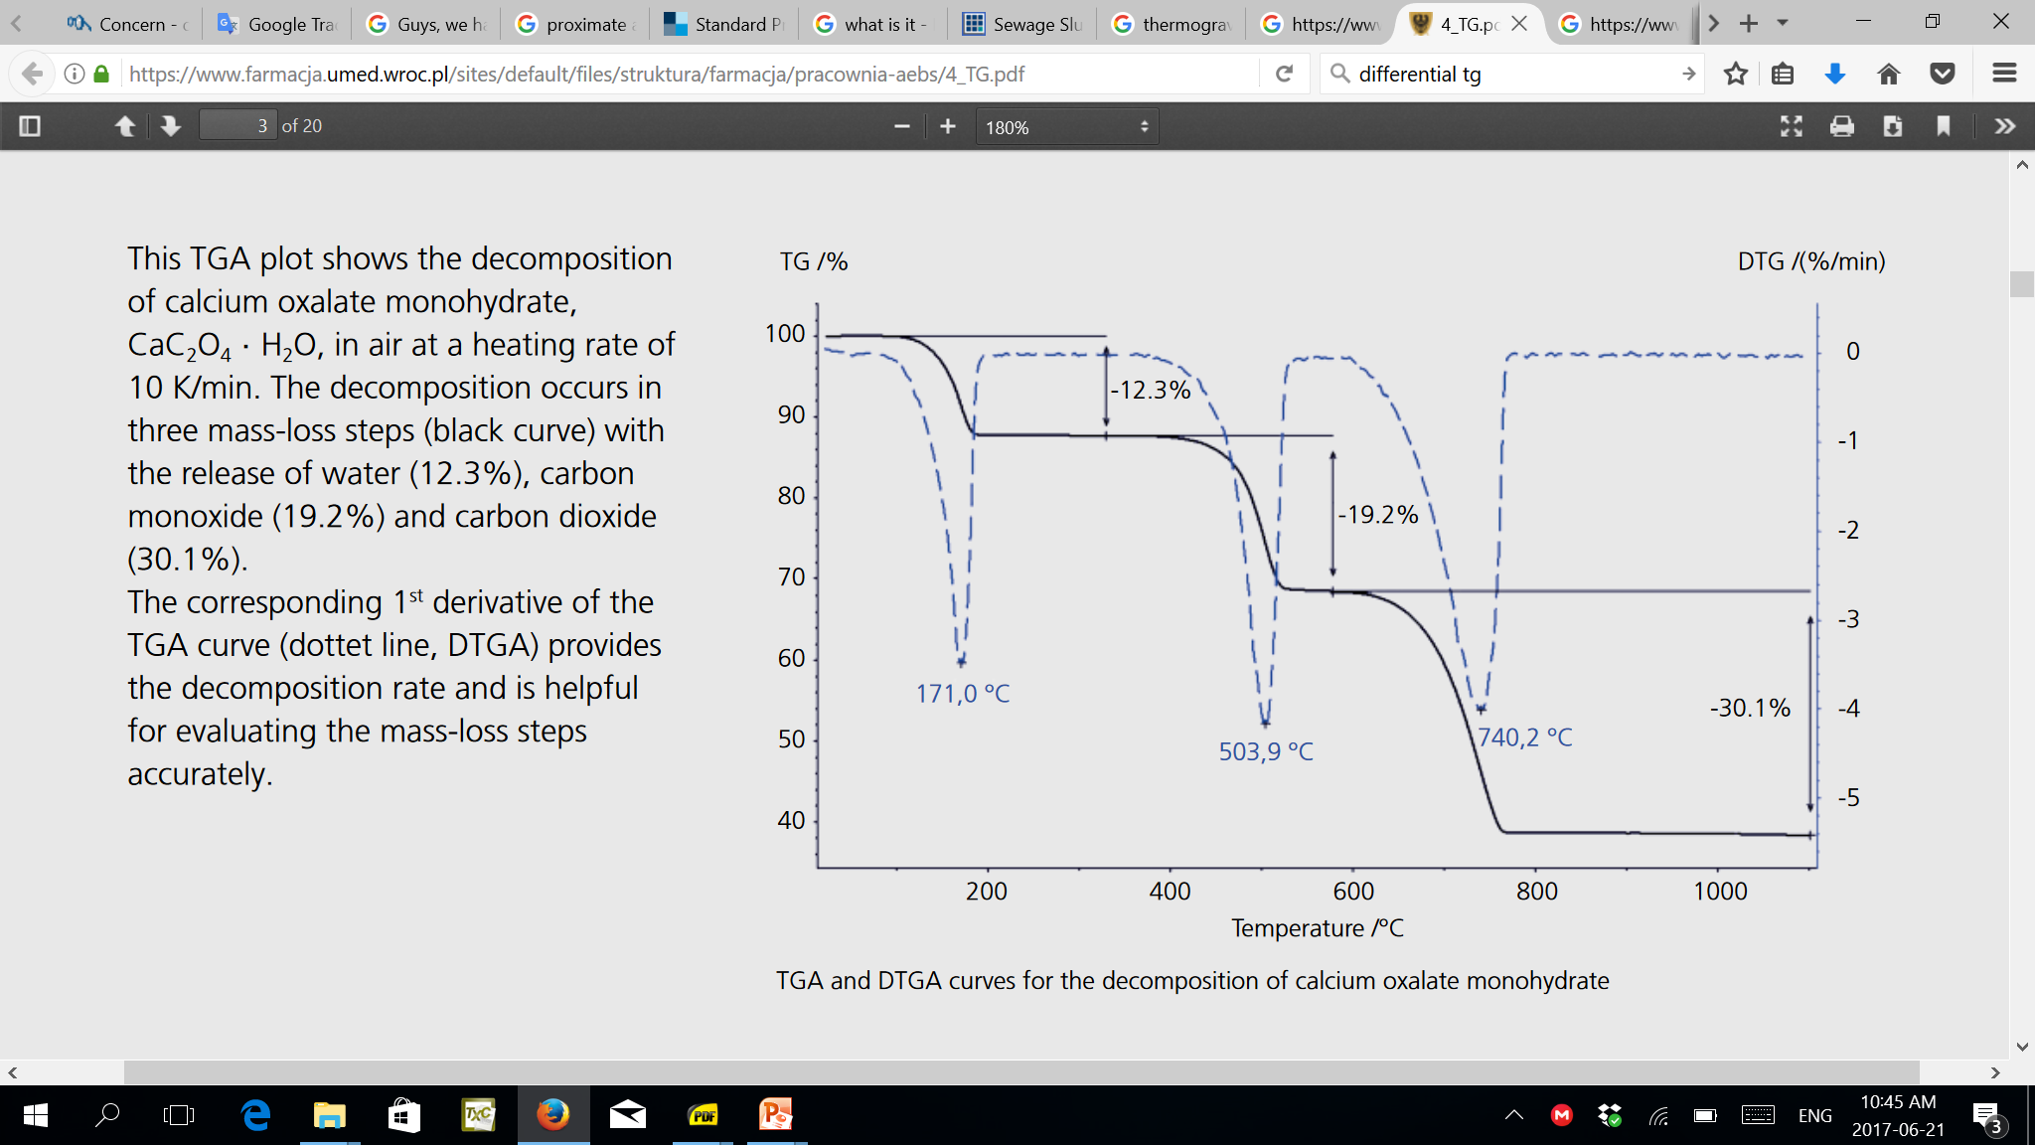
Seminar I – Unconventional fuel
A typical interpretation from TG/ DTG curves

Slide 26
Seminar I – Unconventional fuel
TG/ DTG – Typical interpretation from curves
Ca(C₂0₄)*xH₂O ←→ Ca(C₂0₄) *H₂O + x-1 H₂O
Ca(C₂0₄)*H₂O←→ Ca(C₂0₄) + H₂O
Ca(C₂0₄) ←→ CaCO₃ + CO
CaCO₃ ←→ CaO + CO₂

Slide 27
Suggestions:
xx
Hypothesis:
xx
Practice:
xx

Slide 28
Seminar I – Unconventional fuel
References:
[1] Matheus Poletto; Vinícios Pistor; Ruth Marlene Campomanes SantanaI; Ademir José Zattera. Materials produced from plant biomass. Part II: evaluation of crystallinity and degradation kinetics of cellulose.
[2] Philips Research bulletin , “Thermal Analysis (TA)”.
[3] Roberto Comesaña, Miguel A. Gómez, Miguel A. Álvarez, Pablo Eguía. Thermal lag analysis on a simulated TGA-DSC device, 2012.
[4] Available at http://itc.tu-bs.de/Abteilungen/Makro/Methods/dsc.htm.

