Slide 1

Software Project Lab - 1
Imitating MAC Layer

Slide 2
Submitted by Md. Azizul Hakim BSSE0905

Slide 3

Why This Project?
To communicate within a LAN.
Some packets could be corrupted; that
can’t be retrieved.
Raw socket is used so that capture all
packets including corrupted packets also.

Slide 4
Project Outline
Broadcasting packet
Receive packets and point out broadcasted packet
Analyze received packet.

Slide 5
What is Raw Socket?
A socket is one endpoint of a two-way communication link within a network.
There are three kind of socket
1.Datagram Socket.
2.Stream Socket.
3.Raw socket.
A raw socket is a network socket that allows direct sending and receiving of IP packets without any protocol-specification.

Slide 6
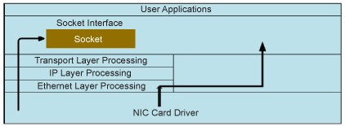
Why Raw Socket?

Slide 7

Broadcasting process
Generating packet
Packet
LAN

Slide 8
Receiving packets
Receiving packets
Give massage if find broadcasted packet
Formatting
Pcap
File

Slide 9
Analyzing File
Pcap
File
Pcap
File
Printing
Pcap
File
Processing
Pcap
File
Analyzing and split them according to protocol.

Slide 10
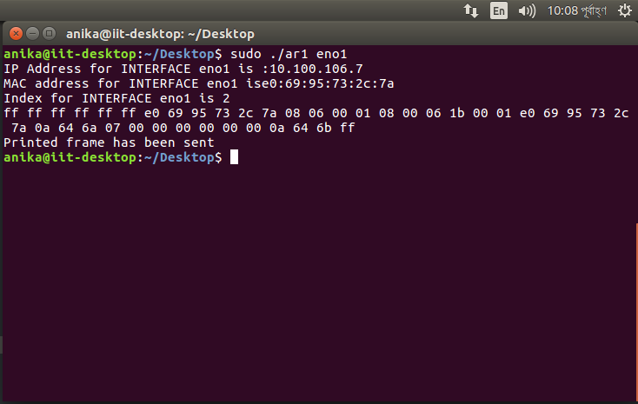
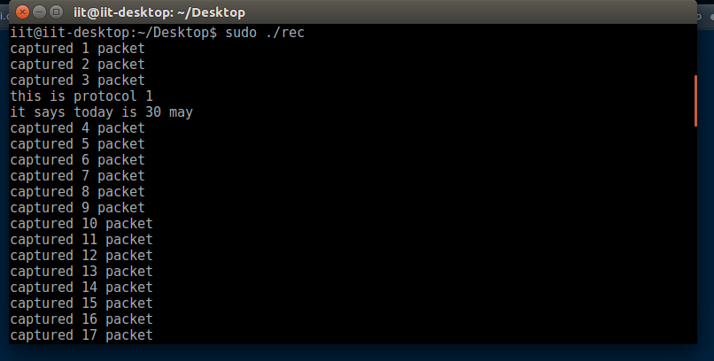
Outputs

Slide 11


Slide 12
References
http://www.kroosec.com/2012/10/a-look-at-pcap-file-format.html0/a-look-at-pcap-fileformat.html
https://www.binarytides.com/socket-programming-c-linux-tutorial/
https://opensourceforu.com/2015/03/a-guide-to-using-raw-sockets/
Github Repository : https://github.com/akib1162100/Spl

Slide 13


