Slide 1
System Analysis and Design on Institute of Information & Communication Technology, CUET
Submitted By :
Shafiul Alam (1904006) Md. Akib Hasan (1904015)
K.M Mahabub Hossain (1904017)
Sadman Rahman Ananta (1904020)
Sawmik Kumar Paul (1904021)
Supervised By:
Prof. Dr. Kaushik Deb Professor, Dept of CSE, CUET Sabiha Anan Assistant Professor, Dept of CSE, CUET
1
Notes:
1
*

Slide 2
Contents
Organization Overview
General Information
Management Structure
Position Hierarchy
Types of Information
Information Gathering
System Requirements Specification
Conclusion

Slide 3
Organization Overview
Institute of Information & Communication Technology (IICT)
Location :
6th floor, Academic Building - 3, CUET, Chittagong.
Institution Type:
Non-profit educational organization.

Slide 4
Motivation
Provide Facilities for Post Graduation Study.
Actively Pursue Advance Research in ICT.
Develop Knowledge Based Products & Services.
Produce Expertise in ICT.

Slide 5
General Information
Total Sections to Operate : 02
Total Employee : 19
Services :
Promote 24 hour internet service up to 70mbps
Online Payment System for Teachers & Employee
Developing Required Software
Offers ICT Based Training Programs

Slide 6
Wings
IICT
Academic
System & Support
Providing Email
Networking.
Manufacturing ID Card.
Software (Website & Conference Site).
Online Registration.
Technical Support.
Figure 1 : Wings of IICT

Slide 7
Management Structure
Top Level
Director
Mid Level
Supportive Engineers
Low Level
Technicians , Lab Assistants
Figure 2 : Management Structure

Slide 8
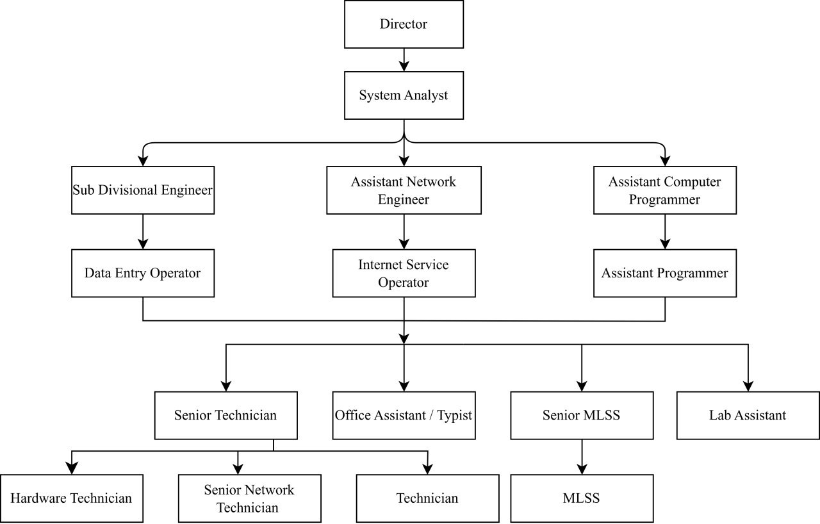
Position Hierarchy
Figure 3 : Position Hierarchy

Slide 9
Types of Information
Operational Information
Data Entry
Maintain Email Service
Managing Server
Maintain Broadband Service
Surveilling whole institution (CUET)
Operating Online Registration
Manufacturing ID Card

Slide 10
Types of Information
Tactical Information
Offering Technical Courses
Providing Training Courses
PGD (Postgraduate Diploma) in ICT
Providing Server for Undergraduate Admission Test

Slide 11
Types of Information
Strategic Information
Offering Edu-Roam Facilities
Introducing GPU Service
Providing D-nothi Service
Bringing SSO (Single Sign On) Service

Slide 12
Types of Information
Statutory Information
Budget Allocation Report
Financial Year Report

Slide 13
Information Gathering
Basic Concept of IICT (CUET)?
Number of Wings?
Management Hierarchy?
Total Number of Employees?
Day to Day Activities?
Short Term Activities?
Long Term Planning?
Providing Facilities?

Slide 14
Information Gathering (Contd…)
Variety of Activity?
Available Services ?
Diversification?

Slide 15
System Requirement Specification
Increasing Bandwidth Up to Double.
Recruiting Young, Talented Workers.
Updating the Registration System.
Designing Automated Communication System.

Slide 16
Conclusion
Choosing IICT, CUET Because of Being Well Developed System.
Encountered Time Constraints on Information Collecting.

Slide 17


