Slide 1

Zakat & Donation Platform
Chittagong University of Engineering and Technology
Department of Computer Science & Engineering
Course Code : CSE-252 Course Title : Database Management System(Sessional)
Supervised by
PRESENTED BY-
Md. Akib Hasan (1904015)
K.M Mahabub Hossain (1904017)
Sadman Rahman Ananta (1904020)
MD. SHAFIUL ALAM FORHAD
Assistant Professor
Department of CSE,CUET
MD. ATIQUL ISLAM RIZVI Assistant Professor
Department of CSE,CUET

Slide 2

Contents
Introduction
Motivation
ER Diagram
Conclusion

Slide 3
INTRODUCTION
The purpose of this application is to collect & distribute zakat & charity centrally.
It maintains proper collection & donation in a systematic way.

Slide 4
Motivation
Main inspiration behind this project is to do betterment for the Muslim Ummah by collecting & distributing Zakat centrally according to Shariah so that we can achieve real goal of Zakat.
Another situation arises when any natural calamity occurs. We can distribute the relief goods in an organized way so that actual affected deprived people may get the benefit .

Slide 5

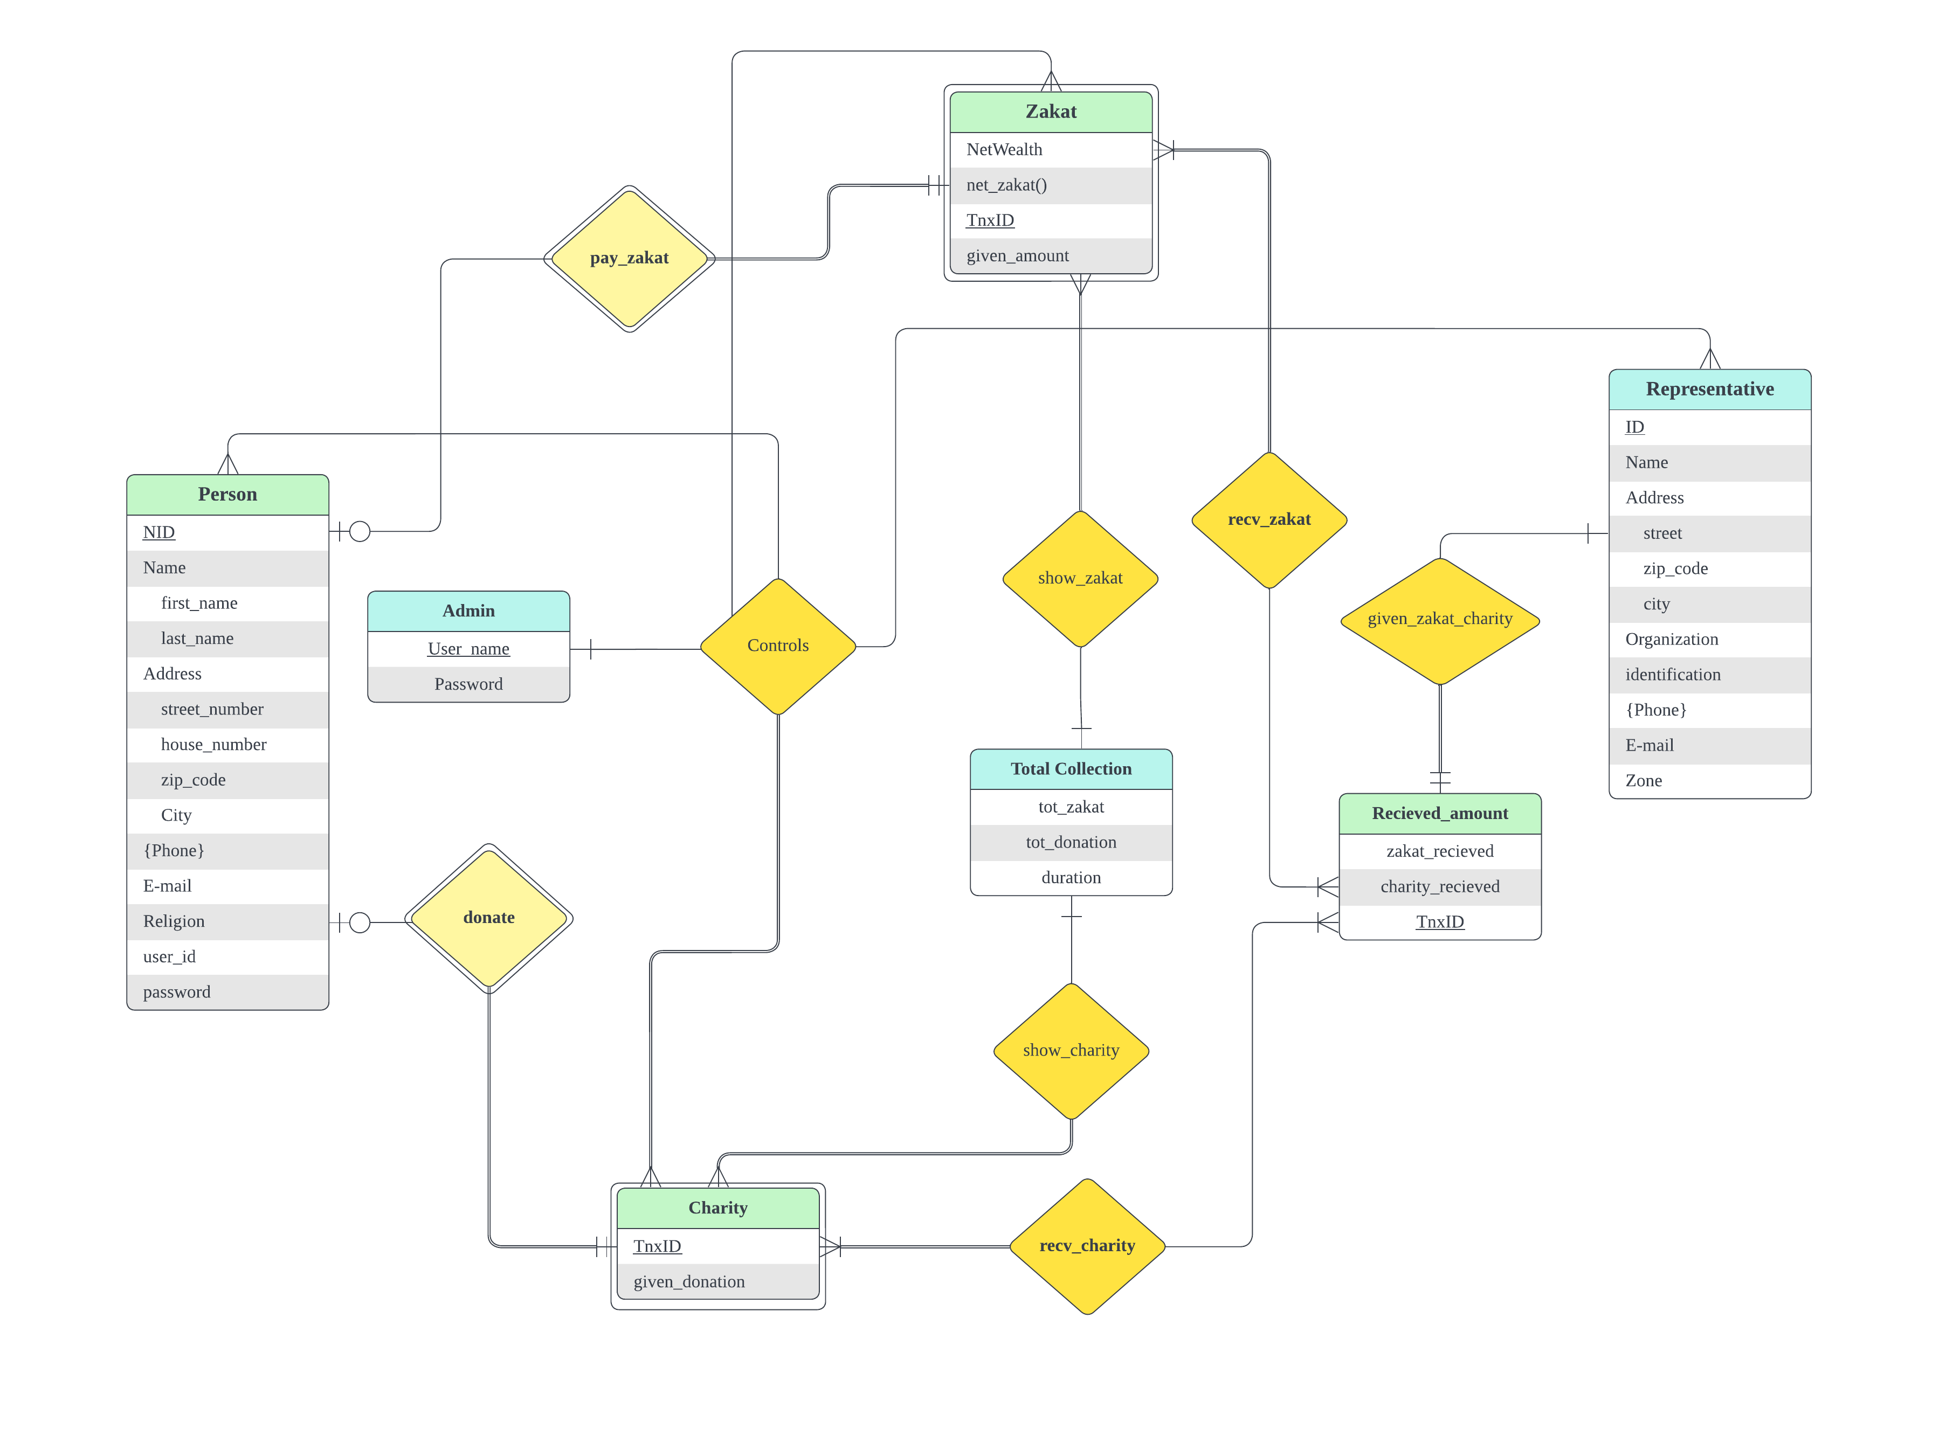
ER DIAGRAM

Slide 6
Conclusion
In our country, there’s no proper way to collect & distribute zakat which is one of the pillars of Islam. So we come up with a solution to meet the lacking by do this centrally. In our country, calamity affected people do not always get proper relief in time. We will make sure to collect their data in advance & reach them as soon as possible & diminish the damage.

Slide 7
Thank You!

