Slide 1
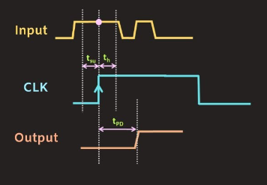

Slide 2


$$T_{su}$$
$$T_{H}$$

