Slide 1
Bio-inspired ADC design for biomedical application
IFTAKHER Mohammed Akib
KIBIWOTT Albert Kiplagat
31 March 2023

Slide 2
Outline
Introduction
Objectives
Algorithm
Methodology
State Machine
Results & Analysis
Conclusion

Slide 3
Introduction
Most biomedical application requires converters with a modest speed of about 10kS/s and a resolution of 10 bits.
As these systems are integrated in personal area network (PAN), energy-efficient conversion techniques and area play a key role.
Classical architectures like SAR, Sigma-Delta, single-slope, algorithmic, successive-approximation could be used.
The ADC design is inspired by the operation of integrate-and-fire spiking neurons where it explicitly exploits time as a signal variable.

Slide 4
Objectives
To study and design a bio-inspired ADC architecture presented in the literature [1] ,[2].
To perform high level of modeling in MATLAB.
To implement the circuit and simulate the behavior in Cadence.

Slide 5
Bio-inspired ADC
I_{in}
I_{ref}
V₁
comp
SCp
SCm
V₂
SEp
SEm
SFp
SBp
SBm
SFm
comp
result
clock
clock
SAm
SAp
SAm
SDp
SDm
reset
reset
SAp
start
start
SBm
SBp
SCm
C₁
SCp
C₂
SDm
SDp
SEm
SEp
SFm
SFp

Slide 6
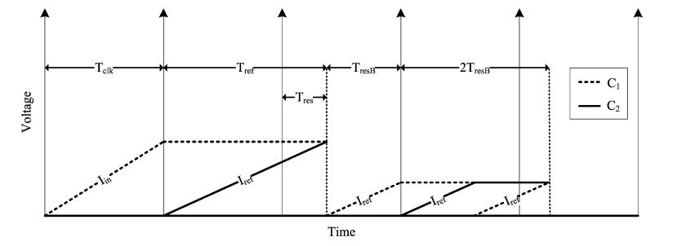
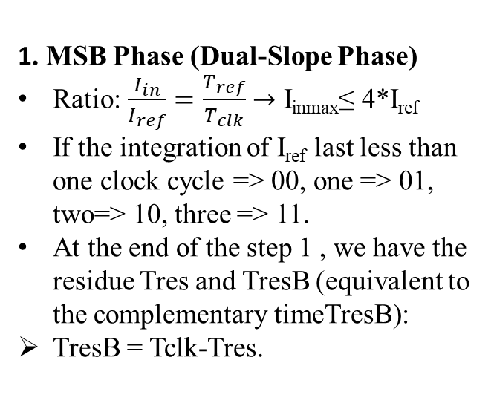
Algorithm : Explanation
1. MSB Phase (Dual-Slope Phase)
Ratio: $\frac{I_{in}}{I_{ref}}=\frac{T_{ref}}{T_{clk}}$ $→$ I_{inmax}≤ 4*I_{ref}
If the integration of I_{ref} last less than one clock cycle => 00, one => 01, two=> 10, three => 11.
At the end of the step 1 , we have the residue Tres and TresB (equivalent to the complementary timeTresB):
TresB = Tclk-Tres.
MSB phase
Next bit
[1]
2. Quantizing The Residue (Novel Successive Subranging Phase)
Two cases:
Tres < Tclk/2 : 3TresB + Tres = 2Tclk + Tres1. Replacing TresB =>Tres1 = Tclk-2Tres
Tres > Tclk/2: 3TresB + Tres = Tclk + Tres1. Replacing TresB =>Tres1 = 2Tclk-2Tres
At each step the initial residue is multiplied by 2 (Amplification)
${Tres}_{n}={\left(−1\right)}^{n−1}Tclk+ {\left(−2\right)}^{n }{TresB}_{n−1}$
[1]

Slide 7
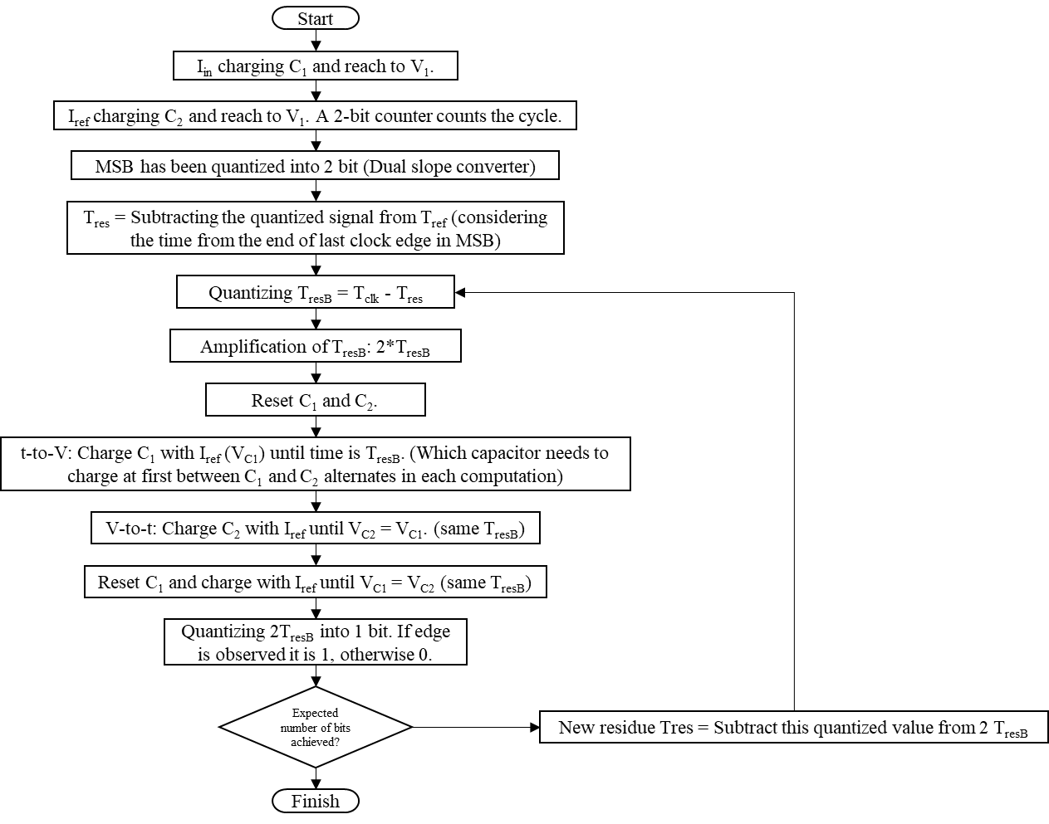
Algorithm
2 MSB
Bit n

Slide 8
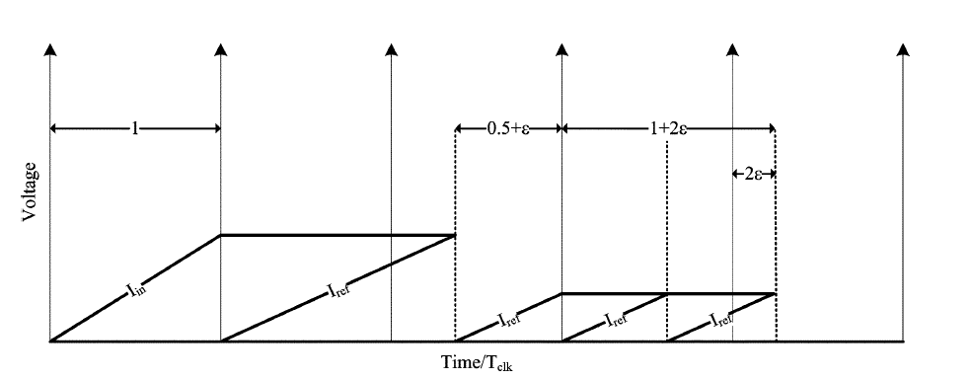

Evolution of residue and Example
TresB
2TresB
Tres
Tres
TresB
2TresB
Tres
C1
C2
C1
C2
C1
C2
C1
C2
$$V_{c1}=\frac{I_{ref}T_{resB}}{C_{1}}→\text{Time}\text{−}\text{to}\text{−}\text{Voltage}$$

Slide 9
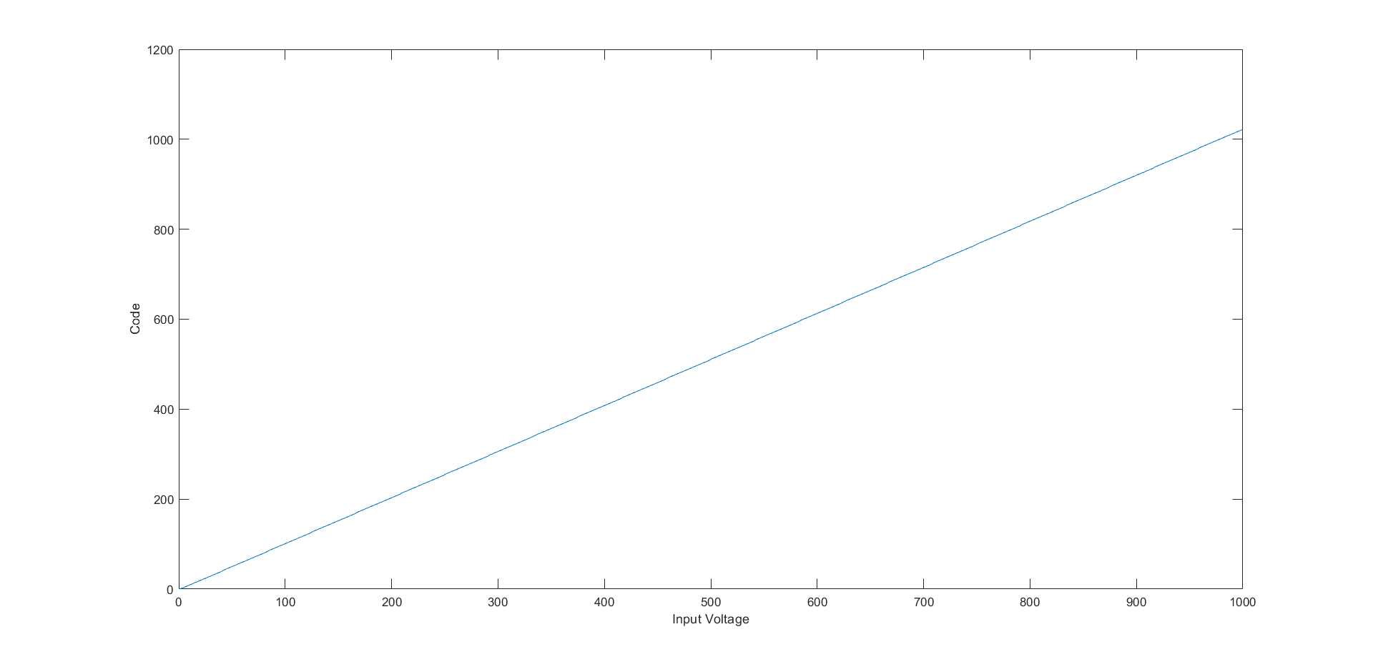
Methodology : High Level Modeling

Slide 10
State Machine
Negative Index Phase
Initial
S_TVN
S_VTN
S_disC1
S_2XN
CE
CO
CO
CO
CE
CO
S_in
S_dis_C1C2
MSB
CO
CE
CO
S_ref
CO
S_TVP
S_VTP
S_disC2
S_2XP
CE
CO
CO
CE – Clock Edge
CO – Comparator Output
Positive Index Phase

Slide 11
Reset
I_{in}
I_{ref}
V₁
comp
SCp
SCm
V₂
SEp
SEm
SFp
SBp
SBm
SFm
comp
result
clock
clock
SAm
SAp
SAm
SDp
SDm
reset
reset
SAp
start
start
SBm
SBp
SCm
C₁
SCp
C₂
SDm
SDp
SEm
SEp
SFm
SFp

Slide 12
Initial
I_{in}
I_{ref}
V₁
comp
SCp
SCm
V₂
SEp
SEm
SFp
SBp
SBm
SFm
comp
result
clock
clock
SAm
SAp
SAm
SDp
SDm
reset
reset
SAp
start
start
SBm
SBp
SCm
C₁
SCp
C₂
SDm
SDp
SEm
SEp
SFm
SFp

Slide 13
S_in
I_{in}
I_{ref}
V₁
comp
SCp
SCm
V₂
SEp
SEm
SFp
SBp
SBm
SFm
comp
result
clock
clock
SAm
SAp
SAm
SDp
SDm
reset
reset
SAp
start
start
SBm
SBp
SCm
C₁
SCp
C₂
SDm
SDp
SEm
SEp
SFm
SFp

Slide 14
S_ref
I_{in}
I_{ref}
V₁
comp
SCp
SCm
V₂
SEp
SEm
SFp
SBp
SBm
SFm
comp
result
clock
clock
SAm
SAp
SAm
SDp
SDm
reset
reset
SAp
start
start
SBm
SBp
SCm
C₁
SCp
C₂
SDm
SDp
SEm
SEp
SFm
SFp

Slide 15
S_ref (If V₁ and V₂ are equal)
I_{in}
I_{ref}
V₁
comp
SCp
SCm
V₂
SEp
SEm
SFp
SBp
SBm
SFm
comp
result
clock
clock
SAm
SAp
SAm
SDp
SDm
reset
reset
SAp
start
start
SBm
SBp
SCm
C₁
SCp
C₂
SDm
SDp
SEm
SEp
SFm
SFp

Slide 16
S_dis_C1_C2 (Proposed)
I_{in}
I_{ref}
V₁
comp
SCp
SCm
V₂
SEp
SEm
SFp
SBp
SBm
SFm
comp
result
clock
clock
SAm
SAp
SAm
SDp
SDm
reset
reset
SAp
start
start
SBm
SBp
SCm
C₁
SCp
C₂
SDm
SDp
SEm
SEp
SFm
SFp

Slide 17
S_TVN (Proposed)
I_{in}
I_{ref}
V₁
comp
SCp
SCm
V₂
SEp
SEm
SFp
SBp
SBm
SFm
comp
result
clock
clock
SAm
SAp
SAm
SDp
SDm
reset
reset
SAp
start
start
SBm
SBp
SCm
C₁
SCp
C₂
SDm
SDp
SEm
SEp
SFm
SFp

Slide 18
S_VTN (Proposed)
I_{in}
I_{ref}
V₁
comp
SCp
SCm
V₂
SEp
SEm
SFp
SBp
SBm
SFm
comp
result
clock
clock
SAm
SAp
SAm
SDp
SDm
reset
reset
SAp
start
start
SBm
SBp
SCm
C₁
SCp
C₂
SDm
SDp
SEm
SEp
SFm
SFp

Slide 19
S_disC1 (Proposed)
I_{in}
I_{ref}
V₁
comp
SCp
SCm
V₂
SEp
SEm
SFp
SBp
SBm
SFm
comp
result
clock
clock
SAm
SAp
SAm
SDp
SDm
reset
reset
SAp
start
start
SBm
SBp
SCm
C₁
SCp
C₂
SDm
SDp
SEm
SEp
SFm
SFp

Slide 20
S_2XN (Proposed)
I_{in}
I_{ref}
V₁
comp
SCp
SCm
V₂
SEp
SEm
SFp
SBp
SBm
SFm
comp
result
clock
clock
SAm
SAp
SAm
SDp
SDm
reset
reset
SAp
start
start
SBm
SBp
SCm
C₁
SCp
C₂
SDm
SDp
SEm
SEp
SFm
SFp

Slide 21
S_disC1C2 (Proposed)
I_{in}
I_{ref}
V₁
comp
SCp
SCm
V₂
SEp
SEm
SFp
SBp
SBm
SFm
comp
result
clock
clock
SAm
SAp
SAm
SDp
SDm
reset
reset
SAp
start
start
SBm
SBp
SCm
C₁
SCp
C₂
SDm
SDp
SEm
SEp
SFm
SFp

Slide 22
S_TVP (Proposed)
I_{in}
I_{ref}
V₁
comp
SCp
SCm
V₂
SEp
SEm
SFp
SBp
SBm
SFm
comp
result
clock
clock
SAm
SAp
SAm
SDp
SDm
reset
reset
SAp
start
start
SBm
SBp
SCm
C₁
SCp
C₂
SDm
SDp
SEm
SEp
SFm
SFp

Slide 23
S_VTP (Proposed)
I_{in}
I_{ref}
V₁
comp
SCp
SCm
V₂
SEp
SEm
SFp
SBp
SBm
SFm
comp
result
clock
clock
SAm
SAp
SAm
SDp
SDm
reset
reset
SAp
start
start
SBm
SBp
SCm
C₁
SCp
C₂
SDm
SDp
SEm
SEp
SFm
SFp

Slide 24
S_disC2 (Proposed)
I_{in}
I_{ref}
V₁
comp
SCp
SCm
V₂
SEp
SEm
SFp
SBp
SBm
SFm
comp
result
clock
clock
SAm
SAp
SAm
SDp
SDm
reset
reset
SAp
start
start
SBm
SBp
SCm
C₁
SCp
C₂
SDm
SDp
SEm
SEp
SFm
SFp

Slide 25
S_2XP (Proposed)
I_{in}
I_{ref}
V₁
comp
SCp
SCm
V₂
SEp
SEm
SFp
SBp
SBm
SFm
comp
result
clock
clock
SAm
SAp
SAm
SDp
SDm
reset
reset
SAp
start
start
SBm
SBp
SCm
C₁
SCp
C₂
SDm
SDp
SEm
SEp
SFm
SFp

Slide 26
S_dis_C1C2 (Proposed)
I_{in}
I_{ref}
V₁
comp
SCp
SCm
V₂
SEp
SEm
SFp
SBp
SBm
SFm
comp
result
clock
clock
SAm
SAp
SAm
SDp
SDm
reset
reset
SAp
start
start
SBm
SBp
SCm
C₁
SCp
C₂
SDm
SDp
SEm
SEp
SFm
SFp

Slide 27
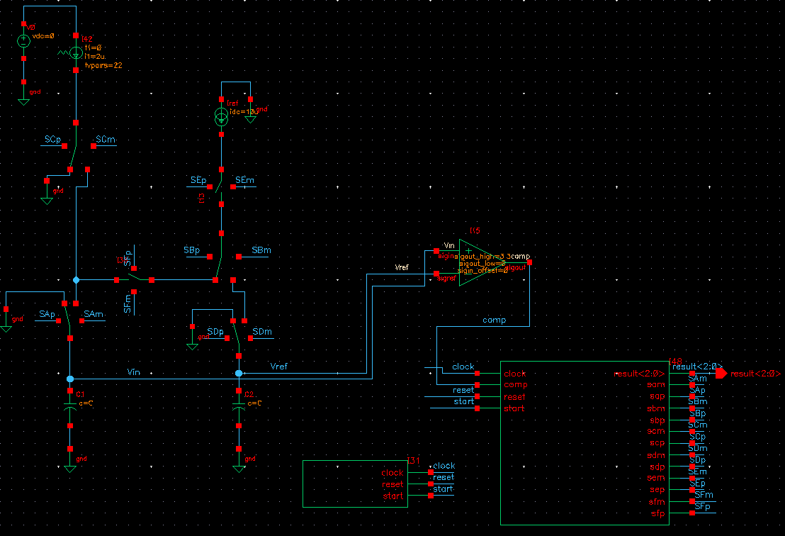
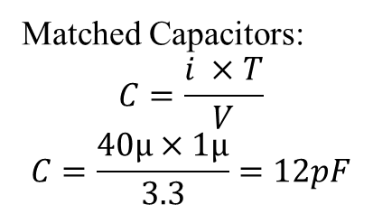
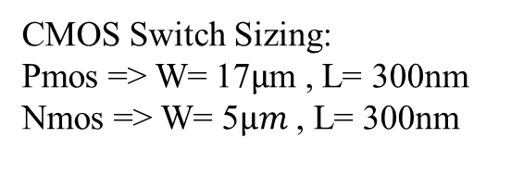
Circuit Implementation
Matched Capacitors:
$$C=\frac{i ×T}{V}$$
$$C=\frac{40µ×1µ}{3.3}=12pF$$
CMOS Switch Sizing:
Pmos => W= 17$µ$m , L= 300nm
Nmos => W= 5$µm$ , L= 300nm

Slide 28
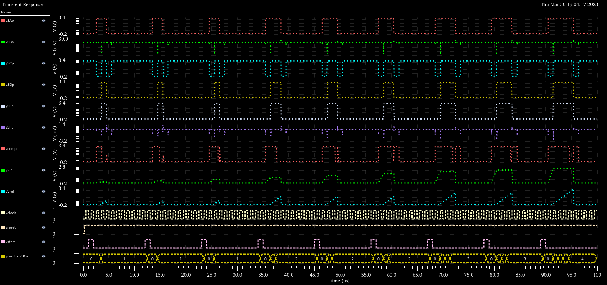
Results & Analysis (Only MSB)

Slide 29
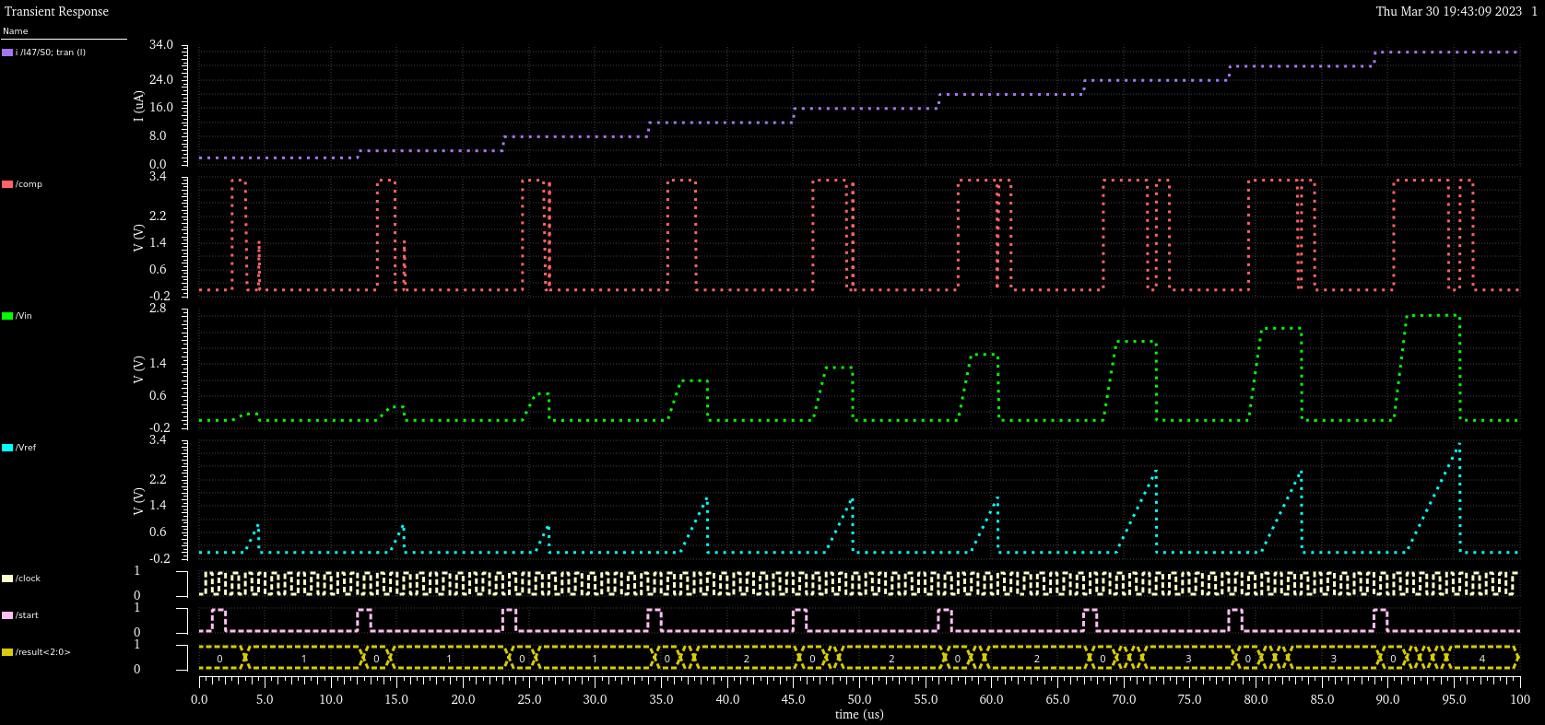
Results & Analysis (Only MSB)

Slide 30
Error Cancellation Properties
Idea: whatever elements “add” error to our signal during time-to-voltage conversion also “subtract” the same error from our signal during voltage-to-time conversion.
I. Comparator Delay and Offset
Voltage offset in our comparator can simply be translated into a comparator delay → the comparator requires a finite amount of time to signal that the voltages on the two capacitors are equal.
Reintroduction of the delay is required for the successive stage errors to cancel, and the process starts anew.
II. Switching Charge Injection:
Each capacitor requires a switch to reset its charge to zero (dc offset)
Each time a current source switches away from a capacitor, it introduces a finite amount of charge onto the capacitor
Charge injection are minimized in a manner similar to that of the comparator delay.

Slide 31
Conclusion
Operating on time-based residues with a sequence of integrate-and-fire operations allows for extremely energy-efficient conversion.
We demonstrated that the algorithm naturally alleviates errors due to charge injection, noise, comparator delay and offset.
Power consumption is minimized since amplification is achieved by doing things twice in time rather than through the use of an explicit amplifier.
It could be very useful in portable and wireless biomedical sensors for ECG, PCG, EEG

Slide 32

Thank You

Slide 33
References
[1] Yang, H. Y., & Sarpeshkar, R. (2005). A time-based energy-efficient analog-to-digital converter. IEEE Journal of Solid-State Circuits, 40(8), 1590-1601.
[2] Yang, H. Y., & Sarpeshkar, R. (2006). A bio-inspired ultra-energy-efficient analog-to-digital converter for biomedical applications. IEEE Transactions on Circuits and Systems I: Regular Papers, 53(11), 2349-2356.

Slide 34
Appendix I : Matlab Code
% Capacitor charging simulation
clc;
clear all;
Tclk = 1;
n_bits = 10;
Iref = 10; % reference charging current
nb_points = 1000;
for k = 1:nb_points
Iin = k*40/nb_points; % Input charging current
fprintf('Iin : %d\n', Iin);
% Check if I1 is less than 4 times I2
if Iin >= 4*Iref
warning('Iin should be less than 4 times Iref');
end
% Calculate the charge required for capacitor C1
Q1 = Tclk * Iin;
% Calculate the time required to charge capacitor C2
Tref = Q1 / Iref;
Tref_int = fix(Tref);
Code = Tref_int * 2^(n_bits-2); % Giving weight to MSB
Tres = zeros(1,n_bits-1); % set the value of Tres
TresB = zeros(1,n_bits-1);
% Calacultate the residual time
Tres(1) = Tref - Tref_int;
TresB(1) = Tclk - Tres(1);
for n = 1:n_bits-2
m = n+2;
if 2*TresB(n) > Tclk
ADC(m) = 1;
TresB(n+1)=2*Tclk-2*TresB(n);
else
ADC(m) = 0;
TresB(n+1)=Tclk-2*TresB(n);
end
Code = Code + (ADC(m)+1)*(-2)^(n_bits-2-n);
end
Code_fin(k)=Code+254;
fprintf('Code = %d \n', Code);
end
figure();
plot(Code_fin);
xlabel('Input Voltage');
ylabel('Code’);

Slide 35
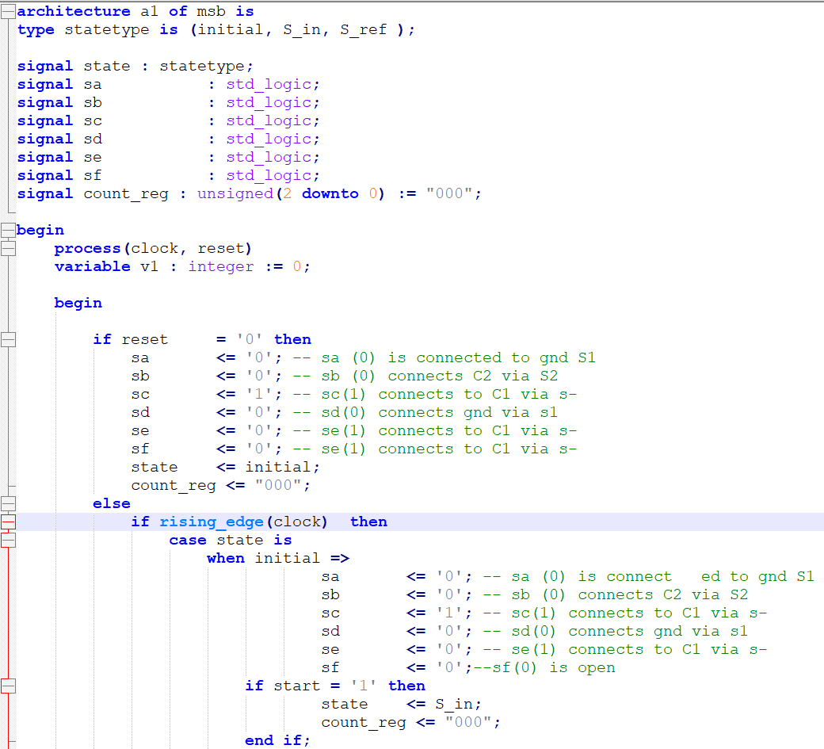
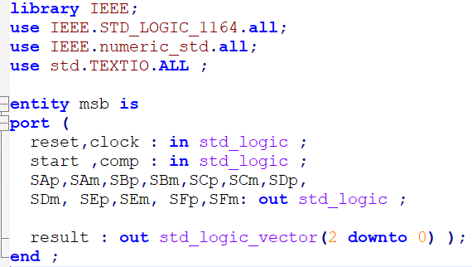
Appendix II : VHDL Code (MSB only)

Slide 36
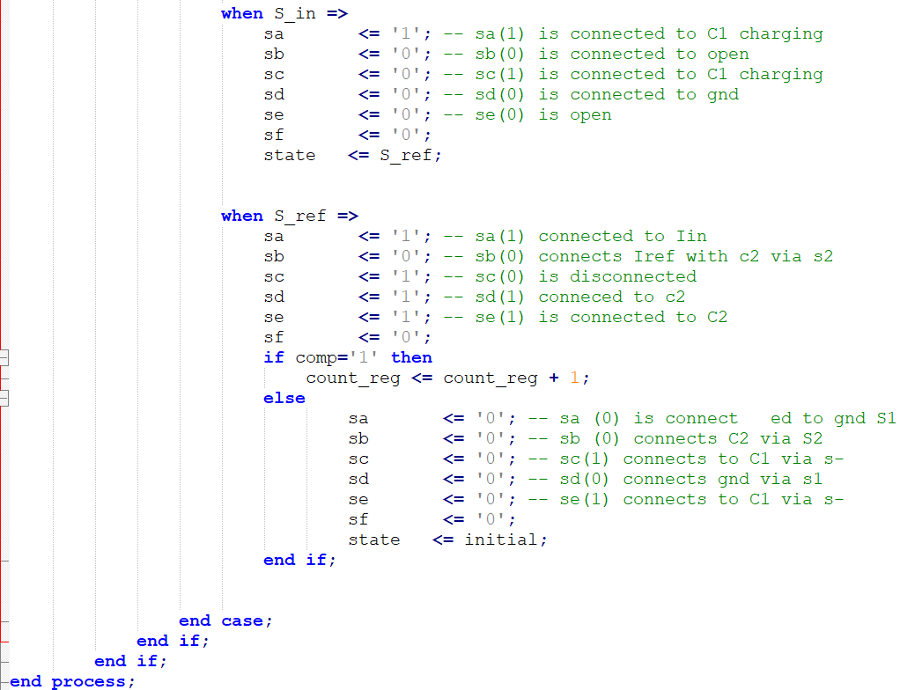
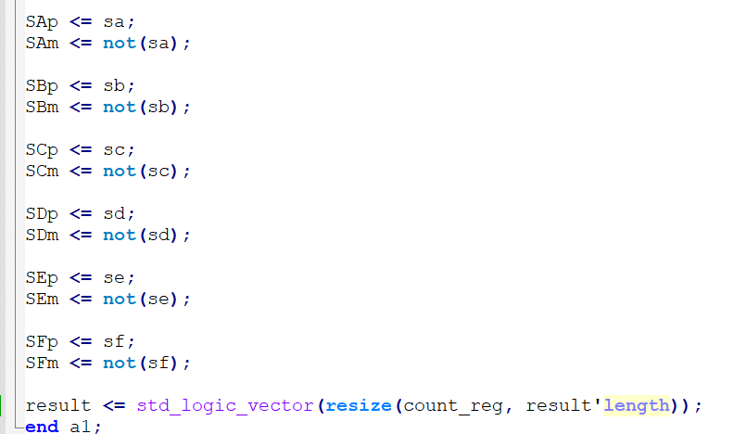
Appendix III : VHDL Code (MSB only) cont’

Slide 37
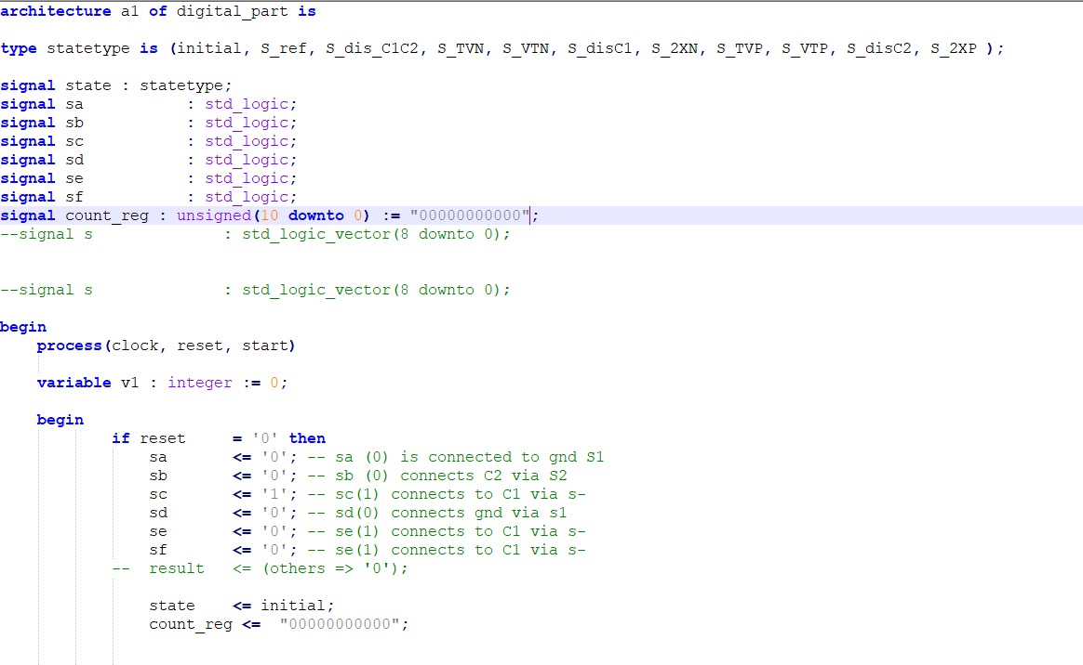
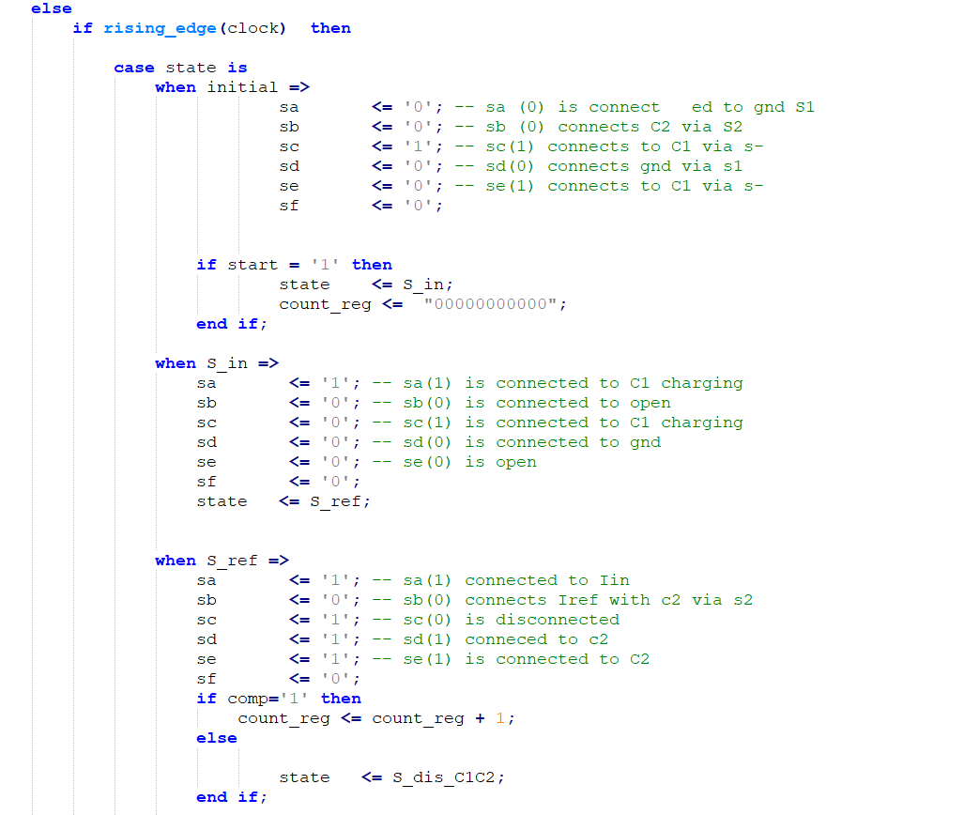
Appendix III : VHDL Code (with subranging part suggestion)

Slide 38
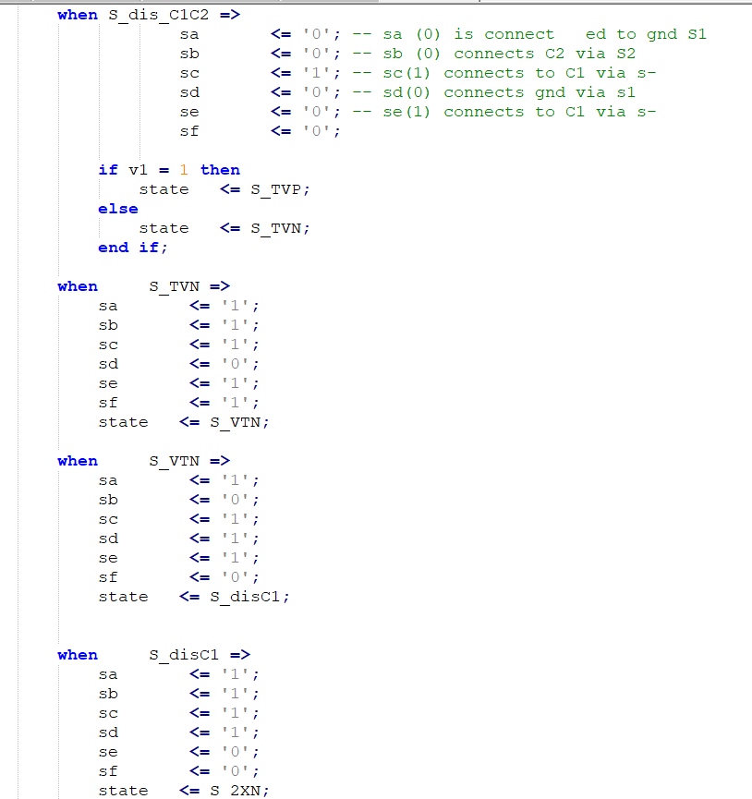
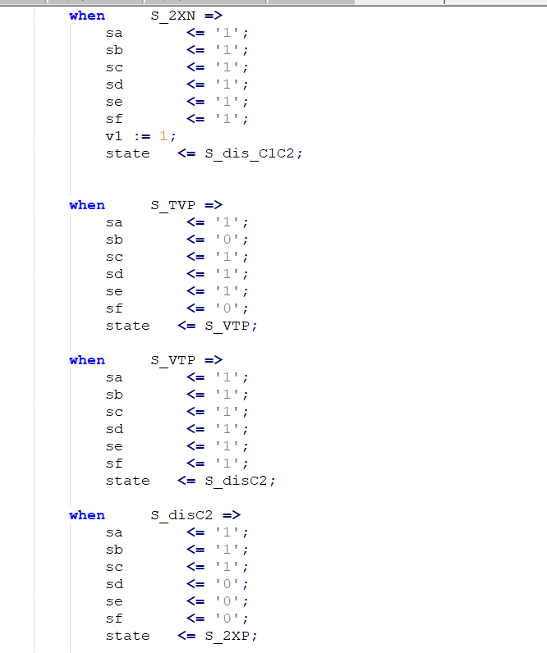
Appendix III : VHDL Code (with subranging part suggestion)

Slide 39
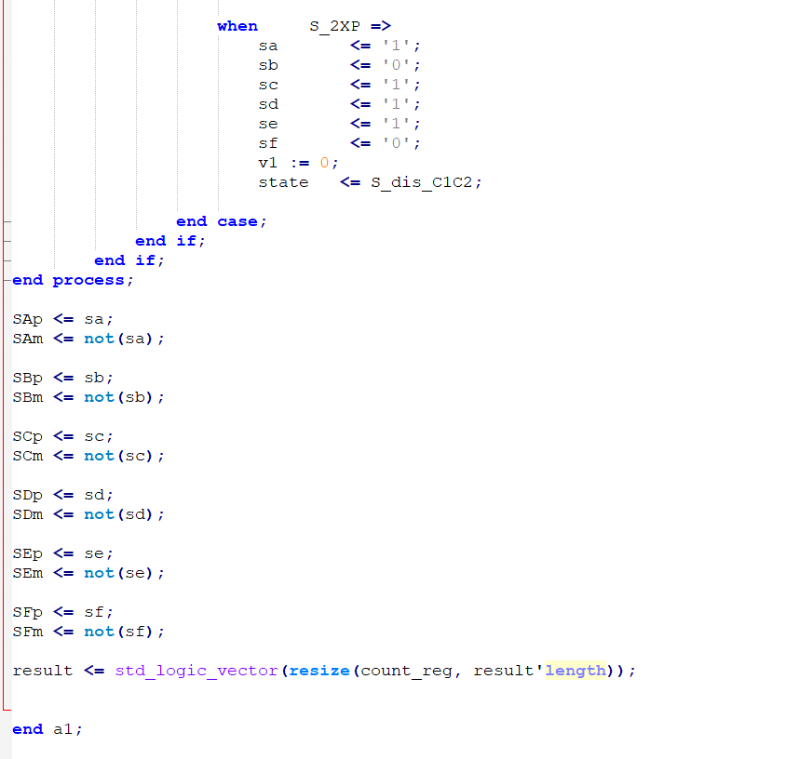
Appendix III : VHDL Code (with subranging part suggestion)

Slide 40
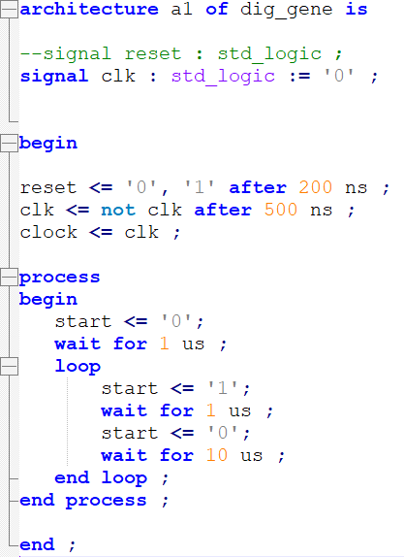
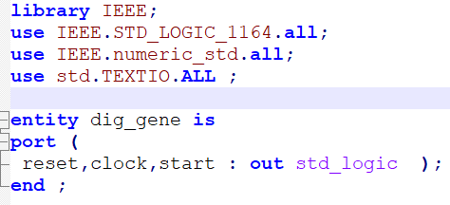
Appendix IV : Clock & Start Generator Code

Slide 41
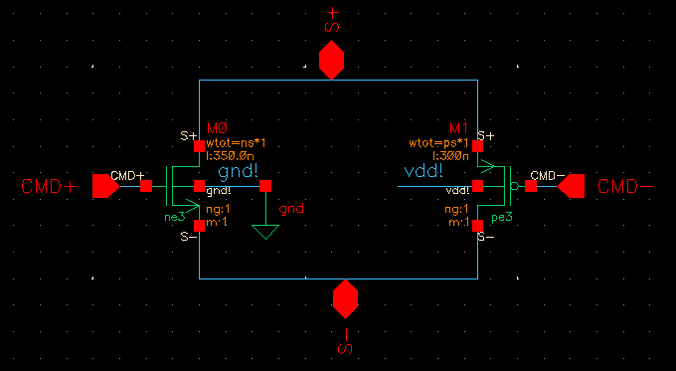
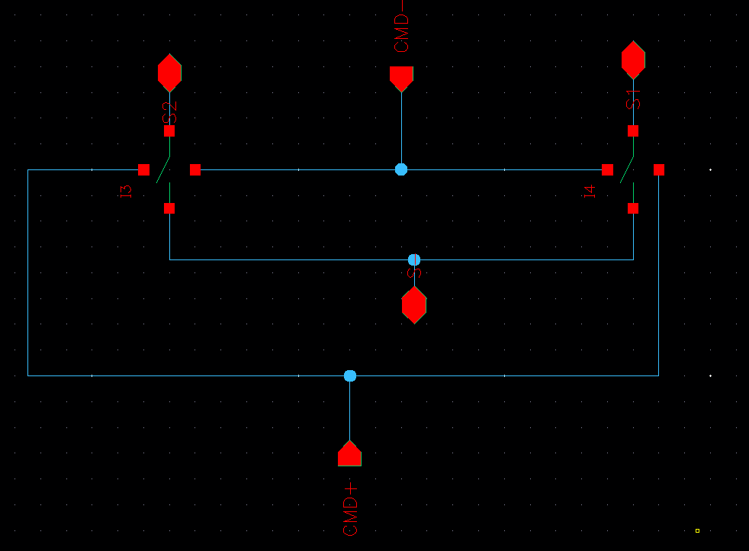
Appendix V : CMOS Switch Schematic
Figure : CMOS-based Switch
Figure : Double Switch Implementation

Slide 42
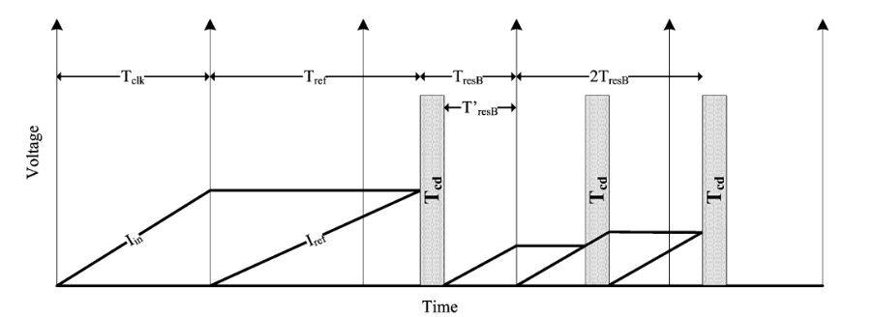
Appendix VI : Illustration of comparator delay cancellation
[1]

