Slide 1
Cryptography:
Exploiting the GPU
By: Aleksandr Kibis
CSC746
6/22/14

Slide 2

What is Cryptography?
Definition: the practice and study of techniques for secure communication in the presence of third parties
Raw Data
Raw Data
Encrypted Data

Slide 3
Parallel Nature
AddRows
Add Columns
Start
Key Expansion
End
Invert Bits
Shift bits
Mix Rows

Slide 4
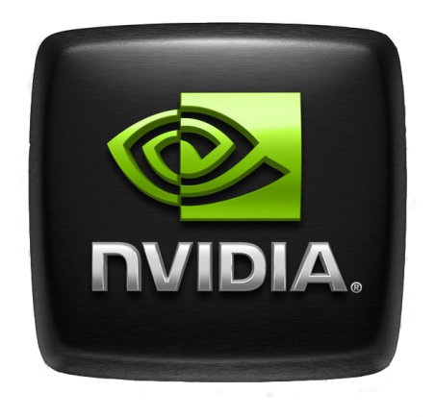

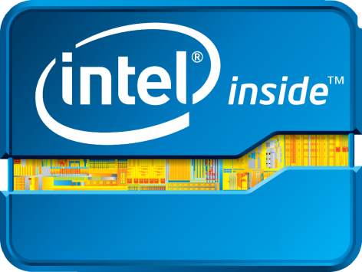

GPUs!
Tesla/GeForce
Radeon/FirePro
HD2000/3000/4000
Adreno 320/330

Slide 5


Applications
Protect integrity of block chain
Encrypt user wallets
SSL encryption

Slide 6



Cryptocurrency
Emerging currencies taking advantage of SHA3

Slide 7
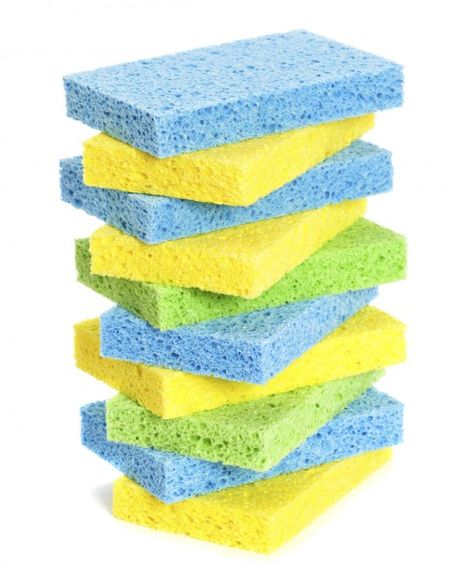
Secure Hash Algorithm (SHA)
Keccak selected by NIST for SHA3
One-way
In the sponge function family
  In
    Input file of any desired length
  Out
    Hash of any desired length
How?
  A series of conditional operations:
    Phase 1: parity + XOR
    Phase 2: Bitwise rotation
    Phase 3: Permutation
    Phase 4: Bitwise combination
    Phase 5: Final XOR
Exclusive OR Operation
0x7 ^ 0x5
0111 ^ 1001
=1110

Slide 8
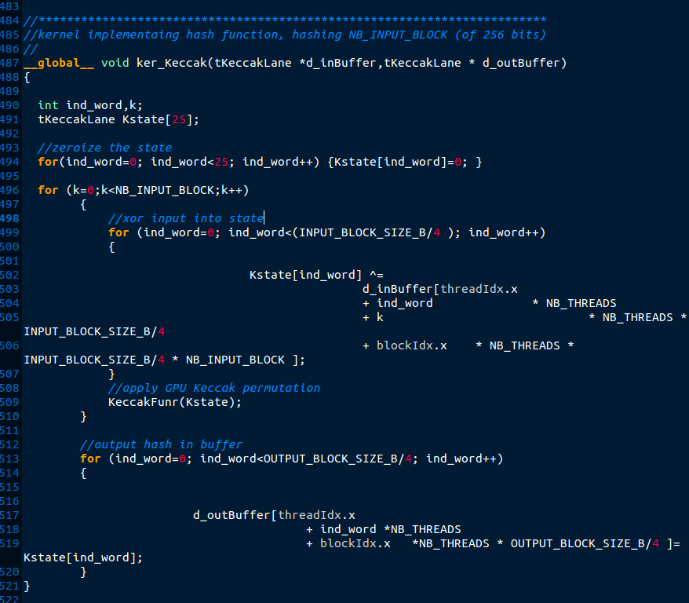
Keccak: CUDA
  45-80X faster hashing
16MB/s vs 1GB/s
SHA on other systems?
Source code provided by: Guillaume Sevestre

Slide 9
The Test
How fast is a GPU compared to a CPU in cryptography?
System Specifications
CPU
GPU
Model: Intel 4770K
Speed: 4.5GHz
Cores: 4 + 4(HT)
Memory: DDR3 2133MHz
Model: AMD Radeon HD5850
Speed: 765MHz
Cores: 1440
Memory: GDDR5 1125MHz
Software:
Windows 8.1 x64 Professional
AIDA64 Extreme v.4.30.2900

Slide 10
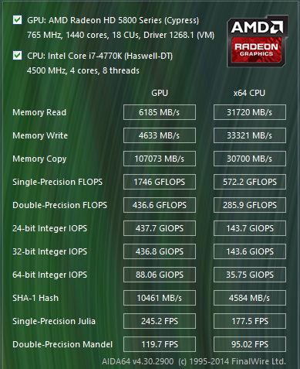
Results

Slide 11
Results

Slide 12
Results
Over 2X performance increase for hashing applications!

Slide 13
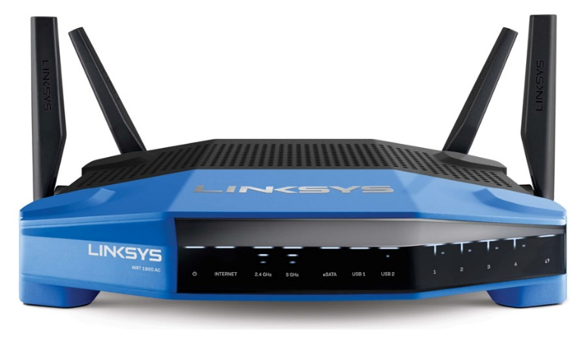
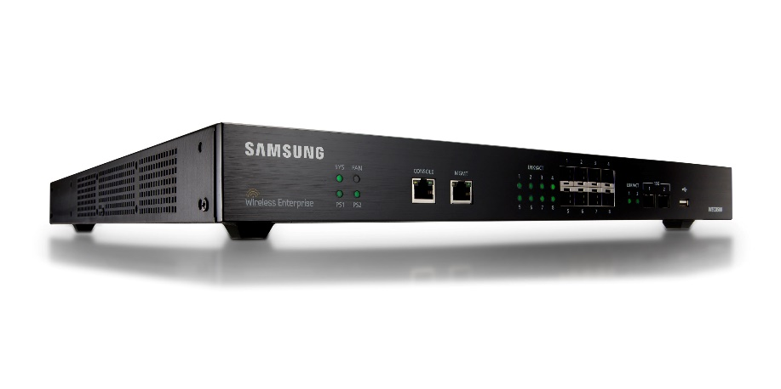


Wireless Networking
Home
Work
Vacation
Even break!

Slide 14


Wireless Networking
Unencrypted data can be sniffed
  WireShark
  AirCrack
AES is the most secure encryption with least overhead
  AES (5%)
  WEP (10%)
  WPA-PSK (17%)
Used to encrypt data stream between router and computer

Slide 15
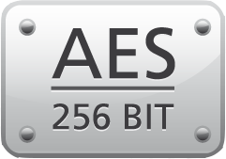

Advanced Encryption Standard
Symmetric encryption
Standard is set by the NSA
Secret
  128, 192, and 256 bit
Top Secret
  192 or 256 bit
GPU performance?

Slide 16
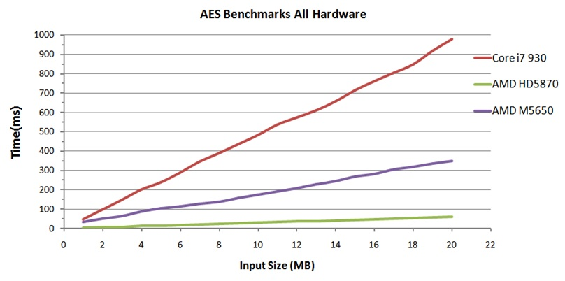
AES: OpenCL
Graph Courtesy of AMD

Slide 17
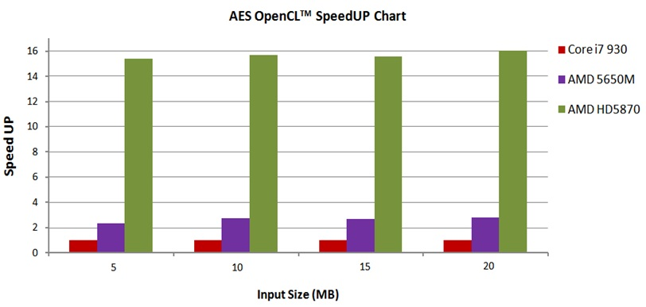
AES: OpenCL
Graph Courtesy of AMD

Slide 18

What’s Next?
GPU crypto is still in its infant stage, but growing quickly!
New GPU implementations of cryptographic algorithms are being built and tested
Heterogeneous System Architecture (HSA) Foundation:
  AMD, ARM, Qualcomm, Samsung, Texas Instruments
  Change the way system architecture is structured
  Make it dramatically easier to program heterogeneous parallel devices
CUDA 6.0:
  Unification of memory
  Drop-in library support
  Higher GPU support

Slide 19
End

Slide 20
References
Bertoni, G., Daemen, J., Peeters, M., & Asche, G. V. (2009, September 10). KECCAK Specifications. The Keccak sponge function family. Retrieved May 22, 2014, from http://keccak.noekeon.org/
CUDA Toolkit. (n.d.). NVIDIA Developer Zone. Retrieved May 21, 2014, from https://developer.nvidia.com/cuda-toolkit
Efficient Hardware Implementations and Hardware Performance Evaluation of SHA-3 Finalists. (2012, March 1). National Institute of Standards and Technology. Retrieved May 22, 2014, from http://csrc.nist.gov/groups/ST/hash/sha-3/Round3/March2012/documents/papers/KASHIF_paper.pdf
Gavrichenkov, I. (2011, February 22). Intel HD Graphics 3000 and Intel HD Graphics 2000 Review. Page 9. - X-bit labs. Retrieved May 22, 2014, from http://www.xbitlabs.com/articles/graphics/display/intel-hd-graphics-2000-3000_9.html
Gervasi, O., Russo, D., & Vella, F. (n.d.). The AES implantation based on OpenCL for multi/many core architecture. IEEE Xplore. Retrieved May 22, 2014, from http://ieeexplore.ieee.org/xpl/mostRecentIssue.jsp?punumber=5476389

Slide 21
References
HSA Foundation ARM, AMD, Imagination, MediaTek, Qualcomm, Samsung, TI. (n.d.). HSA Foundation RSS2. Retrieved May 22, 2014, from http://www.hsafoundation.com/
de Souza, A. M., Pereira, F., & Moreno, E. (n.d.). Exploiting Heterogeneous Systems: Keccak on OpenCL. Worldcomp Proceedings. Retrieved May 20, 2014, from http://worldcomp-proceedings.com/proc/p2013/PDP2982.pdf
Qualcomm Snapdragon 600 & 800 (Adreno 320 & 330). (n.d.). StreamComputing. Retrieved May 22, 2014, from http://streamcomputing.eu/knowledge/sdks/qualcomm-snapdragon-600-and-800/
Sevestre, G. (n.d.). Implementation of Keccak hash function in Tree hashing mode on Nvidia GPU. High performance computing on graphics processing units RSS. Retrieved May 22, 2014, from http://hgpu.org/?p=6833
Haq, S. U., Masood, J., Majeed, A., & Aziz, U. (2011, October 11). Bulk Encryption on GPUs - AMD. AMD RSS2. Retrieved May 22, 2014, from http://developer.amd.com/resources/documentation-articles/articles-whitepapers/bulk-encryption-on-gpus/

