Slide 1
Frankenstein: Advanced Wireless Fuzzing to Exploit New Bluetooth Escalation Targets
Author: Jan Ruge and Jiska Classen, Secure Mobile Networking Lab, TU Darmstadt; Francesco Gringoli, Dept. of Information Engineering, University of Brescia; Matthias Hollick, Secure Mobile Networking Lab, TU Darmstadt
Presenter: Akib Jawad Nafis

Slide 2
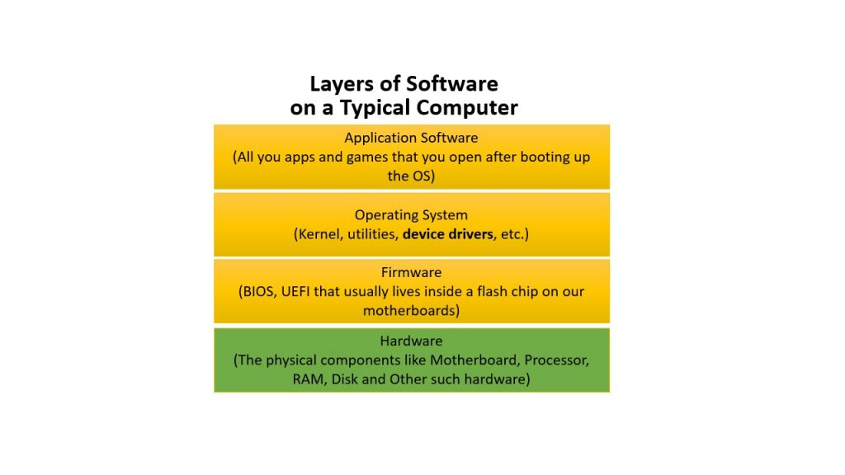
Security of Firmware: Topic of Interest
Each electronic device you can think of has some code in it's own ROM. That code is called firmware. Right on top of the hardware. Author’s specific interest in this article would be Bluetooth Firmware.
Notes:
Our topic of interest today would be security of firmware. Firmware is that piece of software that sits right on top hardware. On one side it interacts with device driver portion of operating system. On the opposite end it interacts with hardware directly.

Slide 3
Wireless Firmware Fuzzing. Problem?
Finding Remote Code Execution (RCE) vulnerabilities in the Bluetooth Firmware.
Fuzzing could help. But
Over-the-air fuzzing is too slow.
Repetition of a test case is limited. Let's say we want to fuzz the part which is executed while pairing.
It's tough to debug while fuzzing physically. Because there are no debug symbol in the firmware.
Notes:
Ensuring security means ensuring lack of vulnerabilities. The type of vulnerabilities authors are interested is something called RCE vulnerabilities. So, In short, we can say, authors goal is to find RCE vulnerabilities in the Bluetooth firmware.
A tried and tested method to find this is Fuzzing. Fuzzing is means basically testing a software by generating inputs for this software.
To fuzz Bluetooth firmware, we have to generate the Bluetooth packets and send them over Bluetooth to the device. If we want to fuzz from device driver it most probably won’t work because of modified driver might not match firmware.
Now if we want to fuzz over wireless technology there are certain problems need to be considered.
It is slow. Because we have to add time in the air.
Repetition of test case in limited.
Debugging though. In the broadest sense, authors goal is to get rid of these problems of wireless fuzzing.

Slide 4
Motivation: Why fuzz in the firmware level?
There is a huge attack surface. If Bluetooth is on, an attacker can initiate an attack. The Same goes for any wireless firmware (Wifi, LTE, etc).
RCE bugs are dangerous. If there is any RCE vulnerability in the Operating System level, attacker will have the highest privilege to run this code.
Firmware vulnerability which might cause an on-chip RCE is complex to patch up but easy from an attacker’s perspective.
An Attack on firmware might escalate out of chip. A vulnerability in the bluetooth chip might hamper wifi-performace.
Notes:
Any wireless technology has a comparatively broader attack surface. So chances of attack is high. Hence ensuring safety form those attacks is also high.
These attacks has can be wormable to OS. Suchs as a specific packet in Bluetooth can even execute a certain portion of the operating system. It might happen when the device driver of Bluetooth is also compromised.
Another motivation to fuzz is the complexity of firmware patching.

Slide 5
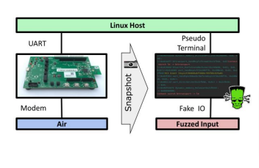

Solution: In one word "Emulation"
Creates a snapshot from the physical device and emulates it with QEMU.
Connect the emulated device to host part of bluetooth stack via BlueZ.
Generate over-the-air data virtually to fuzz the emulated firmware.
Give it a cool name "Frankenstein"
Notes:
So, what is the solution to wireless fuzzing problems:
Remove the wireless part. Even remove the physical device itself.
Take the firmware and emulate the firmware on QEMU. There are complexities in using QEMU this way. But we really reduced a huge latency.

Slide 6
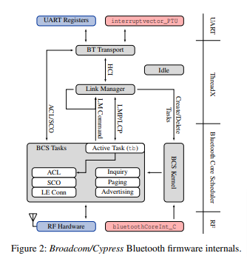
Background: Bluetooth Firmware
UART part connects with the host (Operating System).
ThreadX is the operating system of the Bluetooth Controller chip.
Bluetooth Core Schedular handles time critical events.
After turning on bluetooth, at every 0.3ms BCS will schedule any of the tasks based on the state of the firmware.
Notes:
We will look at how the emulation system proposed in the article works. Before that, here is a short overview of what’s inside Bluetooth firmware. UART interface communicates with device driver. RF interface is the direct hardware.
In the middle ThreadX and Bluetooth Core Scheduler makes our firmware. ThreadX is an RTOS with 3 execution threads. BT transport, Link Management, Idle. Bluetooth Core Schedular is the portion of Bluetooth firmware which actually completes tasks using hardware.

Slide 7
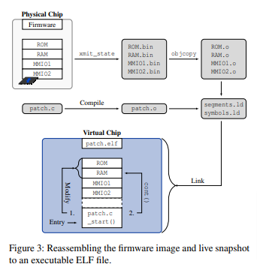
Frankenstein: Make the frimware ready for Emulation
collect the snapshot (running instance of the firmware) from physical device.
We need create a patch including
Debug symbols
Instrumentation for fuzzing.
Disabled interrupts and timing related functionality from the firmware. Cause frankenstein is a user space program it will not support interrupt.
Add interrupts and timers as a software function.
Reassamble the firmware to an executable ELF file.
Notes:
How the emulation system is created?

Slide 8
Frankenstein: Connect the host.
Physical Device used to connect to the host device via UART.
We connect UART of virtual device to the host via PS (Pseudo-Terminal).
Pseudo Terminal Master(PTM) will have the virtual device end.
Pseudo Terminal Slave(PTS) will have the host end.
PTS is then passed btattach() method to attach the emulator to the Linux BlueZ bluetooth stack.
Notes:
Virtual Bluetooth chip is made ready, now if it is connected to the host operating system, It will have a complete Bluetooth emulation.
How to connect? Using PS (Pseudo Terminal). It basically a pipe connects two piece of softwares.

Slide 9
Frankenstein: Generate Fuzzing Input
A virtual modem will call the Bluetooth Core Scheduler interrupt handlers and generates specific packets.
It is done via hooking the bluetoothCoreInt_C via patching.
In real device, at every 312.5 microsecond bluetoothCoreInt_C does the same.

Slide 10
To sum it up: Overall fuzzing and emulation system

Slide 11
Frankenstein: Evaluation
Evaluation of Frankenstein is done from 2 aspects.
Performance of Fuzzing.
Found novel vulnerabilities.
RCE vulnerabilities.
Heap Corruption Vulnerabilities.

Slide 12
Frankenstein Evaluation: Fuzzing Performance
Authors fuzzed Link Management Protocol(LMP) of Bluetooth firmware.
They reached overall code coverage of 3.4%.
Authors argued it is comparable since LMP is only 4.5% of the total Bluetooth firmware.
In terms fuzzing speed there is no comparison. Since it is the first approach to fuzz Bluetooth firmware.

Slide 13
Fuzzing Result and Exploitation
Found two remote code execution bug in the bluetooth firmware.
Link Key Extraction.
Disabling Wifi by writing a specified value while testing in a wifi/bluetooth combo chip. (CVE-2019-15063).
Found 3 Heap Overflow Bugs.
Device Scanning EIR (CVE-2019-11516)
Any BLE Packet (CVE-2019-13916)
Any ACL Packet (CVE-2019-18614)
Notes:
Authors evaluated their method and

Slide 14
Fuzzing Result and Exploitation: RCE bugs
Found three remote code execution bug in the bluetooth firmware.
Link Key Extraction.
Authors argue it is a design problem in the Bluetooth specification.
When a Bluetooth device pairs it shares a link key. And it is created for the first-time connection only.
This key is then saved in the host stack.
In later connections, Bluetooth controller or firmware asks the host for key verification.
Authors argue a hook inside the firmware can expose the key to the attacker.
Which then can lead to privacy attacks such overhearing phone calls.
Notes:
Authors evaluated their method and

Slide 15
Fuzzing Result and Exploitation: RCE bugs
Found three remote code execution bug in the bluetooth firmware.
One a combo chip wifi and Bluetooth share a common address to coexist and share the transceiver.
Authors disabled Wifi by writing a specified value in that address (CVE-2019-15063).
Notes:
Authors evaluated their method and

Slide 16
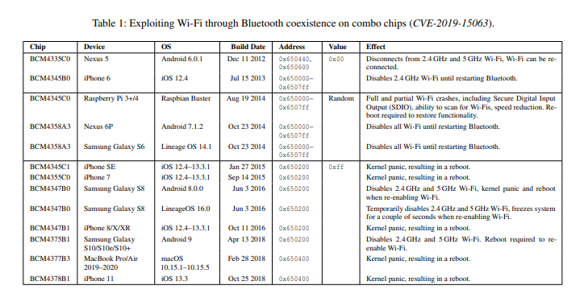
RCE bug: Disabling wifi via bluetooth.
Notes:
This is a list of devices authors tested. It surprised me a bit cause my phone, laptop and tab all are listed here.

Slide 17
Fuzzing Result and Exploitation: Heap Corruption
Found 3 Heap Overflow Bugs.
Device Scanning EIR (CVE-2019-11516)
Any BLE Packet (CVE-2019-13916)
Any ACL Packet (CVE-2019-18614)
Notes:
Authors evaluated their method and

Slide 18
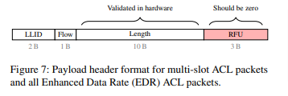
Heap Corruption: During device inquiry (CVE-2019-11516).
This attack happens during device inquiry. A device is searching for other Bluetooth devices. When other devices are responding via Enhanced Inquiry Response frame this error occurs.
Ideally RFU(Reserved for future usage) bit should be zero. But if RFU is not zero, payload length will be huge. This huge length will cause a heap-overflow error while transmitting this event to host via HCI. Payload length for a HCI event is 240.

Slide 19
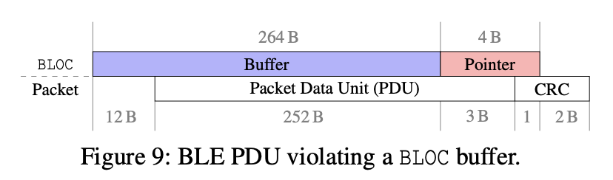
Heap Corruption: Any BLE Packet (CVE-2019-13916)
Victim Bluetooth device
Sending page scan packets or transferring data packets
Attacker device
Sending packets with greater than PDU size greater 252 bytes
Notes:
Second bug triggers when this firmwares tries to connect to a ble device. See ble packets has a portion named pdu which consists of payload length and payload data. Due to a different implementation of heap in the ThreadX RTOS, an pdu with size greater than 252 crashes the firmware.

Slide 20
Fuzzing Result and Exploitation: Heap Corruption
Found 4 Heap Overflow Bugs.
Any ACL Packet (CVE-2019-18614)
When firmware initializes it sends it’s buffer size to host.
On the chip CYW20735, It has a buffer size 384B.
But it sends the buffer size to host as 1021B.
Notes:
on the CYW20735 chip only, there is a buffer mis- configuration that makes ACL exploitable. The global vari- ables BT_ACL_HOST_TO_DEVICE_DEFAULT_SIZE and BT_ ACL_DEVICE_TO_HOST_DEFAULT_SIZE are set to 384B, while the chip still signals a size of 1021 B to the host.

Slide 21
Related Works
Previous attempts of to find vulnerabilities in mostly based on searching the host software stack.
Not the firmware.
In terms of emulation, there are previous works which uses QEMU for firmware emulation.
But in those cases, authors modified QEMU and use it as system software for emulation.
Notes:
on the CYW20735 chip only, there is a buffer mis- configuration that makes ACL exploitable. The global vari- ables BT_ACL_HOST_TO_DEVICE_DEFAULT_SIZE and BT_ ACL_DEVICE_TO_HOST_DEFAULT_SIZE are set to 384B, while the chip still signals a size of 1021 B to the host.

Slide 22
Thank you. Any question?

