Slide 1
Entrance
Slit
CollimatorMirror
Grating
Exit
Slit
Photography
Mirror

Slide 2
Diffracted
Light
Incident
Light
β
α
θB
θB

Slide 3
Clad
Core

Slide 4
E
Conducition Band
Forbidden Band
Photon
Photon
Photon
Valence Band

Slide 5
Mirror
Mirror
Population
Inversion
L

Slide 6
Positive
Semiconductor
+
+
+
Intrinsic
Semiconductor
-
-
-
Negative
Semiconductor
L

Slide 7
E
L
-
-
-
Ec
-
-
-
Eg
Photon
+
+
+
Ev
+
+
+

Slide 8
E
Condition Band
Forbidden Band
Photon
Photon
Valence Band

Slide 9
E
Conduction Band
Electron
Forbidden Band
Eg
Photon
Photon
Electron
Valence Band

Slide 10
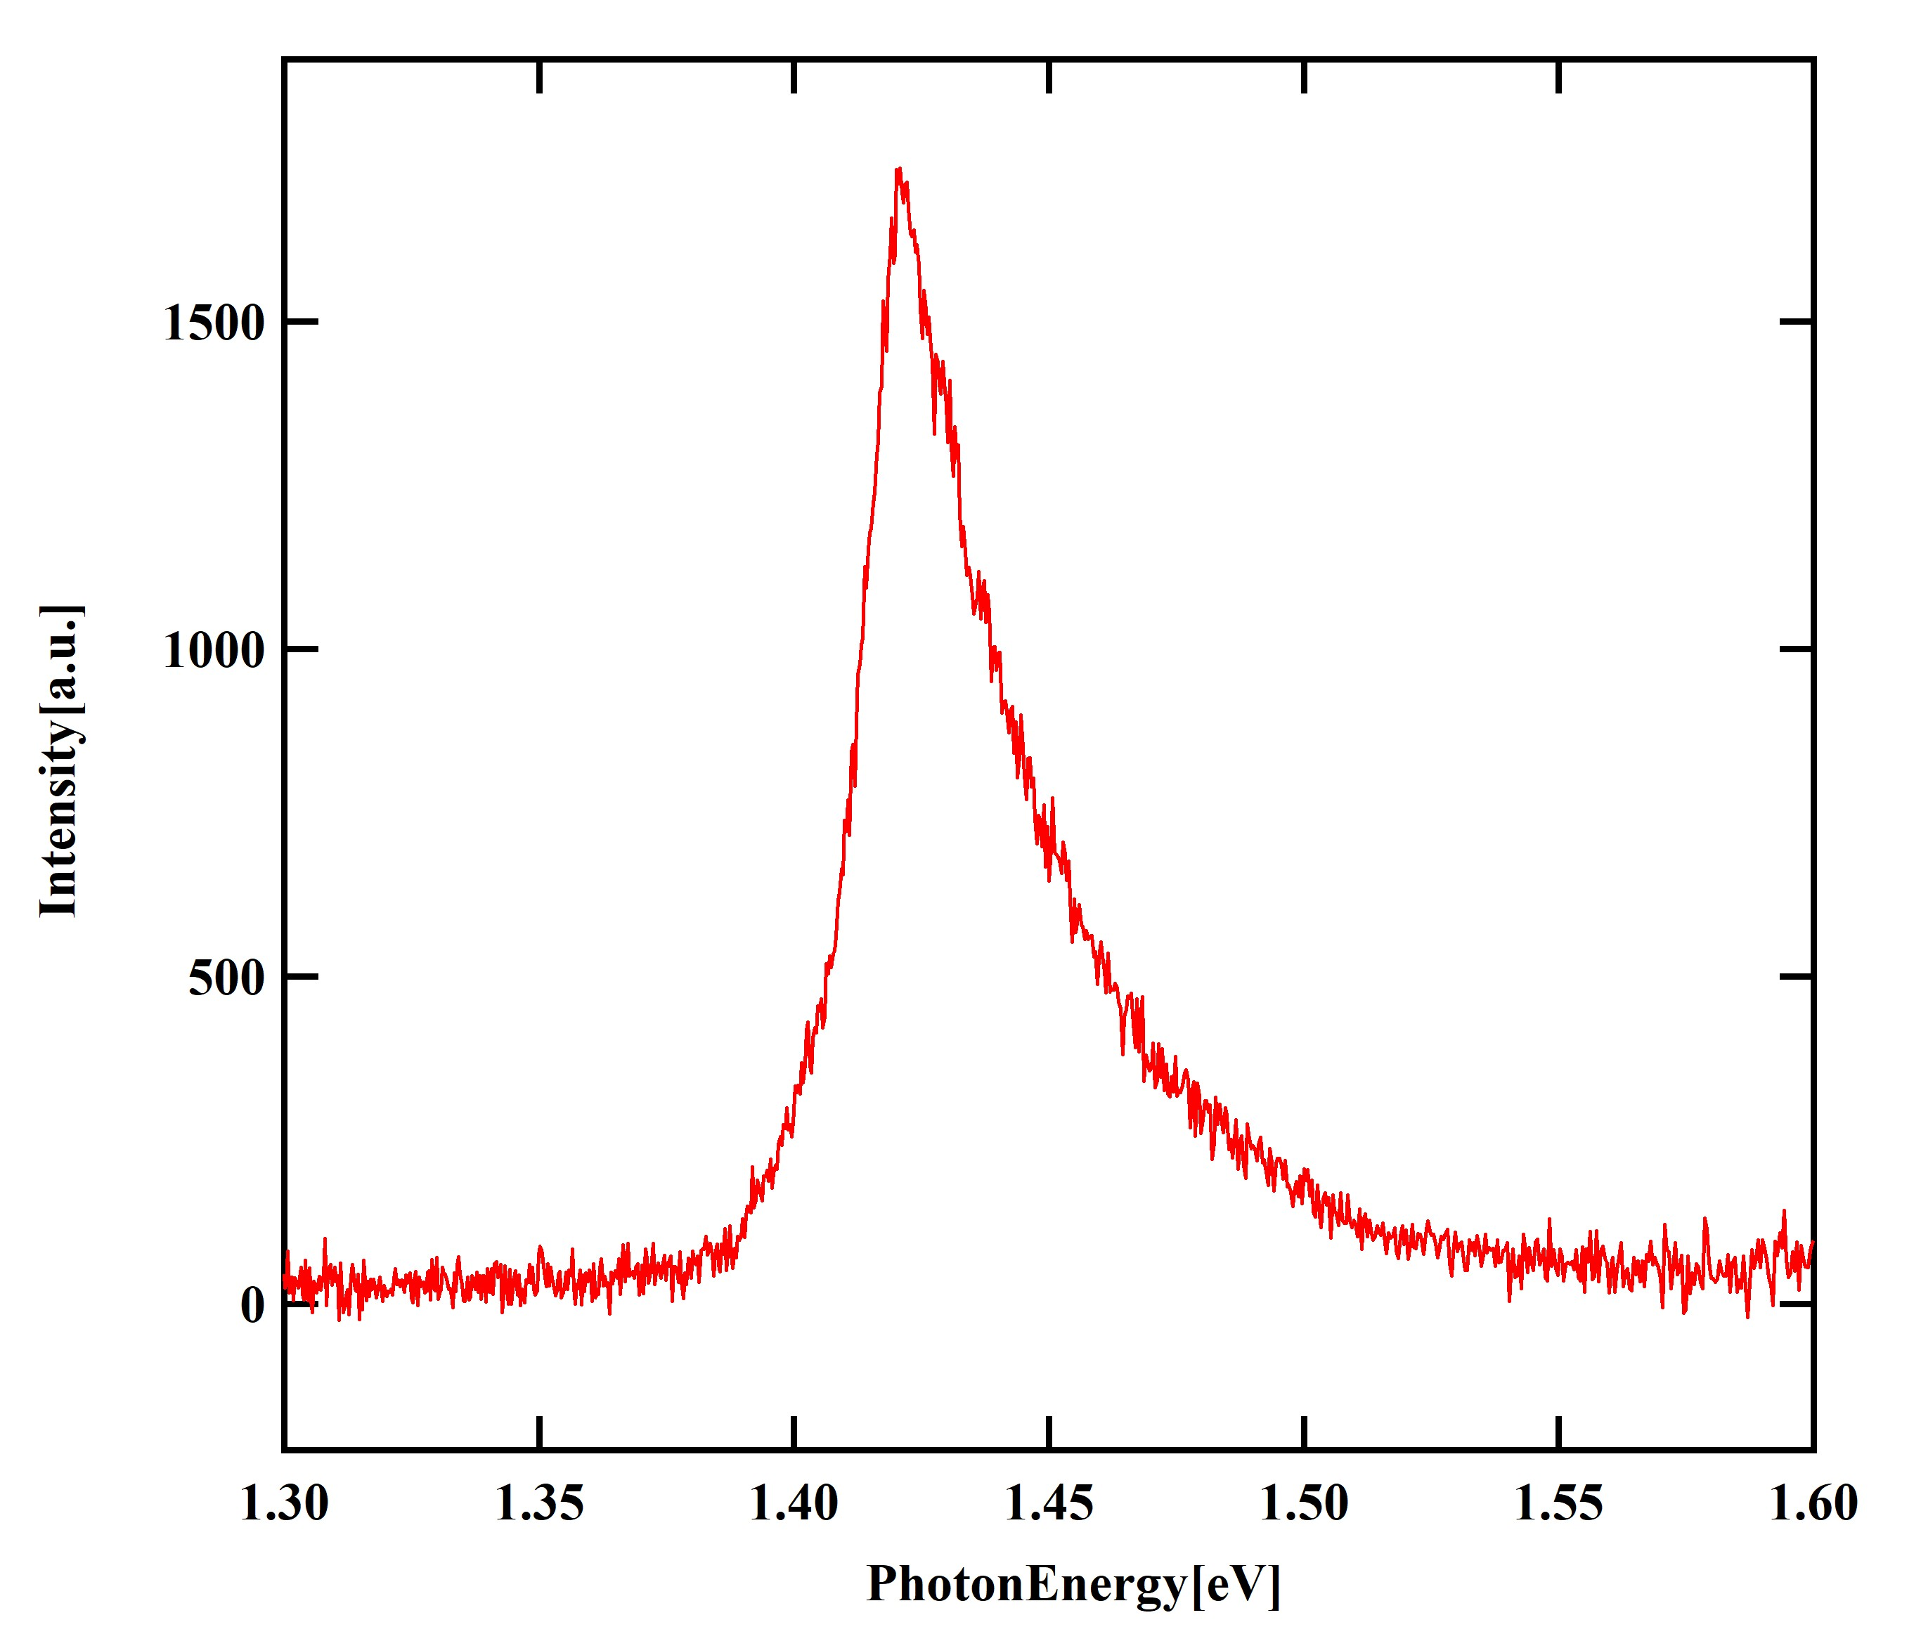
①
②

Slide 11
E
Condition Band
Exciton Binding Energy
Forbidden Band
Exciton Level
Exciton
Photon
Photon
Exciton Level
Valence Band

Slide 12
Wannier Exciton
e
h

Slide 13
E
Conduction Band
L
Forbidden Band
Subband
ΔE
Eg
Photon
Photon
Sub Band
Valence Band

Slide 14
Hg Lamp
CCD
Monochro
mator
White Paper
Fiber

Slide 15
Interfere Filter
Mirror
Mirror
ND Filter
Single-Convex Lens
Mirror
Mirror
Single-Convex Lens
Mirror
Mirror
Red
Laser
Iris
Blue
Laser
Iris
Single-Convex
Lens
ND Filter
CCD
Filter
Fiber
Monochro
mator
Sample
Convex Lens

Slide 16
Interfere Filter
Mirror
Mirror
ND Filter
Single-Convex Lens
Mirror
Mirror
Single-Convex Lens
Mirror
Mirror
Red
Laser
Iris
Blue
Laser
Iris
Single-Convex
Lens
ND Filter
Sample
CCD
Filter
Fiber
Monochro
metor
Convex Lens

Slide 17
ND Filter
Plano-Convex Lens
Mirror ②
Mirror ①
Plano-Convex Lens
Mirror ③
Mirror ④
Iris
Semiconductor
Laser
Iris
Plano-Convex
Lens
ND Filter
Sample
CCD
Filter
Fiber
Monochro
mator
Convex Lens

Slide 18
Interference Filter
Mirror ①
Mirror ②
Plano-Convex Lens
Mirror ③
Mirror ④
He-Ne
Laser
Iris
Iris
Plano-Convex
Lens
ND Filter
CCD
Sample
Filter
Fiber
Monochro
mator
Convex Lens

Slide 19
Interference Filter
Mirror ①
Mirror ②
Plano-Convex Lens
Mirror ③
Mirror ④
He-Ne
Laser
Iris
Iris
Plano-Convex
Lens
ND Filter
Cryostat
CCD
Vacuum
Pump
Sample
Filter
Fiber
Monochro
mator
Convex Lens

Slide 20
Z
GaAs
GaAs/Al0.3Ga0.7As Qw×5(L= 5 nm)
Al0.3Ga0.7As
GaAs/Al0.3Ga0.7As Qw×5(L= 6 nm)
GaAs 10nm
Al0.3Ga0.7As
GaAs/Al0.3Ga0.7As Qw×5(L= 7 nm)
GaAs 10nm
GaAs/Al0.3Ga0.7As Qw×5(L= 8 nm)
Al0.3Ga0.7As
GaAs/Al0.3Ga0.7As Qw×5(L= 9 nm)
GaAs 10nm
GaAs/Al0.3Ga0.7As Qw×5(L=10nm)
Al0.3Ga0.7As
GaAs 10nm
Al0.3Ga0.7As
Al0.3Ga0.7As
GaAs(001)Substrate
GaAs 10nm
Al0.3Ga0.7As

Slide 21
E
L
Condition Band
n-type
AlGaAs
GaAs
Forbidden Band
Eg
p-type
AlGaAs
Valence Band

