Slide 1

Basic Laws of Electric Cicuits

Slide 2
Basic Electric Circuit Concepts
System of Units:
We use the SI (System International) units. The system uses meters (m),
kilograms (kg), seconds (s), ampere (A), degree kelvin (^{O}K) and candela (cd)
as the fundamental units.
We use the following prefixes:
pica (p): 10⁻¹²
nano (n): 10⁻⁹
micro (μ): 10⁻⁶
milli (m): 10⁻³
tera (T): 10¹²
giga (G) : 10⁹
mega (M): 10⁶
kilo (k): 10³
1

Slide 3
Basic Electric Circuit Concepts
What is electricity?
One might define electricity as the separation of positive and
negative electric charge. (see slide note)
When the charges are separated and stationary we call this
static electricity. The charging of a capacitor is an example.
The separation of charge between clouds and the earth before
a lighting discharge is a static electricity.
When the charges are in motion (changing with time relative
to one another) we have variable electricity.
2
Notes:
Defining electricity is sort of like defining a force. We know what a force does just as we know what electricity does but it
is a little difficult to define either at a simple level. In this first course of circuits we will not go into deep understanding of definitions.

Slide 4
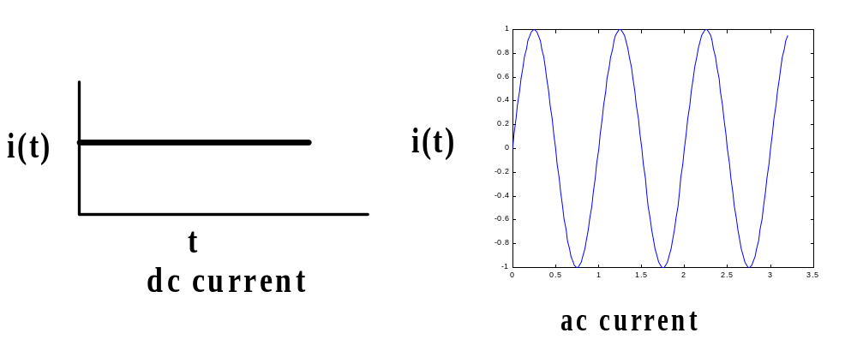
Basic Electric Circuit Concepts
Basic Quantities: Current
The unit of current is the ampere (A). We note that
1 ampere = 1 coulomb/second
We normally refer to current as being either direct (dc) or
alternating (ac).
3

Slide 5
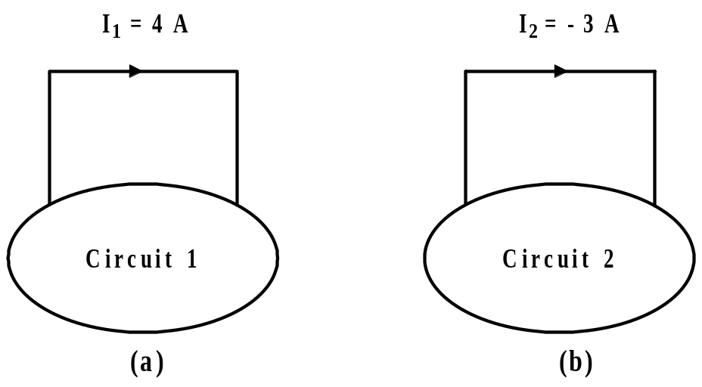
Basic Electric Circuit Concepts
Basic Quantities: Current
In solving for current in a circuit, we must assume a direction, solve
for the current, then reconcile our answer. This is illustrated below.
In the diagram above, current I₁ is actually 4 A as assumed. The
actual positive direction of current I₂ (equal to -3 A) in the opposite
direction of the arrow for I₂.
4

Slide 6
Basic Electric Circuit Concepts
Basic Quantities: Voltage
The next quantity of interest is voltage. Voltage is also called an
electromotive force (emf). It is also called potential (coming from
the expression, “potential energy.” However, voltage is not energy.)
Suppose one coulomb of charge is located at point b and one joule
of energy is required to move the charge to point a. Then we say
that V_{ab} = 1 volt = 1 joule/coulomb = 1 newton.meter/coulomb.
V_{ab} = 1 volt states that the potential of point a (voltage at point a)
is l volt (positive) with respect to point b.
The sign associated with a voltage is also called its polarity.
5

Slide 7
Basic Electric Circuit Concepts
Basic Quantities: Voltage
As in the case for current, we must assume a positive direction (polarity) for
the voltage. Consider the three diagrams below.
.
+
a
v = 4 v
.
v_{ab} = 4 v
v = 4 v
-
b
(a)
(b)
(c)
Each of the above gives the same information.
6

Slide 8
Basic Electric Circuit Concepts
Basic Quantities: Voltage
We need to keep in mind that we assume a polarity for the voltage.
When we solve the circuit for the voltage, we may find that the actual
polarity is not the polarity we assumed.
+
The negative sign for 6 v
indicates that if the red lead of a
voltmeter is placed on + terminal
and the black lead on the – terminal
the meter will read downscale or –6v.
A digital meter would read –6 v.
What would an analog meter do?
v = -6 v
-
7

Slide 9
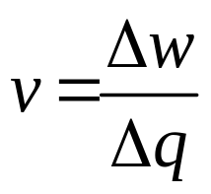
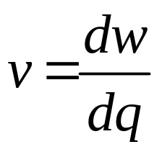
Basic Electric Circuit Concepts
Basic Quantities: Voltage
In summary, we should remember that,
(2)
This can be expressed in differential form as,
(3)
w: energy in joules q: charge in coulombs
8

Slide 10
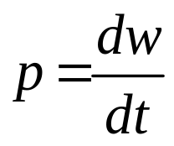
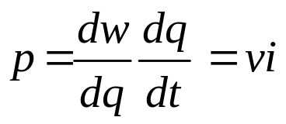
Basic Electric Circuit Concepts
Basic Quantities: Power
Power is defined as the time rate of change of doing work. We
express this as,
(3)
We can write equation (3) as follows:
(4)
Power has units of watts.
9

Slide 11
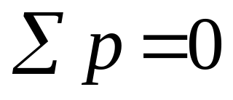
Basic Electric Circuit Concepts
Basic Quantities: Power
In any closed electric circuit, power is both supplied and absorbed.
The amount that is supplied must be equal to the amount that is
absorbed.
Stated another way, we can say that the law of conversation of
energy must hold. Therefore, in any electric circuit the algebraic
sum of the power must be zero.
(5)
10

Slide 12
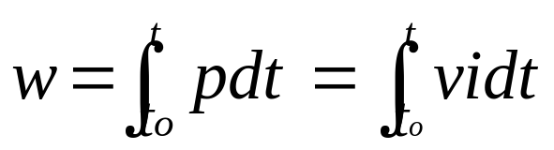
Basic Electric Circuit Concepts
Basic Quantities: Power and Energy
When we pay our electric bills we pay for (watt)(hours) but
because this is such as large number we usually think kWH.
Cost of 1 kWH is approx. 4 – 8 cents.
A profile of the power you use during a day may be as shown below.
p
t
The energy we pay for is the area under the power-time curve.
(6)
11

Slide 13
Basic Electric Circuit Concepts
Basic Quantities: Power
We adopt a passive sign convention in order to define the sign of
supplied power and the sign of absorbed power. Consider the following.
I
+
+
source
v_{s}
v_{L}
load
_
_
Power supplied: If the assumed direction of the current leaves
the assumed positive polarity of the voltage, power is supplied.
Power absorbed: If the assumed direction of the current enters
the assumed positive polarity of the voltage, power is absorbed.
12

Slide 14
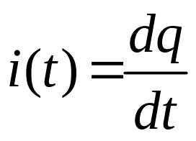
Basic Electric Circuit Concepts
Basic Quantities: Charge
Charge is the most fundamental quantity of electric circuits. In most
electric circuits, the basic charge is that of an electron, which is
-1.602x10⁻¹⁹ coulombs (C).
The entity, charge, is expressed as Q or q. If the charge is constant
we use Q. If the charge is in motion we use q(t) or q.
According to fundamental laws, charge cannot be either created or
destroyed, only transferred from one point to another.
We define charge in motion as current. That is,
(7)
13

Slide 15
Basic Electric Circuit Concepts
Basic Quantities: Power
We consider the following examples:
I=4A
I=4A
I=4A
I=4A
_
_
+
+
v = 5 v
v = 5 v
v = 5 v
v = 5 v
+
-
+
(a) P = 20W
(b) P = 20W
(c) P = -20W
(d) P = -20W
absorbed
absorbed
absorbed absorbed
14

Slide 16
Basic Electric Circuit Concepts
Circuit Elements:
We classify circuit elements as passive and active.
Passive elements cannot generate energy. Common examples of
passive elements are resistors, capacitors and inductors. We will
see later than capacitors and inductors can store energy but cannot
generate energy.
Active elements can generate energy. Common examples of active
elements are power supplies, batteries, operational amplifiers.
For the present time we will be concerned only with sources. The types
of sources we consider are independent and dependent.
15

Slide 17

Basic Electric Circuit Concepts
Circuit Elements:
Ideal independent voltage source
An ideal dependent voltage source is characterized as having a
constant voltage across its terminals, regardless of the load
connected to the terminals.
The ideal voltage source can supply any amount of current.
Furthermore, the ideal independent voltage source can supply any
amount of power.
The standard symbols of the ideal independent voltage source are
shown below.
Most often
used
₊
Sometimes
used
v(t)
_
E
16

Slide 18

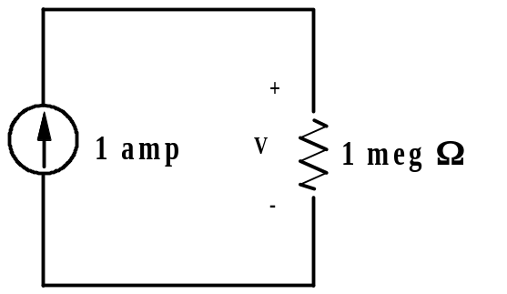
Basic Electric Circuit Concepts
Circuit Elements:
Ideal independent current sources
An ideal independent current source is characterized as
providing a constant value of current, regardless of the load.
If the current source is truly ideal, it can provided any value
of voltage and any amount of power.
The standard symbol used for the ideal independent current
source is shown below.
i(t)
V = ?
17

Slide 19
Basic Electric Circuit Concepts
Circuit Elements:
Comments about ideal model
The ideal independent voltage and current sources are models.
As such, they are subject to limitations.
For example, an independent voltage source, that one commonly
works with, cannot put-out 1x10³²⁰ volts.
Neither can an ordinary independent current source put out
4x10⁷⁶⁵ amps.
We must always keep these limitations in mind. Otherwise one
might think that one could start an automobile engine with a
12 V radio battery!
18

Slide 20

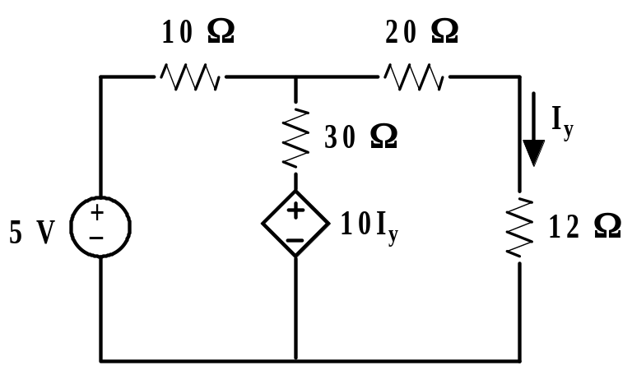
Basic Electric Circuit Concepts
Circuit Elements:
Dependent voltage source
A dependent voltage source is characterized by depending on
a voltage or current somewhere else in the circuit. The symbol
For the current source is shown below. Note the diamond shape.
A circuit containing a dependent voltage source is shown below.
A circuit with a current
controlled dependent
voltage source.
19
Notes:
We can have current controlled dependent voltage sources and voltage controlled dependent voltage sources.

Slide 21

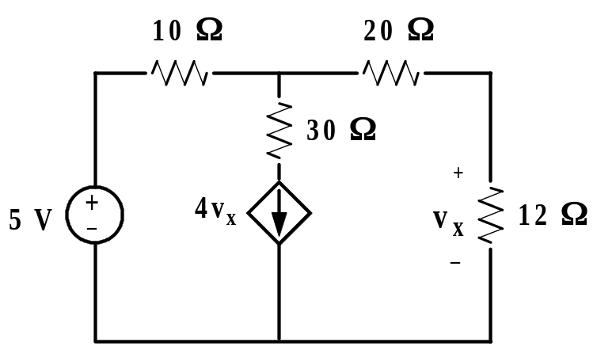
Basic Electric Circuit Concepts
Circuit Elements:
Dependent current source
A dependent current source is characterized by depending on
a voltage or current somewhere else in the circuit. The symbol
for a dependent current source is shown as follows:
A circuit containing a dependent current source is shown below.
A circuit with a voltage
controlled dependent
current source
20
Notes:
You can have current controlled dependent current sources and voltage controlled dependent current sources.

Slide 22

Basic Electric Circuit Concepts
circuits
Fundamentals

Slide 23
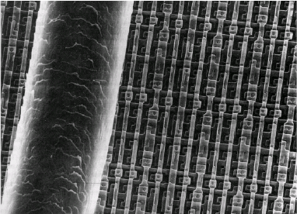
Introduction to Electronics
(Semiconductor Devices)

Slide 24
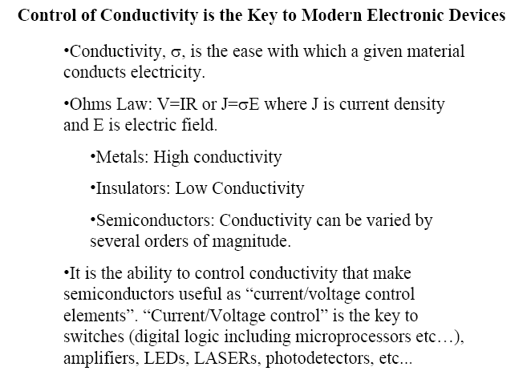
Why Semiconductors?

Slide 25
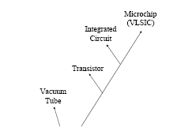

Evolution of Electronics

Slide 26
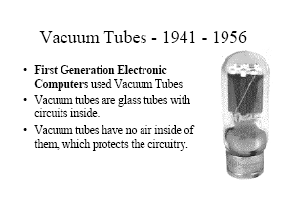
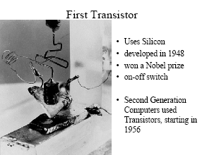

Slide 27
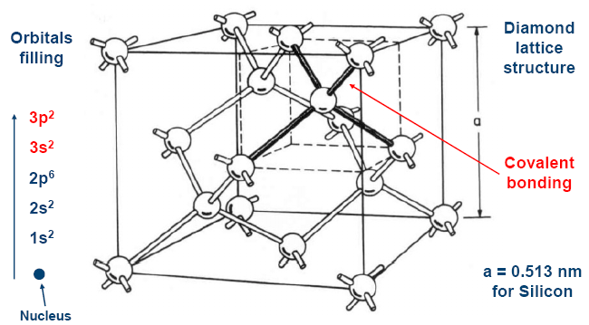
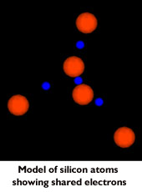

Slide 28
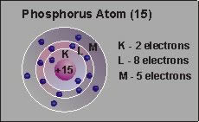
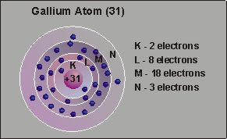
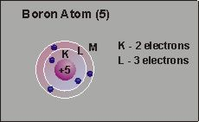
N-Type Semiconductor
P-Type Semiconductor

Slide 29
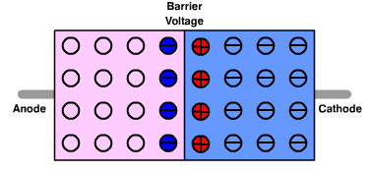
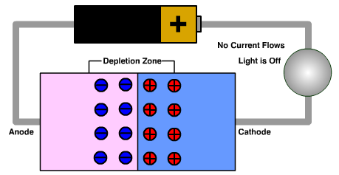
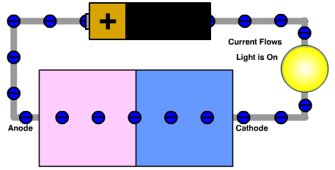
E
E

Slide 30
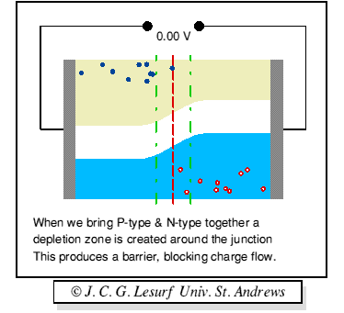

Slide 31
Diode Types
Rectifier Diodes
Light Emitting Diodes (LED)
Photodiodes
Zener Diodes
Schottky Diodes

Slide 32
Diode Applications
Reverse Voltage Protection
Rectifying
Display
Light Sensing

Slide 33
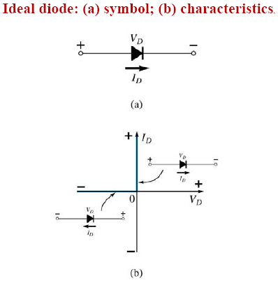


Slide 34
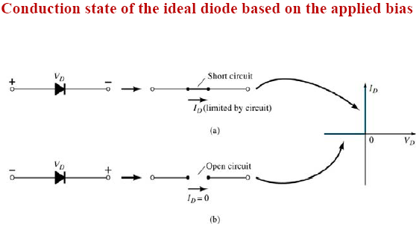

Slide 35
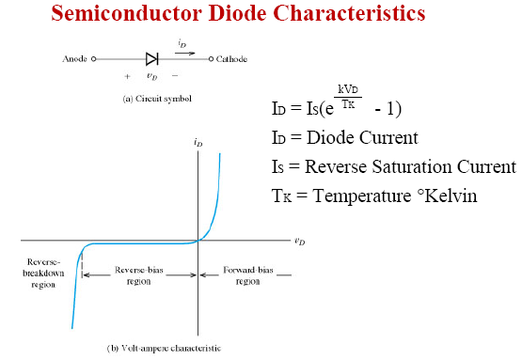

Slide 36
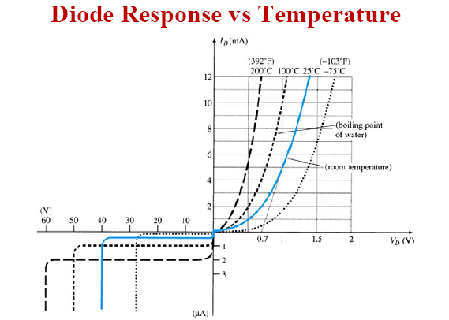

Slide 37
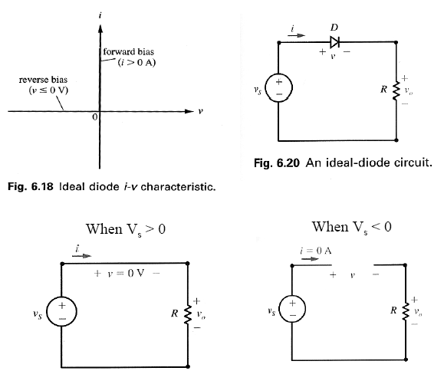

Slide 38
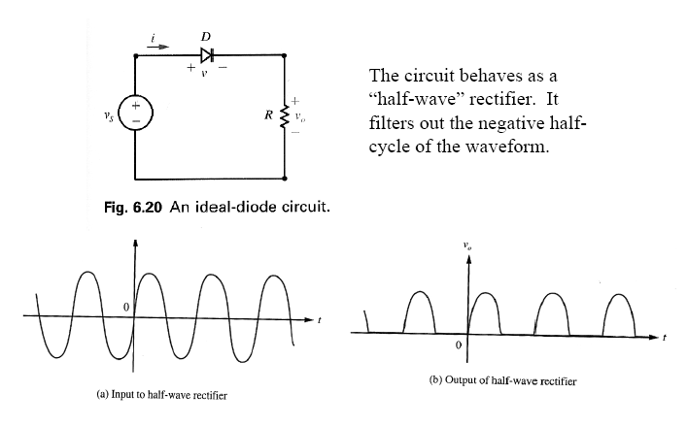


Slide 39
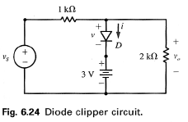
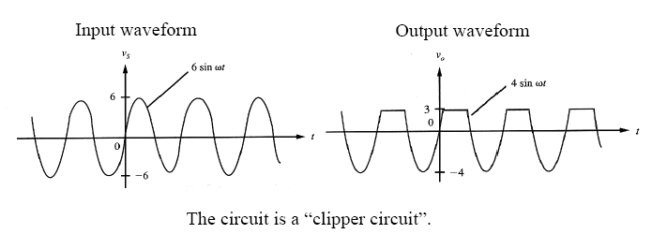

Slide 40

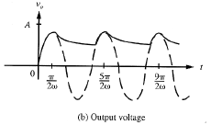
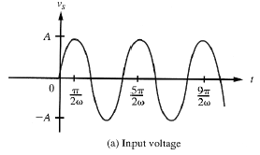

Slide 41
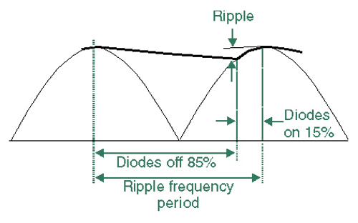
Ripple
Full-wave ripple frequency is twice AC frequency

Slide 42

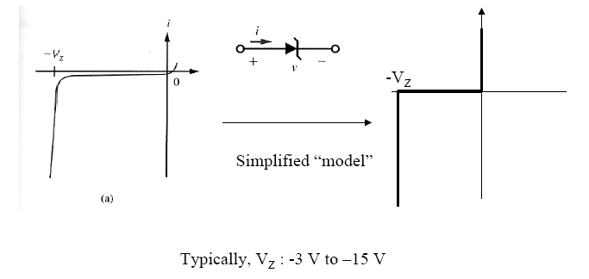
Zener Diode

Slide 43
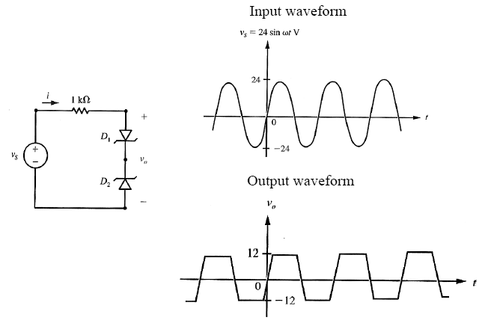

Slide 44
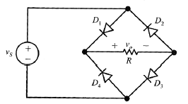
Diode Bridge

Slide 45
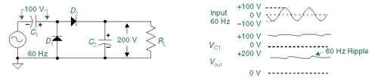
Voltage Doubler
On negative half-cycle, D1 charges C1 to Vp.
On positive half-cycle D2 adds AC peak to Vp on C1
and transfers it all to C2.

Slide 46
Voltage Doubler
Voltage doublers allow you to develop higher voltages without a transformer.
Stages can be cascaded to produce triplers, quadruplers, etc.
Voltage multipliers usually supply low currents to a high-resistance load.
Output voltage usually drops quickly as load current increases.

