Slide 1
Photographic Style Transfer
Mohammad Akif Beig
Graduate Student, Concordia University
09/August/2018

Slide 2
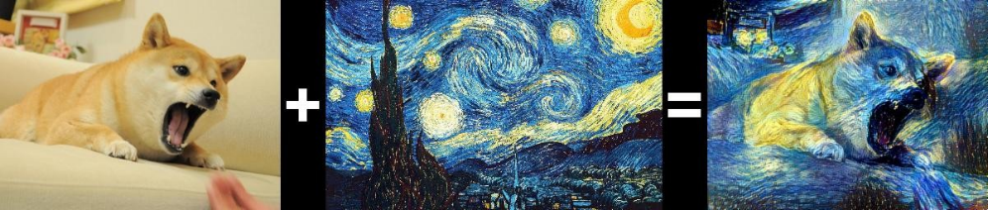
What is Neural Style Transfer
Style transfer also known as neural style transfer is a Convolution neural network application.
This was introduced by L.A. Gatys et. al. In 2015 in the paper “A Neural Algorithm of Artistic Style Transfer”
The key idea discussed in the paper is to take the content of an image and style from another image and create a new generated image with the hybrid.
Content (c)
Style (t)
Generated (x)

Slide 3
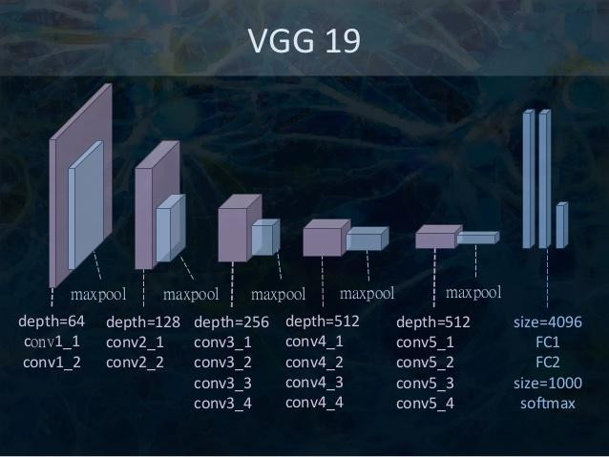
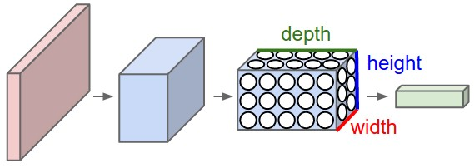
Convolution Neural Network
Convolution Neural Network
VGG 19 Convolution Neural Network
Basic Convolution Neural Network
A ConvNet arranges its neurons in three dimensions (width, height, depth), as visualized in one of the layers. Every layer of a ConvNet transforms the 3D input volume to a 3D output volume of neuron activations. In this example, the red input layer holds the image, so its width and height would be the dimensions of the image, and the depth would be 3 (Red, Green, Blue channels)
Image Source : Stanford Course on Convolution Neural Network (Coursera)

Slide 4
Mathematical Model (How does it work ?)
Gatys formulated this as a problem of optimization, where given a Content image c, and a style Image t, we want to generate an image x, that has texture, colour etc. from t and content from image c.
X* = argmin (α L _{content}(c , x) + β L _{style}(t , x ))
Here α = weight of the content loss and β = weight of the style loss, these are referred to as hyperparameters in the paper and we need to perform hyperparameter tuning to get the desired result.
We want to find out the output image x that minimizes the loss or differs as little as possible from c in content and t in style.
This is also considered as a minimization of the Cost Functions ( Content Loss Function and Style Loss Function).
Content Loss is the mean squared error between the feature representation of the content image and combined image and Style loss is the scaled squared loss of frobenius norm of the difference between the gram matrices of the style and combination images. Gram matrix as we know is a matrix formed by multiplying the transpose of a matrix by itself.

Slide 5
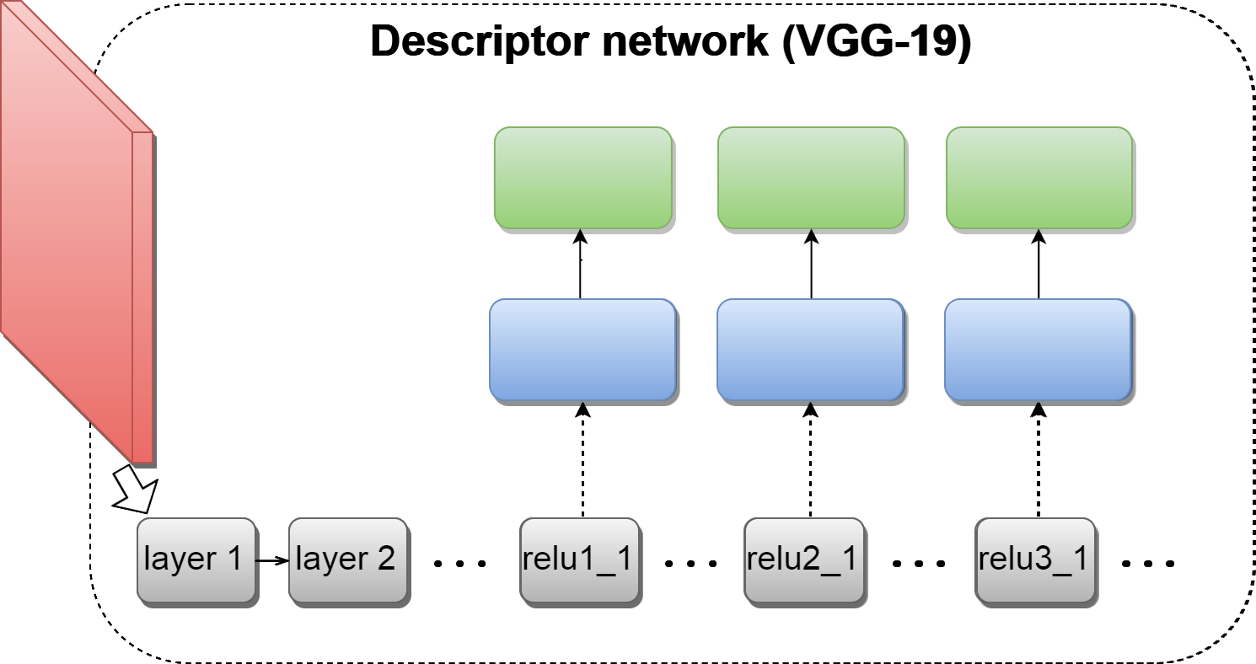
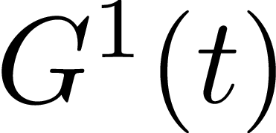
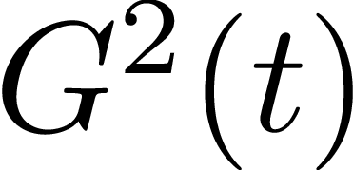
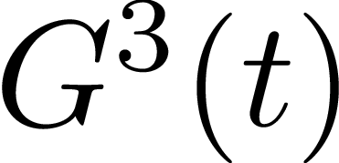

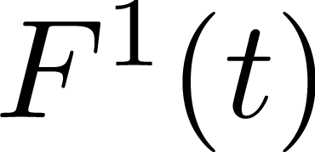
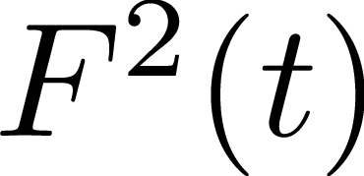
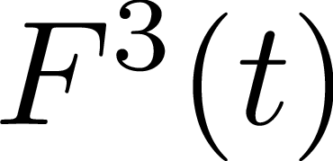

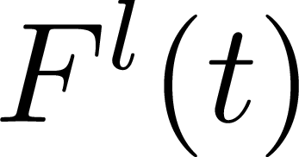
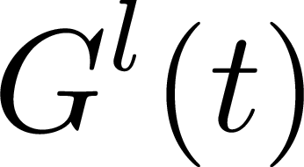
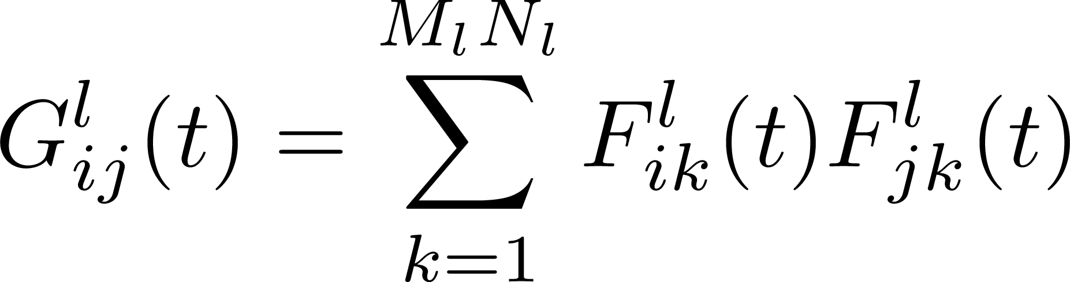
Gatys et. al.: Optimization based texture synthesis
Texture:
Activations at layer : Gram matrix at layer :
Dmitry Ulyanov

Slide 6

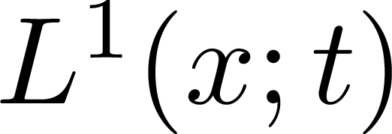
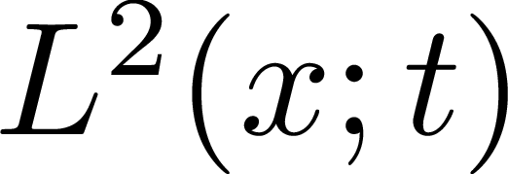
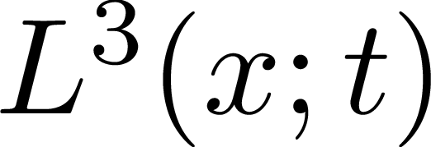

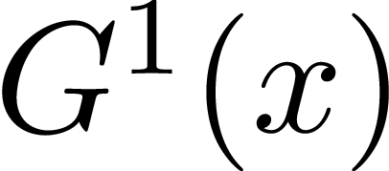
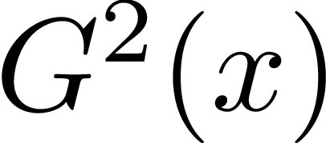
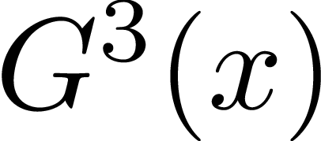

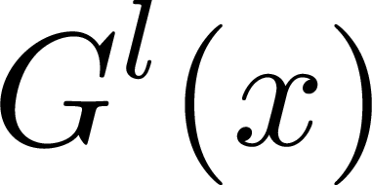
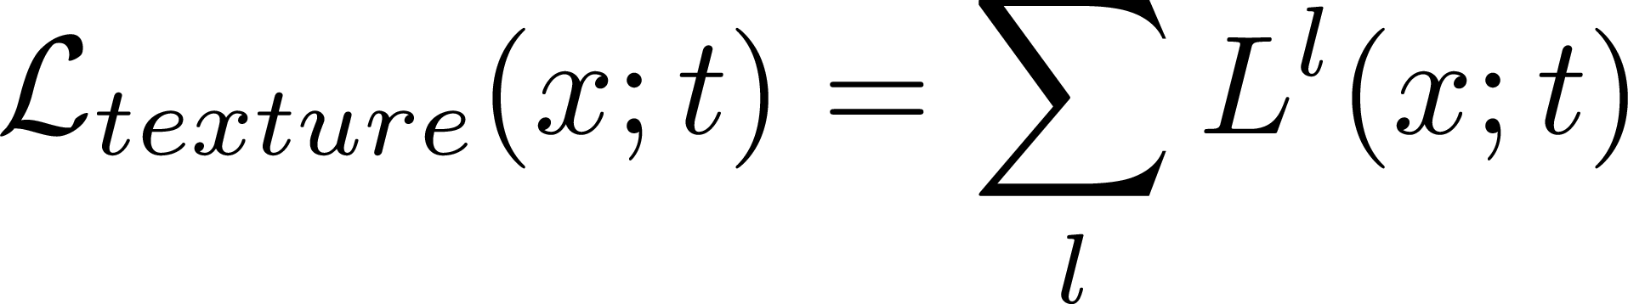
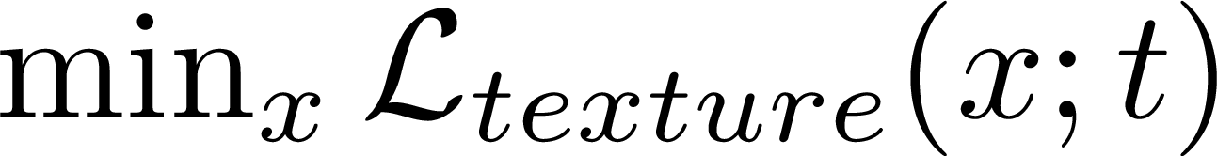
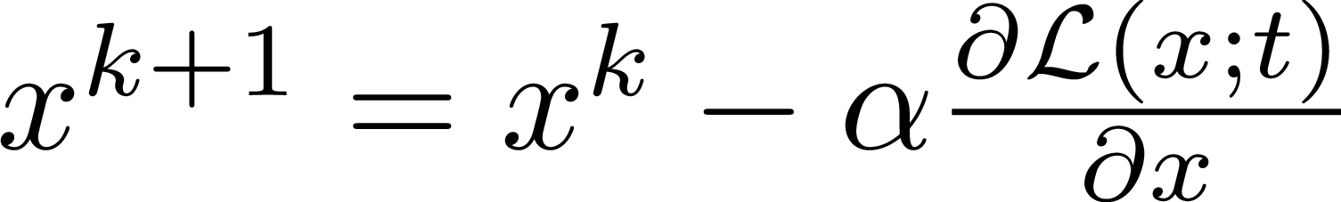
Gatys et. al.: Optimization based texture synthesis
Image:
Gram matrix at layer : Loss at layer :
Solve :
By gradient descent :
Dmitry Ulyanov

Slide 7
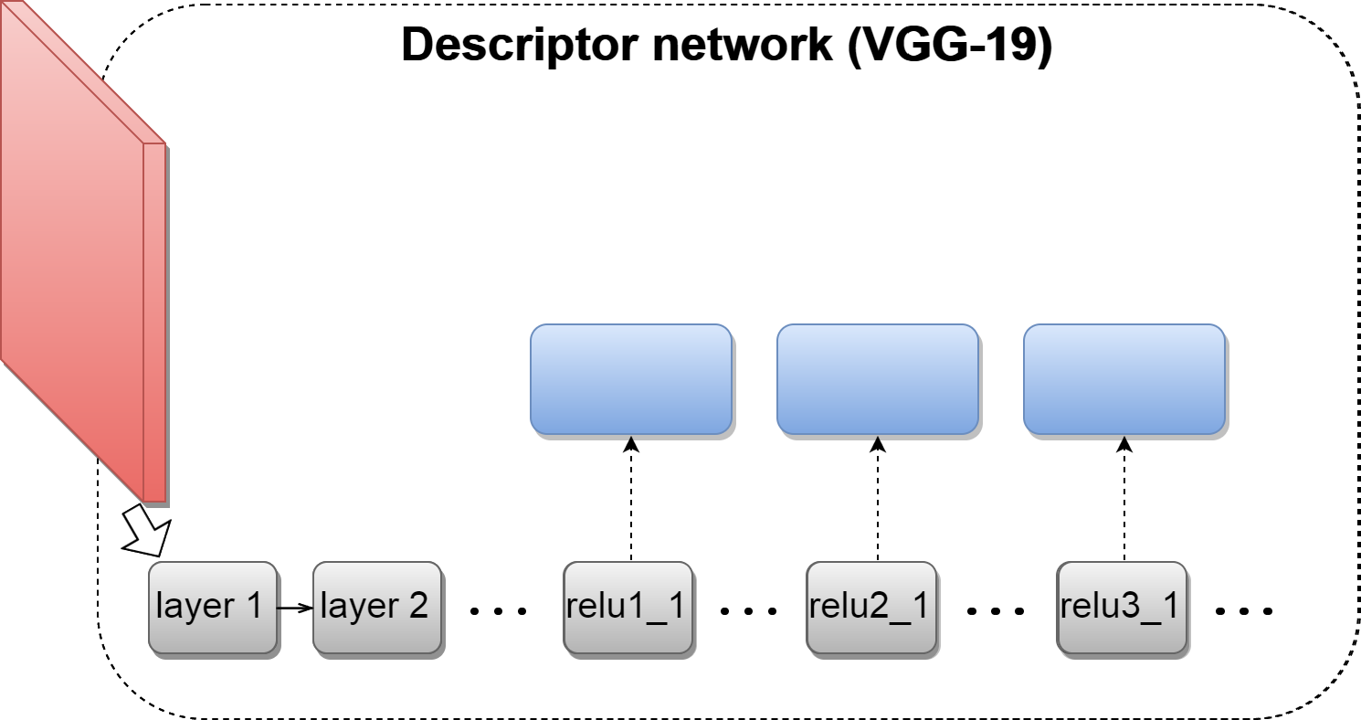


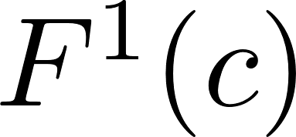
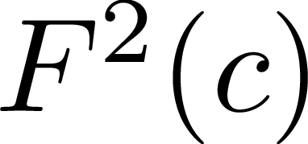
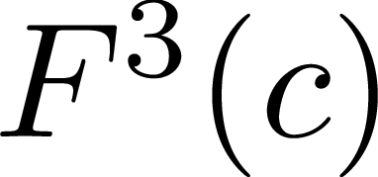
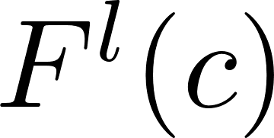
Gatys et. al. : Content Loss for Style Transfer
Content Image:
Activations at layer
Dmitry Ulyanov

Slide 8


Gatys et. al. : Content Loss for Style Transfer
Content
Style
Result
Total loss:
Texture loss: Content loss:
Dmitry Ulyanov

Slide 9
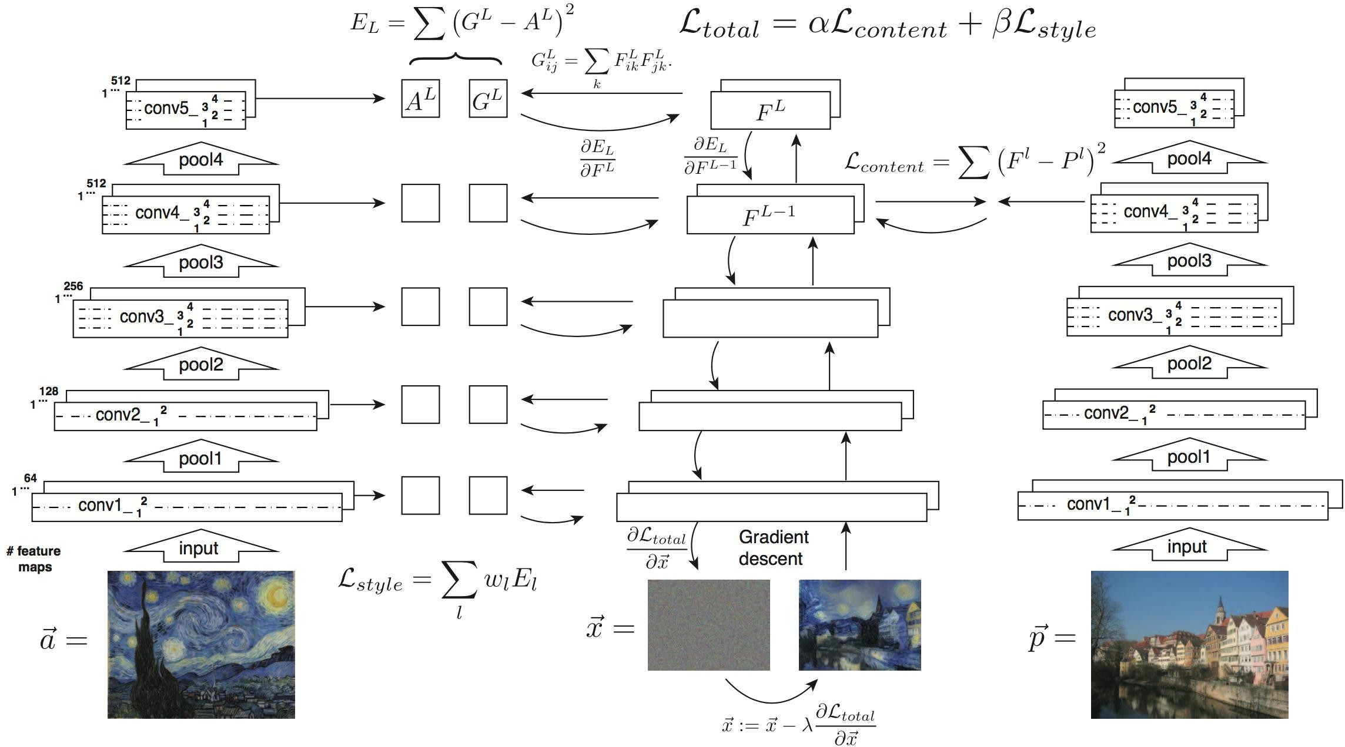
The Total Loss Function

Slide 10
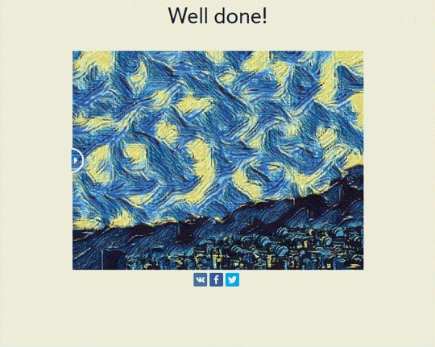
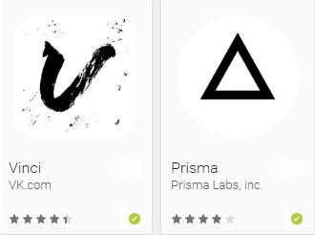

Industrial Applications

Slide 11
Future Research
Color Preservation in Style Transfer
Multi Style Transfer
Style Transfer in Videos (Optimal Flow)
Application in Fashion Industry Design

Slide 12
References
[1] Leon A Gatys, Alexander S Ecker, and Matthias Bethge. A neural algorithm of artistic style. arXiv preprint arXiv:1508.06576, 2015.
[2] Erik Reinhard, Michael Adhikhmin, Bruce Gooch, and Peter Shirley. Color transfer between images. IEEE Computer graphics and applications, 21(5):34–41, 2001.
[3] Francois Pitie, Anil C Kokaram, and Rozenn Dahyot. N-dimensional probability density function transfer and its application to color transfer. In Computer Vision, 2005. ICCV 2005. Tenth IEEE International Conference on, volume 2, pages 1434–1439. IEEE, 2005.
[4] Jacob R Gardner, Paul Upchurch, Matt J Kusner, Yixuan Li, Kilian Q Weinberger, Kavita Bala, and John E Hopcroft. Deep manifold traversal: Changing labels with convolutional features. arXiv preprint arXiv:1511.06421, 15
[5] Yichang Shih, Sylvain Paris, Frédo Durand, and William T Freeman. Data-driven hallucination of different times of day from a single outdoor photo. ACM Transactions on Graphics (TOG), 32(6):200, 2013.
[6] Pierre-Yves Laffont, Zhile Ren, Xiaofeng Tao, Chao Qian, and James Hays. Transient attributes for high-level understanding and editing of outdoor scenes. ACM Transactions on Graphics (TOG), 33(4):149, 2014.
[7] Aaron Hertzmann, Charles E Jacobs, Nuria Oliver, Brian Curless, and David H Salesin. Image analogies. In Proceedings of the 28th annual conference on Computer graphics and interactive techniques, pages 327–340. ACM, 2001.
[8] Chuan Li and Michael Wand. Combining markov random fields and convolutional neural networks for image synthesis. In Proceedings of the IEEE Conference on Computer Vision and Pattern Recognition, pages 2479–2486, 2016.
[9] Ahmed Selim, Mohamed Elgharib, and Linda Doyle. Painting style transfer for head portraits using convolutional neural networks. ACM Transactions on Graphics (ToG), 35(4):129, 2016.
[10] Karen Simonyan and Andrew Zisserman. Very deep convolutional networks for large-scale image recognition. arXiv preprint arXiv:1409.1556, 2014.
[11] F. Pedregosa, G. Varoquaux, A. Gramfort, V. Michel, B. Thirion, O. Grisel, M. Blondel, P. Prettenhofer, R. Weiss, V. Dubourg, J. Vanderplas, A. Passos, D. Cournapeau, M. Brucher, M. Perrot, and E. Duchesnay. Scikit-learn: Machine learning in Python. Journal of Machine Learning Research, 12:2825–2830, 2011.
[12] Noah Makow and Pablo Hernandez. Exploring style transfer: Extensions to neural style transfer.
[13] Yann LeCun, Léon Bottou, Yoshua Bengio, and Patrick Haffner. Gradient-based learning applied to document recognition. Proceedings of the IEEE, 86(11):2278–2324, 1998.
[14] Siraj Raval. Convolution Neural Network, 2018.
[15] Leon A Gatys, Alexander S Ecker, and Matthias Bethge. Image style transfer using convolutional neural networks. In Proceedings of the IEEE Conference on Computer Vision
and Pattern Recognition, pages 2414–2423, 2016.

Slide 13
Thank you

