Slide 1
Question 1
Trace the Dijkstra’s weighted shortest path algorithm on the graph given in Figure 1. Use vertex E as your start vertex.

Slide 2
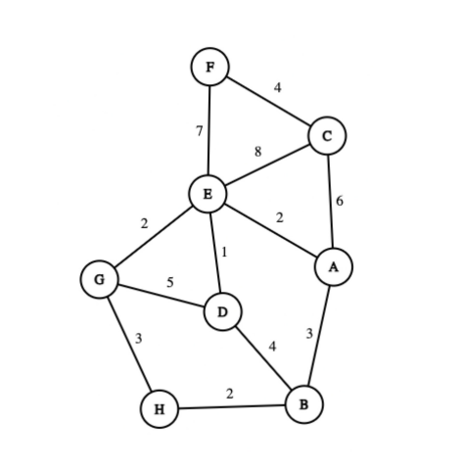
Parameters:
1 - Distance (d)
2 - Known/Unknown (s)
3 - Previous Vertex (p)
Every vertex is labeled as:
d (s,p)
∞ (U,?)
∞ (U,?)
0 (K,E)
∞ (U,?)
∞ (U,?)
∞ (U,?)
∞ (U,?)
∞ (U,?)

Slide 3
Known Vertices:
- E
Unknown Vertices:
- A,B,C,D,F,G,H
7 (U,E)
8 (U,E)
0 (K,E)
2 (U,E)
2 (U,E)
1 (U,E)
∞ (U,?)
∞ (U,?)

Slide 4
Known Vertices:
- E,D
Unknown Vertices:
- A,B,C,F,G,H
7 (U,E)
8 (U,E)
0 (K,E)
2 (U,E)
2 (U,E)
1 (K,E)
∞ (U,?)
5 (U,D)

Slide 5
Known Vertices:
- E,D,G
Unknown Vertices:
- A,B,C,F,H
7 (U,E)
8 (U,E)
0 (K,E)
2 (K,E)
2 (U,E)
1 (K,E)
5 (U,G)
5 (U,D)

Slide 6
Known Vertices:
- E,D,G,A
Unknown Vertices:
- B,C,F,H
7 (U,E)
8 (U,E)
0 (K,E)
2 (K,E)
2 (K,E)
1 (K,E)
5 (U,G)
5 (U,D)

Slide 7
Known Vertices:
- E,D,G,A,H
Unknown Vertices:
- B,C,F
7 (U,E)
8 (U,E)
0 (K,E)
2 (K,E)
2 (K,E)
1 (K,E)
5 (K,G)
5 (U,D)

Slide 8
Known Vertices:
- E,D,G,A,H,B
Unknown Vertices:
- C,F
7 (U,E)
8 (U,E)
0 (K,E)
2 (K,E)
2 (K,E)
1 (K,E)
5 (K,G)
5 (K,D)

Slide 9
Known Vertices:
- E,D,G,A,H,B,F
Unknown Vertices:
- C
7 (K,E)
8 (U,E)
0 (K,E)
2 (K,E)
2 (K,E)
1 (K,E)
5 (K,G)
5 (K,D)

Slide 10
Known Vertices:
- E,D,G,A,H,B,F,C
Unknown Vertices:
- None
7 (K,E)
8 (K,E)
0 (K,E)
2 (K,E)
2 (K,E)
1 (K,E)
5 (K,G)
5 (K,D)

Slide 11
Question 2
Trace the Prim’s minimum spanning tree algorithm on the graph in Figure 1.
Use vertex E as your start vertex.

Slide 12
Prim’s Algorithm:
1 - Start with one of the vertices in the graph
2 - Grow the tree in successive stages
3 - At each stage, add an edge (U,V) to the tree if (U,V) has the smallest cost among all the edges such that U is in the tree and V is not and mark the edge as known

Slide 13
Prim’s Algorithm:
1 - Start with E
2 - Grow the tree in successive stages
3 – At each stage, add an edge (U,V) to the tree if (U,V) has the smallest cost among all the edges such that U is in the tree and V is not and mark the edge as known

Slide 14
Prim’s Algorithm:
- Add edge (E,D) as (E,D) has the smallest cost among all the edges such that u is in the tree and v is not

Slide 15
Prim’s Algorithm:
- Add edge (E,G) as (E,G) has the smallest cost among all the edges such that u is in the tree and v is not

Slide 16
Prim’s Algorithm:
- Add edge (E,A) as (E,A) has the smallest cost among all the edges such that u is in the tree and v is not

Slide 17
Prim’s Algorithm:
- Add edge (G,H) as (G,H) has the smallest cost among all the edges such that u is in the tree and v is not

Slide 18
Prim’s Algorithm:
- Add edge (H,B) as (H,B) has the smallest cost among all the edges such that u is in the tree and v is not

Slide 19
Prim’s Algorithm:
- Add edge (A,C) as (A,C) has the smallest cost among all the edges such that u is in the tree and v is not

Slide 20
Prim’s Algorithm:
- Add edge (C,F) as (C,F) has the smallest cost among all the edges such that u is in the tree and v is not
- All vertices have been marked as known, finalize

Slide 21
Question 3
Trace the Kruskal’s minimum spanning tree algorithm on the graph in Figure 1

Slide 22
Kruskal’s Algorithm:
1 - Pick smallest edge which is not yet in the tree
2 - Check if it creates a cycle, if not add it to the tree
3 - Repeat until there are V-1 edges in the tree

Slide 23
Kruskal’s Algorithm:
1 - Pick E-D
2 - Does not create a cycle, add it to the tree
3 - Repeat until there are 7 edges in the tree. Current edge count: 1

Slide 24
Kruskal’s Algorithm:
1 - Pick E-G or E-A (Picked E-G)
2 - Does not create a cycle, add it to the tree
3 - Repeat until there are 7 edges in the tree. Current edge count: 2

Slide 25
Kruskal’s Algorithm:
1 - Pick E-A
2 - Does not create a cycle, add it to the tree
3 - Repeat until there are 7 edges in the tree. Current edge count: 3

Slide 26
Kruskal’s Algorithm:
1 - Pick H-B
2 - Does not create a cycle, add it to the tree
3 - Repeat until there are 7 edges in the tree. Current edge count: 4

Slide 27
Kruskal’s Algorithm:
1 - Pick B-A or G-H (Picked B-A)
2 - Does not create a cycle, add it to the tree
3 - Repeat until there are 7 edges in the tree. Current edge count: 5

Slide 28
Kruskal’s Algorithm:
1 - Pick G-H
2 - Creates a cycle, do not add it to the tree
3 - Repeat until there are 7 edges in the tree. Current edge count: 5

Slide 29
Kruskal’s Algorithm:
1 - Pick F-C or D-B (Picked F-C)
2 - Does not create a cycle, add it to the tree
3 - Repeat until there are 7 edges in the tree. Current edge count: 6

Slide 30
Kruskal’s Algorithm:
1 - Pick D-B
2 - Creates a cycle, do not add it to the tree
3 - Repeat until there are 7 edges in the tree. Current edge count: 6

Slide 31
Kruskal’s Algorithm:
1 - Pick G-D
2 - Creates a cycle, do not add it to the tree
3 - Repeat until there are 7 edges in the tree. Current edge count: 6

Slide 32
Kruskal’s Algorithm:
1 - Pick C-A
2 - Does not create a cycle, add it to the tree
3 - Repeat until there are 7 edges in the tree. Current edge count: 7
Finalize the process

Slide 33
Question 4
Trace the breadth-first search traversal algorithm on the graph in Figure 1 starting from vertex E.

Slide 34
Breadth First Search Traversal:
Traverse vertices in increasing order while marking them as known
- Traverse vertices 1 away
- Traverse vertices 2 away
- Traverse vertices 3 away
…
- Traverse vertices V-1 away

Slide 35
Breadth First Search Traversal:
- Traverse vertices 1 away

Slide 36
Breadth First Search Traversal:
- Traverse vertices 1 away

Slide 37
Breadth First Search Traversal:
- Traverse vertices 1 away

Slide 38
Breadth First Search Traversal:
- Traverse vertices 1 away

Slide 39
Breadth First Search Traversal:
- Traverse vertices 1 away

Slide 40
Breadth First Search Traversal:
- No more vertices 1 away left,
- Traverse vertices 2 away

Slide 41
Breadth First Search Traversal:
- Traverse vertices 2 away
- No more unvisited vertices left, finalize

Slide 42
Question 5
Find a topological ordering of the graph in Figure 2.

Slide 43
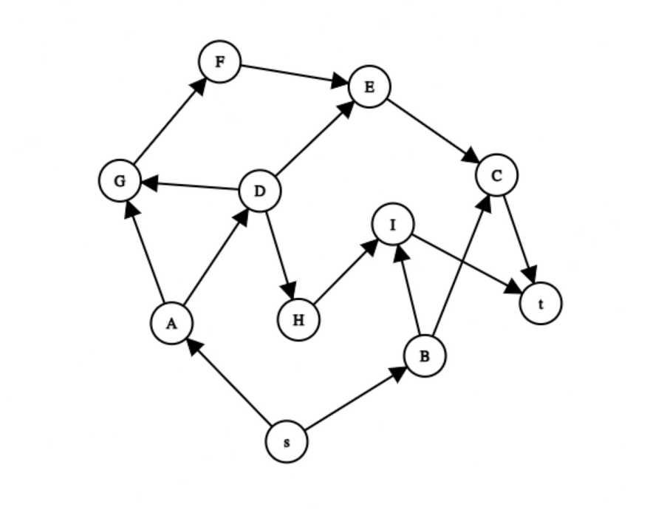
Topological Sort:
1 - Select any vertex with in-degree 0
2 - Print it out
3 - Remove it
4 - Repeat

Slide 44
Topological Sort:
1 - Select s
2 - Print it out
3 - Remove it
4 - Repeat
Current sequence:
s

Slide 45
Topological Sort:
1 - Select A
2 - Print it out
3 - Remove it
4 - Repeat
Current sequence:
s A

Slide 46
Topological Sort:
1 - Select D
2 - Print it out
3 - Remove it
4 - Repeat
Current sequence:
s A D

Slide 47
Topological Sort:
1 - Select H
2 - Print it out
3 - Remove it
4 - Repeat
Current sequence:
s A D H

Slide 48
Topological Sort:
1 - Select B
2 - Print it out
3 - Remove it
4 - Repeat
Current sequence:
s A D H B

Slide 49
Topological Sort:
1 - Select I
2 - Print it out
3 - Remove it
4 - Repeat
Current sequence:
s A D H B I

Slide 50
Topological Sort:
1 - Select G
2 - Print it out
3 - Remove it
4 - Repeat
Current sequence:
s A D H B I G

Slide 51
Topological Sort:
1 - Select F
2 - Print it out
3 - Remove it
4 - Repeat
Current sequence:
s A D H B I G F

Slide 52
Topological Sort:
1 - Select E
2 - Print it out
3 - Remove it
4 - Repeat
Current sequence:
s A D H B I G F E

Slide 53
Topological Sort:
1 - Select C
2 - Print it out
3 - Remove it
4 - Repeat
Current sequence:
s A D H B I G F E C

Slide 54
Topological Sort:
1 - Select t
2 - Print it out
3 - Remove it
4 - No more vertices left, finalize
Possible topological sort:
s A D H B I G F E C t

