Slide 1

CSE 414 Databases
Final Project
Akif Kartal
18 June 2022
GTU - Computer Engineering Department
CSE 414 Databases - Final Project

Slide 2
Database Tables and Relations
In this project we have 25 table. Tables are as follows.
• Customer
• Address
• AddressType
• CustomerAdress
• TelephoneNumber
• Email
• Orders
• FavouriteRestaurant
• Basket
• BasketFood
• OrderFood
• DigitalWallet
• Restaurant
• PaymentType
• PaymentRestaurant
• WorkingHours
• Food
• Category
• Review
• Campaign
• Coupon
• CouponCustomer
• FoodLog
• WalletLog
• Offer
Relations
Between these tables we have following relations;
• 4 one to one relation
• 20 one to many relation
• 6 many to many relation
Total we have 30 relations.
GTU - Computer Engineering Department
CSE 414 Databases - Final Project

Slide 3
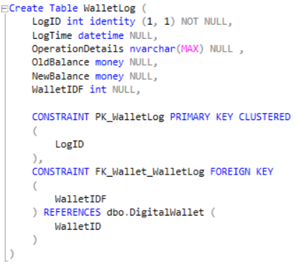
Creating Tables and Inserting Data
In this database everything made with SQL language. You can see in following images.
GTU - Computer Engineering Department
CSE 414 Databases - Final Project

Slide 4
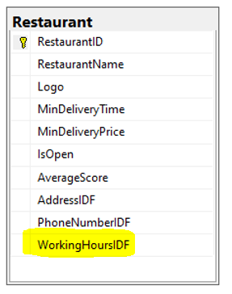
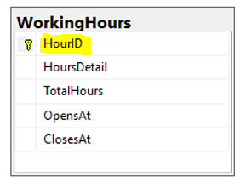
Normalization
In this project, I have 3NF and BCNF normalization. For example, we have WorkingHours table for restaurant. This is example of 3NF and BCNF normalization.
Functional Dependency
HourID HoursDetail, TotalHour, OpensAt, ClosesAt
GTU - Computer Engineering Department
CSE 414 Databases - Final Project

Slide 5
Triggers
In this project, I have 5 triggers. They are as follows.
trg_LogWallet
trg_ReviewAverage
trg_BasketPriceUpdate
trg_LogFood
trg_OrderFood
GTU - Computer Engineering Department
CSE 414 Databases - Final Project

Slide 6
Views
In this project, I have 5 views. They are as follows.
vm_Customer
vm_Order
vm_Max40Food
vm_Restaurant
vm_Comment
GTU - Computer Engineering Department
CSE 414 Databases - Final Project

Slide 7
Join Queries
Since Customer and Email tables are relational tables, we can join them by using following queries.
➢ select * from Customer c Left Outer Join Email e on c.EmailIDF = e.MailID
➢ select * from Customer c Right Outer Join Email e on c.EmailIDF = e.MailID
➢ select * from Customer c Full Outer Join Email e on c.EmailIDF = e.MailID
I also used inner join in views
from Customer c
inner join Email e on c.EmailIDF = e.MailID
inner join Basket b on b.BasketID = c.BasketIDF
inner join DigitalWallet d on d.WalletID = c.WalletIDF
GTU - Computer Engineering Department
CSE 414 Databases - Final Project

Slide 8

Extra Details
In this project, I have additional features.
GTU - Computer Engineering Department
CSE 414 Databases - Final Project

Slide 9
Transactions
In this project, I have 3 transaction. They are as follows.
OrderPayment
insertCustomer
insertReview
GTU - Computer Engineering Department
CSE 414 Databases - Final Project

Slide 10
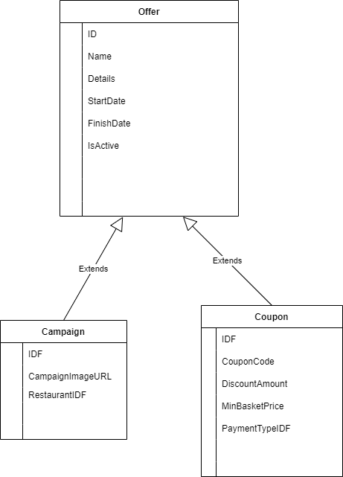
Inheritance (Specialization)
In this project, I have implemented inheritance. Between Campaign and Coupon tables there is an inheritance.
GTU - Computer Engineering Department
CSE 414 Databases - Final Project

Slide 11
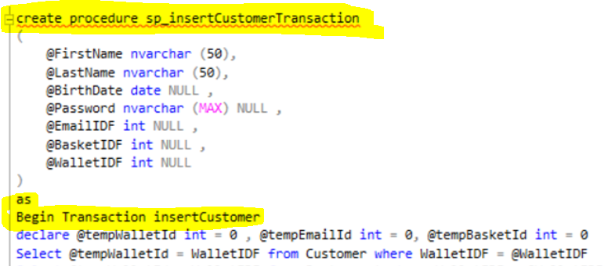
Using Store Procedure
In this project, I have used store procedures.
GTU - Computer Engineering Department
CSE 414 Databases - Final Project

Slide 12
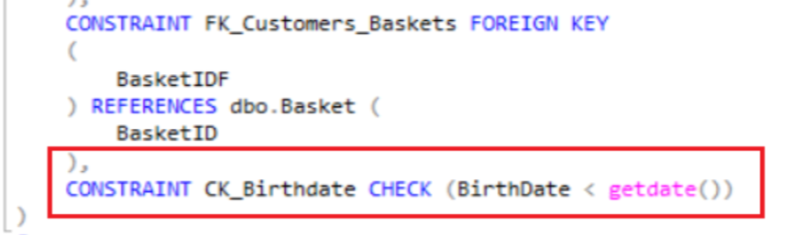
Using Check Constraint
In this project, I have used check constraint in customer create table query.
GTU - Computer Engineering Department
CSE 414 Databases - Final Project

Slide 13

GTU - Computer Engineering Department
CSE 414 Databases - Final Project

