Slide 1
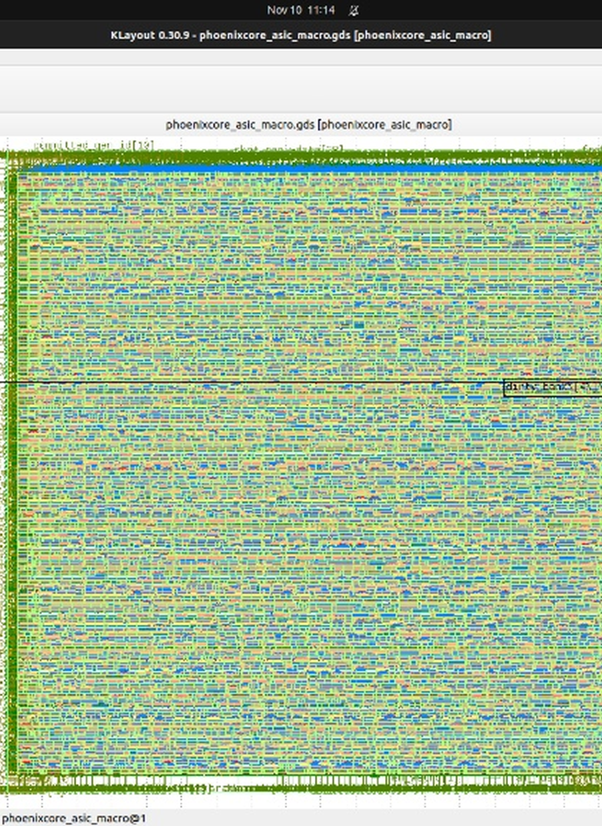
VCONNECTECH MARATHON 2026 · TEAM M2026-165
PhoenixCore: Secure Checkpoint Engine
Round 02 Mid-Work Review — 4/4 RTL Verification, Basys3 Artix-7 Synthesis, & Sky130A GDSII Signoff
100% ROUND 02 MILESTONES DONE
NEXUS V: Akif · Nandikha · Mariam · Hiran · Dharshini
Team NEXUS V (M2026-165) · PhoenixCore Mid-Work Review · 13 Nov 2026 · 1
Notes:
Mid-Work Progress Review presentation for Team NEXUS V (M2026-165), GCE Srirangam & ACGCET Karaikudi.

Slide 2




01 EXECUTIVE SUMMARY
Mid-Work Snapshot: All 4 Targets Verified
Verified across Python 1,000-trial sim, Icarus Verilog/GTKWave, Yosys Artix-7, and OpenLane 2 Sky130A.
4 / 4 PASS
-49.9%
22.02%
55.53%
Cycle-Accurate RTL
Save Energy vs. DiCA
Basys3 Artix-7 LUTs
Sky130A GPL Util
Snoop, dV cal, torn-write, & 20 ns wipe
7.70 uJ vs. 15.38 uJ (ICCAD'23 / ISQED'25)
4,580 LUTs & 12 BRAMs @ 50 MHz
54.12% raw cell/core · LVS/DRC/STA OK
All RTL, testbenches, OpenLane 2 scripts, and 8-page IEEE DPR are live in GitHub: PhoenixCore-M2026-165.
Team NEXUS V (M2026-165) · PhoenixCore Mid-Work Review · 13 Nov 2026 · 2
Notes:
Sources: Measured Icarus Verilog log (36778.jpg), Yosys 0.9 synthesis report (image_6b6692.png), and OpenLane 2 Sky130A run RUN_2026-11-10_11-22-23 (image_ca5277.jpg, image_d4525d.jpg).

Slide 3


02 PROBLEM & ARCHITECTURAL GAP
Closing 4 Hardware Gaps in 2023–2025 Systems
Why prior block-differential systems (DiCA ICCAD'23 [5], ISQED'25 [7]) fail under aging and encryption.
Prior Art (DiCA '23 / ISQED '25)
PhoenixCore Hardware Engine (Ours)
Ciphertext Expansion: Encrypting a 64 B block turns zero-valued words into random ciphertext, wasting 40–50% energy.
Fixed-Cap Crash: Static C = 100 uF trigger crashes below 1.80 V once capacitor ages >= 20% (<= 80 uF).
Torn Writes & Slow Boot: In-place writes risk corruption and require 785.9–2,997.8 us full restore (0.32 us/B @ 25 MHz SPI).
Cold-Boot Key Exposure: 200+ cycle software key scrub loops fail before brownout voltage collapse.
PC-WMC Zero-Word Masking: Suppresses zero 32b words (`word == 0`) via 16-bit `w_mask` BEFORE AES encryption (-49.9% energy).
SH-PDAT Aging Trigger: Online dV slope calibrator (+25 mV step) survives 45% cap aging down to 55 uF.
Commit-Last + Hot Restore: Atomic 0x5043 trailer + 2-block Hot Restore resumes CPU in 89.6 us (8.8x–59.0x faster).
1-Cycle Key Zeroizer: Hardware clear wipes active AES-128 round keys in 1 clock tick (20 ns).
Grounded against Hibernus++ [2], DICE [4], DiCA (ICCAD 2023) [5], Sah & Hicks (ENSsys 2023) [6], and ISQED 2025 [7].
Team NEXUS V (M2026-165) · PhoenixCore Mid-Work Review · 13 Nov 2026 · 3
Notes:
Comparison grounded in Section II and Table I of M2026-165_PhoenixCore_DPR.pdf.

Slide 4
03 SYSTEM ARCHITECTURE
PhoenixCore Micro-Architecture: 4 Subsystems
Co-designed with a checkpoint-instrumented RV32I core + 4-lane INT8 TinyML MAC unit & wide-VDD MB85RS256TY FRAM (1.8–3.6 V).
1
0-Cycle Bus-Snoop & PC-WMC
-49.9% ENERGY
2
Closed-Loop dV Trigger (SH-PDAT)
55 uF SURVIVAL
Snoops RV32I writes in 0 wait states across 8x32 banked dirty bitmaps (256 blocks) and suppresses zero words (word == 0) via w_mask[15:0] pre-crypto (MAC-authenticated).
Computes E_save from active words saved and increments V_aging_offset by +25 mV whenever post-save V_end < 1.85 V (gamma=1.20 absorbs 1-save lag).
3
Commit-Last & 89.6 us Hot Restore
8.8x–59x FASTER
4
OTP/BBRAM Counter & 20 ns Key Wipe
20 ns WIPE
Writes 16B Commit Frame (Magic 0x5043 + GenID + MAC) LAST. Boot restores 136B regs + 2 hot blocks (280 B @ 25 MHz SPI) in 89.6 us vs. 785.9–5,291.5 us.
Root key & 64-bit monotonic counter persist in on-chip OTP/BBRAM (or ATECC608B); active AES-128 round-key DFFs zeroize in 1 cycle (20 ns) on tamper.
Full synthesizable RTL implemented in phoenixcore_asic_macro.v and phoenixcore_top.v.
Team NEXUS V (M2026-165) · PhoenixCore Mid-Work Review · 13 Nov 2026 · 4
Notes:
Detailed mathematical derivations (Equations 1-4) and security/hardware defenses are in Sections IV and VI of M2026-165_PhoenixCore_DPR.pdf.

Slide 5
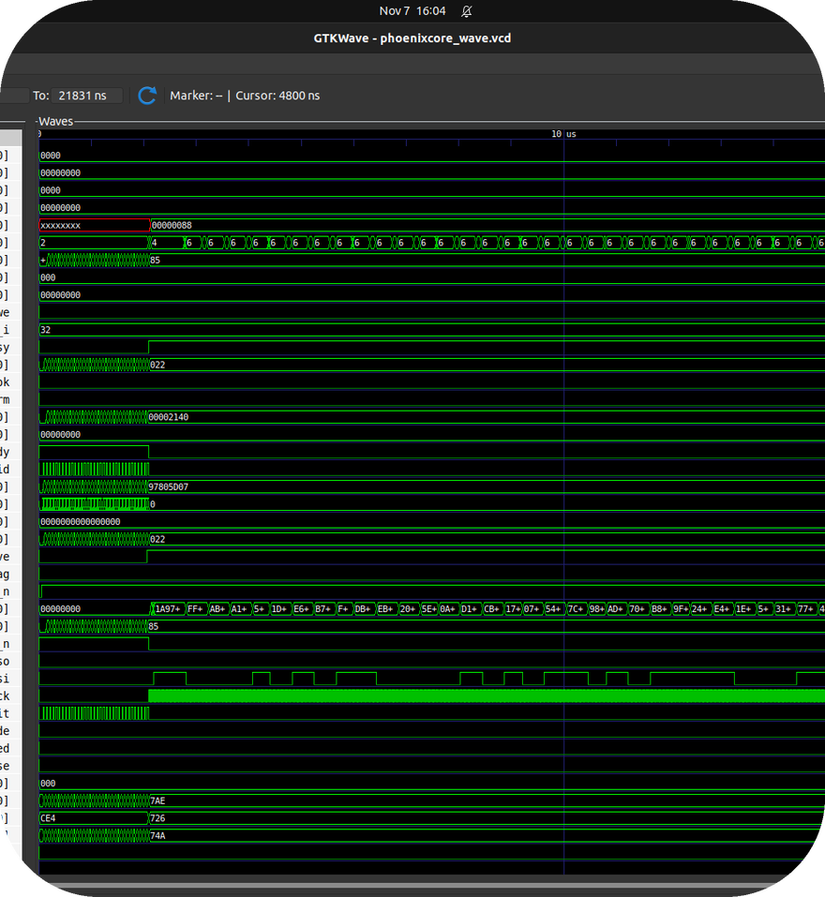
04 RTL FUNCTIONAL SIGNOFF
RTL Verification (4/4 Tests Passed in GTKWave)
Verified in Icarus Verilog (iverilog + vvp) and inspected in GTKWave (0 to 21.83 us).
[TEST 1] 0-Cycle Bus Snoop (PASS): Tracked 33 dirty blocks (`0x022`) from RV32I + TinyML workload with `V_trig = 1864 mV` (`0x74A`).
[TEST 2] Atomic Save & +25 mV Cal (PASS): Committed `Gen = 1` (`0x5043`, MAC `0x848F0B37`) and incremented `+25 mV` (`0x019`) aging offset.
[TEST 3] Mid-Save Torn-Write Cut (PASS): Power cut injected mid-Gen 2 save safely discarded uncommitted frame and restored `Gen = 1` (`led_restore_ok = 1`).
[TEST 4] 1-Cycle Tamper Wipe (PASS): `btn_inject_tamper=1` wiped key to `0x0` in 1 tick (`20 ns`) & set `led_tamper_alarm=1`.
Live Ubuntu GTKWave capture (phoenixcore_wave.vcd).
Verification log committed in rtl_verification_log.txt and waveform in phoenixcore_wave.vcd.
Team NEXUS V (M2026-165) · PhoenixCore Mid-Work Review · 13 Nov 2026 · 5
Notes:
Source: Live Ubuntu verification run by Akif Mohamed J (screenshots 36778.jpg and image_7742de.png).

Slide 6
05 BENCHMARK EVALUATION
3-Way Save Energy & Cap-Aging Resilience
PhoenixCore cuts save energy by 41.3%–49.9% below DiCA/ISQED'25 and survives 45% cap loss.
-49.9%
Energy Saved vs. DiCA
7.70 uJ vs. 15.38 uJ (ICCAD'23); -96.4% vs. SW.
55 uF (-45%)
Cap-Aging Survival
Maintains V_end >= 1.838 V across 1,000/1,000 trials.
F_core=50 MHz, F_spi=25 MHz (0.32 us/B), V_DD=3.3V, V_min=1.8V (MB85RS256TY), C_nom=100 uF.
Team NEXUS V (M2026-165) · PhoenixCore Mid-Work Review · 13 Nov 2026 · 6
Notes:
Source: Section VIII & Table III of M2026-165_PhoenixCore_DPR.pdf and phoenixcore_brownout_sim.py.

Slide 7
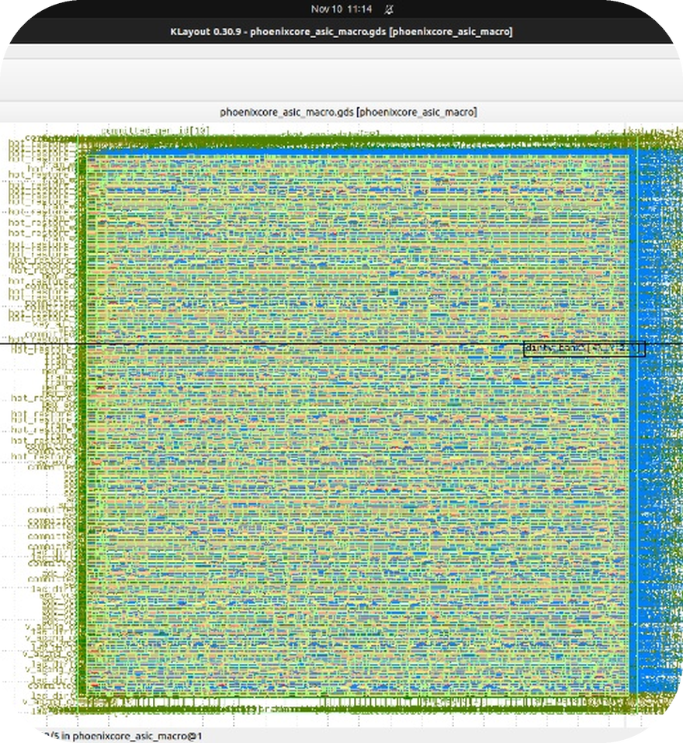
06 HARDWARE & ASIC SIGNOFF
Basys3 Artix-7 & Sky130A GDSII Physical Signoff
Synthesized for Xilinx Artix-7 (XC7A35T) and taped out to GDSII in OpenLane 2 (SkyWater 130 nm).
Basys3 XC7A35T (`8,046` Cells): 8,044 primitives (4,580 LUTs [22.02%], 2,031 FDREs) + 2 BRAM macros (12 RAMB36E1s).
Sky130A GDSII Die & Core Area: 357.69 x 368.41 um die (`0.132 mm^2`), 119,653.51 um^2 core, and 64,753.35 um^2 standard-cell area.
55.53% GPL Util (`54.12%` Raw Cell/Core): 6,199 cells (939 DFFs via on-the-fly key & FRAM shadow vs 3,219 unopt).
78 / 78 Stages Complete: 0 Setup, 0 Hold, 0 MaxCap, Netgen LVS Passed, & Magic/KLayout DRC Passed.
KLayout 0.30.9 view of phoenixcore_asic_macro.gds.
Logs: yosys_basys3_fpga_utilization.txt (hash b5dbe39415) & OpenLane 2 RUN_2026-11-10_11-22-23.
Team NEXUS V (M2026-165) · PhoenixCore Mid-Work Review · 13 Nov 2026 · 7
Notes:
Source: User's live Ubuntu Yosys 0.9 synthesis (image_6b6692.png), OpenLane 2 Stage 78 completion (image_ca5277.jpg), and KLayout 0.30.9 GDSII layout (image_d4525d.jpg).

Slide 8
07 PROJECT SCHEDULE & GOVERNANCE
Execution Timeline, Roles, & DPR Readiness
All Round 02 milestones are verified 15 days ahead of the 25 November 2026 DPR submission deadline.
PHASE / DATES | LEAD MEMBER(S) | KEY TECHNICAL DELIVERABLE | STATUS
Phase 1 Oct 30–Nov 05 | Akif Mohamed J, Nandikha M | PC-WMC & SH-PDAT math model; 1,000-trial Python brownout/aging simulator | COMPLETED 1,000/1,000 Pass
Phase 2 Nov 05–Nov 07 | Akif Mohamed J, Hiran Sruthi N | RV32I + PhoenixCore RTL, 4/4 Icarus Verilog testbench, & GTKWave waveform | COMPLETED 4/4 RTL Pass
Phase 3 Nov 07–Nov 10 | Akif Mohamed J, Nandikha M | Yosys Artix-7 Basys3 (22.02% LUTs) & OpenLane 2 Sky130A GDSII (55.53% Util) | COMPLETED LVS/DRC/STA OK
Phase 4 Nov 10–Nov 13 | Mariam Farisha D, Dharshini K | 8-page IEEE DPR (M2026-165_PhoenixCore_DPR.pdf), GitHub push, & 13 Nov Review | READY NOW < 5% Plagiarism
Phase 5 Nov 14–Nov 25 | All 5 Members (NEXUS V) | GCE Srirangam lab Basys3 demo video + KiCad 4-layer BQ25570/MB85RS256TY PCB | ON TRACK Due 25 Nov 2026
GitHub Repo: https://github.com/akifmohamed2217/PhoenixCore-M2026-165 (All RTL, SDC, XDC, GDSII config, and DPR uploaded).
Strictly compliant with VConnecTech 2026 IEEE template rules (<= 12 pages, 10-pt Times New Roman, < 10% plagiarism).
Team NEXUS V (M2026-165) · PhoenixCore Mid-Work Review · 13 Nov 2026 · 8
Notes:
Schedule and role mapping from Section VI.B and Table II of M2026-165_PhoenixCore_DPR.pdf.

Slide 9
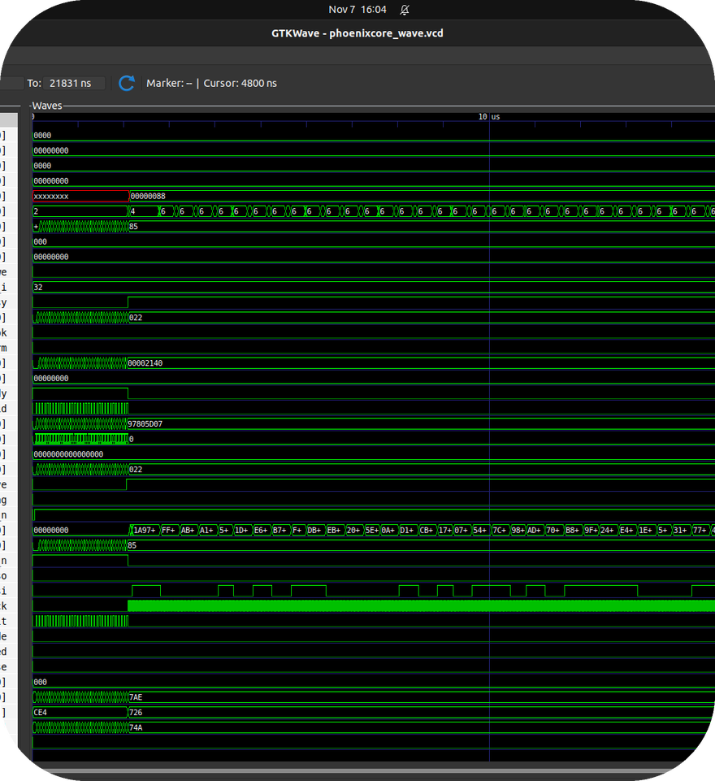
CONCLUSION & Q&A
PhoenixCore: Ready for 13 Nov Progress Review
Zero-corruption intermittent computing with 49.9% lower checkpoint energy, 45% cap-aging immunity, and 20 ns key zeroization.
1
Pre-Crypto Zero-Word Masking (PC-WMC) — Cuts save energy to 7.70 uJ (-49.9% vs. DiCA ICCAD'23 / ISQED'25).
2
Self-Healing Cap-Aging Trigger (SH-PDAT) — Closed-loop +25 mV dV calibrator survives 45% cap loss down to 55 uF.
3
Commit-Last + 89.6 us Hot Restore — Eliminates torn-write corruption with 8.8x–59.0x faster wake-up resume.
4
Verified on Basys3 FPGA & Sky130A GDSII — 22.02% Artix-7 LUTs and DRC/LVS/STA-clean Sky130A layout (55.53% GPL util).
TEAM NEXUS V (M2026-165) · GCE SRIRANGAM & ACGCET KARAIKUDI
Team NEXUS V (M2026-165) · PhoenixCore Mid-Work Review · 13 Nov 2026 · 9
Notes:
Closing slide for 13 November 2026 Mid-Work Progress Review.

