Slide 1

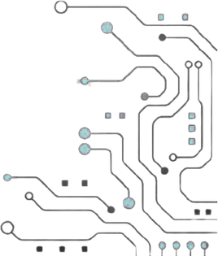




TEAM NAME: QuadraX
PROBLEM STATEMENT NO: PS 16
PROBLEM STATEMENT TITLE: Open Domain-Specific Silicon / Edge Hardware Innovation (Wildcard)
PS Category: Hardware
TEAM MEMBERS:
AKIF MOHAMED J
PAVISSH S K
SELVI STELLA M
SOWBARNIHA N D

Slide 2
Problem Statement:
REAL-WORLD PROBLEM
• Edge IoT devices need AES-128 encryption and decryption in hardware.
• Software AES on Cortex-M4: ~1,136 cycles per 128-bit block.
• Physical attacks can target cryptographic keys through fault injection.
WHY IT MATTERS
• Slow software crypto limits secure communication on battery devices.
• A fault-leaked key can compromise an entire device fleet.
• Closed crypto silicon / EDA flows increase development cost.
CURRENT CHALLENGES
• Separate encrypt/decrypt datapaths increase area.
• Fault detection and rapid key wiping must be tightly coupled.
• The accelerator must integrate cleanly with a standard SoC bus.

Slide 3
QuadraX AES-128 Cryptographic SoC for Edge Silicon:
ONE-LINE SOLUTION
• Resource-shared bidirectional AES-128 SoC with 1-cycle tamper zeroization, AXI4-Lite integration and FPGA verification.
HOW IT SOLVES THE PROBLEM
• One datapath supports encryption + decryption using a shared composite GF(2^8) S-Box/InvS-Box.
• Tamper detection → 1-cycle abort + atomic wipe of 1,408 round-key bits, master key and outputs.
• Unmaskable security_irq reports an active security fault.
• AXI4-Lite register file: CTRL, STATUS, KEY0–3, DIN0–3, DOUT0–3.
• 10 cycles/block at 50 MHz; 9/9 regression tests passed.

Slide 4
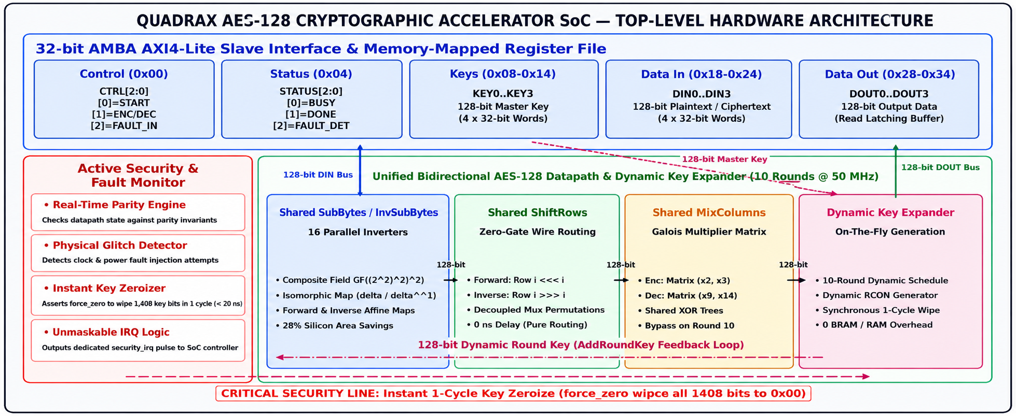
ARCHITECTURAL BLOCK DIAGRAM:
security_irq

Slide 5
PURPOSE OF BLOCKS :
INPUT — AXI4-LITE SLAVE + REGISTER FILE
• Receives key, data and control commands from a bus master.
• Standard interface makes the accelerator reusable SoC IP.
PROCESSING — BIDIRECTIONAL AES-128 CORE
• One shared round datapath for forward and inverse transforms.
• Shared S-Box, ShiftRows and MixColumns; on-the-fly key expansion.
OUTPUT — DOUT REGISTERS + STATUS / LEDS
• Ciphertext / recovered plaintext is read back through AXI.
• Hardware demo: 0x97 encrypt • 0x2A decrypt • 0x00 tamper wipeout.
ARCHITECTURAL TRADE-OFFS
• Iterative vs unrolled: lower area; cost = 10 cycles/block.
• Shared S-Box vs two tables: smaller substitution logic; added mux/affine logic.
• Parity tamper check vs redundant core: low overhead; narrower fault coverage.
• AXI4-Lite vs full AXI: simpler integration; no burst transfers.

Slide 6
OUTPUTS AND RESULTS:
LIVE FPGA DEMONSTRATION — BASYS3 / ARTIX-7 @ 50 MHz
• Encryption: 0x97 — PASS.
• Decryption: 0x2A — PASS.
• Tamper / zeroization: 0x00 — PASS.
PERFORMANCE
• Latency: 10 cycles = 200 ns per 128-bit block.
• Throughput: 0.64 Gbps.
IMPLEMENTATION
• Yosys 0.9 gate-level netlist committed.
• RTL, simulation and FPGA evidence are included in the project repository.
• SkyWater 130 nm ASIC physical flow is future work; current delivered scope is RTL + synthesis + simulation + FPGA.

Slide 7
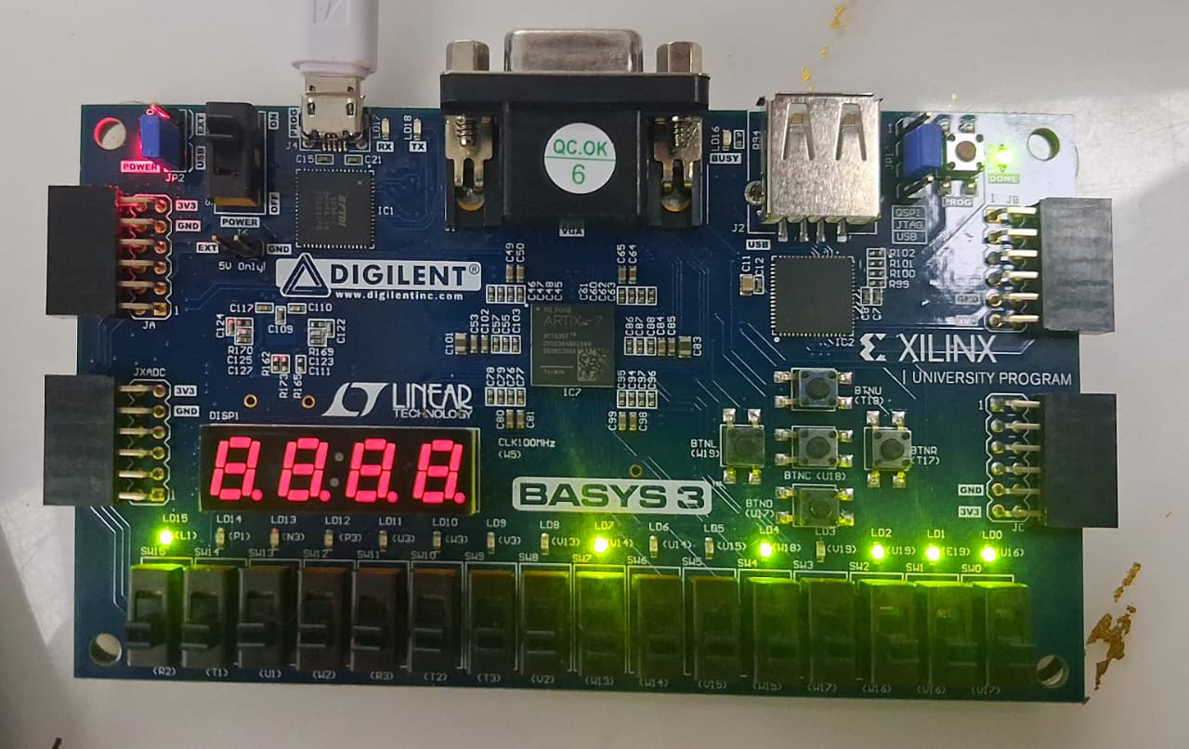
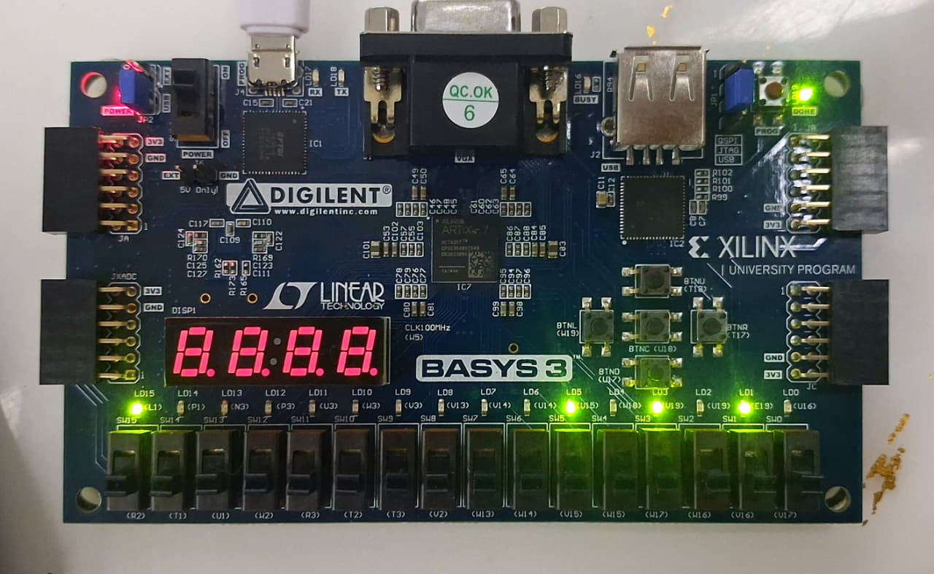
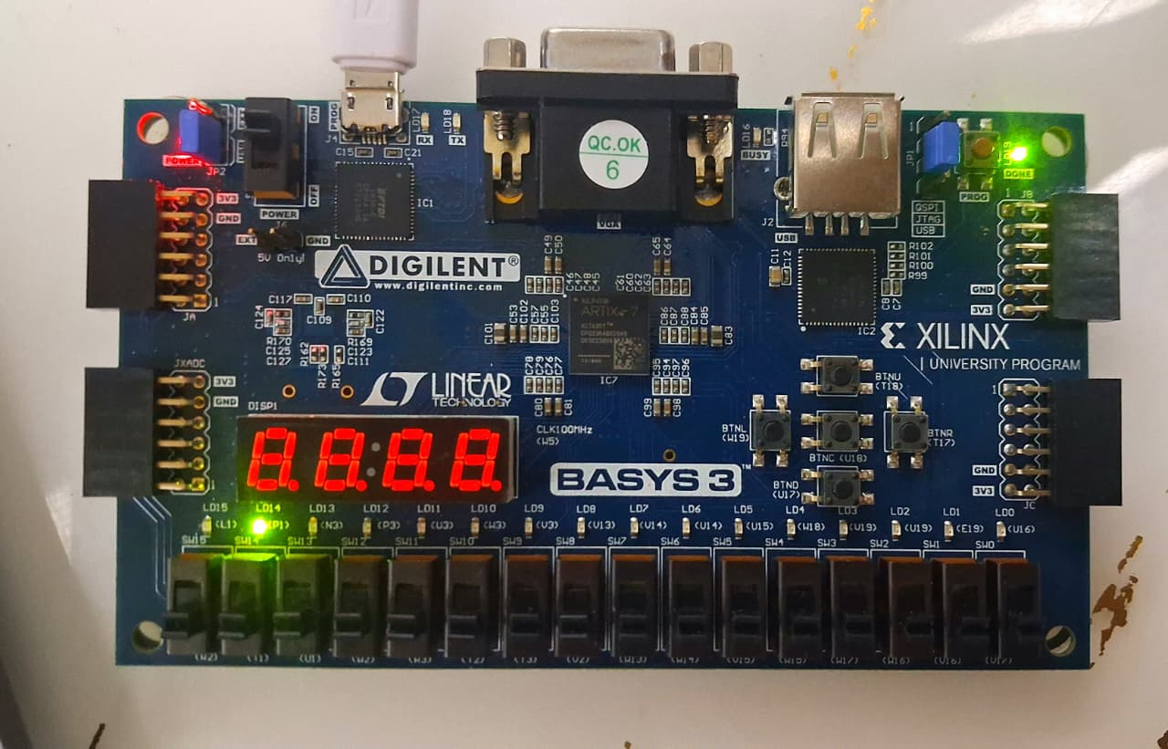
OUTPUTS AND RESULTS:
NIST Enc (0x97 PASS)
NIST Dec (0x2A PASS)
Tamper Wipe (0x00 PASS)

Slide 8
OUTPUTS AND RESULTS :
VERIFICATION
• 9/9 regression tests PASS: 4 encrypt KAT + 4 decrypt KAT + fault/zeroization.
• 3/3 architectural directives PASS: bidirectional core, tamper/zeroize + IRQ, AXI4-Lite.
• Fault injection: STATUS = 0x0000000C; security_irq asserted → PASS.
NIST KNOWN-ANSWER TEST
• TV1 encryption ciphertext: 3AD77BB40D7A3660A89ECAF32466EF97 → PASS.
• TV1 decryption plaintext recovered → PASS.
EVIDENCE
• Self-checking Verilog testbenches + GTKWave waveform evidence committed in the repository.

Slide 9
RESEARCH AND REFERENCES :
• NIST — FIPS 197, Advanced Encryption Standard (AES).
• NIST SP 800-38A — block-cipher test vectors.
• ARM — AMBA AXI4-Lite Interface Specification.
• mbed TLS Cortex-M4 benchmark used for the software baseline.
• Yosys Open Synthesis Suite; Icarus Verilog; AMD Vivado.
PROJECT SOURCES :
• VELTRAXX26-PS16-QuadraX — architecture, RTL, verification and FPGA evidence.
• AES-Crypto-SoC — AES-128 SoC and RTL-to-GDSII implementation work.

