Slide 1
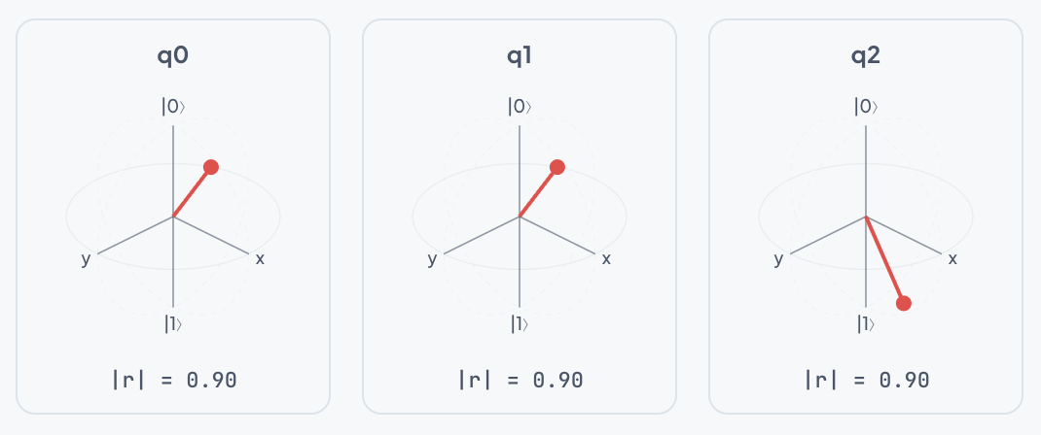
Presentation Overview
01 / 12
Quantum Circuit Simulator
• Background and motivation
• What was done this semester
• How it was implemented
• Live app demonstration

Slide 2
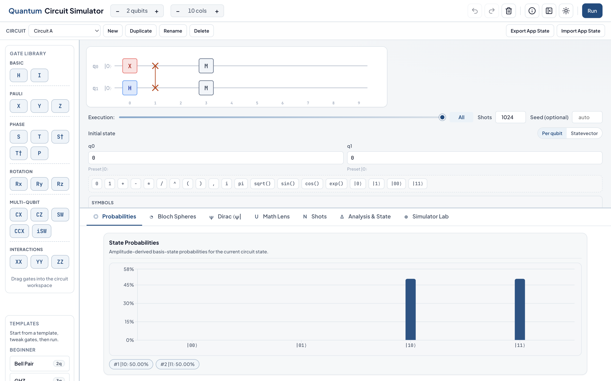
A. Background
02 / 12
Project Motivation
• Need a local quantum simulator for teaching and experimentation
• Many existing tools are either hard for beginners or too limited for deeper work
• Wanted one interface for visual learning and technical analysis
• Design target: no backend dependency, reproducible outputs, offline-ready

Slide 3
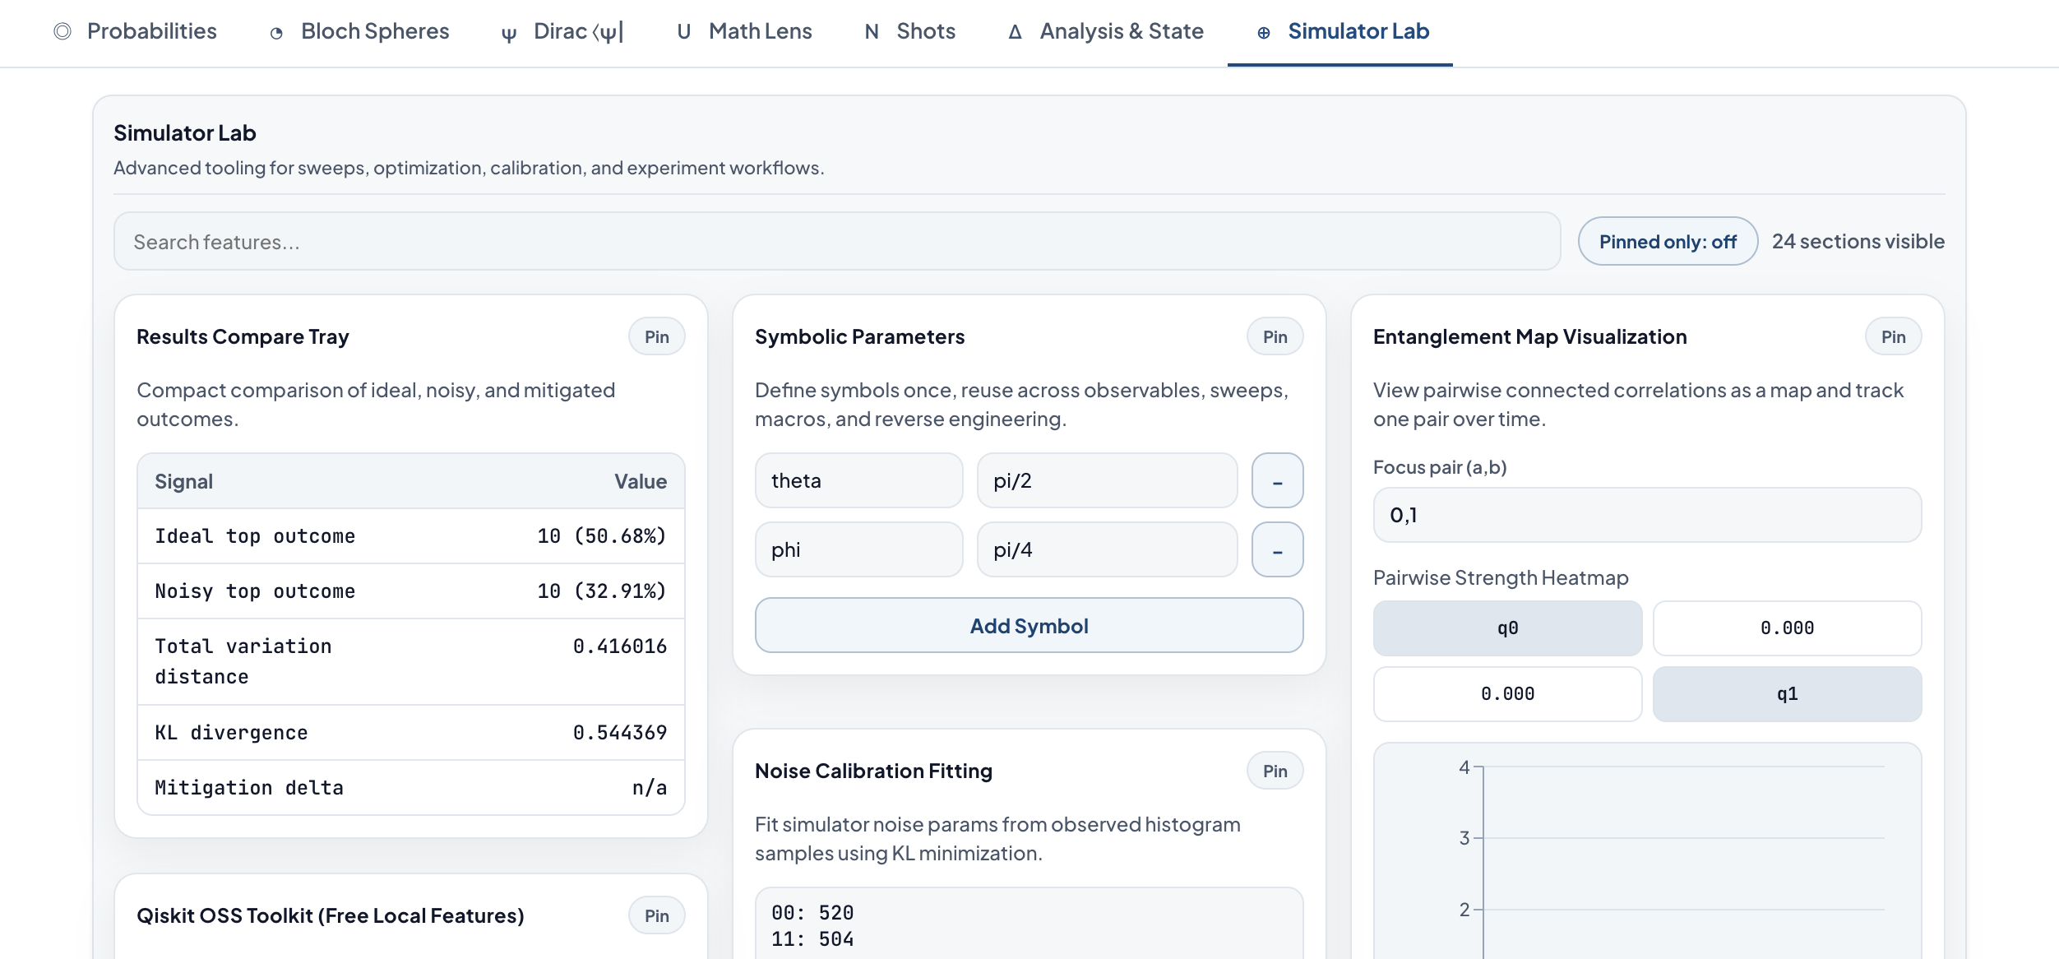
A. Background
03 / 12
Project Goals
• Build circuits quickly with clear visual feedback
• Run ideal and noisy simulations in the browser
• Support export/import workflows for interoperability
• Keep the UI simple first, then reveal advanced tools progressively

Slide 4
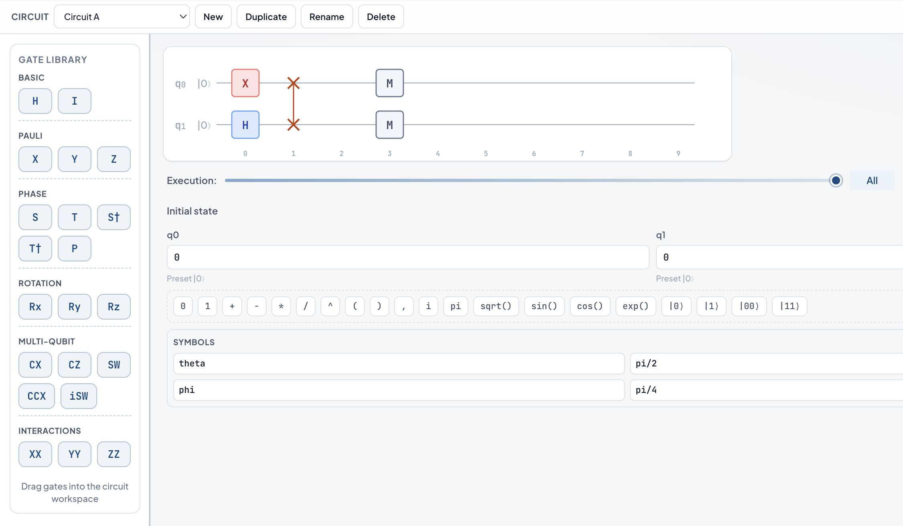
B. What
04 / 12
What Was Implemented
Core Functionality:
• Drag-and-drop circuit editor
• State-vector simulation
• Shots and histogram views
• Bloch and Dirac visualizations
• Step-by-step execution support
Advanced Functionality:
• Noisy simulation with configurable channels
• Hardware compatibility and routing checks
• Optimization and sweep tools
• OpenQASM-lite import/export
• Experiment save/load and report export

Slide 5
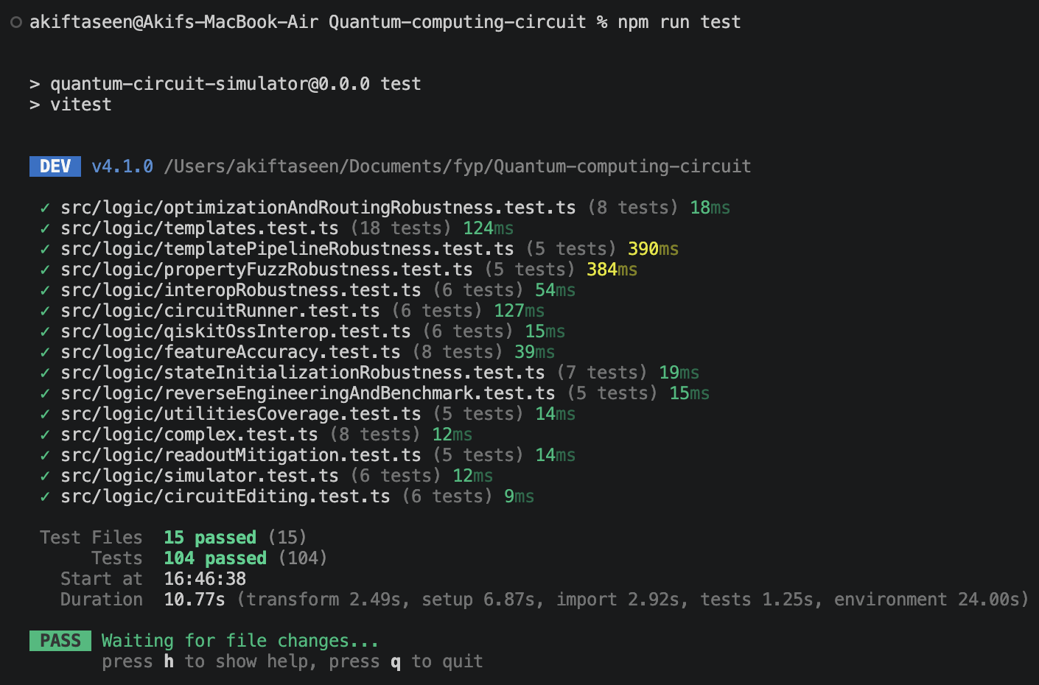
B. What
05 / 12
Evidence of Completed Work
• App state persistence, draft management, and theme persistence are implemented
• Simulator Lab includes calibration, mitigation, and optimization features

Slide 6
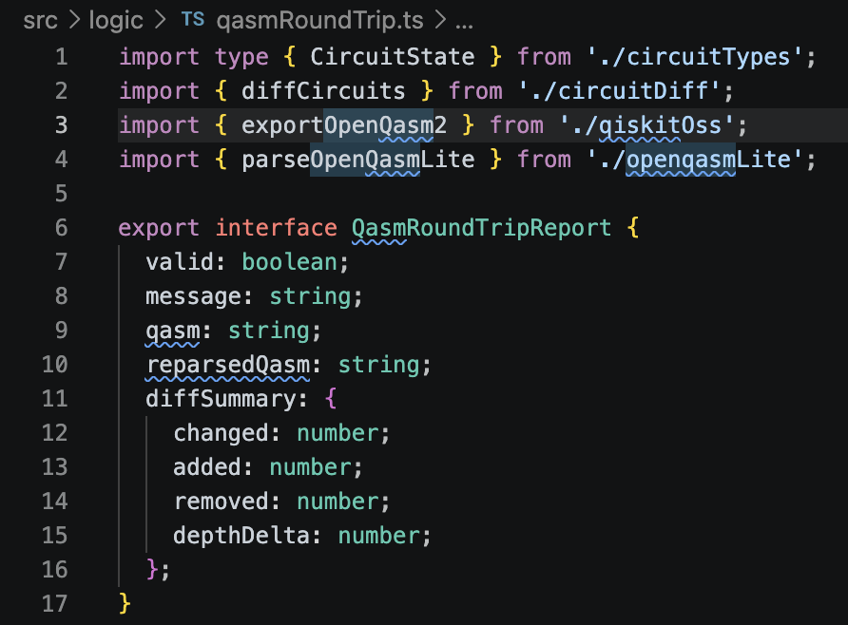
B. What
06 / 12
Scope and Honest Limits
• Current simulator limit is 6 qubits for browser practicality
• OpenQASM support is intentionally a practical lite subset
• Routing uses heuristic SWAP insertion, not globally optimal routing
• Noise calibration uses a coarse 216-point parameter search

Slide 7
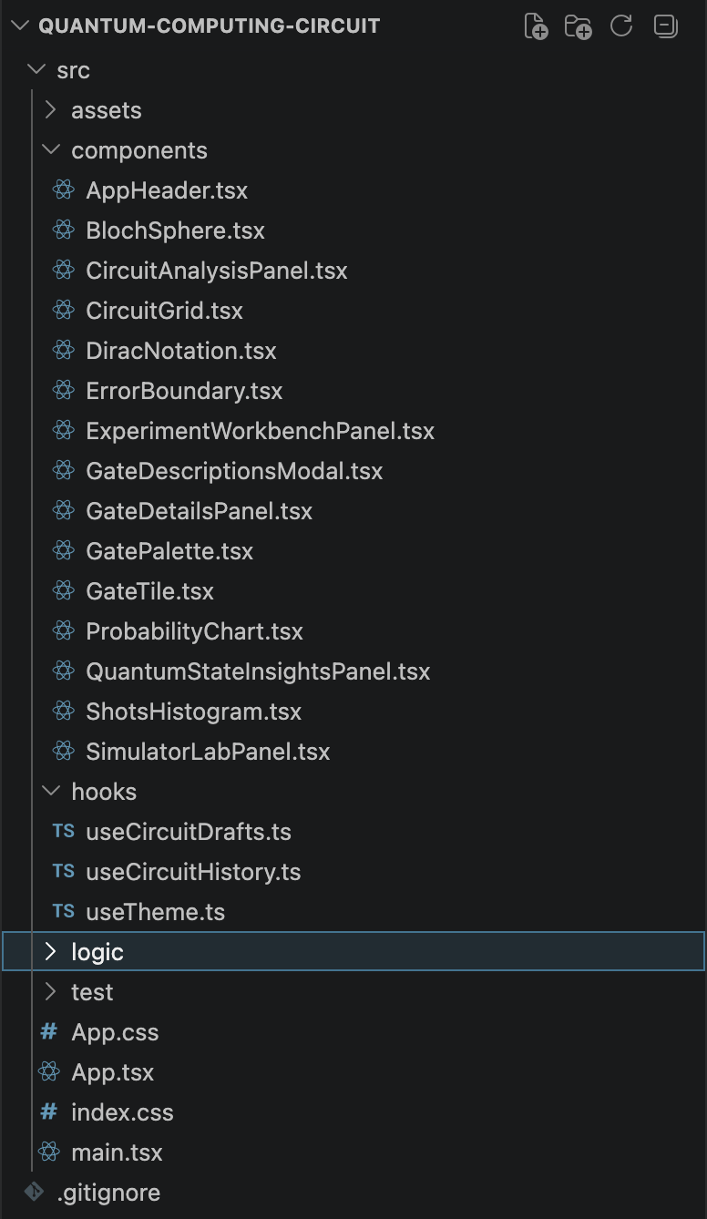
C. How
07 / 12
How It Was Built - Architecture
Technology:
• React + TypeScript + Vite
• Recharts for chart rendering
• PWA support for offline usage
• Local-first storage model
Code Structure:
• UI components for interaction and rendering
• Hooks for shared state and persistence
• Pure logic modules for simulation and analysis
• Tests focused on logic correctness

Slide 8
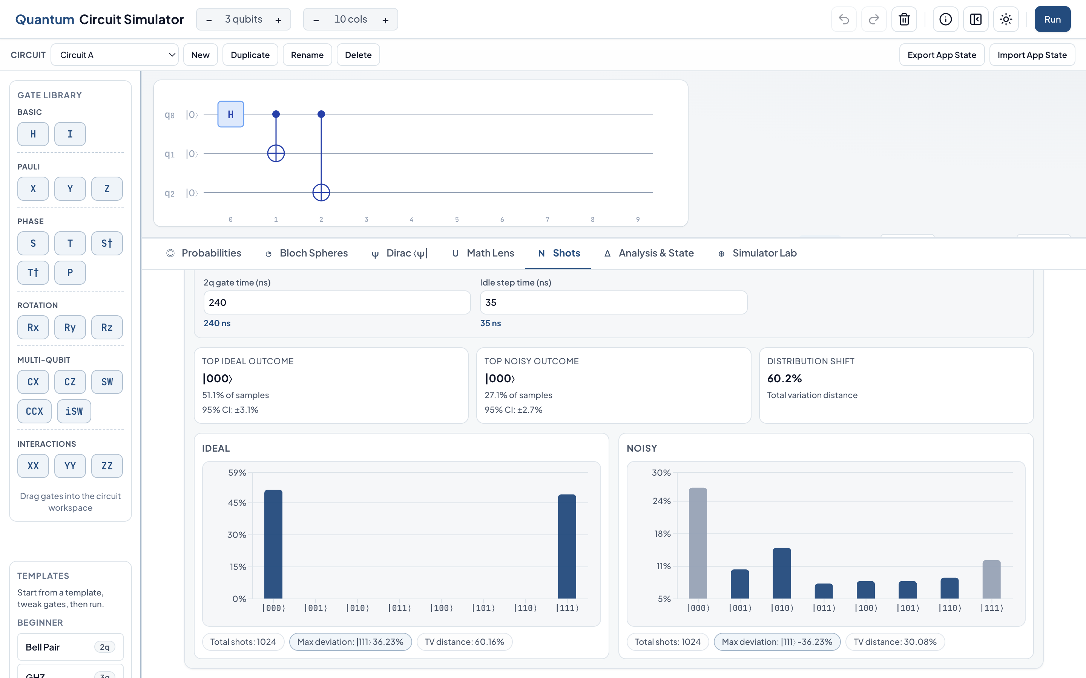
C. How
08 / 12
How It Was Built - Execution Flow
• Edit circuit in UI and validate placement/state inputs
• Compile circuit plan and run simulation kernels
• Sample outcomes (ideal and noisy paths)
• Compute analysis metrics and render synchronized views
• Use caching and alias sampling to keep interaction responsive

Slide 9
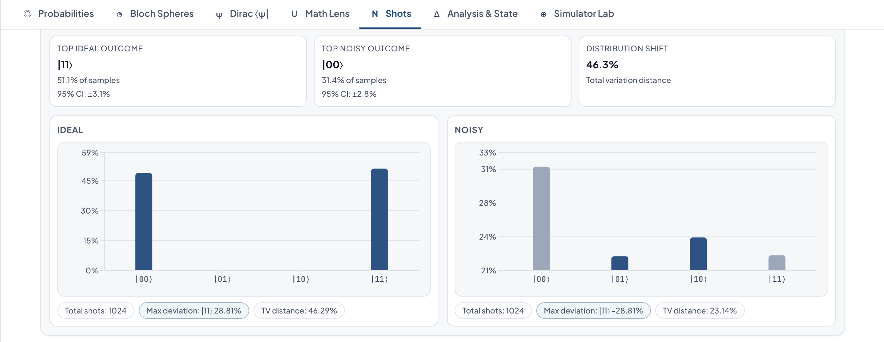
C. How
09 / 12
How It Was Built - Engineering Choices
Choice:
• Local-first execution
• Strict typing + tests
• Progressive disclosure UI
Reason and Tradeoff:
• Easy classroom/lab usage, with bounded qubit scale
• Lower regression risk, with heuristic optimizers
• Simple beginner flow, with lite interop scope

Slide 10
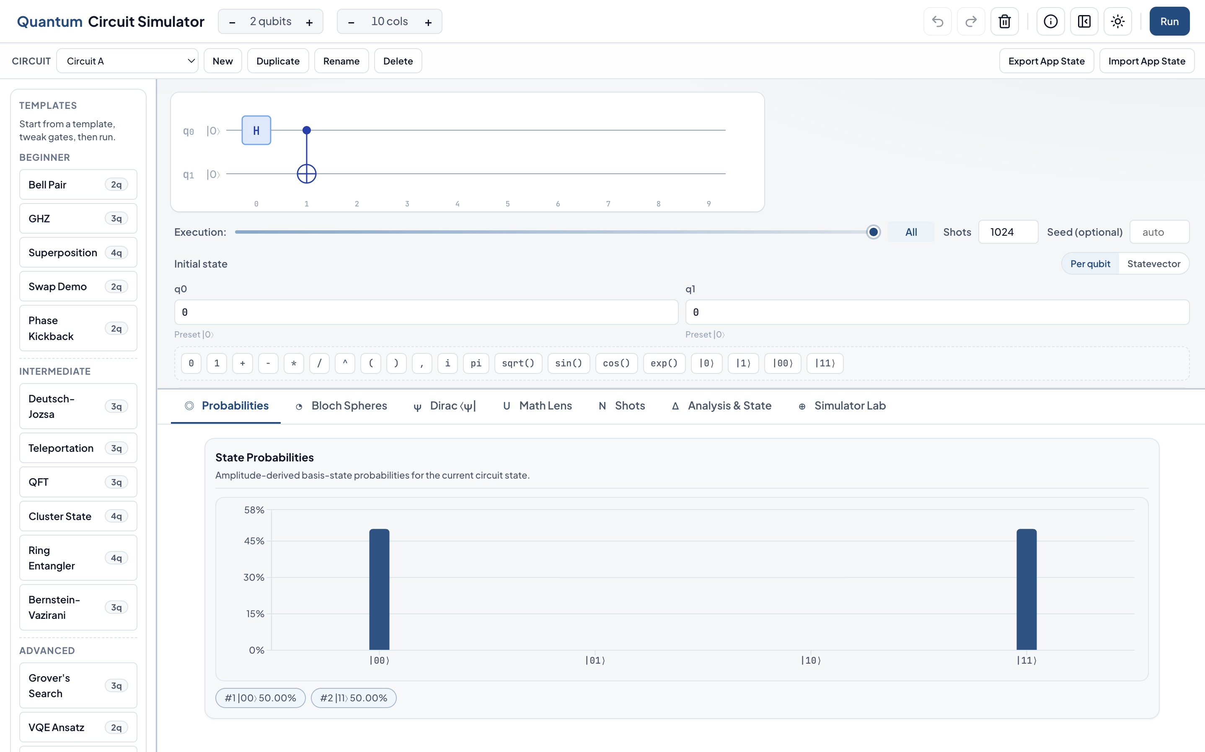
D. Demo
10 / 12
App Demonstration Plan
• 01Load Bell template and explain the circuit editor
• 02Run ideal shots and inspect probability/histogram tabs
• 03Turn on noise and compare ideal vs noisy outcomes
• 04Open analysis panels and summarize key metrics

Slide 11
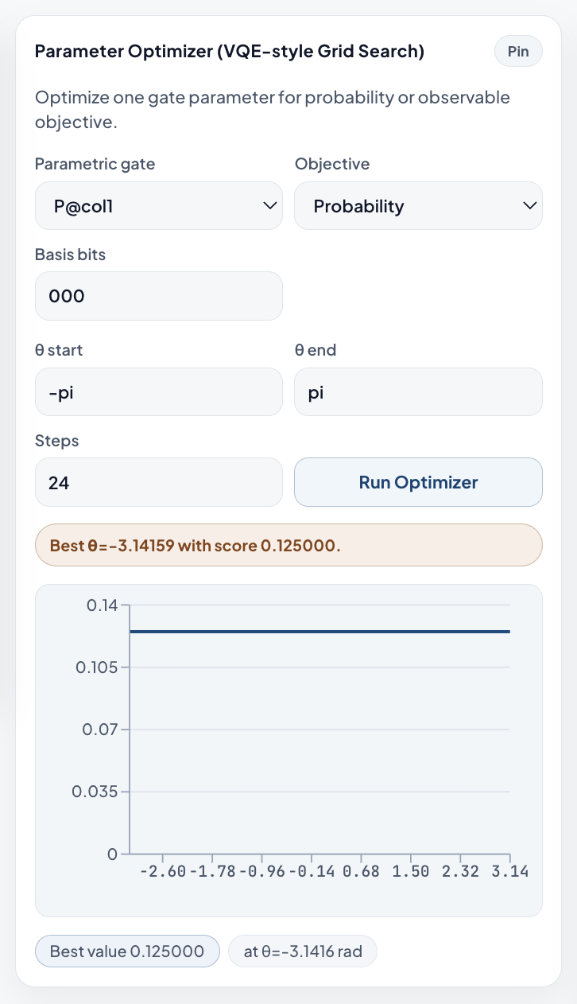
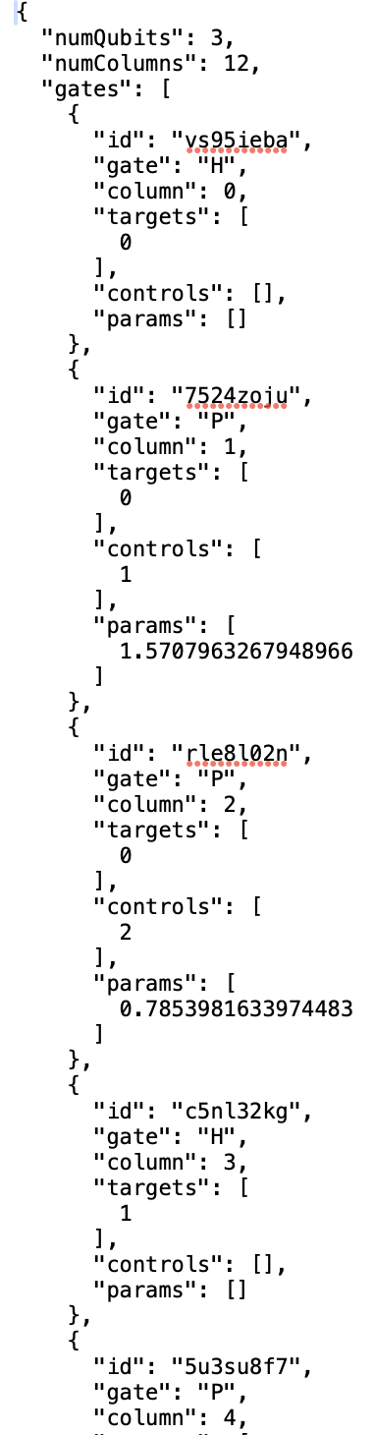
D. Demo
11 / 12
Demo Continuation
• 05Run one Simulator Lab workflow (optimizer or sweep)
• 06Show hardware compatibility and routing feedback
• 07Export OpenQASM and report artifacts
• 08State current limits and expected future improvements

Slide 12
Closing
12 / 12
Summary and Questions
• Background: local-first simulator for learning and technical workflows
• What: editor, simulation, analysis, advanced lab, and interop implemented
• How: modular architecture with test-backed logic core
• Demo: end-to-end run from circuit creation to export

