Slide 1
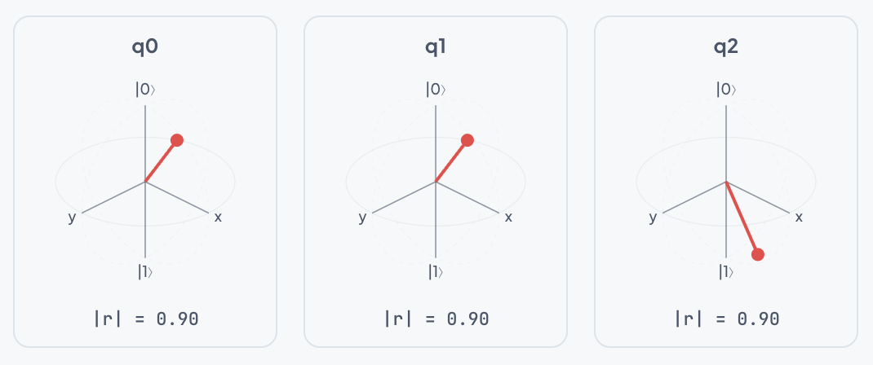
Presentation Overview
01 / 12
Quantum Circuit Simulator
Background and motivation
What was done this semester
How it was implemented
Live app demonstration
BLOCH SPHERE VISUALIZATION

Slide 2
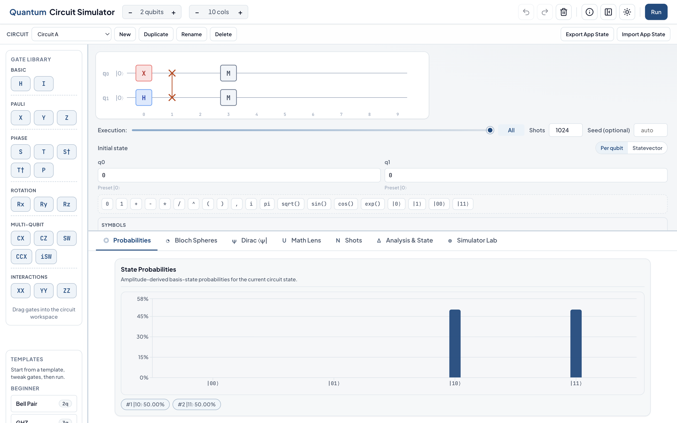
A. Background
02 / 12
Project Motivation
Need a local quantum simulator for teaching and experimentation
Many existing tools are either hard for beginners or too limited for deeper work
Wanted one interface for visual learning and technical analysis
Design target: no backend dependency, reproducible outputs, offline-ready
MAIN APPLICATION OVERVIEW

Slide 3
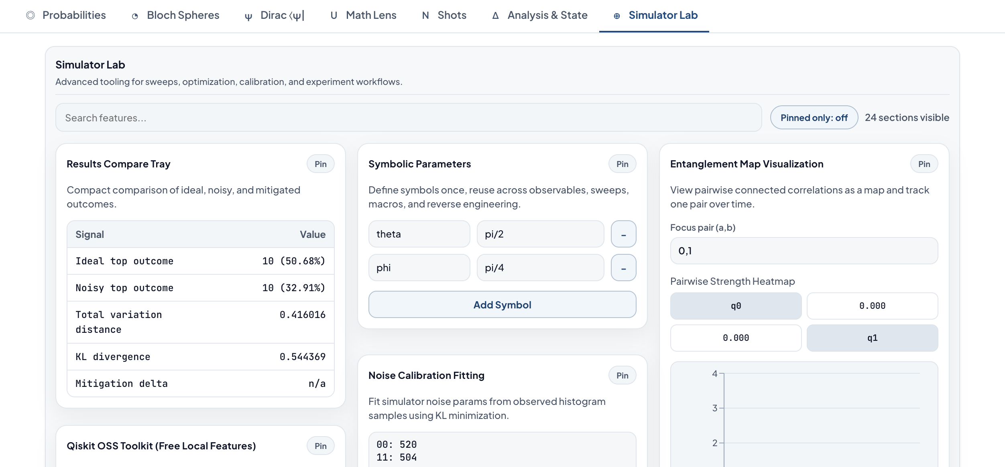
A. Background
03 / 12
Project Goals
Build circuits quickly with clear visual feedback
Run ideal and noisy simulations in the browser
Support export/import workflows for interoperability
Keep the UI simple first, then reveal advanced tools progressively
ADVANCED SIMULATOR LAB OVERVIEW

Slide 4
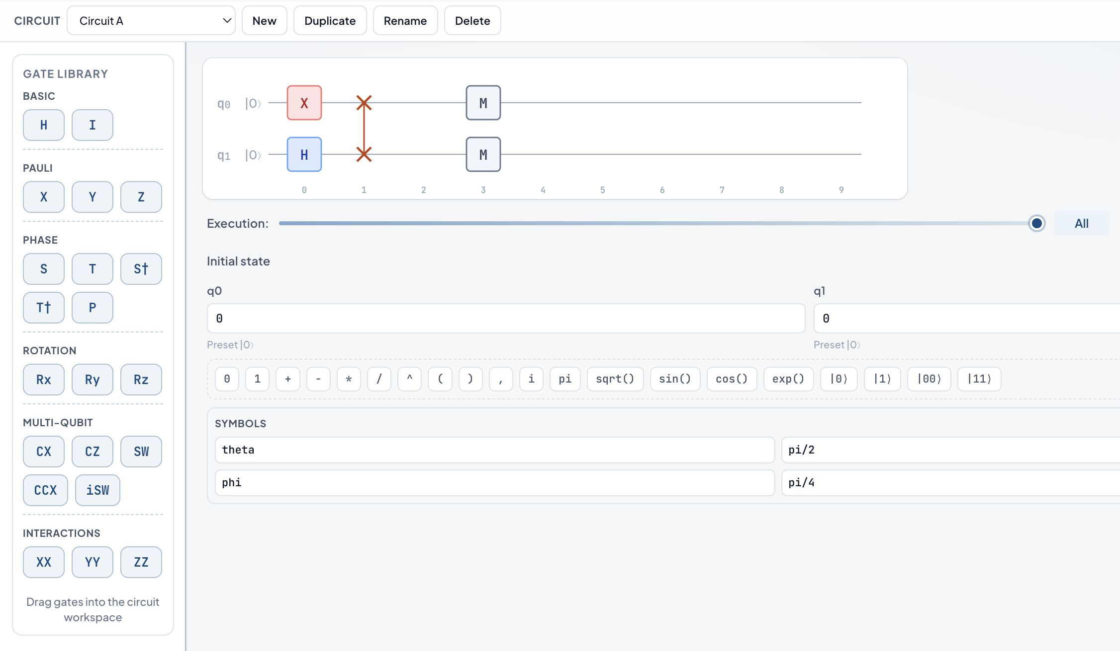
B. What
04 / 12
What Was Implemented
Core Functionality
Drag-and-drop circuit editor
State-vector simulation
Shots and histogram views
Bloch and Dirac visualizations
Step-by-step execution support
Advanced Functionality
Noisy simulation with configurable channels
Hardware compatibility and routing checks
Optimization and sweep tools
OpenQASM-lite import/export
Experiment save/load and report export
CORE EDITOR WORKFLOW

Slide 5
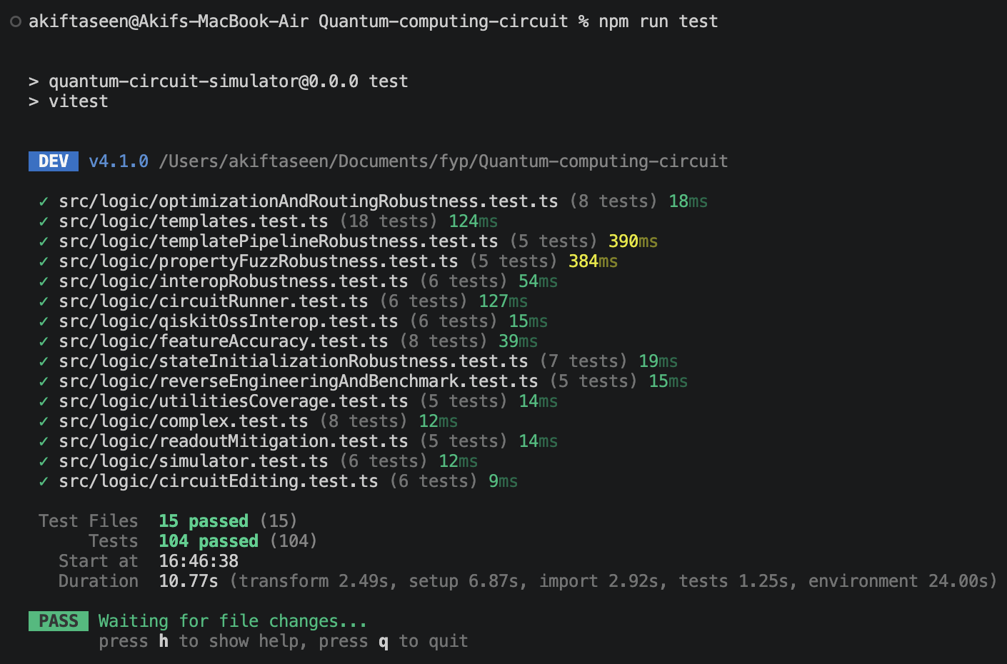
B. What
05 / 12
Evidence of Completed Work
App state persistence, draft management, and theme persistence are implemented
Simulator Lab includes calibration, mitigation, and optimization features
TERMINAL TEST EVIDENCE

Slide 6
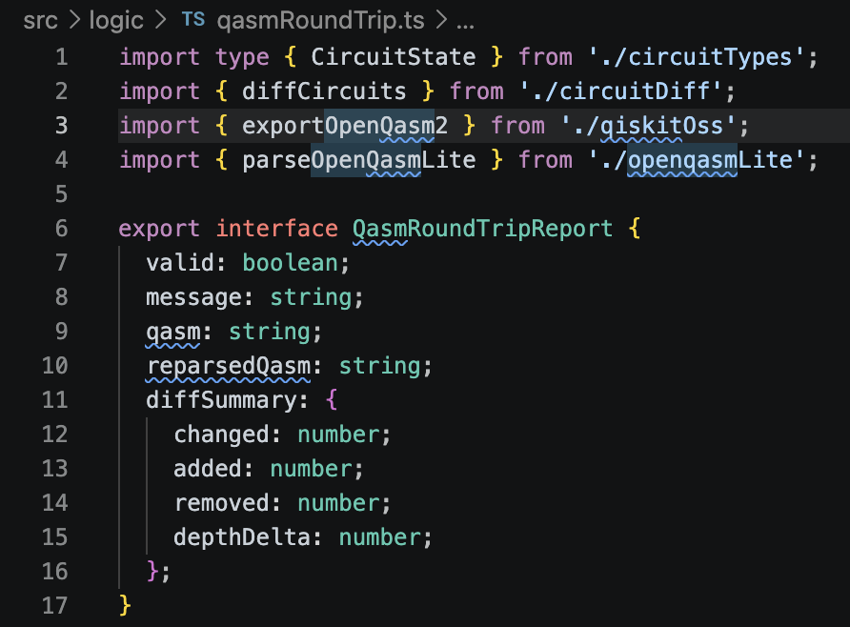
B. What
06 / 12
Scope and Honest Limits
Current simulator limit is 6 qubits for browser practicality
OpenQASM support is intentionally a practical lite subset
Routing uses heuristic SWAP insertion, not globally optimal routing
Noise calibration uses a coarse 216-point parameter search
OPENQASM AND REPORT EXPORT OUTPUTS

Slide 7
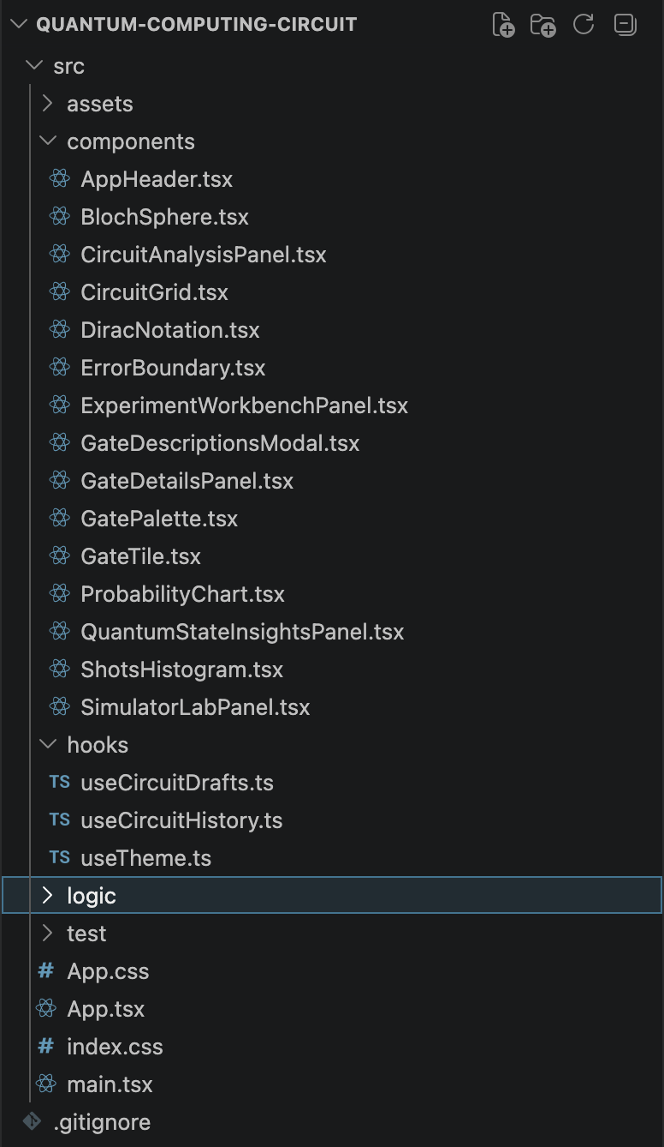
C. How
07 / 12
How It Was Built - Architecture
Technology
React + TypeScript + Vite
Recharts for chart rendering
PWA support for offline usage
Local-first storage model
Code Structure
UI components for interaction and rendering
Hooks for shared state and persistence
Pure logic modules for simulation and analysis
Tests focused on logic correctness
APPLICATION STRUCTURE VIEW

Slide 8
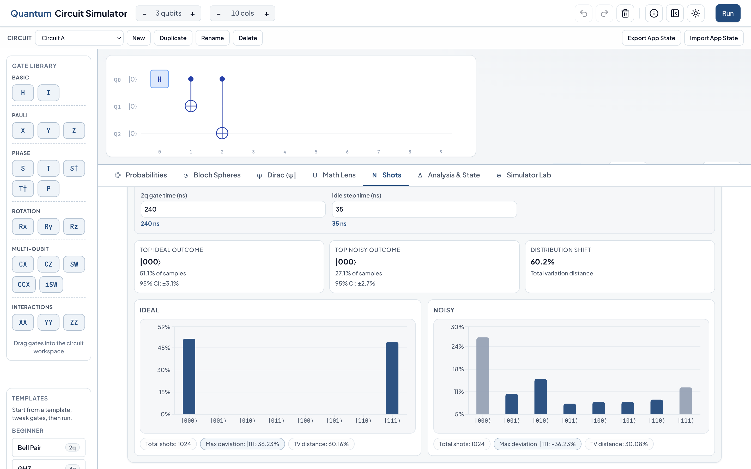
C. How
08 / 12
How It Was Built - Execution Flow
Edit circuit in UI and validate placement/state inputs
Compile circuit plan and run simulation kernels
Sample outcomes (ideal and noisy paths)
Compute analysis metrics and render synchronized views
Use caching and alias sampling to keep interaction responsive
EXECUTION RESULTS VIEW

Slide 9
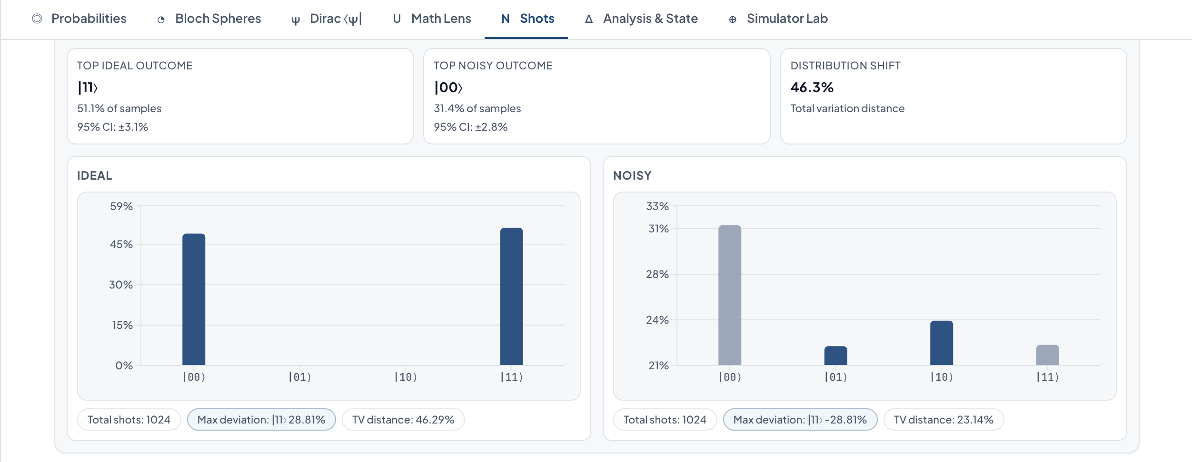
C. How
09 / 12
How It Was Built - Engineering Choices
Choice
Local-first execution
Strict typing + tests
Progressive disclosure UI
Reason and Tradeoff
Easy classroom/lab usage, with bounded qubit scale
Lower regression risk, with heuristic optimizers
Simple beginner flow, with lite interop scope
IDEAL VS NOISY COMPARISON

Slide 10
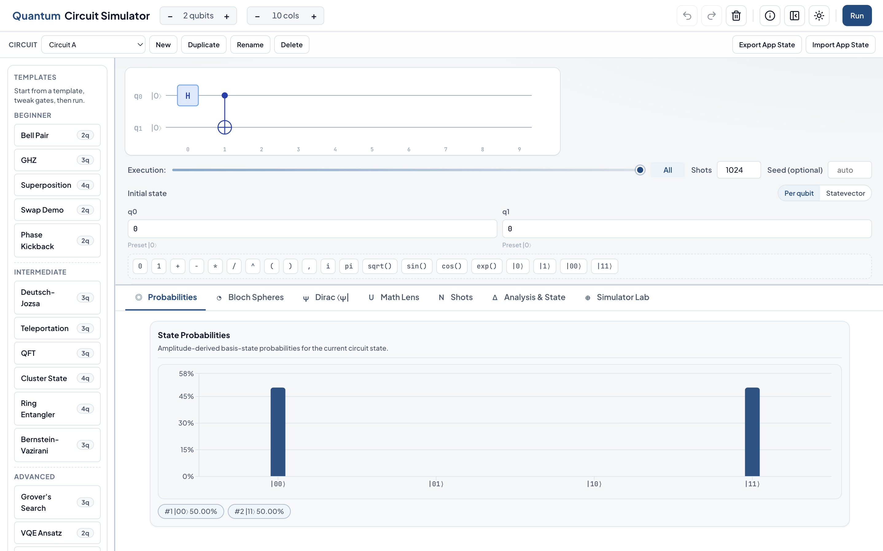
D. Demo
10 / 12
App Demonstration Plan
01Load Bell template and explain the circuit editor
02Run ideal shots and inspect probability/histogram tabs
03Turn on noise and compare ideal vs noisy outcomes
04Open analysis panels and summarize key metrics
BELL CIRCUIT IDEAL RUN

Slide 11
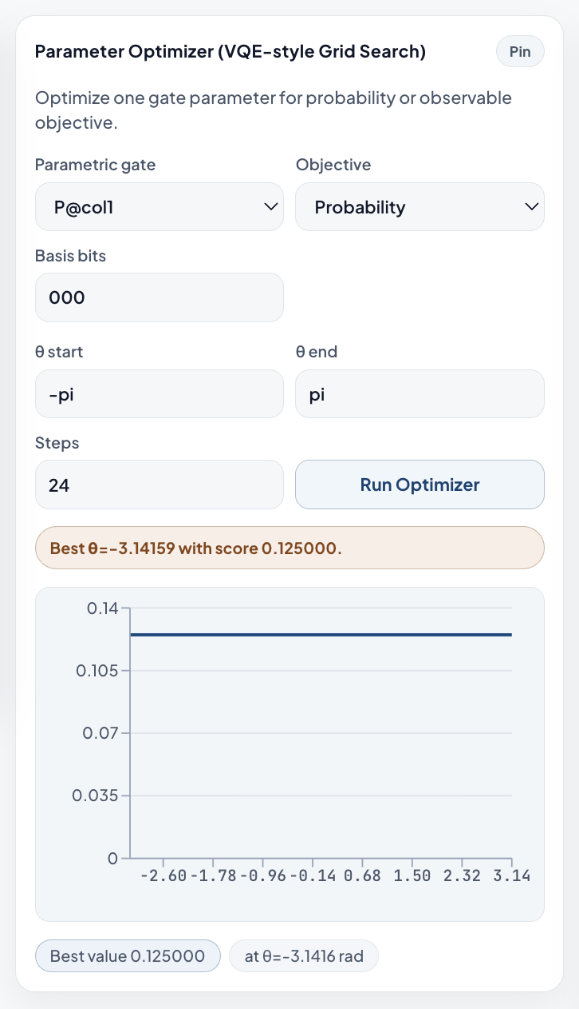
D. Demo
11 / 12
Demo Continuation
05Run one Simulator Lab workflow (optimizer or sweep)
06Show hardware compatibility and routing feedback
07Export OpenQASM and report artifacts
08State current limits and expected future improvements
SIMULATOR LAB WORKFLOW

Slide 12
Closing
12 / 12
Summary and Questions
Background: local-first simulator for learning and technical workflows
What: editor, simulation, analysis, advanced lab, and interop implemented
How: modular architecture with test-backed logic core
Demo: end-to-end run from circuit creation to export
EXECUTION AND ANALYSIS OVERVIEW

Slide 13
Template
13 / 14
Empty Template Page

Slide 14
Style Guide
14 / 14
Fonts, Colors, and PPTX Rules
Typography
Headings: Plus Jakarta Sans, bold
Body: Plus Jakarta Sans, regular/medium
Code and labels: JetBrains Mono
Color and Layout
Primary blue: #0F4C81
Background: white + soft blue gradients
Use square corners and tight margins in PPTX
REFERENCE IMAGE FOR PRESENTATION STYLE

