Slide 1
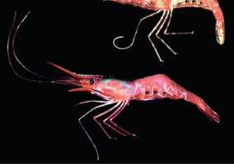
Temporal and environmental population stratification of near-shore and offshore Northern Shrimp (Pandalus borealis) off Iceland
Photograph courtesy of the Kodiak Fisheries Research Center
Áki Jarl Láruson¹, Snæbjörn Pálsson², Ingibjörg G. Jónsdóttir¹
¹Marine and Freshwater Research Institute, Hafnarfjörður, Iceland
²University of Iceland, Faculty of Life and Environmental Sciences, Reykjavík, Iceland

Slide 2
Temporal and environmental population stratification of near-shore and offshore Northern Shrimp (Pandalus borealis) off Iceland
Methods
Photograph courtesy of the Kodiak Fisheries Research Center
Áki Jarl Láruson¹, Snæbjörn Pálsson², Ingibjörg G. Jónsdóttir¹
¹Marine and Freshwater Research Institute, Hafnarfjörður, Iceland
²University of Iceland, Faculty of Life and Environmental Sciences, Reykjavík, Iceland

Slide 3
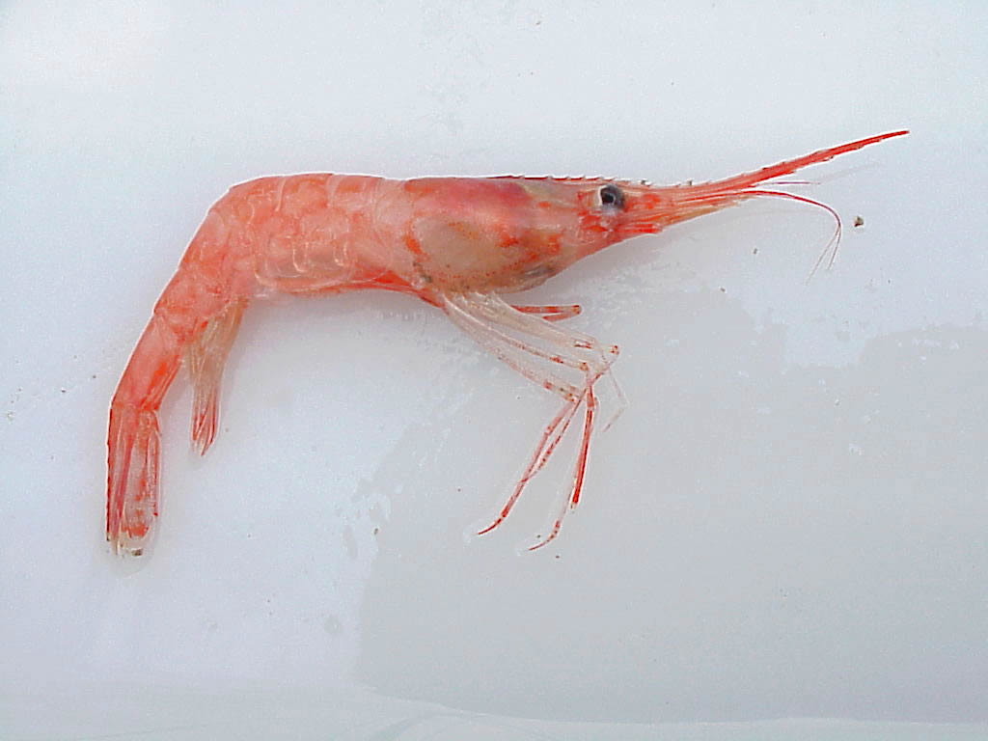

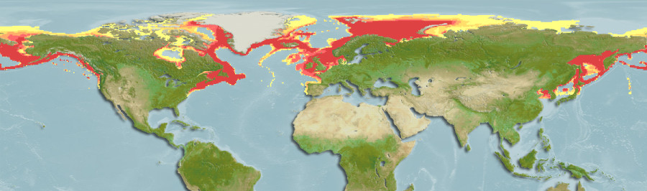
Pandalus borealis - Northern Shrimp - Stóri Kampalampi
Circumpolar distribution - from arctic waters to near tropics
Large depth range - from nearshore up to 700 meters

Slide 4
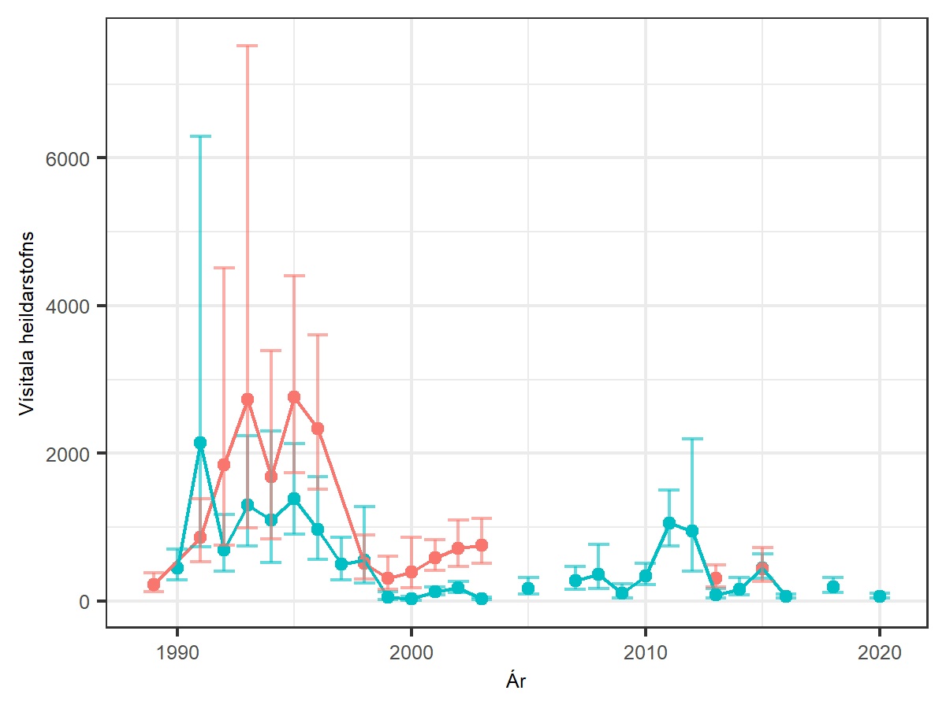
Highly commercial species harvested in Iceland since 1936

Slide 5
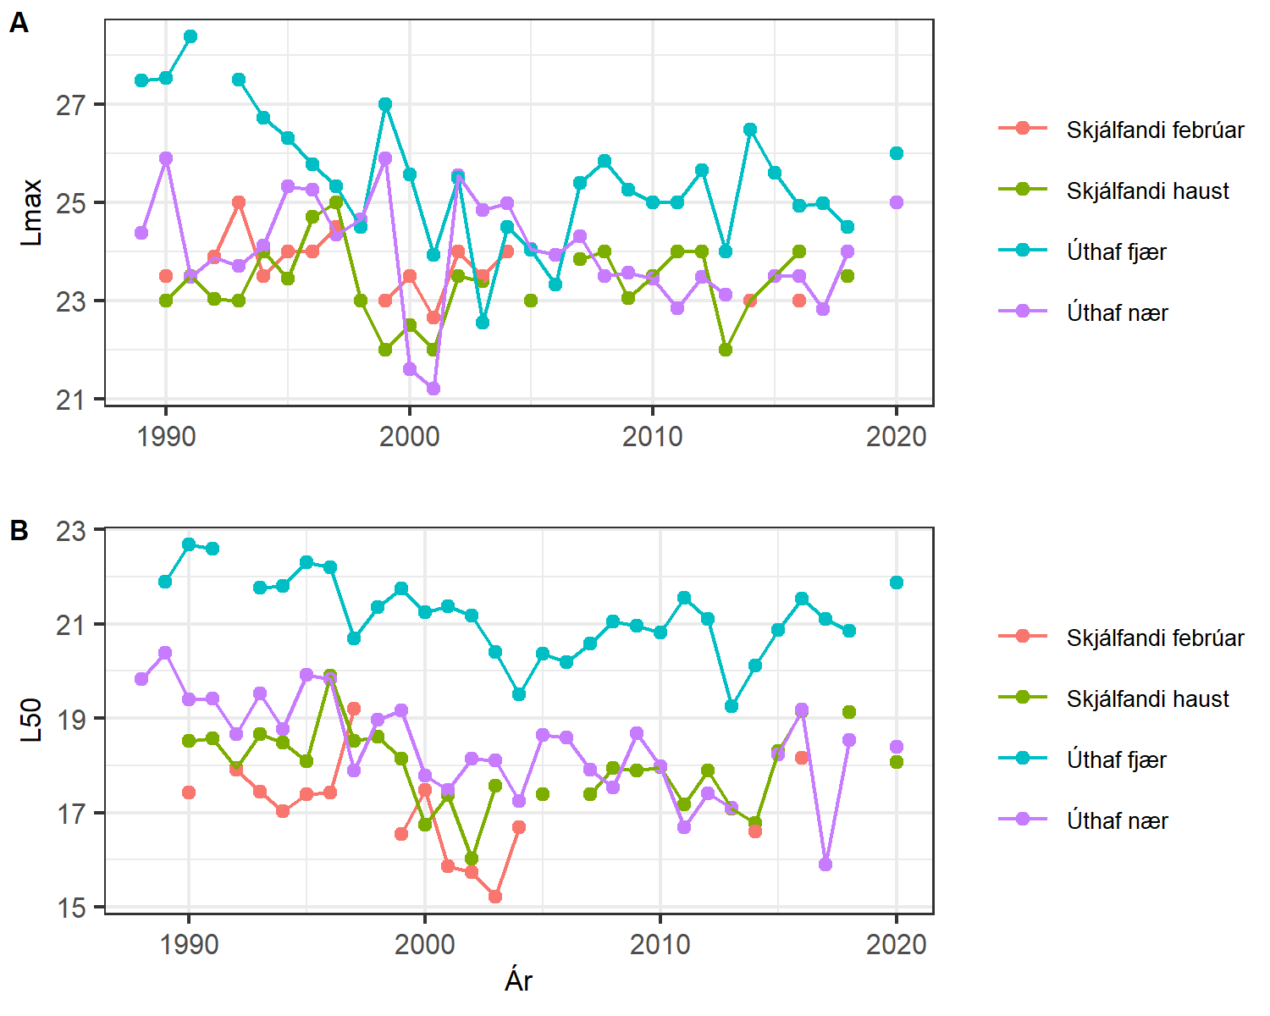
Highly commercial species harvested in Iceland since 1936
Protandrous life history start life male, become female Cues for sex change both environmentally and community controlled

Slide 6
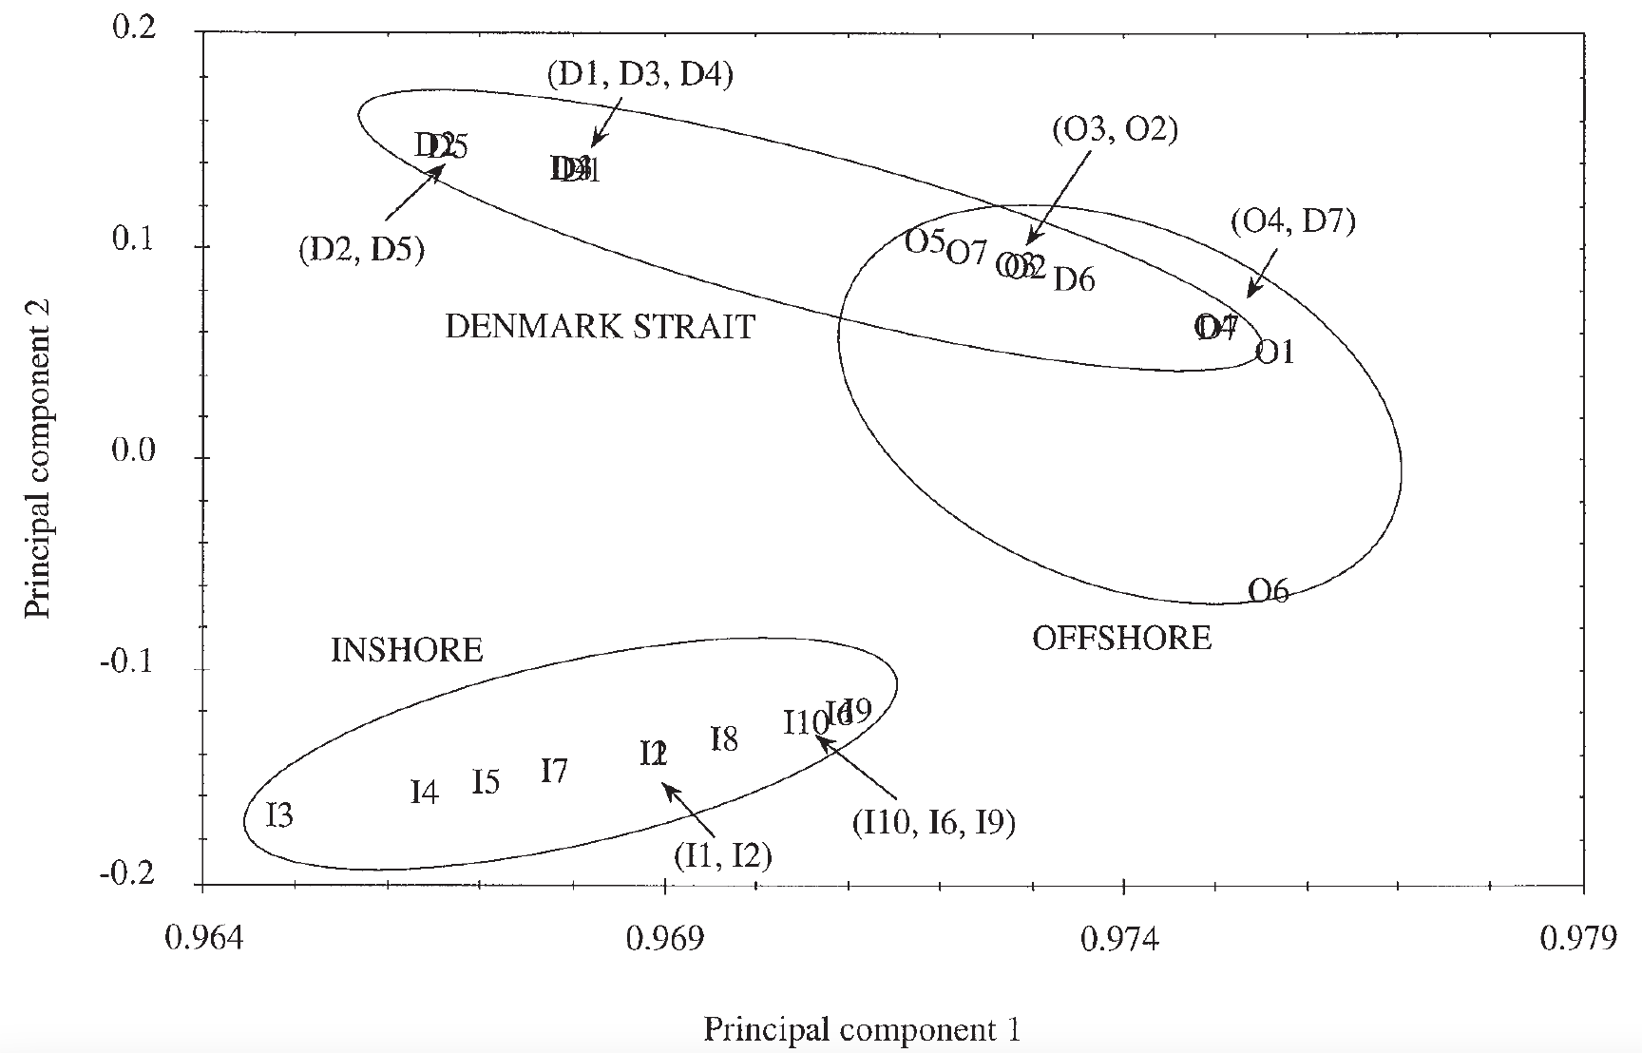
Highly commercial species harvested in Iceland since 1936
Protandrous life history start life male, become female Cues for sex change both environmentally and community controlled
Allozyme analysis suggested difference between near shore and offshore
Jónsdóttir et al. (2011) Canadian Journal of Fisheries and Aquatic Sciences. 55(3): 770-780

Slide 7
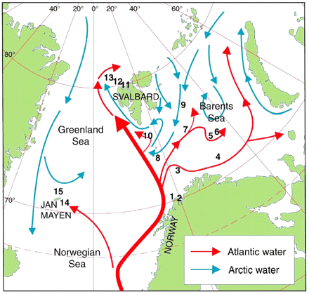
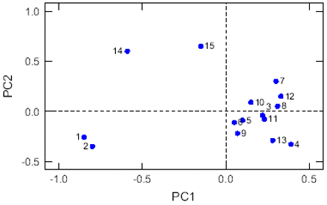
34 RAPD markers
Martinez et al. (2006) ICES Journal of Marine Science, 63(5): 840–850

Slide 8
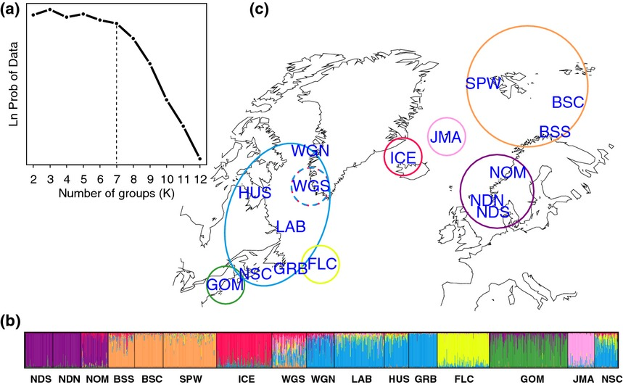
10 microsatellite loci
Jorde et al. (2015) Molecular Ecology, 24: 1742-1757

Slide 9
22,227 SNPs from PstI and MspI
restriction enzyme digestion
Leung et al. (2023) Frontiers in Ecology and Evolution, 11. 10.3389/fevo.2023.1125134

Slide 10
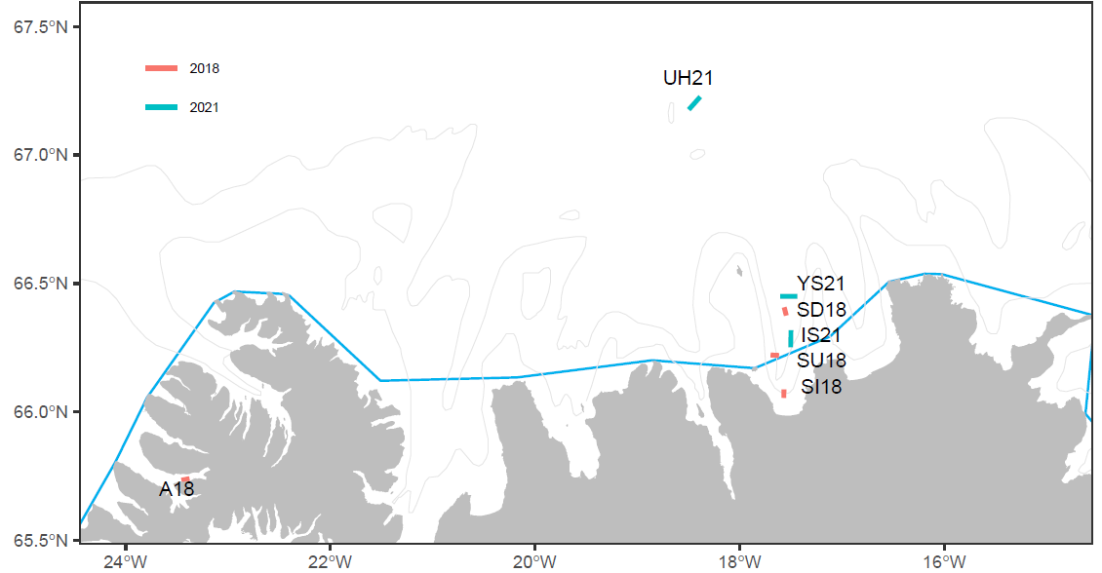
OS
S5
S4
S3
S2
S1
AR

Slide 11
ddRAD sequencing library - ApeKI and BamHI-hf restriction enzymes
Genome size unknown (except to C3G at McGill, possibly quite large)
Filtering for high representation across all sampling sites left 1,471 SNPs

Slide 12
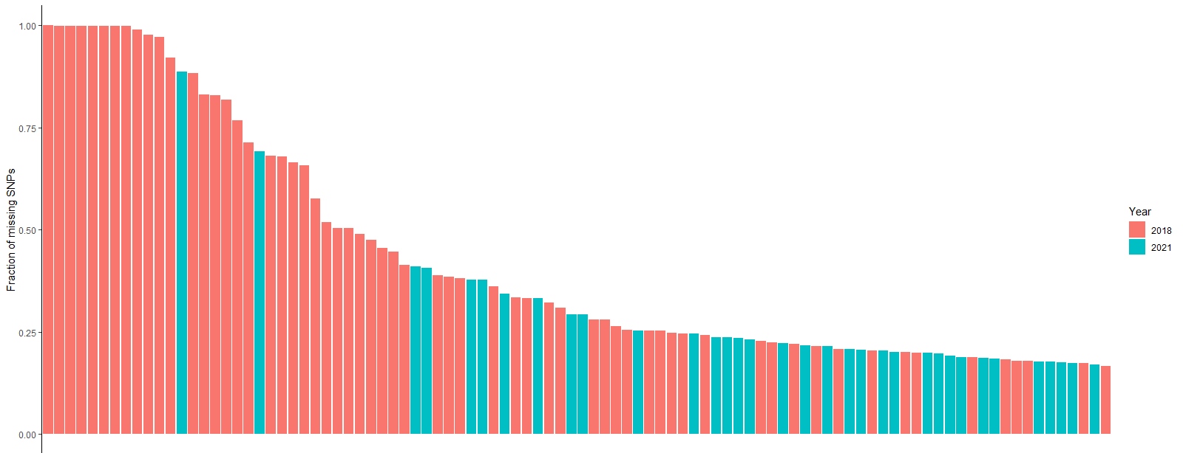
ddRAD sequencing library - ApeKI and BamHI-hf restriction enzymes
Genome size unknown (except to C3G at McGill, possibly quite large)
Filtering for high representation across all sampling sites left 1,471 SNPs

Slide 13
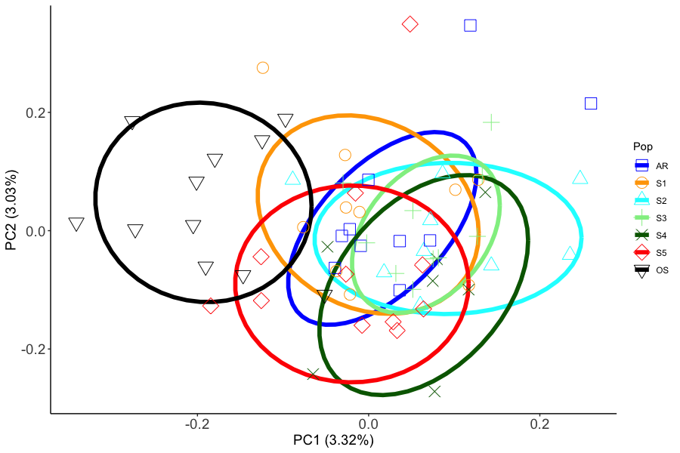
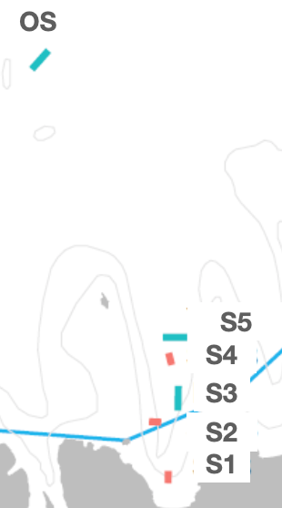

Slide 14
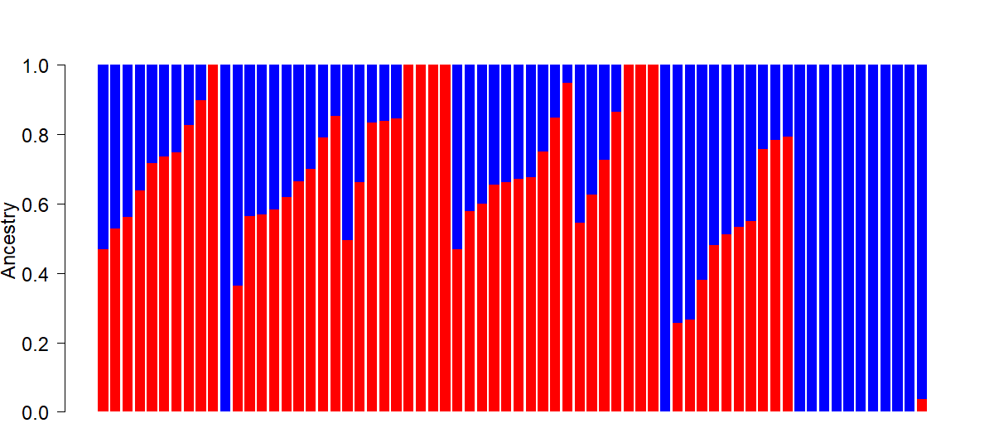
AR
Arnarfjörður
S1
Inner Bay
S2
Inner Bay
S3
Outer Bay
S4
Outer Bay
S5
Outer Bay
OS
Offshore

Slide 15
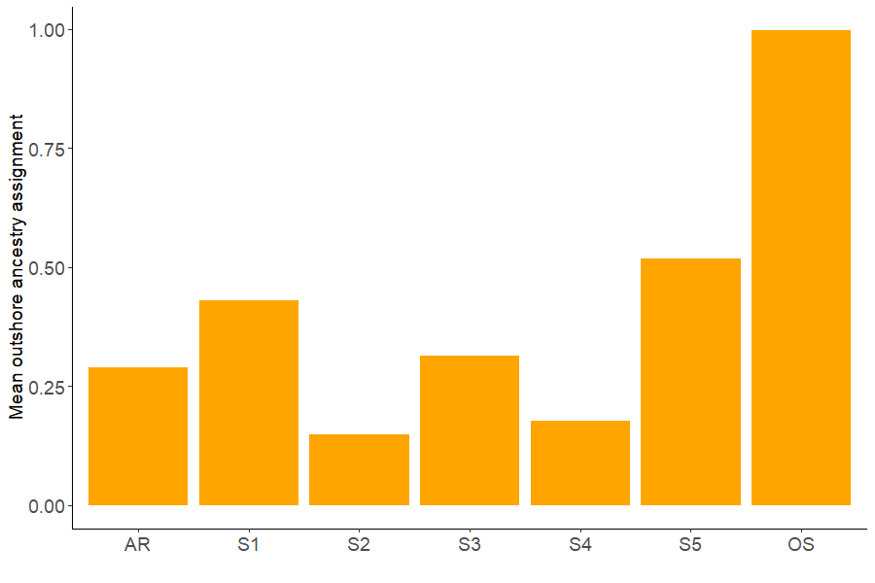

Slide 16
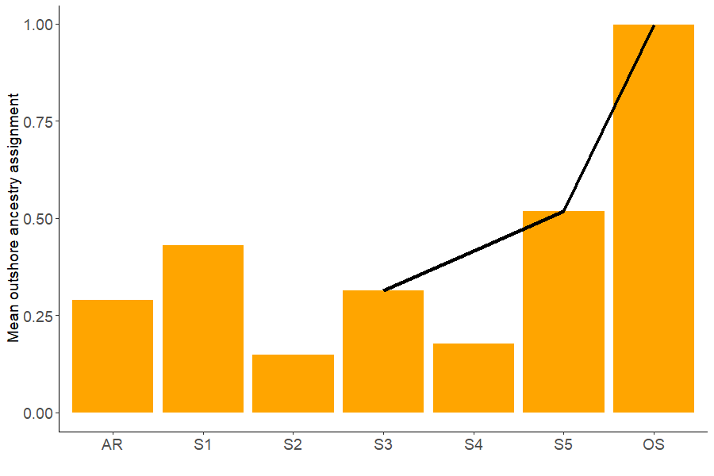
2021

Slide 17
2021 - February

Slide 18
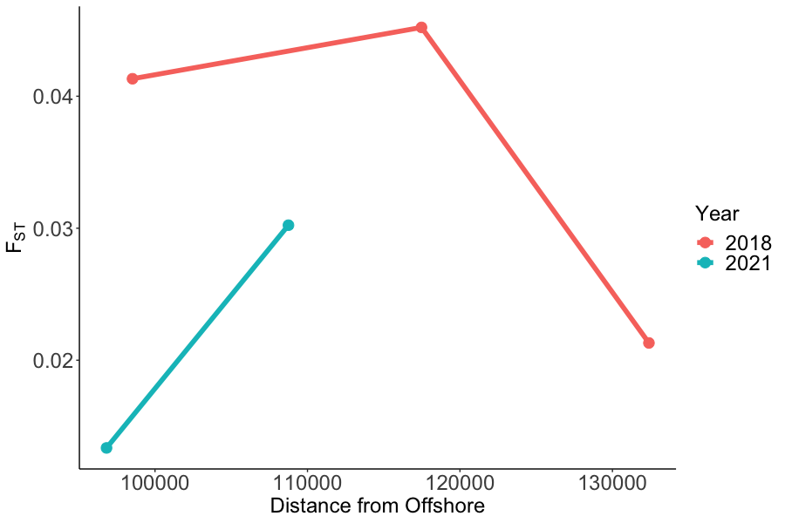
Pop1 | Pop2 | WC FST
OS | S2 | 0.045
OS | S4 | 0.041
OS | AR | 0.033
OS | S3 | 0.030
OS | S1 | 0.021
OS | S5 | 0.013
S1 | S2 | 0.008
S1 | S4 | 0.006
AR | S1 | 0.005
AR | S4 | 0.004
S2 | S4 | 0.003
AR | S2 | 0.003
S5 | S3 | 0.001

Slide 19
OS
S5
S4
S3
S2
S1
AR

Slide 20








Acknowledgements
Dr. Ingibjörg G. Jónsdóttir
Marine and Freshwater Research Institute
Dr. Snæbjörn Pálsson
University of Iceland
Dr. Jake Goodall
Uppsala University
Hafrún Gunnarsdóttir, MSc.
West Iceland Nature Research Center
Notes:
Acknowledgements

Slide 21
References
Bechmann et al. (2011) Effects of ocean acidification on early life stages of shrimp (Pandalus borealis) and mussel (Mytilus edulis), Journal of Toxicology and Environmental Health, Part A, 74:7-9, 424-438, DOI: 10.1080/15287394.2011.550460
Jónsdóttir et al. (2011) Population genetic studies of northern shrimp, Pandalus borealis, in Icelandic waters and the Denmark Strait. Canadian Journal of Fisheries and Aquatic Sciences. 55(3): 770-780
Jorde et al. (2015) Genetically distinct populations of northern shrimp, Pandalus borealis, in the North Atlantic: adaptation to different temperatures as an isolation factor. Mol Ecol, 24: 1742-1757. https://doi.org/10.1111/mec.13158
Leung et al. (2023) The lack of genetic variation underlying thermal transcriptomic plasticity suggests limited adaptability of the Northern shrimp, Pandalus borealis, Frontiers in Ecology and Evolution, 11 https://doi.org/10.3389/fevo.2023.1125134
Martinez et al. (2006) The genetic structure of Pandalus borealis in the Northeast Atlantic determined by RAPD analysis, ICES Journal of Marine Science 63(5): 840–850, https://doi.org/10.1016/j.icesjms.2006.03.006

