Slide 1

Home Land Data Science Project
Jan 21 2023

Slide 2
Agenda
Data Science Lifecycle​
Project Overview​
Data
Analysis
Modeling
Model Evaluation
Recommendations

Slide 3
Data Science Lifecycle
Problem Definition
Data Mining
Data preparation
Exploratory Data Analysis
Feature Engineering
Model Building
Model Evaluation

Slide 4
Project Overview
Business Problem:
Current process involves loan officers to manually process loan applications. It takes 2-3 days for applicant to know whether the loan has been granted or not.
Business Objective:
Use machine learning to assess the credit worthiness of an applicant by implementing a model and predict whether applicant will default on his/her loan
Hypothesis:
Null hypothesis H0:- Loan has been not approved.
Alternate hypothesis H1:- Loan has been approved.

Slide 5
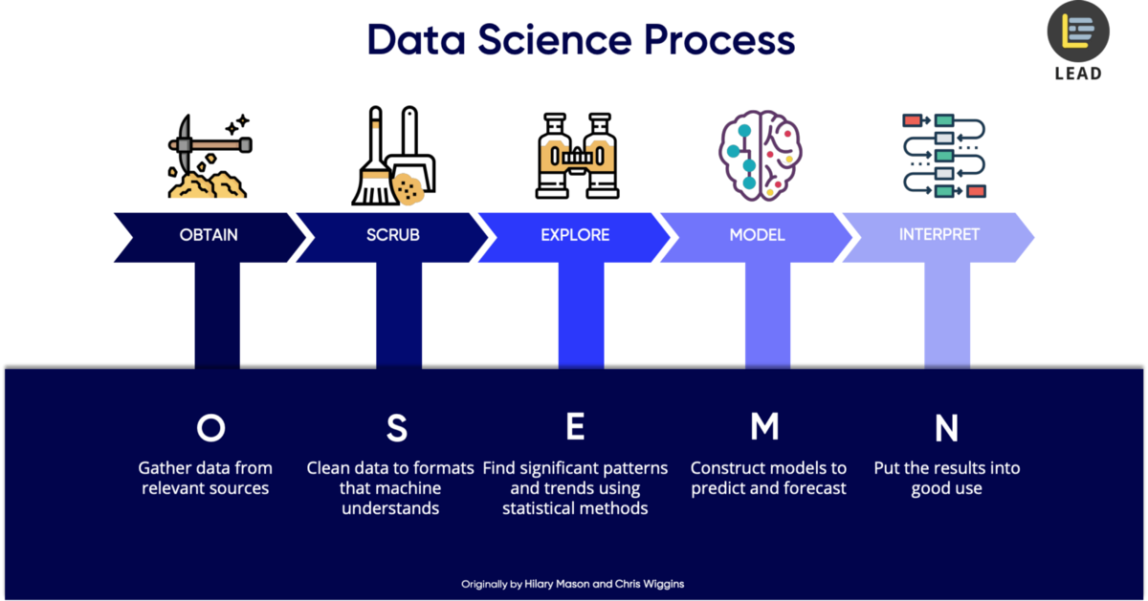
Process Overview / Solution

Slide 6
Historical Data
Historical data consists of 614 records (rows) and 13 fields(columns).
Out of which 8 fields are of object,4 float and 1 int datatypes.
The data consists of missing values for certain fields.
Data doesn’t contain any duplicates.
Target filed in Data is loan status (Y) or (N).

Slide 7
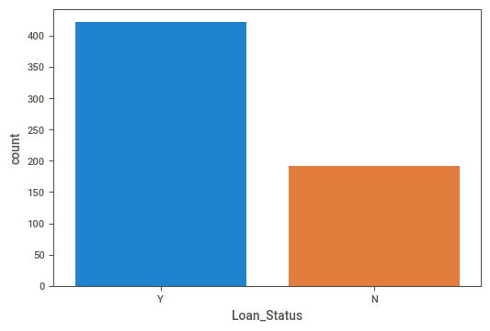
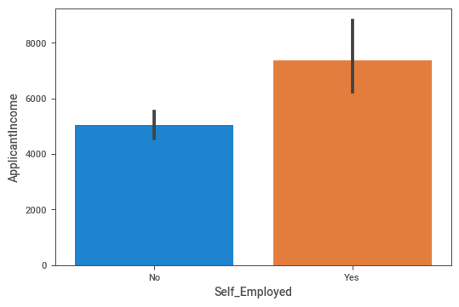
Analysis
Distribution of Loan status Distribution of Income based on Employment

Slide 8
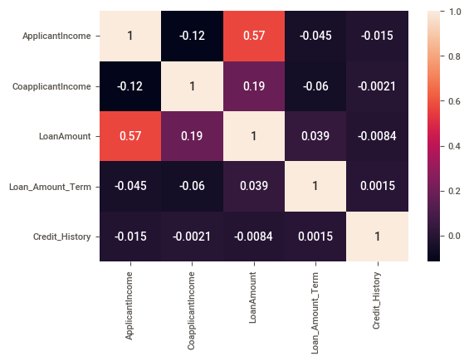
Analysis
Heat map shows the Correlation between various fields.
There is Correlation between “Loan Amount” and “Applicant Income”

Slide 9
Modeling
Missing values for various fields were handled.
Categorical labels were encoded into numeric values.
The RandomForestClassifier machine learning model is one that has been trained.
Along with traditional machine learning models, AutoML is also applied.
Custom-made machine learning model required pre-processing .
AutoML did not required pre-processing
Results from AutoML and conventional machine learning models are equivalent.

Slide 10
Model Evaluation
Metric Results
Accuracy 77%
Precision score | Recall | F1 score
0.7702 | 0.95 | 0.850

Slide 11
Recommendations
Bespoke ML is better than auto ML.
Bespoke ML is better as auto ML .
In Bespoke ML we are fully aware of the steps, how it was performed, and what algorithm was applied to accomplish the goal.
If we can train and forecast in real time, it will benefit us and take less time to do so, although this use case may not allow for it.

