Slide 1

Executive Fraud Risk & Loss Mitigation Strategy
End-to-End Analytics & Predictive Insights on $1.13M Fraud Exposure
Project Lead: Akila Jayarathna
Executive Summary: Comprehensive end-to-end data pipeline analyzing high-volume transaction channels, peak vulnerability windows, and targeted automated controls to curtail financial loss while maintaining optimal checkout speed.

Slide 2





Baseline Risk Metrics
TOTAL FRAUD LOSS
TOTAL FRAUD CASES
OVERALL FRAUD LOSS RATE
AVG FRAUD TRANSACTION
$1.13M
2,145
2.94%
$528.35
Primary Vulnerability Identified: Online channels drive 63.4% ($718.35K) of overall financial loss exposure compared to In-Person (POS) transactions. High-risk digital checkouts represent the primary channel gap requiring immediate rule intervention.

Slide 3




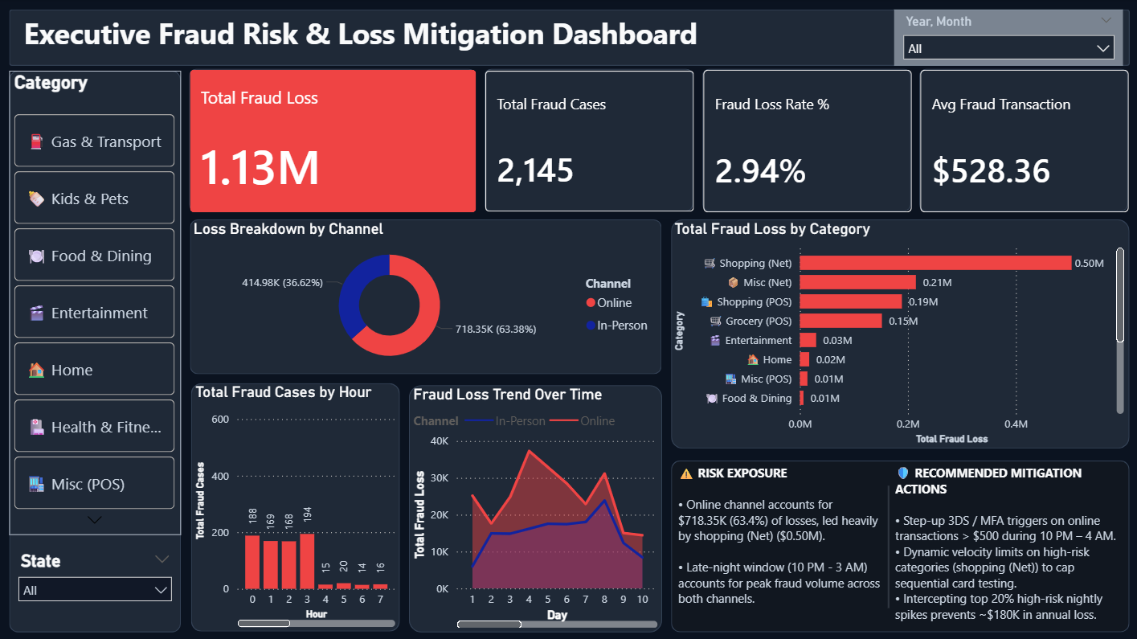


Attack Vectors & Peak Windows
Category Exposure Breakdown
Shopping (Net) and Online Services account for over 65% of unauthorized digital transactions, led heavily by card testing scripts.
Peak Time Windows
Fraud activity peaks sharply during late-night and early-morning hours (10:00 PM – 3:00 AM), taking advantage of lower manual review coverage.
Key Security Gap
Unrestricted low-friction checkout protocols during off-peak night hours create a key structural gap for automated testing scripts.

Slide 4




Actionable Mitigation Rules
Rule 1: Dynamic Multi-Factor Authentication
Rule 2: Velocity & Capping Controls
Automated step-up MFA challenge triggered for high-risk online transactions > $500 initiated during off-peak hours (10:00 PM – 5:00 AM).
Automated temporary holds triggered when a card exhibits >3 consecutive high-value online attempts within a 15-minute rolling window.
Projected Annual Financial Impact
$180K – $220K ~15%–20% Loss Reduction
Targeted friction blocks top 20% high-risk night spikes with minimal impact to legitimate shoppers.

Slide 5
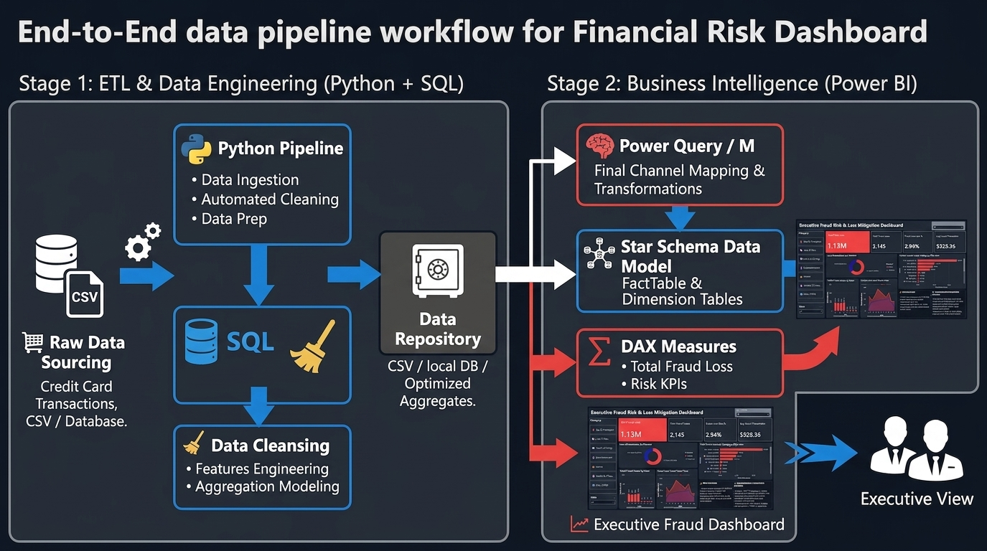


Technical Architecture & Pipeline
Data Engineering (Python & SQL)
Automated ingestion of card transaction streams, missing value imputation, and feature engineering for time/channel attributes.
Data Modeling (Power BI DAX)
Optimized Star Schema design centered around a main Fact table and dedicated DAX measure repository for loss rates and KPI trends.
BI & Interactive Dashboard
Executive Power BI dashboard enabling real-time drill-downs, state slicing, and hourly trend analysis for risk teams.
Technical Artifacts Ready
GitHub Repository & Interactive Portfolio Demo Available

