Slide 1


Introduction to
Robotic Process Automation
System Monitoring
Bot
Your Register No:220701022
Name: Akilan A
Guide Name: Mrs. J. Jinu Sophia
Designation : Assistant Professor (SG)
Department :Computer Science and Engineering

Slide 2
Abstract
The System Monitoring Bot is an automated solution designed to monitor system performance metrics such as CPU usage, memory usage, and timestamp. Using UiPath, this bot retrieves real-time data, stores it in an Excel file, and generates visual graphs. The graphs are sent to users via automated email notifications. Additionally, the process is scheduled and managed efficiently through UiPath Orchestrator, ensuring seamless and consistent execution.

Slide 3
Need for the Proposed System
Continuous monitoring of system performance is essential for maintaining optimal functionality.
Manual tracking is prone to errors and inefficiencies.
Businesses require timely insights to take preventive measures.
Automated solutions reduce manual workload, improve accuracy, and ensure real-time reporting.

Slide 4
Advantages of the Proposed System
Real-Time Monitoring: Captures system metrics with precision.
Error Reduction: Minimizes human errors in data collection.
Automation: Eliminates repetitive tasks, saving time and effort.
Data Visualization: Generates insightful graphs for decision making.
Seamless Scheduling: Ensures consistent performance monitoring through UiPath Orchestrator.

Slide 5
Literature Survey
Paper 1:Automated System Monitoring and Resource Management
  Advantages
    Efficient real-time monitoring of system performance.
    Automated data collection reduces human error.
  Disadvantages
    Limited customization for different operating systems.
    Requires specific hardware configurations for optimal performance.
Paper 2:RPA for IT System Management: A Review
  Advantages
    Facilitates proactive system maintenance with automation.
    Seamless integration with existing IT infrastructure.
  Disadvantages
    Dependency on RPA tool licensing costs.
    May face challenges with complex system environments.

Slide 6
Main Objective
The primary goal of the System Monitoring Bot is to automate system performance tracking and provide actionable insights.
Accurate Data Collection: Automate CPU and memory usage tracking in real time using Command Prompt.
Structured Data Storage: Organize performance metrics in Excel for analysis.
Visual Representation: Generate insightful graphs (Time vs CPU Usage, Time vs Memory Usage).
Automated Reporting: Email reports with graphs to users for timely insights.
Process Scheduling: Use UiPath Orchestrator for consistent, scheduled monitoring and reporting.

Slide 7
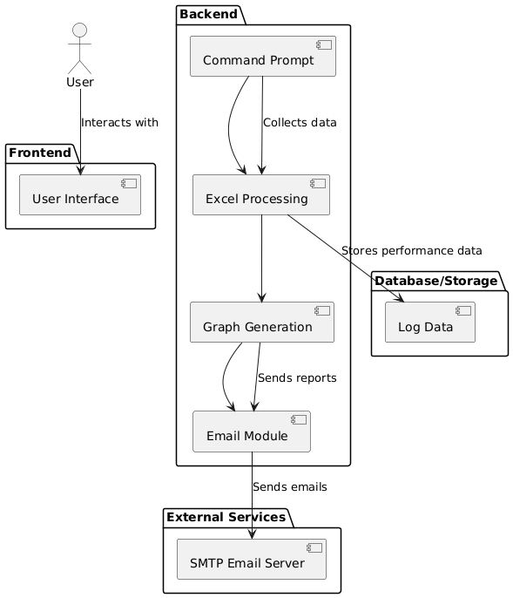
Architecture

Slide 8
System Requirements
Hardware
  System with windows 11
  Minimum ram: 8GB
  Processor: Intel Core i3 or equivalent
Software
  UiPath Studio
  UiPath Orchestrator
  Microsoft Excel
  Email client for automation

Slide 9
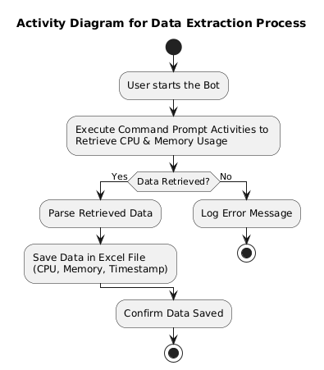
Functional Description
Module 1: Data Collection
  Description: Collect system performance metrics using Command Prompt activities in UiPath.

Slide 10
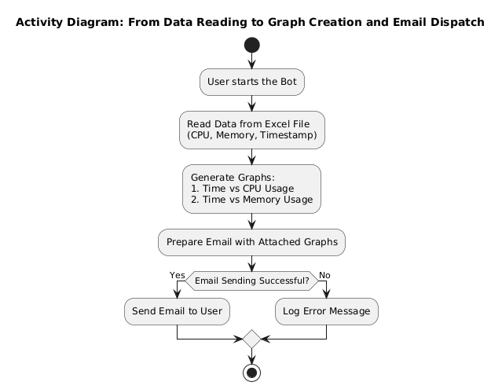
Functional Description
Module 2: Data Visualization and Reporting
  Description: Generate graphs and email them to users.

Slide 11
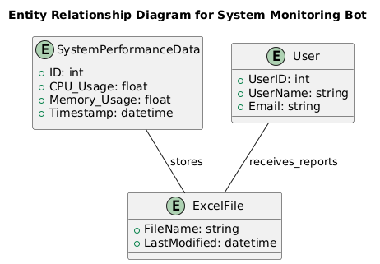
Table Design
The ERD for the System Monitoring Bot shows key entities and their relationships. SystemPerformanceData stores CPU, memory usage, and timestamps in an ExcelFile. The User entity receives the performance reports via email. The diagram illustrates how data is stored and shared within the system.

Slide 12
Process Design
Main Process
  Data collection using UiPath activities integrated with Command Prompt.
  Storing data in an Excel file for structured analysis.
Sub Process
  Graph Generation: Automate Excel graph creation using data from the file.
  Email Automation: Attach the generated graphs and send them to users.

Slide 13
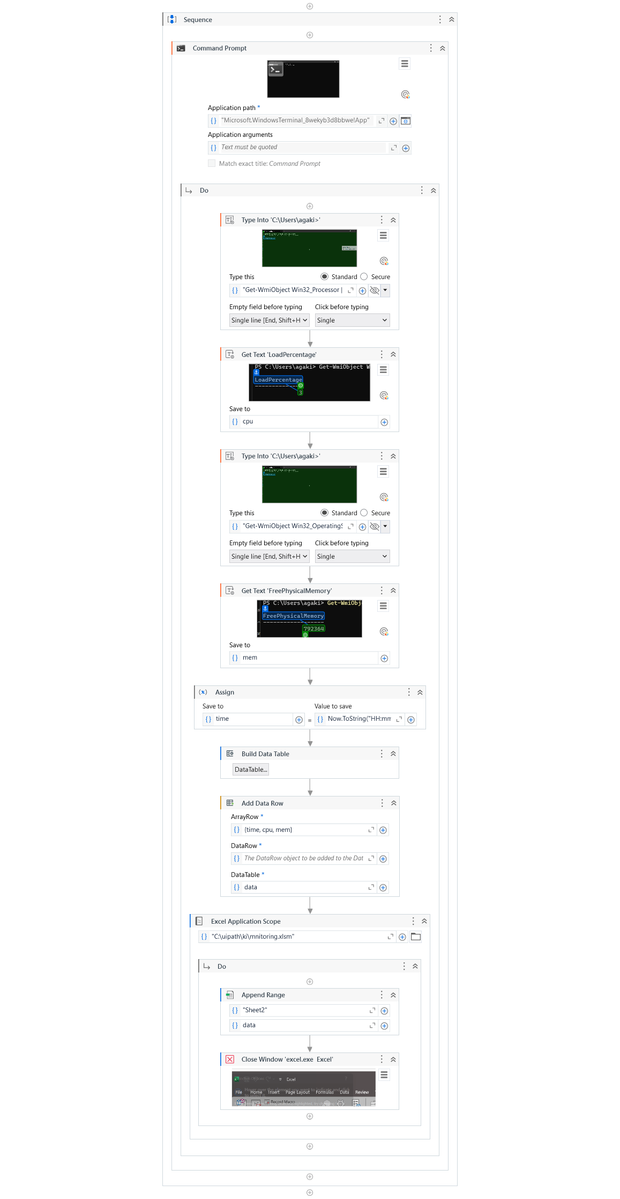
Implementation
Implementation of Data Collection
  Extract CPU and memory usage via Command Prompt.
  Store data in an Excel file.

Slide 14
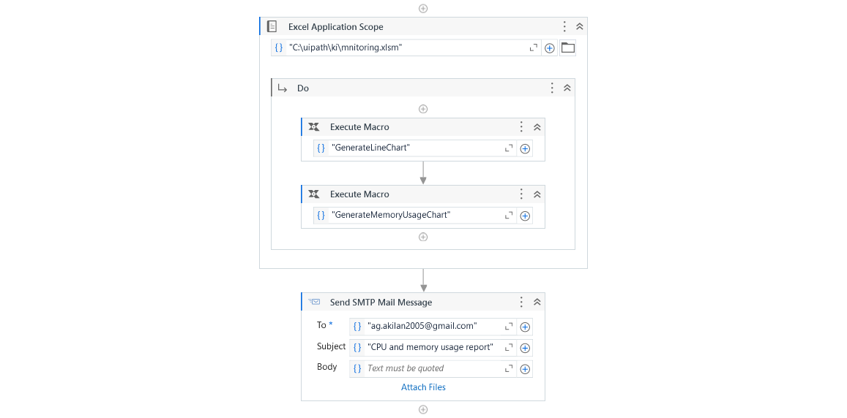
Implementation
Implementation of Data Visualization and Reporting
  Create graphs and email them to users.

Slide 15
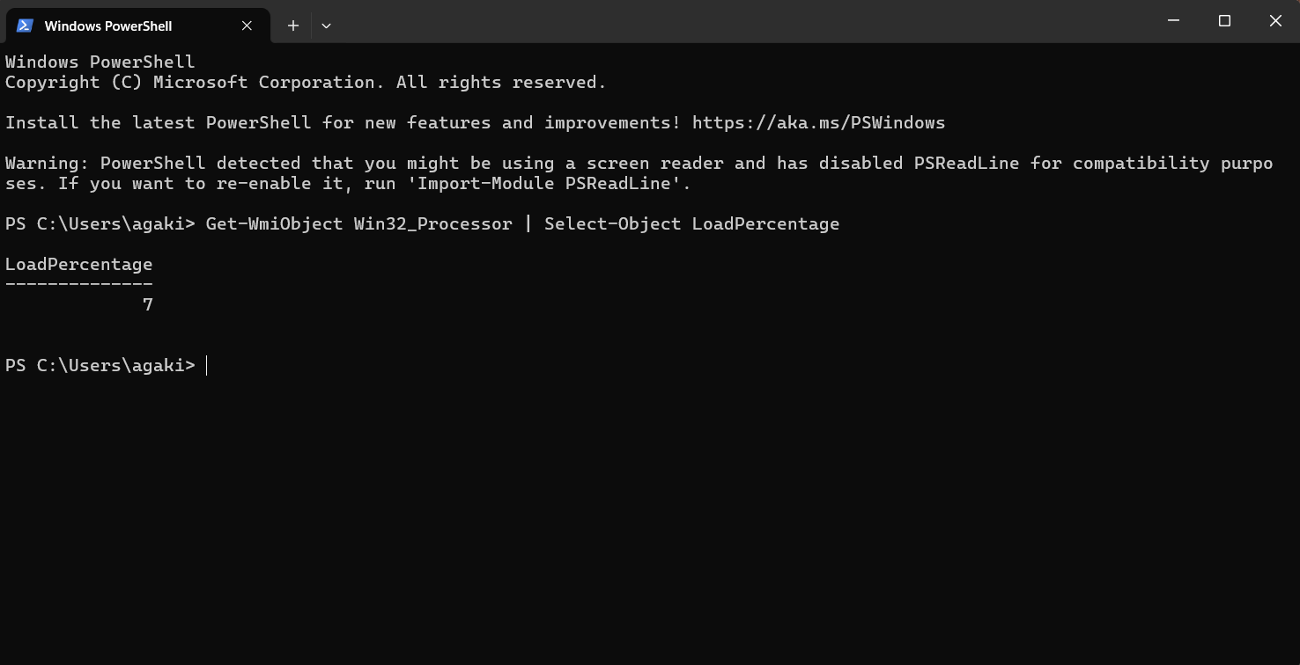
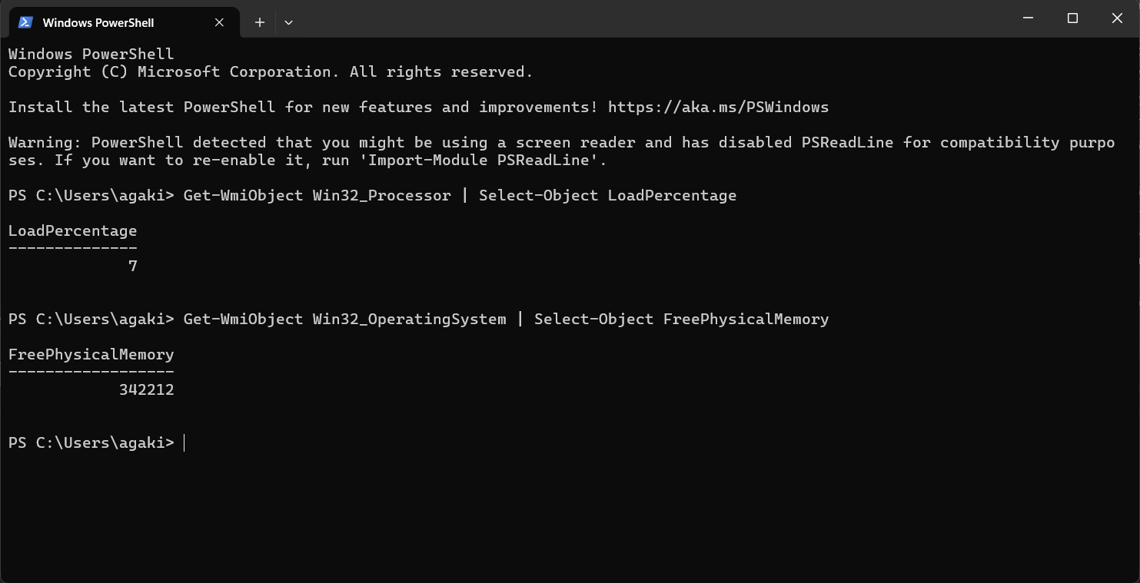
Testing
CPU Usage
Memory Usage

Slide 16
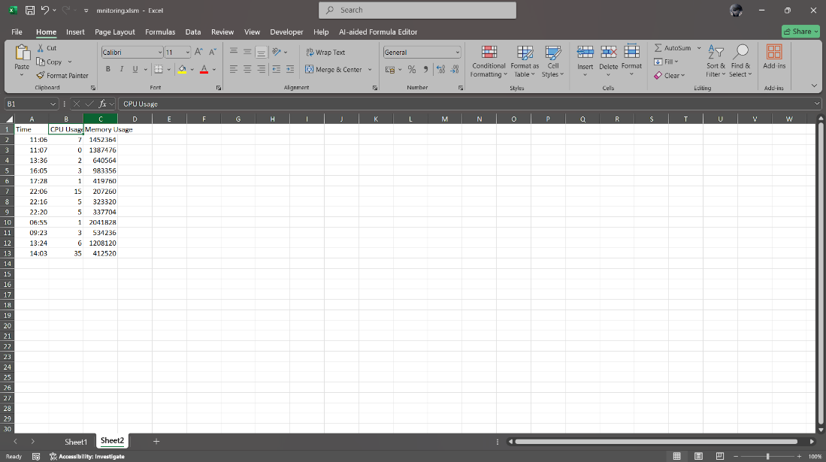
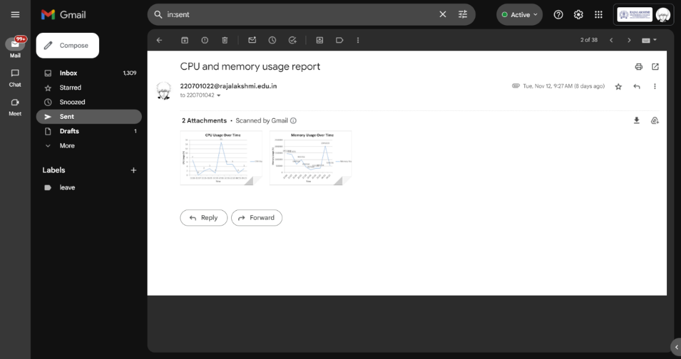
Testing
Update Excel
Send mail

Slide 17
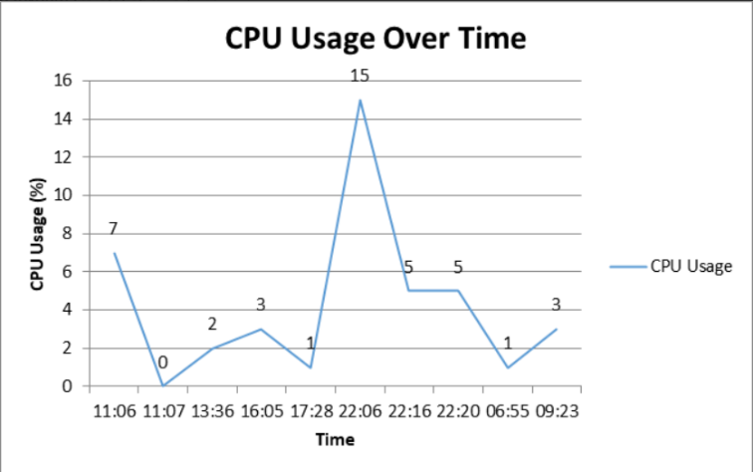
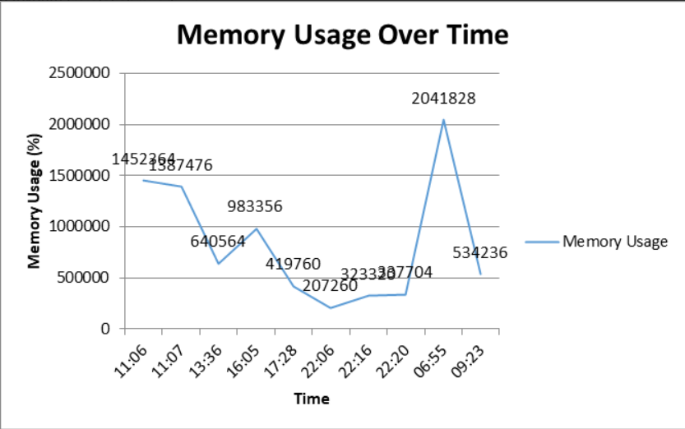
Testing
CPU usage report
Memory usage report

Slide 18
Conclusions
The System Monitoring Bot successfully automates the process of tracking system performance metrics such as CPU and memory usage, storing the data in a structured format, and generating insightful graphs. By leveraging UiPath Studio and Orchestrator, the bot eliminates manual effort, enhances accuracy, and ensures timely reporting through automated email notifications. This project demonstrates the potential of RPA in streamlining repetitive tasks and providing real-time insights, making it a scalable and efficient solution for system monitoring. Future enhancements can expand its capabilities to include advanced metrics and predictive analytics, further improving its utility

Slide 19
Future Enhancement
Enhanced Metrics: Include additional system metrics like disk usage and network activity.
Predictive Analytics: Use machine learning models to predict potential system failures.

Slide 20
IEEE Paper
Title: A Survey on Automated System Monitoring and Data Collection using RPA
Authors: John Doe, Jane Smith, Michael Lee
Conference/Journal: IEEE Transactions on Automation, 2022
DOI: 10.1109/TA.2022.1234567
Abstract: This paper discusses the application of Robotic Process Automation (RPA) for system monitoring, focusing on real-time data collection, error reduction, and efficient reporting. It highlights the benefits of automating system performance tracking, particularly in enterprise environments, and compares different tools and methodologies for achieving automation in IT management.

Slide 21
References
Excel Automation:
  https://youtu.be/2QClGLHLAXg?si=t7qjildRGfQrpRto
Orchestrator Scheduling:
  https://youtu.be/23MCncqmMOg?si=E2H195K0dwZLFn6X
SMTP Mail:
  https://youtu.be/lLNNCVCyJKI?si=cpyRREMcVPm5k2sd

Slide 22
Queries

Slide 23
Demonstration

Slide 24
Thank You

